Slide 1
Quick Android APP
By Satya

Slide 2
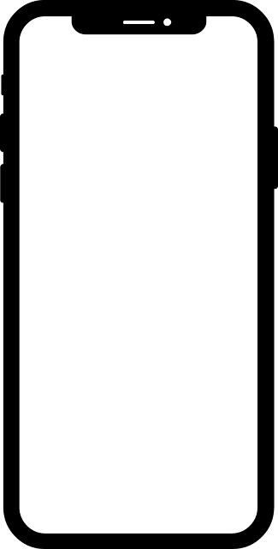

Quick Android App
There is no need of android license key
when you want to build an app for your
own phone for personal use…
And of course, you can distribute it to
your friends and relatives
Let’s start

Slide 3
Quick Android App
Prerequisites
Visual Studio Code for a quick JavaScript/React/Angular App
Android Studio
Go for it now…

Slide 4
Quick Android App
I am using a simple react `todo` app which I customized to make my grocery shopping experience easy…
Here is the app url:
https://codesandbox.io/s/simple-react-todo-list-mo0g05
Next..

Slide 5
Quick Android App
Let me create a file capacitor.config.json in the root folder
Add below code into it:
{ "appId": "io.ionic.yourAppName", "appName": " yourAppName ", "bundledWebRuntime": false, "npmClient": "npm", "webDir": "build", "cordova": {} }
Next..

Slide 6
Quick Android App
Let me create a file ionic.config.json in the root folder
Add below code into it:
{ "name": "yourAppName", "integrations": { "capacitor": {} }, "type": "react" }
Next..

Slide 7
Quick Android App
If you are using react app
Run below command in command prompt
`npm run build`
Command prompt is opened at the root of react project
Make sure the app runs locally
Next..

Slide 8
Quick Android App
Install CAPACITOR locally by running below command in command prompt
Run below commands in command prompt
`npm install @capacitor/core`
`npm install @capacitor/cli --save-dev`
`npx cap init`
Using the same command prompt which was opened at the root of react project
Next..

Slide 9
Quick Android App
Make sure android studio is installed
Run below command in command prompt
`ionic capacitor add android`
This will create the android folder in our project root
* Using the same command prompt which was opened at the root of react project
Next..

Slide 10
Quick Android App
To open the project in android studio
Run below command in command prompt
`npx cap open android`
This will open the project in android studio IDE
* Using the same command prompt which was opened at the root of react project
Next..

Slide 11
Quick Android App
Now we are in Android Studio
Run the project once it is initiated
Now, goto the build menu and select
`Build bundles/apks -> Build apks`
Next..

Slide 12
Quick Android App
Now we have our APK ready to be run in our smart phone
Locate the build folder on your system
Send the APK to your phone using whats-app web or any other technique
Install the app and its ready to use…

Slide 13
Quick Android App
Don’t forget to like..
Let me know what else you are looking for in comments…
in the description
Attached the APK file in the project repo
Given the project link for gitlab
Thank you

