Slide 1

SECURITY MONITORING SYSTEM ON AWS
Prepared in the partial fulfillment of the Summer Internship Program on AWS
Under the guidance of Mrs. Sumana Bethala, APSSDC
Mr.Anil Kumar, APSSDC

Slide 2
Group Members
1.23MH1A0430 – Kalagara Kusuma 2.23MH1A4902 – Aketi Lakshmi Srujana 3.23MH1A4911 – Chevvakula Sireesha 4.23MH1A4951 – Addepalli Ramya Haripriya
Varshini 5.23MH1A4953 – Rayudu Satya Sri

Slide 3
INTRODUCTION
Ever wondered how we can keep tabs on who’s accessing our most sensitive data in AWS? Whether it’s API keys, database credentials, or other critical secrets, every access poses a potential security risk. That’s why organizations invest heavily in robust monitoring systems to track and alert on any unusual activity
In this group project, we built a powerful monitoring system using AWS. Protecting data was an essential skill for roles such as Security Engineer, DevOps Engineer, and Systems or Cloud Administrator. By working together, we gained hands-on experience in designing, deploying, and maintaining a complete audit and alerting solution.

Slide 4
Problem Statement
Security breaches are increasing in cloud
infrastructure.
Traditional monitoring systems are insufficient
for dynamic, scalable AWS environments.
Need for real-time, automated, and scalable security monitoring.

Slide 5
Solution Overview
Built a Security Monitoring System on AWS.
Uses AWS native services to monitor, alert,
and log security threats.
Designed for scalability, automation, and
minimal manual intervention.

Slide 6
Key Components
AWS Secrets Manager: Securely stores sensitive data like API keys and passwords.
AWS CloudTrail: Logs all AWS account activities, including secret access.
Amazon CloudWatch: Monitors logs and sets alarms for suspicious activity.
Amazon SNS: Sends instant alerts via email or SMS when alarms trigger.
S3: Securely stores logs and monitoring data.
AWS CLI: Automates AWS tasks using command-line commands.

Slide 7
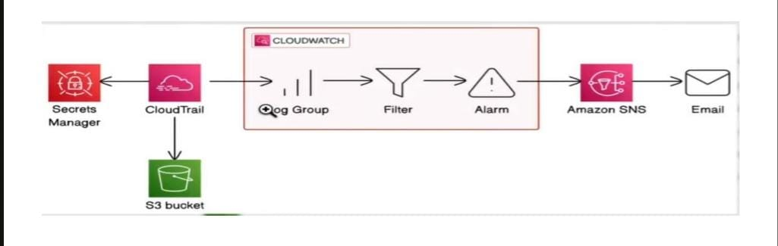
Set up AWS CloudTrail to track secret access events.
Use AWS CloudWatch to log access attempts and trigger notifications.
Create SNS alerts to get notified when your secrets are accessed.
Build a second notification system and compare which approach delivers better security alerts.

Slide 8
Key Features
Real-time anomaly detection
Auto-notifications via SNS
Compliance monitoring via AWS Config
Centralized log collection
Scalable & serverless setup

Slide 9
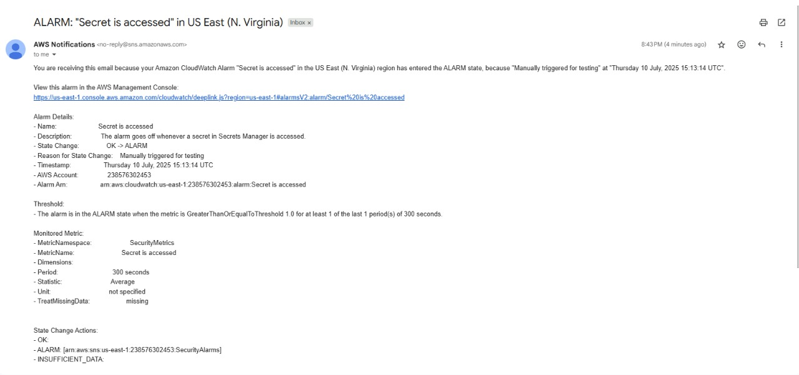
RESULTS/DEMO

Slide 10
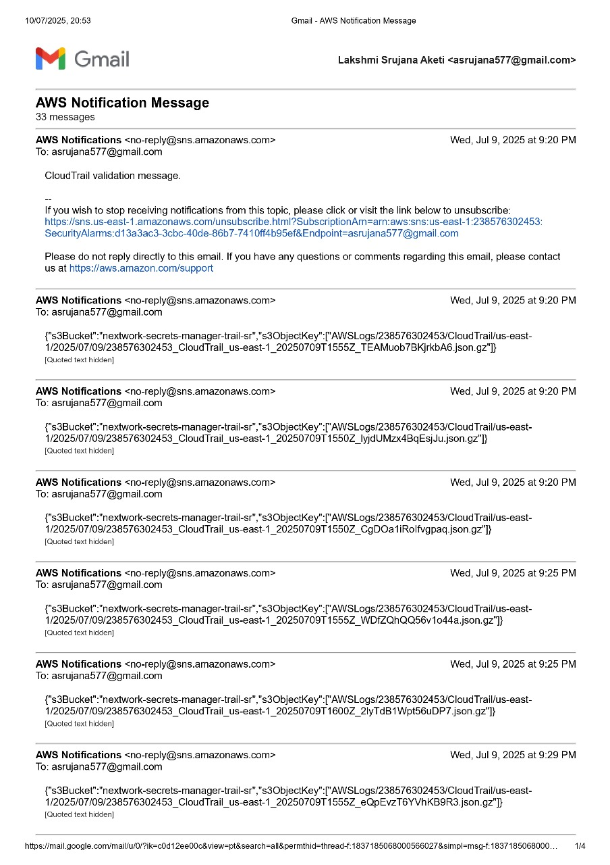
RESULTS/DEMO

Slide 11
Learnings and Outcomes
Gained hands-on experience with AWS monitoring tools
Understood the importance of continuous
compliance
Learned to build scalable, event-driven architecture
Ready to apply this in real-world enterprise security projects

Slide 12
Conclusion
The "Build a Security Monitoring System" project offered hands-on experience with key AWS services to create a real-time alert system for monitoring sensitive data access. We configured CloudTrail to log GetSecretValue events and streamed them into CloudWatch Logs, setting up metrics and alarms to detect secret access and send alerts via SNS.

Slide 13
Thank You

