Slide 1

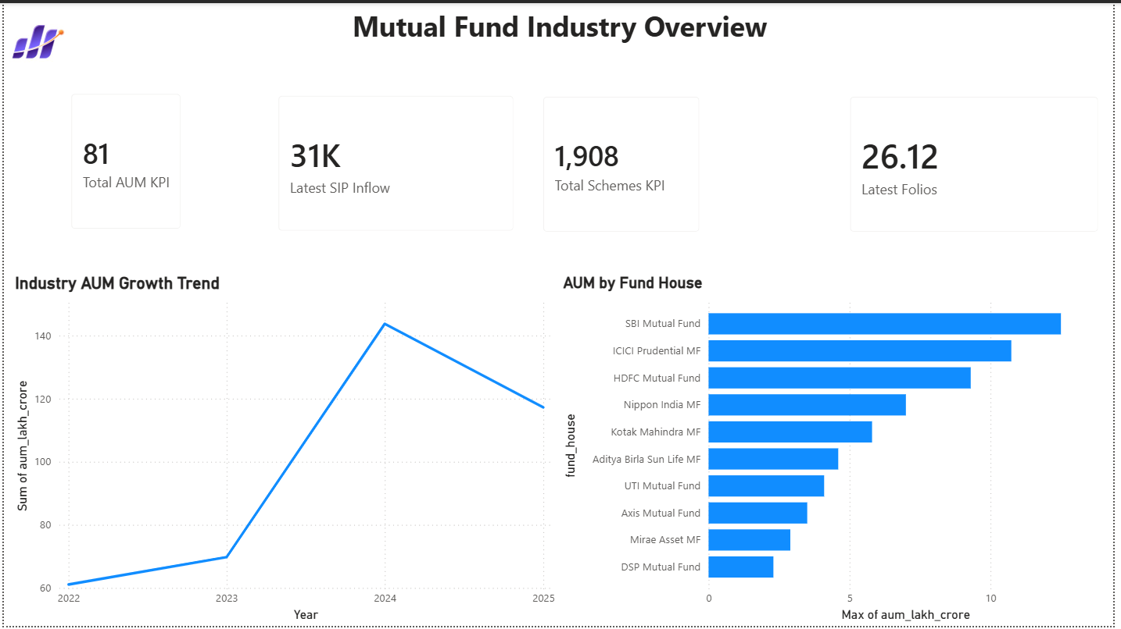
Mutual Fund Analytics
Bluestock Fintech Internship Capstone
End-to-end analytics platform covering data ingestion, ETL, SQL, EDA, fund performance, risk metrics, investor behaviour and Power BI dashboards.
Prepared by: Doddi Satya Sai Sri

Slide 2
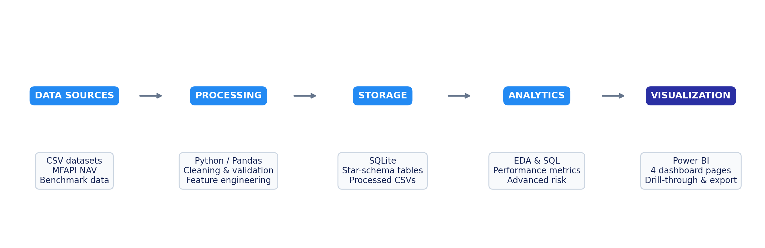
Problem & Objective
2/12
Business Problem
Objective 1
Objective 2
Mutual fund decisions cannot depend only on absolute returns. Analysts need a combined view of risk, return, benchmark performance, investor behaviour and portfolio concentration.
Prepare a clean, validated dataset pipeline from raw mutual fund files and NAV history.
Build analytical notebooks for EDA, performance scoring, risk metrics and investor analysis.
Objective 3
Objective 4
Develop Power BI dashboards with KPIs, slicers, tooltips and fund drill-through.
Deliver report, presentation and GitHub-ready project package.
Bluestock Mutual Fund Analytics Capstone
Doddi Satya Sai Sri

Slide 3
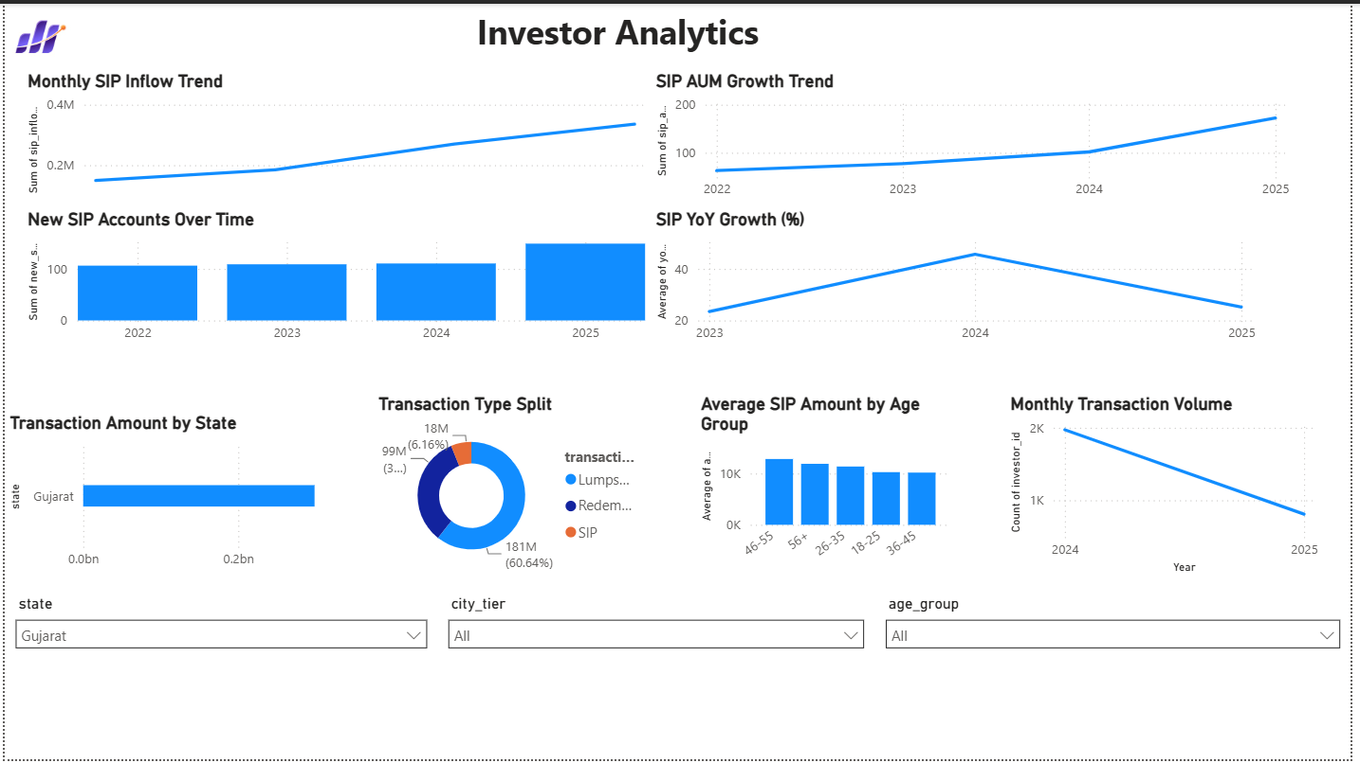
Data Sources
3/12
Fund master: AMFI code, scheme, AMC, category, plan, benchmark and risk class
NAV history: scheme-wise NAV values for return, VaR, CVaR and Sharpe calculations
Investor transactions: SIP, lumpsum and redemption data with demographics
Performance metrics: return, Sharpe, Sortino, Alpha, Beta, drawdown and scoring
Portfolio holdings and benchmark indices for concentration and comparison analysis
40
~46K
~32K
10+
Schemes in performance dataset
NAV history observations
Investor transactions
Raw / processed data files
Bluestock Mutual Fund Analytics Capstone
Doddi Satya Sai Sri

Slide 4
Project Architecture
4/12
The workflow follows an end-to-end analytics pipeline from ingestion to final stakeholder reporting.
Delivery Layer
Analytics Layer
Visualization Layer
GitHub repository, Power BI exports, analytical CSVs, final report and presentation.
Python notebooks produce EDA, performance scoring, risk metrics, cohorts and recommendations.
Power BI gives KPI cards, slicers, tooltips and drill-through views.
Bluestock Mutual Fund Analytics Capstone
Doddi Satya Sai Sri

Slide 5
EDA Highlights — Industry View
5/12
Industry overview shows core industry KPIs with AUM trend and AMC-wise distribution.
₹81L Cr
31K
Total AUM KPI
Latest SIP inflow
1,908
26.12 Cr
Schemes
Folios
Key EDA signal: AUM and SIP metrics show strong retail participation and increasing industry depth.
Bluestock Mutual Fund Analytics Capstone
Doddi Satya Sai Sri

Slide 6
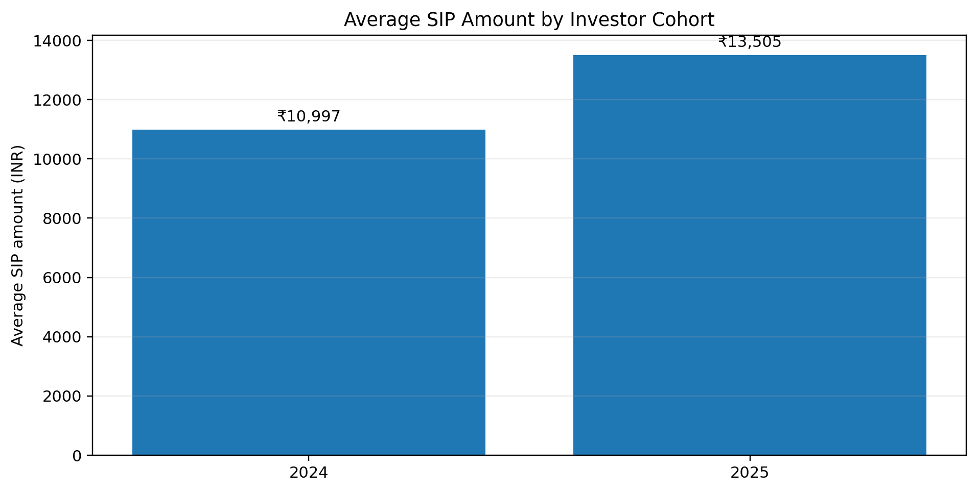
EDA Highlights — Investor Behaviour
6/12
Transaction behaviour was analysed by state, age group, city tier and transaction type.
SIP, Lumpsum and Redemption splits show how investors participate across modes.
Age-group and state views help identify investor segments with higher investment amounts.
Cohort analysis later compares 2024 vs 2025 investor behaviour.
Bluestock Mutual Fund Analytics Capstone
Doddi Satya Sai Sri

Slide 7
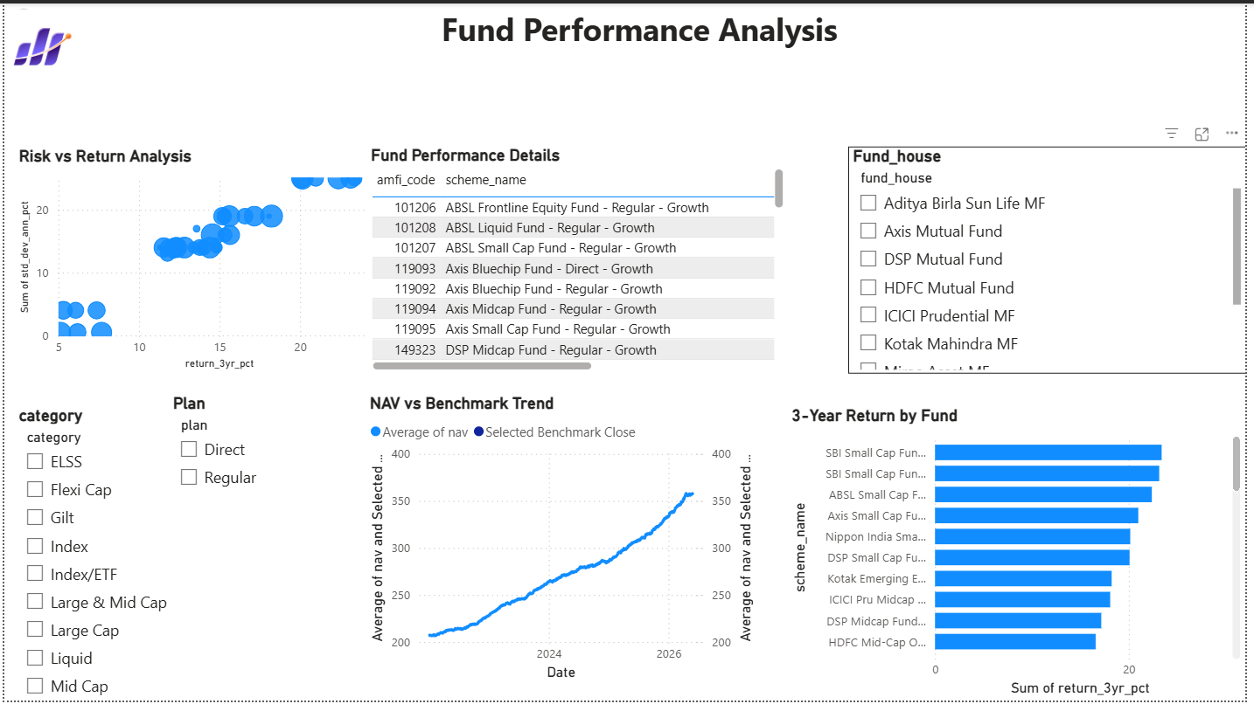
Performance Metrics
7/12
Risk-adjusted scoring combines return, Sharpe, Sortino, Alpha, drawdown and expense measures.
Top Ranked Fund
Mirae Asset Large Cap Fund – Regular – Growth ranked #1 by composite fund score.
Interpretation
High return alone is not enough. Strong funds should balance performance with lower volatility and better risk-adjusted return.
Dashboard Output
Fund Performance page enables scatter analysis, scorecard sorting, slicers and NAV vs benchmark trend.
Main analytical goal: compare funds across return and risk, not only absolute return.
Bluestock Mutual Fund Analytics Capstone
Doddi Satya Sai Sri

Slide 8
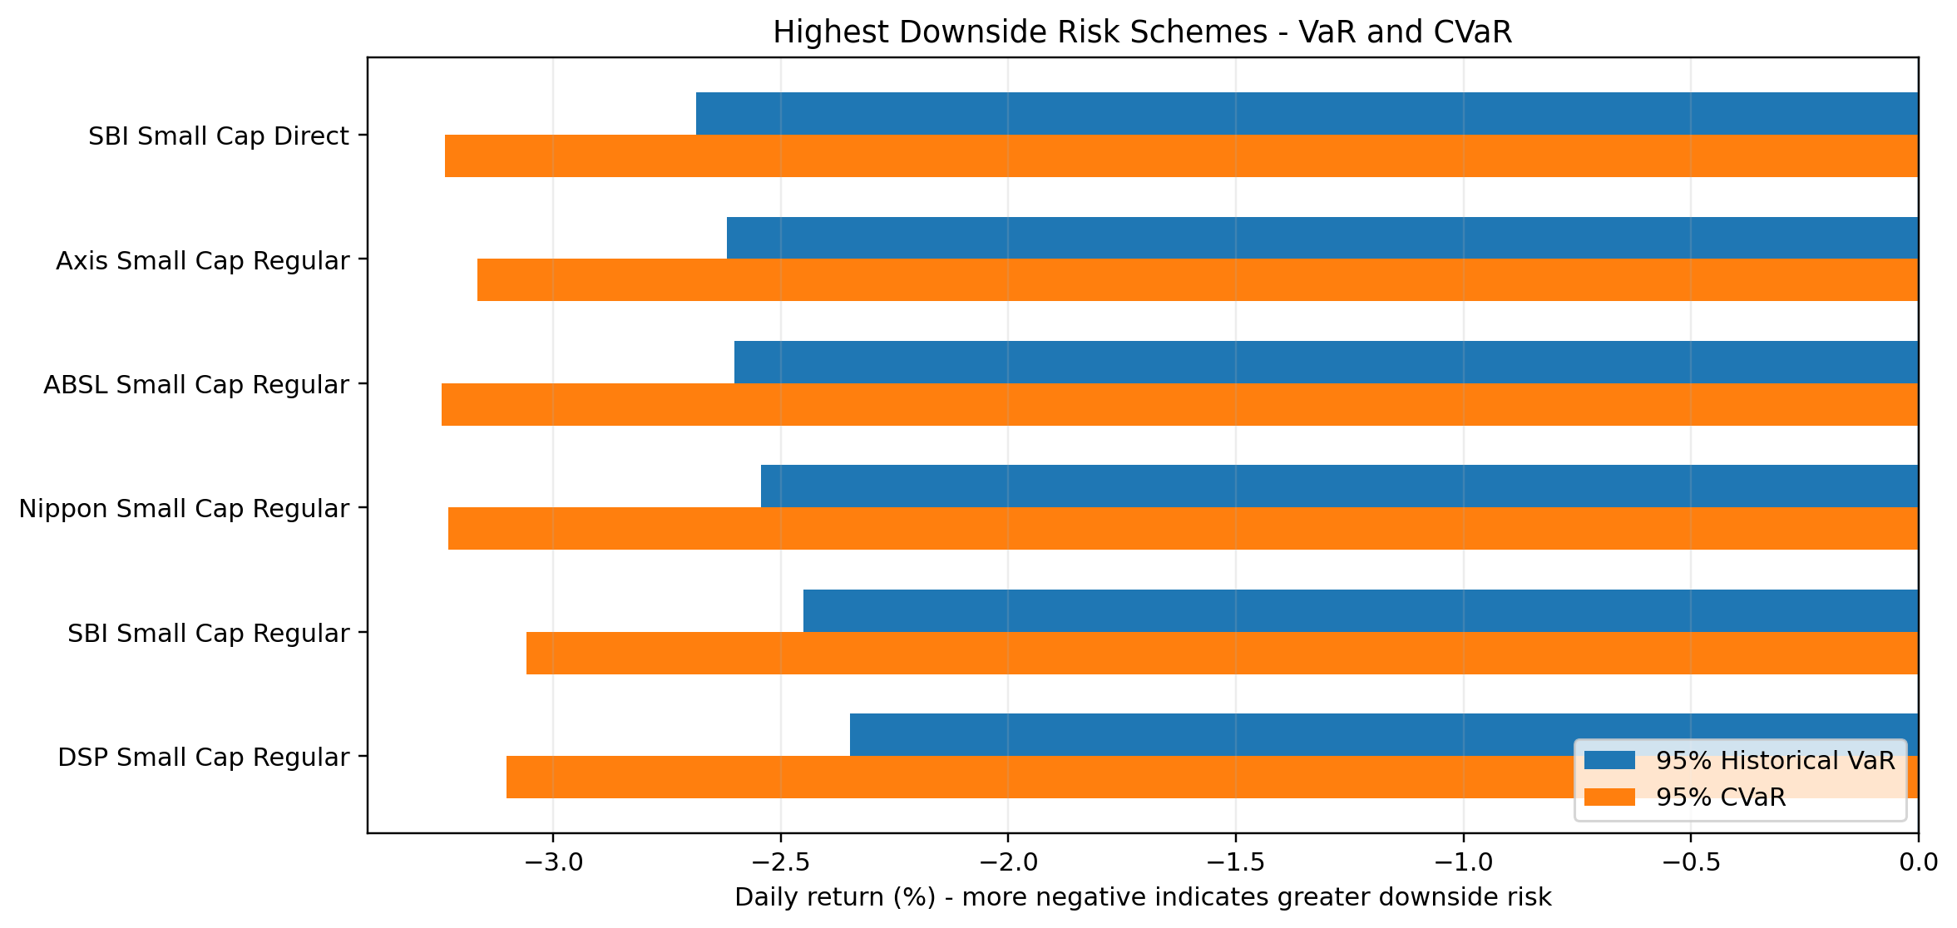
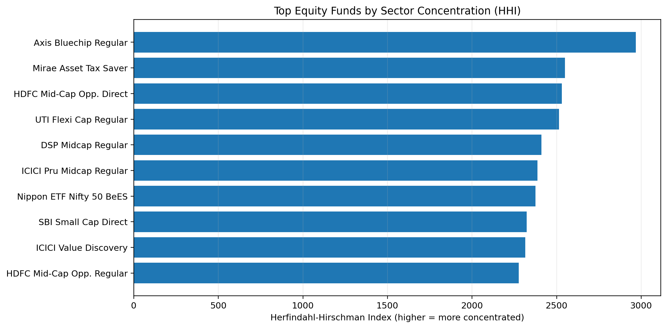
Advanced Risk Analytics
8/12
VaR/CVaR quantify downside risk from daily return distribution.
Rolling 90-day Sharpe tracks time-varying risk-adjusted performance.
SIP continuity identifies investors with irregular contribution gaps.
HHI measures concentration risk using sector portfolio weights.
Recommender ranks funds by Sharpe ratio within risk appetite.
Highest HHI
Axis Bluechip Fund – Regular – Growth showed the highest sector concentration in available holdings.
Risk Insight
Small-cap funds showed higher downside risk compared with debt and liquid schemes.
Bluestock Mutual Fund Analytics Capstone
Doddi Satya Sai Sri

Slide 9
Dashboard Screenshots — Pages 1 & 2
9/12
Industry Overview
Fund Performance Analysis
Bluestock Mutual Fund Analytics Capstone
Doddi Satya Sai Sri

Slide 10
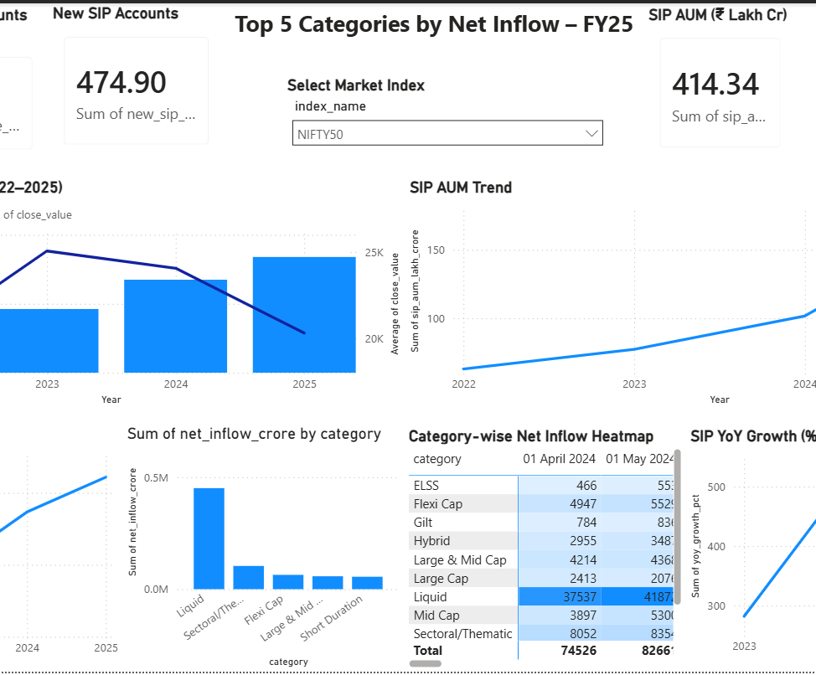
Dashboard Screenshots — Pages 3 & 4
10/12
Investor Analytics
SIP & Market Trends
Bluestock Mutual Fund Analytics Capstone
Doddi Satya Sai Sri

Slide 11
Key Findings & Recommendations
11/12
Key Findings
Recommendations
Risk-adjusted scorecard gives better fund comparison than return alone.
Small-cap schemes show higher downside VaR and CVaR risk.
2025 cohort shows higher average SIP amount than 2024 cohort.
Investor SIP gaps can indicate potential discontinuation risk.
Sector HHI highlights portfolios with concentration risk.
Use multiple metrics: returns, Sharpe, Alpha, drawdown, VaR and CVaR.
Segment investors using cohort and SIP continuity insights.
Monitor concentration before recommending equity funds.
Extend recommender with investor goals, horizon and income profile.
Bluestock Mutual Fund Analytics Capstone
Doddi Satya Sai Sri

Slide 12
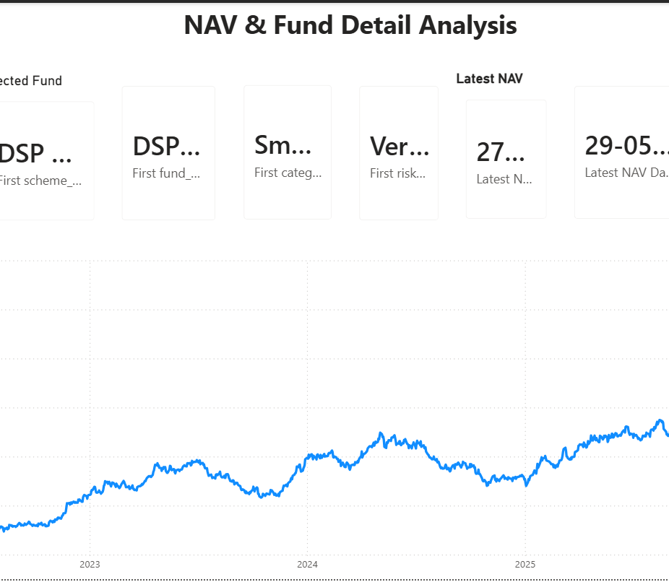
Thank You
Bluestock Mutual Fund Analytics Capstone
Delivered assets: cleaned data, SQL, notebooks, advanced analytics outputs, Power BI dashboard, final report and GitHub repository.
Prepared by: Doddi Satya Sai Sri

