Slide 1
Data Science
Statistics
Data(base) Management
Visualization
Data Intelligence
Data Analytics
Machine Learning
Data Mining
Predictive Modeling
Prespective Modeling
Forecasting
Time Series Analysis

Slide 2
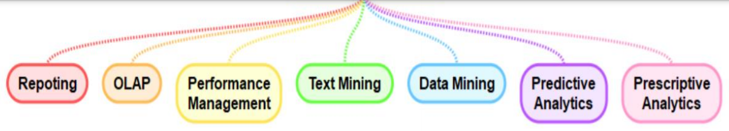
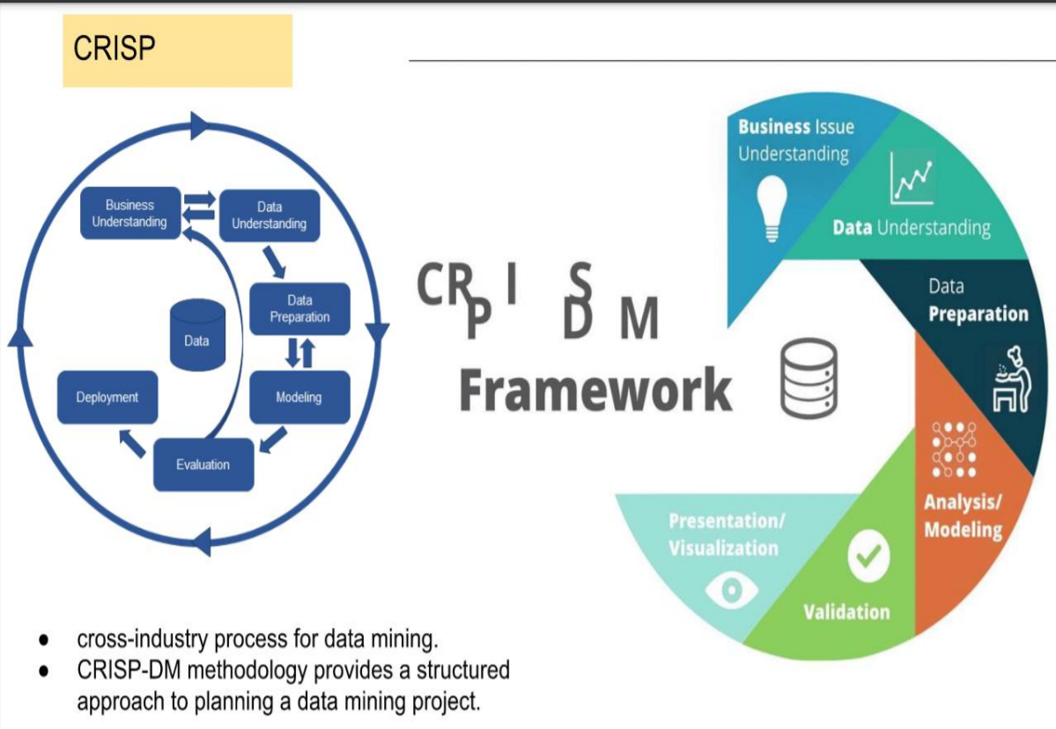

Slide 3
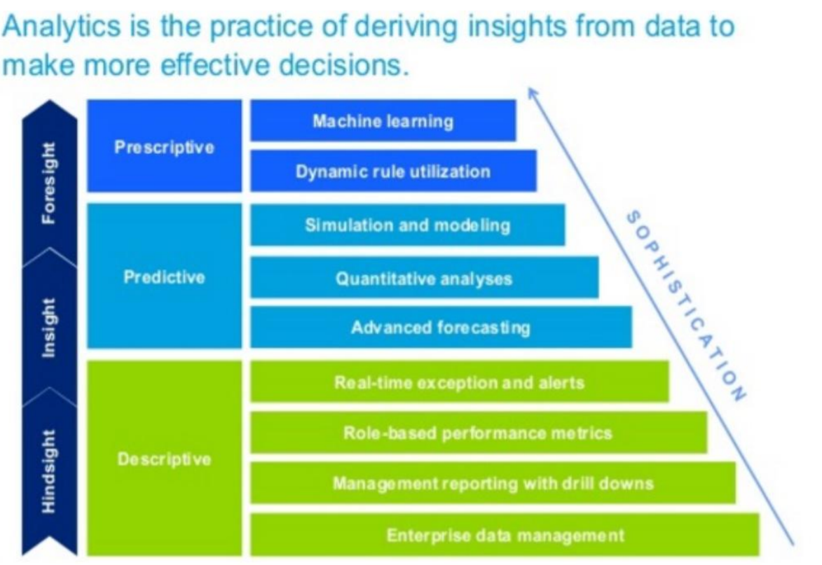

Slide 4
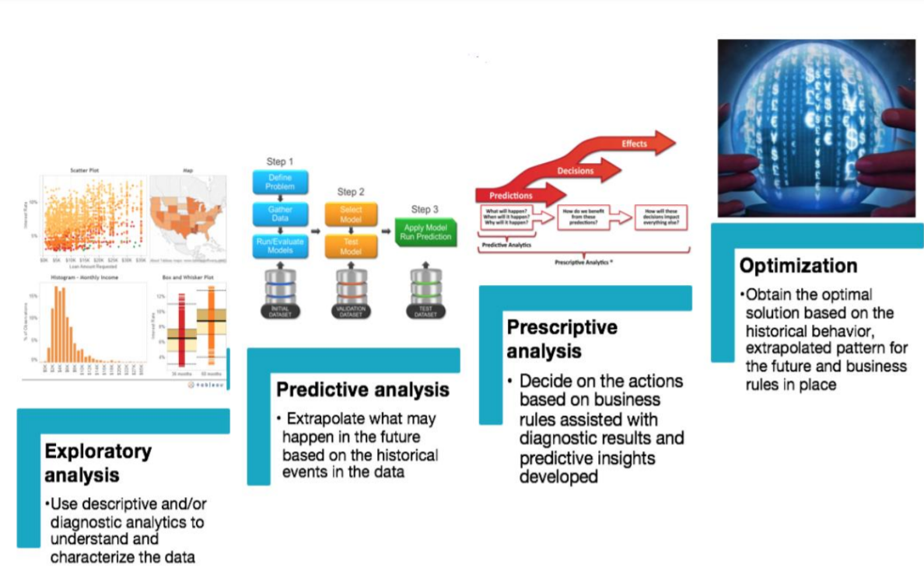

Slide 5
