Slide 1
Anki Pallavi Satya Durga
Final Project

Slide 2
Keylogger & Security
A keystroke logger, often known as a keylogger, is a surveillance tool designed to record every keystroke made on a keyboard. These loggers can be either software-based or hardware-based. Software keyloggers are usually covertly installed on a computer or mobile device, capturing extensive data like passwords, messages, and other personal information. Hardware keyloggers, in contrast, are physical devices attached to a computer, generally placed between the keyboard and the computer to intercept and record keystrokes. While keyloggers can be used for legitimate purposes such as monitoring employee activity or recovering lost data, they are frequently associated with malicious activities like stealing sensitive information and committing identity theft. It's essential for users to stay vigilant and use security measures to protect against unauthorized access and data breaches caused by keyloggers.

Slide 3

Given the significant threat keyloggers pose to the security of personal and organizational data, understanding and defending against them is crucial. Keyloggers, whether implemented as software or hardware, can covertly record sensitive information such as passwords, financial data, and private messages, leading to serious issues like identity theft, financial loss, and corporate espionage. Utilizing strong antivirus programs, regularly monitoring systems, and practicing safe browsing habits are essential strategies for detecting and preventing keylogger infections.

Slide 4


AGENDA
Introduction to Keyloggers
Problem statement
Project overview
Who are the end users?
Solution and its value proposition
The wow in your solution
Detection of Keyloggers
Prevention and Protection Strategies
Modelling
Results
3/21/2024 Annual Review

Slide 5

PROBLEM STATEMENT
The widespread presence of keyloggers poses a significant threat to digital security, endangering the privacy and integrity of sensitive information. Despite advancements in cybersecurity, many individuals and organizations remain vulnerable to these covert tools that record keystrokes to steal passwords, financial information, and confidential data.
This initiative seeks to address the urgent need for effective detection and prevention strategies against keyloggers. It will explore the current landscape of keylogger technology, evaluate the effectiveness of existing security measures, and develop innovative solutions to enhance protection against these threats. Through these efforts, the project aims to mitigate the risks associated with keyloggers, strengthen the security of personal and organizational data, and promote a resilient digital environment.

Slide 6

PROJECT OVERVIEW
Keyloggers:
Keyloggers are tools that capture and record keystrokes made on a keyboard, and they can be either software-based or hardware-based. While they have legitimate uses such as monitoring employee activities or recovering lost data, they are often linked to malicious intentions. Software keyloggers are secretly installed on computers or mobile devices and can gather extensive information, including passwords, messages, and other personal data. In contrast, hardware keyloggers are physical devices attached to a computer, intercepting and recording keystrokes as they are typed.
Security Measures:
Security measures consist of protocols and tools designed to guard against threats like keyloggers and other cyberattacks. Antivirus and anti-malware programs can detect and eliminate keyloggers and other harmful software from a system. Consistent system monitoring and audits are essential for spotting unauthorized access or unusual activity. Using strong, unique passwords and enabling multi-factor authentication can prevent unauthorized access, even if a keylogger captures login information.

Slide 7

Advantages of Keyloggers:
Monitoring and Surveillance: Keyloggers can serve legitimate purposes such as ensuring children's online safety through parental controls or monitoring employees to track productivity and compliance with company policies.
Data Recovery: In cases of accidental data loss, keyloggers can aid in retrieving lost information by recording keystrokes before they are deleted.
Investigative Tool: Law enforcement and legal professionals can utilize keyloggers to gather evidence in criminal investigations or monitor suspicious activities.
System Diagnostics: IT professionals can use keyloggers to diagnose technical issues and troubleshoot problems by providing detailed logs of user interactions.

Slide 8
Disadvantages of Keyloggers:
Privacy Invasion: Keyloggers have the potential to infringe on individuals' privacy by capturing sensitive information, such as passwords, personal messages, and browsing history, without their consent or knowledge.
Misuse and Abuse: Keyloggers can be misused for malicious purposes, such as stealing passwords, financial information, or intellectual property, leading to identity theft, financial fraud, or corporate espionage.
Legal and Ethical Concerns: The use of keyloggers without proper authorization or consent may violate privacy laws and ethical principles, resulting in legal repercussions and damage to reputation if discovered.
Security Vulnerabilities: Keyloggers themselves can become targets for exploitation by cybercriminals, leading to security vulnerabilities and potential breaches if not properly secured or maintained.
Cost and Complexity: Implementing comprehensive security measures can be costly and complex, requiring investment in software, hardware, personnel training, and ongoing maintenance.

Slide 9

WHO ARE THE END USERS?
Ethical Hackers and Security Professionals:
Ethical hackers and security professionals may use keyloggers as part of penetration testing or security assessments to identify vulnerabilities in systems and applications. This helps organizations improve their security posture by addressing potential weaknesses before they can be exploited by malicious actors.
IT Administrators:
IT administrators may utilize keyloggers to troubleshoot technical issues, diagnose problems, or monitor system usage within their organization's network.
Cybercriminals:
Unfortunately, cybercriminals may also be end users of keyloggers, employing them for malicious purposes such as stealing sensitive information like passwords, financial details, or personal data. This stolen information can be used for identity theft, financial fraud, or other illicit activities.

Slide 10

YOUR SOLUTION AND ITS VALUE PROPOSITION
Anti-Keylogger: These programs are designed to detect and remove keyloggers from computer systems, protecting against keylogging activities.
Antivirus: Many antivirus programs also have the capability to detect and eliminate keyloggers, though they are typically more effective against software-based keyloggers and may not address hardware keyloggers.
Automatic Form Filler: Users can utilize automatic form fillers to avoid manually entering data, thus preventing keyloggers from capturing keystrokes.
One-Time Passwords (OTPs): Using OTPs enhances security as they require a new password for each login session, making captured passwords useless.
Patterns or Mouse Recognition: On Android devices, patterns can be used as application passwords, and on PCs, mouse recognition software can replace keystrokes with mouse gestures.
Voice to Text Converter: This software converts spoken words to text, helping to prevent keyloggers from capturing typed information.

Slide 11
THE WOW IN YOUR SOLUTION
Revolutionary AI-Powered Detection: Our solution utilizes cutting-edge artificial intelligence (AI) algorithms to detect and prevent keylogger threats with unprecedented accuracy and efficiency. By continuously analyzing user behavior patterns and keystroke dynamics, our AI-driven system can identify even the most sophisticated keyloggers in real-time, providing proactive protection against evolving threats.
Predictive Behavioral Analysis and Auto-Remediation: Our solution harnesses the power of predictive behavioral analysis to anticipate and preemptively neutralize keylogger threats. By analyzing user behavior patterns and device interactions in real-time, our system can accurately predict when a keylogger is attempting to compromise the system.
3/21/2024 Annual Review
11

Slide 12
MODELLING
Import Required Modules:
Use Python's keyboard module to capture keystrokes.
Optionally, use other modules for logging, encryption, or network communication.
Set Up Logging:
Configure logging settings to specify the format and destination of log files.
Define Keylogger Function:
Create a function to capture and log keystrokes.
Use the keyboard.on_press() method to register a callback function to capture each key press event.
Main Function:
Create a main function to start the keylogger and keep it running indefinitely.
Testing and Deployment:
Test the keylogger program to ensure it captures keystrokes correctly.
Deploy the keylogger on target systems if necessary, ensuring compliance with legal and ethical considerations.
12

Slide 13

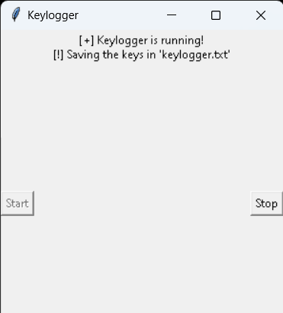
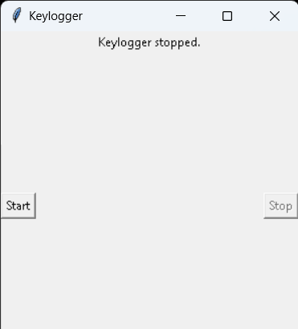
RESULTS
The result of a keylogger program typically involves capturing and logging keystrokes entered by a user on a keyboard. These logged keystrokes can then be used for various purposes, depending on the intent of the keylogger user. The covert nature of keyloggers allows them to capture sensitive information, including passwords, personal messages, and financial details, without the user's knowledge or consent. This poses serious risks to individuals, organizations, and society at large, including identity theft, financial fraud, and unauthorized access to confidential data.
13

Slide 14
Project Link

