Slide 1
LIGHT PATTERN SIMULATOR
Satya Bhavsar (B16CS033)
Paridhi Gehlot (B16CS024)

Slide 2
KEY FEATURES
Simulates Light Pattern on a selected building.
Secure system.
Displays user history.
Variety of patterns and buildings.
User – friendly.

Slide 3
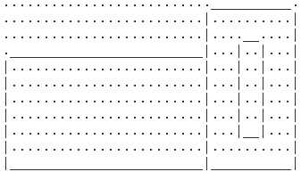
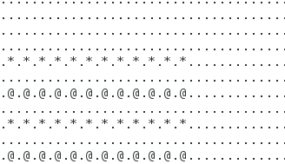
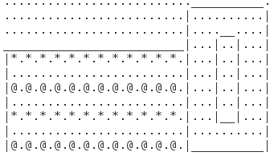
Example of simulation
+
=

Slide 4
Use cases
Admin Login.
Simulate_design.
Display user history.

Slide 5
Structure of database
A folder named buildings store all the buildings.
Each building details are stored in a seperate text file.
Similar storage of pattern and Simulated Design.
Admin details – stored in a text file “Admin_details”.
Customer Details are stored in a binary file “Customer_details.dat”.

Slide 6
Things unimplemented
Password of admin cannot be changed.
Deletion of a customer could not be implemented.
Variation in number of patterns for a particular building could not be implemented.

Slide 7
Statistics of unit testing
Test cases identification- using control flow graph-all statement coverage
Entering multiple characters where only one was to be entered created problems.

Slide 8
Project tested
Book management system – by Chinmay Garg and Anurag Shah.

Slide 9
List of use cases tested
Add / view/ search resources.
Add new member and search and view.
Issue resource.
Return resource.
See user history.
Renew resource.
Pay fine.
Edit profile.
View issue history.
Remove member

Slide 10
Statistics of test cases
10 functionalities were tested.
Some component of all the function were wrong. Ex. Staff login, User deletion, Faculty login, All functions of faculty.
Development team has not used file handling .

Slide 11
conclusion
Lighting Pattern Simulator successfully created.
For scalability, text files containing building, pattern (4 for each building) and design details can be added into respective folders.
Practical implementation of software development processes.
Various software development processes used. For example, CFG for software testing.

Slide 12
Thank you

