Slide 1
SPRING(V5.0)

Slide 2
What is Spring?
Java based open source
Loosely coupled
Aspect oriented
Light weight
Java-J2EE Frame work
Web applications, Native applications, Distributed applications and Mobile applications.
Notes:
Loosely coupled due to Dependency Injection
Can achieve declarative programming through AOP
No need of servers to activate spring containers.
Using spring can develop all kinds of applications and all kinds of logics(view logic, business logic, persistence logic, Integration logic)

Slide 3
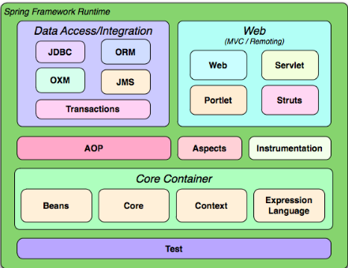
Spring Modules
Notes:
Spring has total 20 modules. Categorized into 6 major categories

Slide 4
Inversion of control (IOC) Containers
BeanFactory :::
A BeanFactory is an implementation of the factory pattern that applies Inversion of Control to separate the application’s configuration and dependencies from the actual application code
The most useful one is org.springframework.beans.factory.xml.XmlBeanFactory, which loads its beans based on the definitions contained in an XML file
XmlBeanFactory xbf = new XmlBeanFactory(“object of Spring bean class”);

Slide 5
Application Context:::
Application Context is an enhancement of XmlBeanFactory.
We can read multiple configuration files
It supports internationalization i18
It is available in spring context/ JEE module
It supports pre-instantiation of beans
Implementation classes of Application Context interface
1. FilesSystemXmlApplicationContext.
2. ClassPathXmlApplicationContext.
3. WebXmlApplicationContext.
Notes:
Pre-instantiation- means creating the object of bean class at the time of spring container activation
FilesSystemXmlApplicationContext:- Spring container loads spring config file from specified File
ClassPathXmlApplicationContext:- Spring container loads spring config file from classpath environment variable
WebXmlApplicationContext:- container loads the XML file with definitions of all beans from within a web application.

Slide 6
Dependency injection
In two ways we can do dependency injection in spring
1. Setter Injection: in setter injection spring container uses setter methods to inject the values to the properties of spring bean.
<property name=“” value=“”/>
2. Constructor Injection: in constructor injection spring container uses constructor of spring bean to inject the values.
<constructor-arg value=“”/>

Slide 7
Bean Scopes
Bean scopes decides what kind of object is going to create by spring container.
Scope is an one attribute in bean tag.
<bean name=“” class=FQN scope=scopetype/>
There are total 5 types of scopes are exist in spring
1. Singleton
2. Prototype
3. Request
4. Session
5. Global Session
Notes:
FQN: Fully qualified class name

Slide 8
Singleton: the default scope of beans in spring is singleton
If the scope is singleton for every request spring container will return only one instance of bean.
Prototype: For Every request spring container will create new instance of bean
Request: This is applicable in web module.
If the scope is request for every HTTP request one new instance of bean will be return.
Session: For every session a new instance of bean will be created.

Slide 9
Wiring:
Injecting the values to the bean property is called wiring.
There are two types of wiring exist in spring
1. Explicit Wiring
2. Auto Wiring

Slide 10
Explicit Wiring
In explicit wiring the dependent values will be injected manually like below.
<property name=“” value=“”/>
<constructor-arg value=“”/>

Slide 11
Auto Wiring
In auto wiring bean properties values will be injected automatically by spring container.
Auto wiring is possible only on references not on primitives.
Auto wire is one parameter in bean property, by using it we can inject values to bean properties. We can do it in 4 ways
1. byName
2. byType
3. constructor
4. autodetect

Slide 12
1.byName: bean property name should match with bean name in spring configuration file.
2.byType: bean property type should match with bean type in spring configuration file.
3.constructor: Spring bean class must have 1-parameter constructor and that parameter should be bean property on which we do auto wiring.
4.autodetect: performs either constructor mode injection or byType mode injection
If spring bean has 0-param constructor then spring container will do setter injection or else it will do constructor injection.

Slide 13
Annotations in spring
@Component: normal bean
@Service: bean at service layer
@Repository: bean at persistence layer
@Controller: bean at integration logic layer
@Value
@Resource(name=“refObj”)
@Configuration
@Autowired
@scope(“”)
@PostConstruct
@PreDestroy
@ComponentScan
@Primary
@Qualifier

