Slide 1
Team HackingParadox
Adapting AI in finance to make Retiree’s future Better

Slide 2
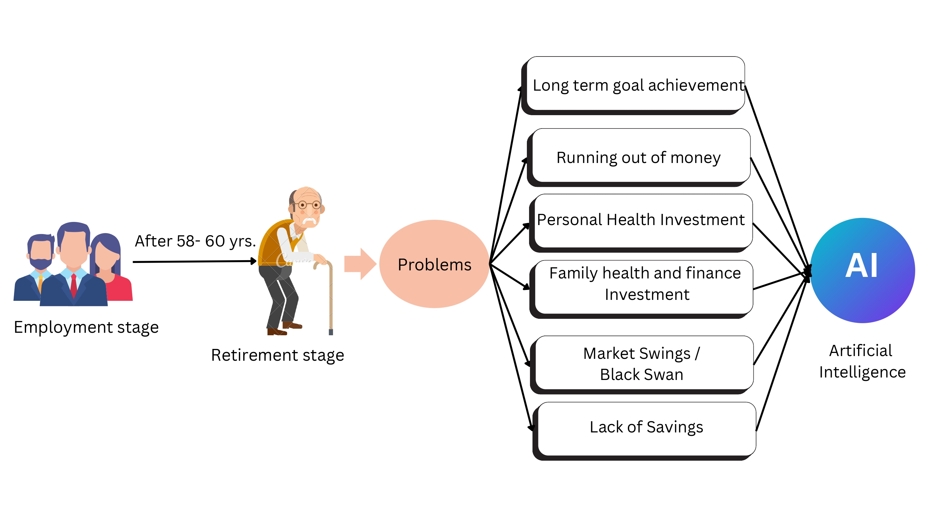
AI in Business Challenges in Retirement Industry
Insights on the challenges:
Health Issues
Age group of 55-60 is the commonly found age group of retiree and also the likely age of getting affected with various Health Problems
Inadequate Risk Management
Retirees face significant risks such as market fluctuation and inflation, which traditional approaches fail to address efficiently.
Regulations
Complex regulations impede the use of modern technologies, adversely affecting the retirement industry's transformation.
Retirement Income Management:
Managing retirement income sources and withdrawals can be complex.
Estate Planning and Legal Guidance:
Estate planning and legal matters can be complex for retirees.
Problems faced by Retiree :
Personal Health Issues
Lack of Savings
Dynamic Financial Landscape
Legacy planning
Discrepancy of Robust Investment Strategies

Slide 3
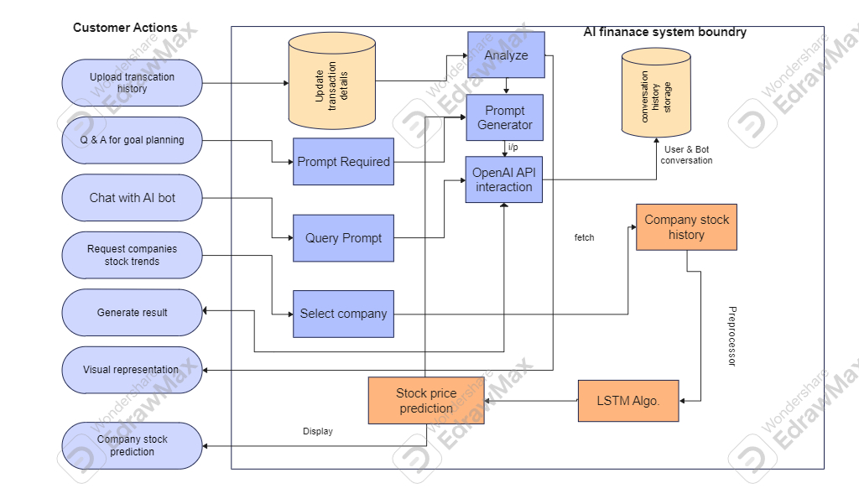
System Architecture
Contribution of AI to the Solution
AI Chatbots: This helps the model to be up to date. Helps Solving queries and improves personalization of the chatbot
AI Finance Assistance:
It uses the transactional data of the user to assist and guide the user for his/her financial well-being future.
Display

Slide 4
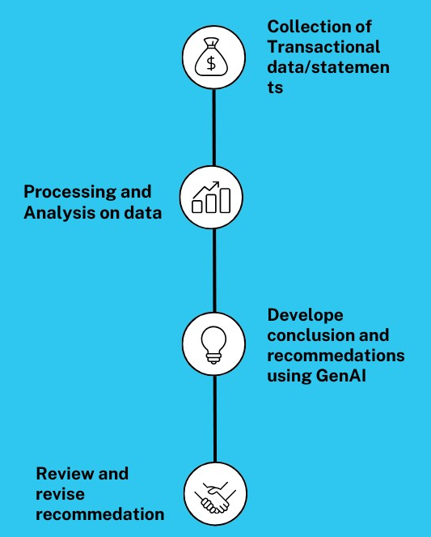
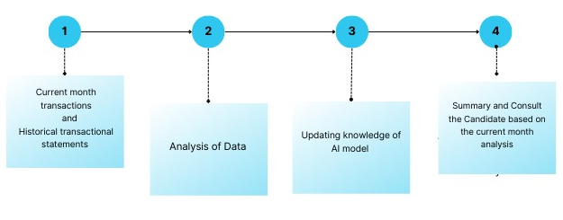
Requirement Gathering and Transaction Analysis:
Collection of transactional history and current month transactional dataset of the candidate for analysis Process.
The model uses transactional data analysis to create investment strategies tailored to retirees' specific financial needs. Identify common spending patterns among retirees.
Understand how spending varies across different categories such as housing, healthcare, leisure, etc.
System Working

Slide 5
AI in Business Challenges in Retirement Industry
Transaction Analysis with generative AI
Tech stack:
Programming language : python
Libraries used :
Streamlit, pandas, plotyly, sklearn, scipy, statmodels, os
APIs used:
openAI – model=gpt-turbo-3.5, engine= text-davinci-003
Cohere – engine= command-nightly
Machine Learning algorithm used:
1] Linear Regression –Trend analysis
2] K-means Clustering –Customer segmentation
3] ARIMA – Forecasting Future Expenses
Parameter to LLM model :
Temperature, max_tokens, model, engine, n (number of completions)
Future Implementation:
Data visualization using Tableau, PowerBI
Use flask and react.js advance web framework to build interactive and user-friendly UI
Fine-tune langchain model for better analysis by Generative AI
Most relevant values of parameters to the LLM model

Slide 6
AI in Business Challenges in Retirement Industry
Post Analysis
Post analysis the identified parameters serve as the foundation for creating a personalized and precise context for generating a summary. Each parameter represents a key surface of your financial landscape
With the baked prompt in hand, we seamlessly integrate it with the LLM REST API. This makes sure our prompt serves the best for the generation of a personalized and insightful summary encapsulating the details captured from your transactional data.
The resultant content is designed with utmost simplicity, tailored specifically for a retiree audience. This ensures that the AI-generated summary is not only accurate but also easily comprehensible, fostering a seamless understanding of the financial analysis insights.
Analysis Insights
Context Generation
Large Language Model (LLM) Integration
API Interaction
Results and Implications
User Interface
Personalized Summary
Effective Dashboard representation
Feedback Loop
Impactful Insights
Enhanced Decision Making

Slide 7
Future Implementation:
Build custom dataset and expert feedback to customize LangChain generative AI.
Use of hugging face transformer libraries and NLP tools to transform text for human understandable way.
Presenting road maps more visually with help of Image Generator model, such as Dall E-2.
Prompt with minimal token and more customized prompt, to get better response from model.
Long-term goal management with AI
Tech stack:
Programming language : python
Libraries used:
Streamlit, openAI
API used:
openAI : model =gpt-turbo-3
Prompt specification:
- Customized prompt based on user feedback survey
- set temperature parameter to lower value to reduce randomness
- make model to remember context using concept of chaining

Slide 8
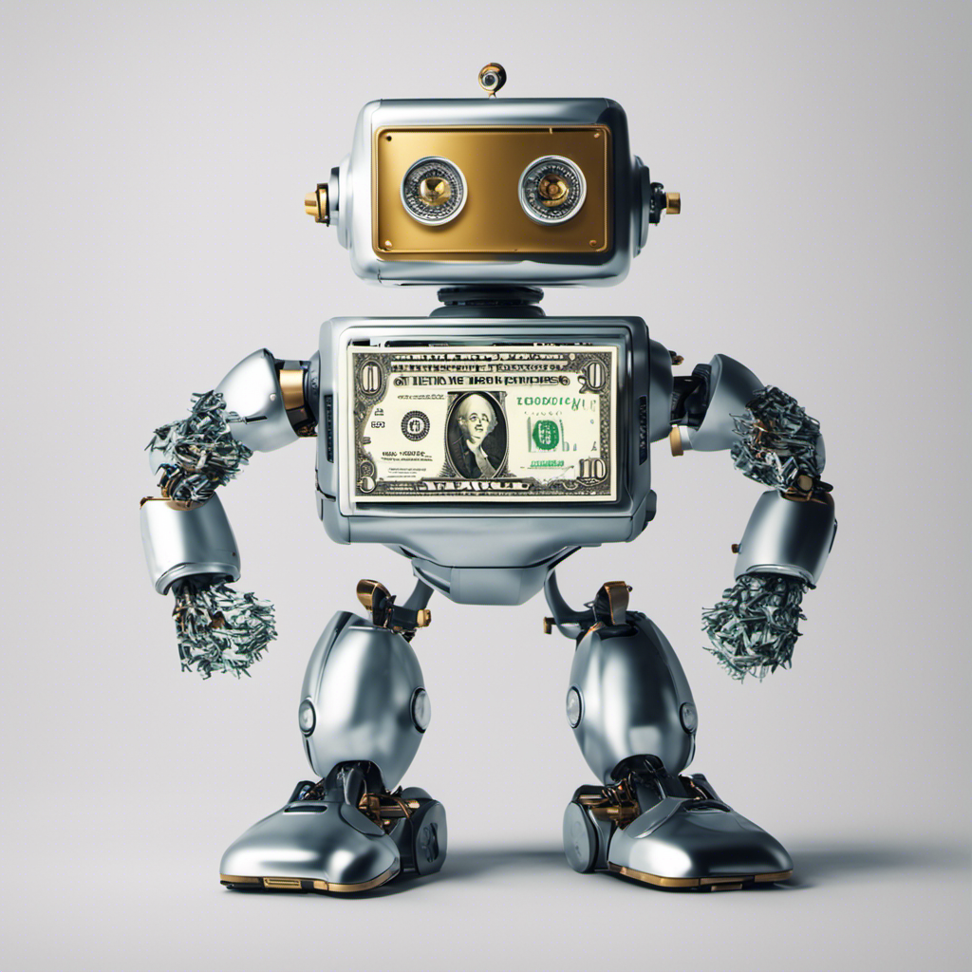
AI in Business Challenges in Retirement Industry
Contribution of Chatbot is like Cheery on the Cake
Timely Alerts:
Receive personalized alerts about transactions, ensuring retirees stay informed about financial activities as well as golden opportunities.
Account Updates:
Real-time notifications about account balance changes, enabling retirees to track their financial health effortlessly.
Automated Insights:
The Chatbot provides automated insights drawn from data analysis, offering a sophisticated understanding of financial patterns.
User-Friendly Interaction:
Designed with retirees in mind, the Chatbot ensures a user-friendly and accessible interaction, simplifying complex financial information.
The deployment of a customized Chatbot, supported by robust data analysis and API functionalities, represents a noteworthy advancement in elevating financial awareness and security for retirees.

Slide 9
Stock Price Prediction with Deep Learning with AI
Tech stack:
Programming Language: Python
Libraries used :
openAI, yfinance, keras, pandas, sklearn, numpy
Deep Learning algorithm used:
LSTM (Long Short Term Memory)
Hyperparameter turning technology used:
Keras tuner
APIs used:
openai : model =gpt-turbo-3
Future Implementations
Making stock trading automated with user specific amount.
Use of LLM and RAG ( Retrieval Augmented Generation) for real-time data access to achieve more trusted and accurate recommendation system
Creating alerts about market condition and suggest company to generate income.

Slide 10
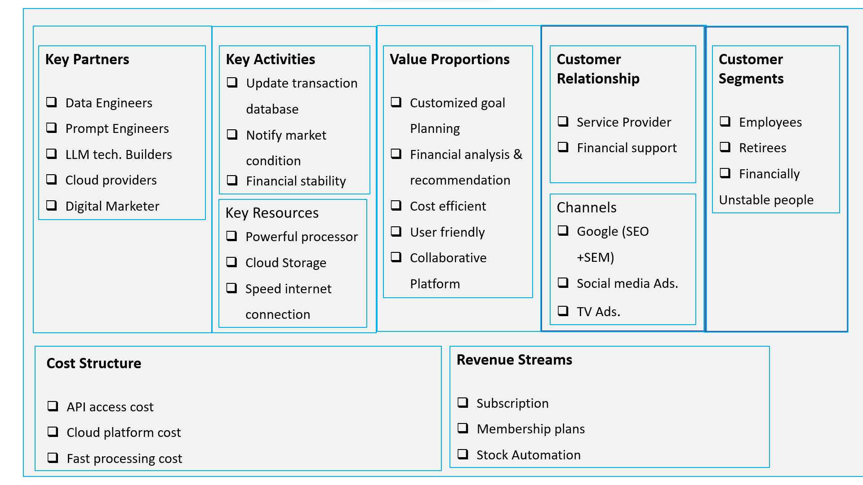
Business Model
Thank You

