Slide 1
LIFE SAVER AT RAINY SEASON
TEAM MEMBERS AND GUIDE DETAILS:
G Satya Swaroop – 2451-19-737-014
M Sai Priyanka – 2451-19-737-016
T Rithika – 2451-19-737-019
Working on this project under the guidance of
Dr. Dumpala Shanthi Associate Professor , ITD.

Slide 2










CONTENTS
ABSTRACT
INTRODUCTION
LITERATURE SURVEY
PROBLEM STATEMENT
EXISTING SYSTEM
PROPOSED SYSTEM
MODULE SPLIT UP
DESIGN PHASE
SYSTEM REQUIREMENTS
REFERENCES

Slide 3
Nowadays, accidents due to broken, missing manhole covers and pits are high in Rainy seasons. Pits and Manholes are not monitored properly in developing countries, especially in rainy seasons. These accidents can lead to severe injuries and also death if there is heavy water flow. Hence, here we need to propose a system to overcome this problem. We need to include an array of sensors including a sonar concept where it can identify and also calculate the distance of the manhole or pits and the same will be alerted to the person who is in the driving seat, this problem generally raises with 2 wheelers.
ABSTRACT

Slide 4
INTRODUCTION
Road accidents are one of the horrific unfortunate events we hear on almost daily basis. In developing countries like India where roads are filled with manholes and deep pits, it is very difficult for one to identify these manholes and pits on a rainy day which is a concerning issue leading to deadly accidents. Thus, This project uses sonar radiation and laser imaging to identify these pits and alerts the driver this about the nearby pits and manholes to prevent such accidents.

Slide 5
OBJECTIVES
Attach the sensor in the front part of the vehicle for easy detection and identification of the potholes and manholes in the normal as well as rainy conditions.
Using the Ultra Sonic Sensor for better output.
Incorporate a program that records the potholes and upload the geometric size and the GPS location of the potholes into the data base.

Slide 6
LITERATURE SURVEY
S.NO | AUTHOR NAME | PROBLEMS IDENTIFIED | TECHNIQUES USED | ACCURACY | DRAWBACKS
1. | Hadistian Muhammad Hanif , Zener Sukra Lie, Winda Astuti , Sofyan Tan | Pothole detection system design with proximity sensor to provide motorcycle with warning system and increase road safety driving | Image Processing, Proximity sensors | 90.2 % | An error was obtained while measuring the distance.
2. | T S Arunlananth, M. Baskar, K.Thrishma | Pothole Detection Using Arduino and Ultrasonic Sensors | Arduino and ultrasonic sensors | 91.5% | The sensor is placed right under the vehicle so there is a small delay faced by the driver.
3. | Stepheena Joseph, K.Edison Prabhu | Role of ultrasonic sensor in automatic pothole and hump detection system. | ultrasonic sensor, ARM7, GPS,GSM, IR speed sensor | 90.8% | For the Humps it only detects if the hump is above a certain height.

Slide 7
4. | Aarthi M, Bhuvaneshwaran A | To detect the volume and depth and delivers information via alerts. | IOT | 80.2% | Highly non-scalable
5. | Himanshu Shriwas | IOT based Manhole Detection and Monitoring System | IOT | 70.5% | Only detection of manholes

Slide 8
PROBLEM STATEMENT
Detect and identify the potholes by using the Sensors during rainy season.

Slide 9
EXISTING SYSTEM
In the existing system, the identification of potholes and calculation of their height, depth, size, distance between potholes and the driver is achieved by using an ultrasonic sensor, Which will assist or alert drivers to take evasive action with the aid of giving earlier warnings . The sensor is arranged beneath the vehicle to sense the presence of potholes using sonic waves, where sonic waves penetrate through water and hit the bottom of the potholes and indicate, alert the presence of potholes.

Slide 10
PROPOSED SYSTEM
We would like to propose a system in which the sensor is placed at the front part of the vehicle which would ease the identification of potholes and helps us to detect the potholes quickly and alerts the driver by providing a buzzer alert.​

Slide 11
SYSTEM REQUIREMENTS
HARDWARE REQUIREMENTS:
ULTRA SONIC SENSORS
ESP32 S3 DEVELOPMENT KIT
BUZZER
BREAD BOARD AND CONNECTING WIRES
BATTERY
SOFTWARE REQUIREMENTS:
Base software: ENVI 5.6.3 and the ENVI Deep Learning 2.0 module
Operating systems:
Windows 7(Intel/AMD 64-bit)
Linux (Intel/AMD 64-bit, kernel 3.10.0 or higher, glibc 2.17 or higher)

Slide 12
MODULE SPLIT UP
VEHICLE : The primary module for which the sensor is attached, the user drives the bike and gets feedback upon detection of pothole.
SENSOR and SYSTEM: The Sensor projects the rays on the road and calculates the time delay for the pothole identification.
USER :Based upon the result of the pothole identification , the user receives feedback in form of Alarm on the presence of pothole on the road.

Slide 13
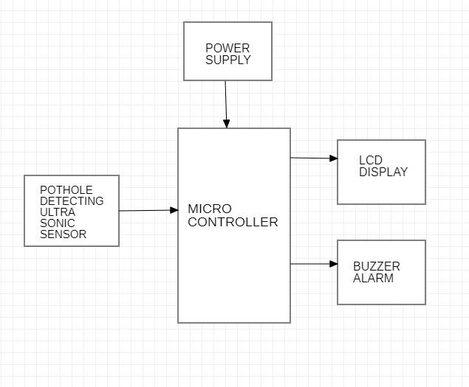
ARCHITECTURE

Slide 14
DESIGN PHASE

Slide 15
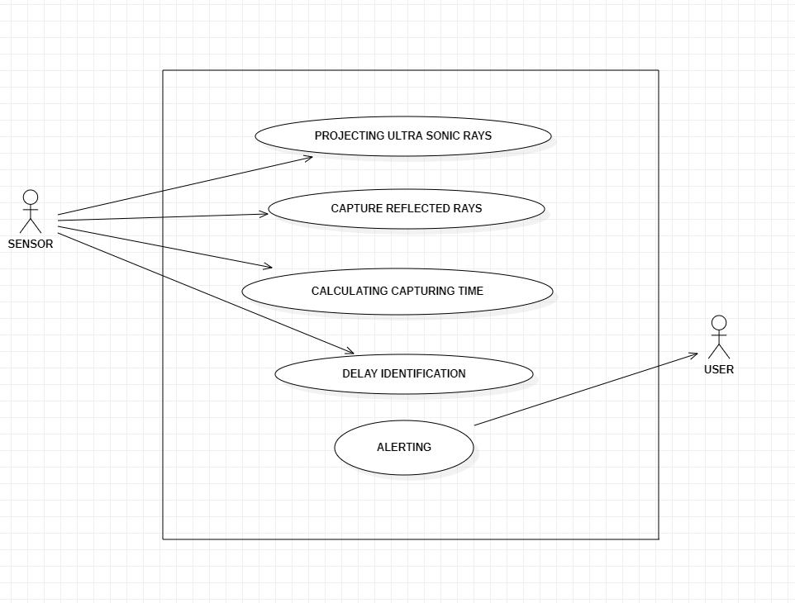
USE CASE DIAGRAM

Slide 16
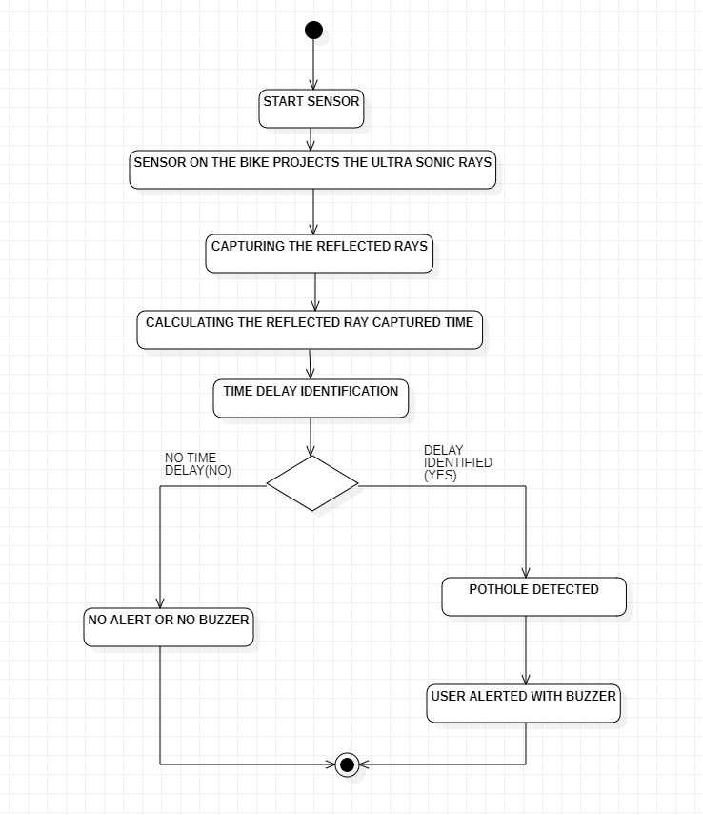
ACTIVITY DIAGRAM

Slide 17
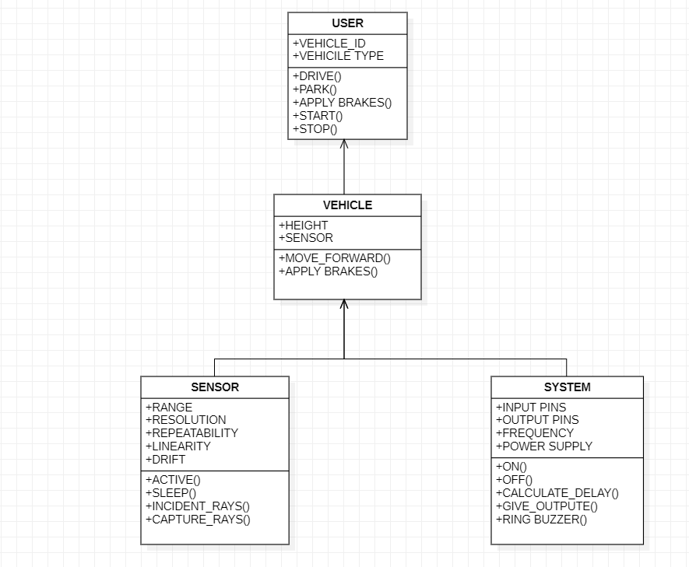
CLASS DIAGRAM

Slide 18
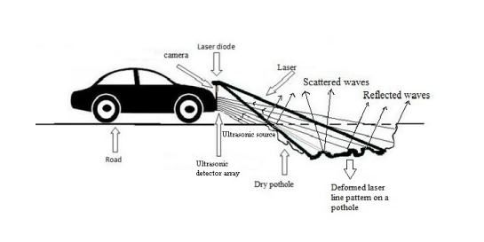
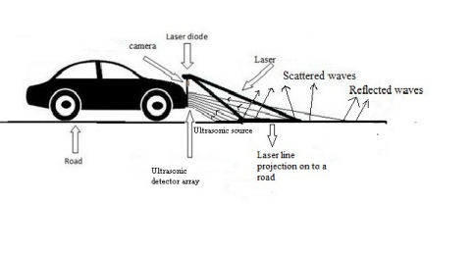
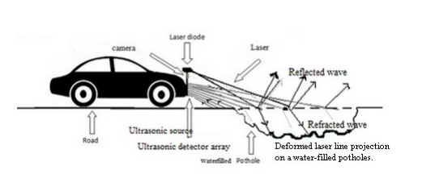

Slide 19
METHODOLOGY
BIKE UNIT:
The bike unit is the main component where the sensors are attached to, the signals are transmitted from the sensors attached to the bike and based upon the detection of the pothole and pit on the road, the rider can apply the brakes.
ESP32 S3 DEVELOPMENT KIT:
ESP32 is a popular low-power system on chip microcontrollers with integrated Wi-Fi and dual-mode Bluetooth, making it suitable for designing and prototyping IoT solutions. This section covers various basic tutorials and projects to start with ESP32 NodeMCU based IoT projects.

Slide 20
METHODOLOGY
ULTRA SONIC SENSORS:
Ultrasonic sensors are used to identify the potholes and humps and also to measure their depth and height, respectively. Ultrasonic sensor, it senses the distance between the vehicle and the pothole. In the correct position the ultrasonic sensor is placed on the vehicle to detect the holes. This sensor provides the distance information to the micro-controller. Since sound travels with a constant speed it would be efficient to detect the objects on the dry surfaces that wouldn’t cause any kind of refraction or attenuation. The sensor used is WATER PROOF ULTRA SONIC SENSOR, with operating range of (3-450)cm, transmits the signals with frequency of (30-80)kHz.

Slide 21
METHODOLOGY
BUZZER:
An active buzzer sensor module has a built-in oscillation circuit, thus the sound frequency is fixed. It is able to generate the sound itself. So, you can simply turn it on and off with an Arduino pin, just like the way of turning on and off a Led which is connected to Arduino board. When there is a pothole detected then the signal is sent to the Buzzer which turns on and alerts the user.
BATTERY:
All the components of this kit are powered by the battery of the vehicle.

Slide 22
METHODOLOGY
Turn on the vehicle which powers up the, ESP32 S3 DEVELOPMENT KIT and all the sensors integrated with it.
The sensors keep on transmitting the signals and the receivers are built on the kit to receive the signals for the identification and detection of the potholes and pits.

Slide 23
REFERENCES
Stephena Joseph, ''ROLE OF ULTRASONIC SENSOR IN AUTOMATIC POTHOLE AND HUMP DETECTION SYSTEM '' ,International Journal of Scientific & Engineering Research Volume 8, Issue 7, July-2017.
P. More, S. Surendran, S. Mahajan, and S. K. Dubey, “Potholes and pitfalls spotter,” IMPACT, Int. J. Res. Eng. Technol., vol. 2, no. 4, pp. 69–74, Apr. 2014.
T S Arulanath, ''Pothole Detection Using Arduino and Ultrasonic Sensor'' in ,LNNS,volume 292.
Hadistian Muhammad Hanif , Zener Sukra Lie, Winda Astuti , Sofyan Tan, “Pothole detection system design with proximity sensor ” , Published under licence by IOP, 13–14 November 2019, Solo, Indonesia.
Himanshu Shriwas, ”IOT based Manhole Detection and Monitoring System” , International Journal
for Research in Applied Science & Engineering Technology ,Volume 10 Issue VI June 2022.

Slide 24
CONCLUSION
This project presented detection of dry and water-filled potholes. The circuit for the functioning of the ultrasonic sensor is fabricated and by using a microcontroller the sensor calculates the distance and depth of the pothole. It gives a warning to the driver in the presence of a pothole. The experimental results show that the algorithm works to detect and warn the driver regarding potholes. By using an array of detectors, we will get the profile of the pothole along with the range and depth. So, by using an array we can acquire the 3D image of the pothole. we can obtain the profile of the pothole. The reflected signals from the different regions can be added up thus obtaining the exact information about the pothole. It has been shown that the proposed feature extraction algorithm works for the laser module for the detection of water-filled potholes. The experimental results show that the algorithm is highly reliable and accurate in detecting the potholes, obtaining the maximum depth, and generating the depth profile of the pothole.

Slide 25
THANK YOU

