Slide 1
InfraHive Consolidated P&L
As of 13 May 2025

Slide 2
P&L Summary (INR)
Account | Amount (INR)
COGS | -1660000
IC_ELIM | 0
IC_EXPENSE | 0
IC_REVENUE | 0
OPEX_RENT | -270000
REVENUE_SALES | 4450000

Slide 3
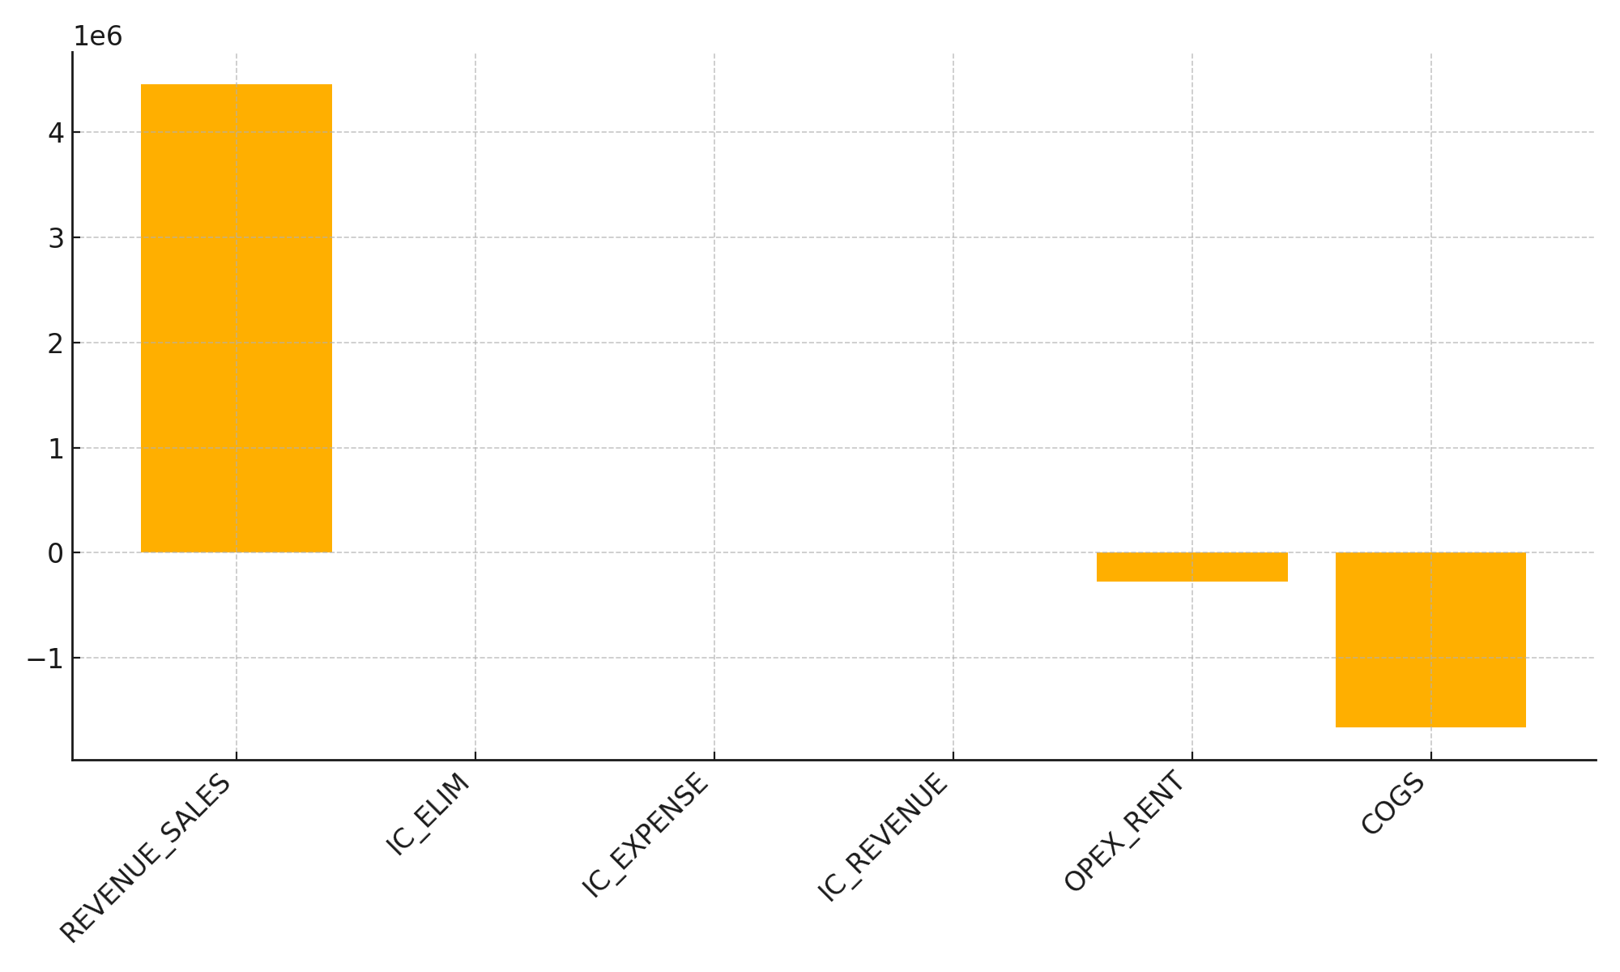
P&L Breakdown

