Slide 1
SALES PERFORMANCE QUARTERLY REVIEW
📊 Comprehensive Analytics & Strategic Insights
📅 Reporting Period: FY 2023-2025
🎯 Executive Management Review
Prepared: June 2025

Slide 2
🎯 EXECUTIVE DASHBOARD
💰 Total Net Revenue
₹48751.3Cr
📈 +-93.9% YoY
🏠 Units Sold
2,634
📊 8 Quarters
💳 Avg Ticket Size
₹1850.8L
📈 Premium Focus
⚠️ Cancel Rate
14.0%
🟡 Monitor
🔍 KEY INSIGHTS: QQ3 FY2024 achieved peak revenue of ₹29475.1Cr • Overall business health: 🟡 Good • Revenue trend: 📉 Declining performance

Slide 3
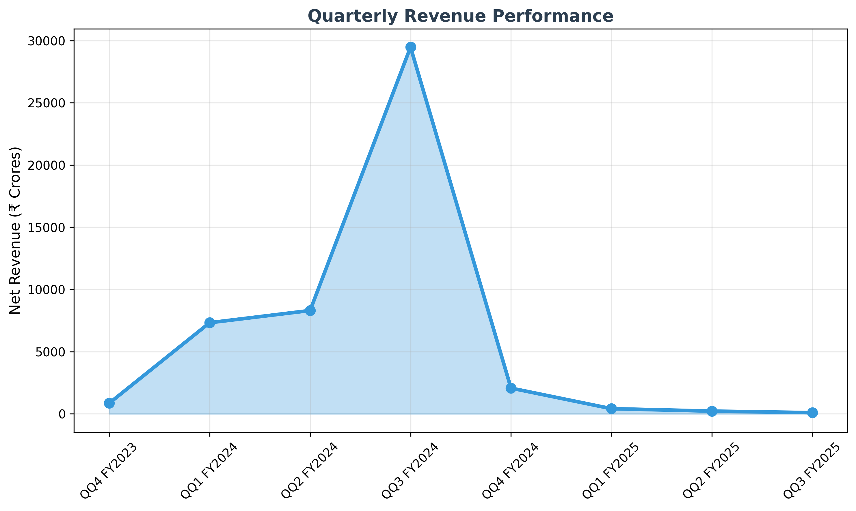
📈 REVENUE TREND ANALYSIS
🎯 BEST QUARTER: QQ3 FY2024 - ₹29475.1Cr | 📊 AVERAGE: ₹6093.9Cr | 📈 GROWTH: -93.9% YoY

Slide 4
🎯 STRATEGIC RECOMMENDATIONS
🚀 SHORT TERM ACTIONS (0-3 months)
• Launch customer retention program targeting high-value segments
• Implement predictive analytics for early cancellation warning
• Expand premium product portfolio to capture market demand
• Enhance digital sales channels and automation
📈 MEDIUM TERM STRATEGY (3-6 months)
• Scale direct sales team by 25% to reduce broker dependency
• Develop seasonal pricing strategy to optimize Q3 performance
• Launch loyalty program with referral incentives
• Invest in CRM automation and customer journey optimization
🎯 LONG TERM VISION (6-12 months)
• Target ₹60939Cr annual revenue (25% growth)
• Enter new geographic markets for expansion
• Develop affordable housing segment for volume growth
• Build strategic partnerships with financial institutions
💡 EXECUTIVE PRIORITIES
✅ Revenue Target: ₹60939Cr by FY2026 through market expansion
✅ Risk Mitigation: Reduce cancellation rate to <8% through early intervention
✅ Operational Excellence: Achieve 90%+ direct sales channel mix
✅ Market Leadership: Maintain #1 position in premium segment
🎯 NEXT STEPS: Board approval for growth investments • Quarterly performance review automation • Implementation timeline finalization

