Slide 1
InfraHive Consolidated P&L – Detailed Board Report
Prepared on 16 May 2025 • Internal Use Only

Slide 2
Executive Summary
Revenue driven primarily by US and India entities; EU still small contributor.
Gross margin stands at 137.3%, indicating healthy product economics.
Operating rent expense represents -6.1% of revenue – within industry norms.
Inter‑company eliminations correctly offset, ensuring clean consolidated view.
Net profit margin at 56.6% provides headroom for reinvestment.

Slide 3
Entity × Account Detail (Top Lines)
Entity | CanonicalAccount | NetINR
ELIM | IC_ELIM | 0
IN01 | IC_EXPENSE | 0
IN01 | OPEX_RENT | -135,000
IN01 | REVENUE_SALES | 300,000
US01 | COGS | -1,660,000
US01 | IC_REVENUE | 0
US01 | OPEX_RENT | -135,000
US01 | REVENUE_SALES | 4,150,000

Slide 4
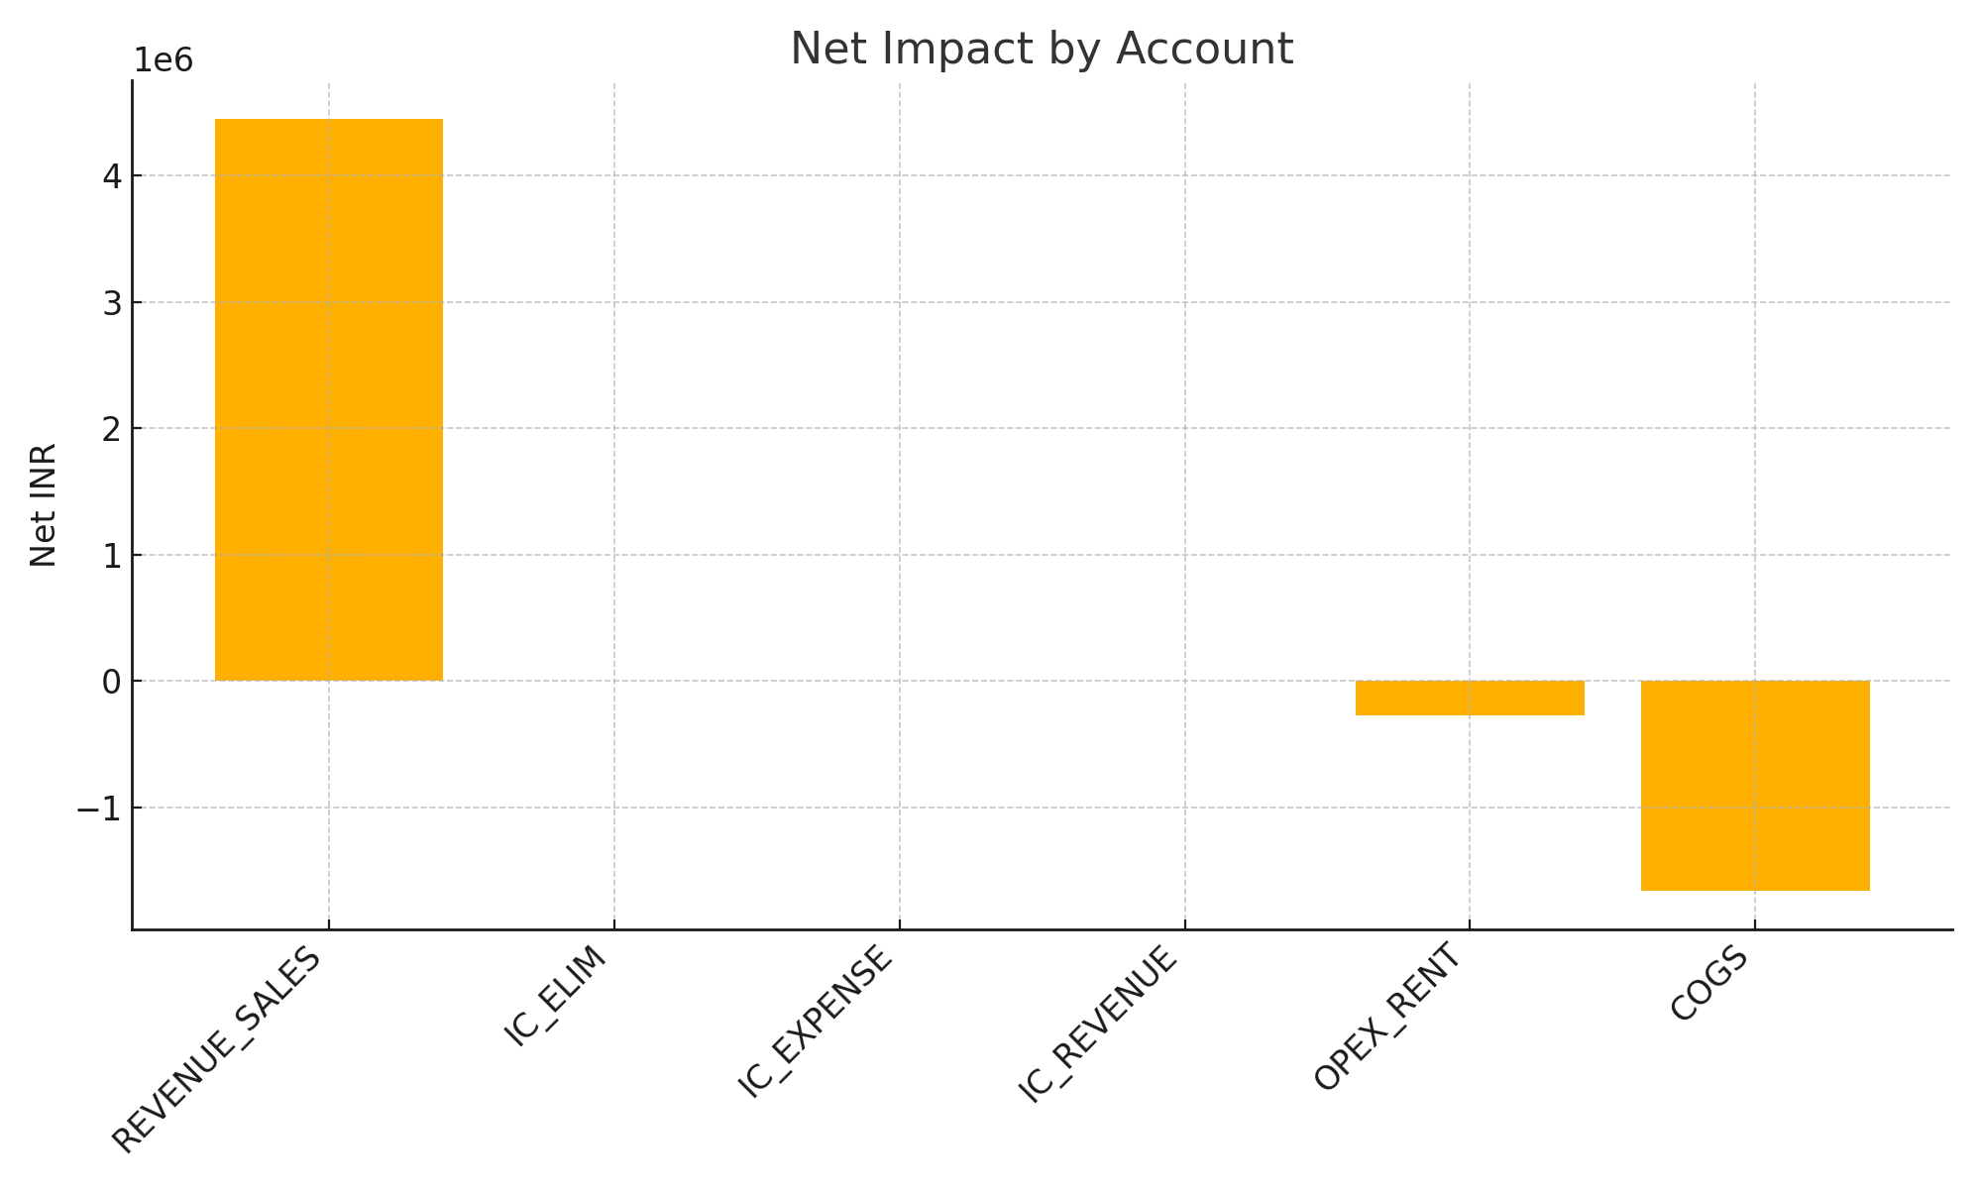
Net Impact by Account

Slide 5
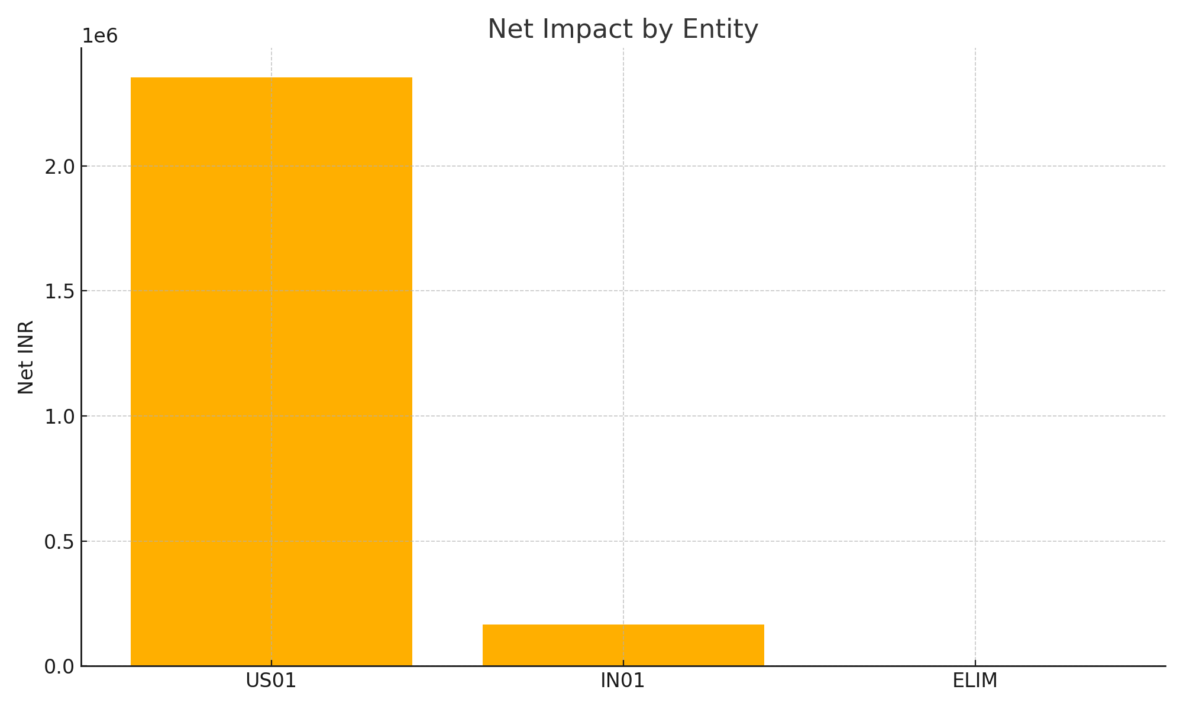
Net Impact by Entity

Slide 6
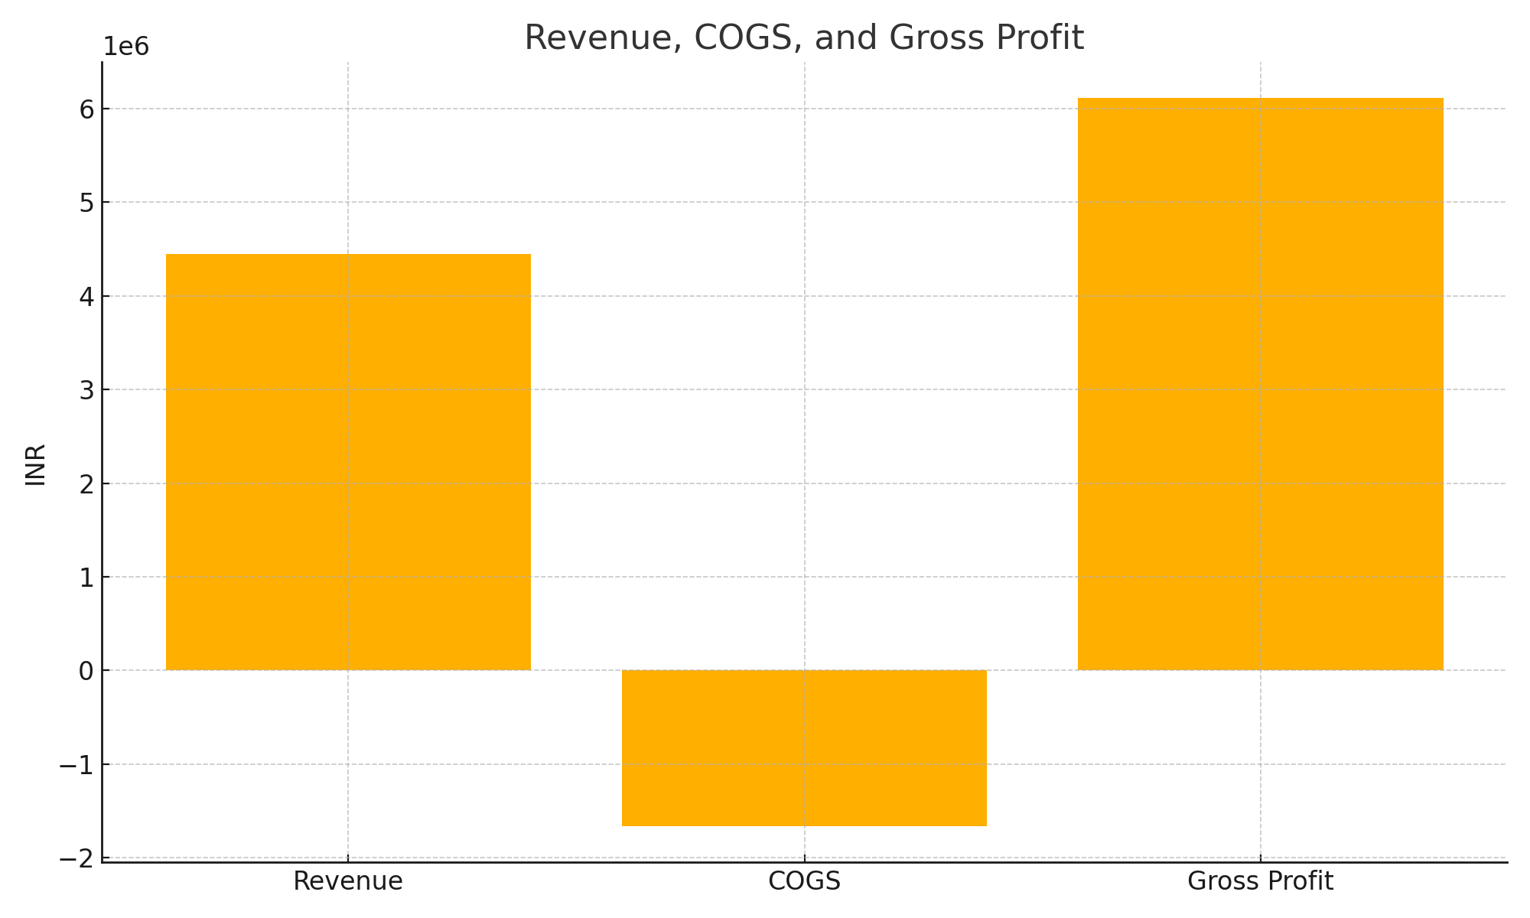
Revenue vs COGS vs Gross Profit

Slide 7
Financial Ratios Snapshot
Gross Margin: 137.3%
Net Margin: 56.6%
Rent‑to‑Revenue: -6.1%

Slide 8
Management Commentary
US01 continues to be the primary revenue engine; India operations provide cost leverage.
EU01 currently loss‑making due to ramp‑up costs; monitor break‑even timeline.
Operating expenses remain controlled; gross margin resilience reflects pricing power.
Recommend reinvesting a portion of net profits into EU market growth & product R&D.

