Slide 1
Python
Environment Setup
Email: satyajeet.pradhan@gmail.com monalisa10pradhan@gmail.com

Slide 2
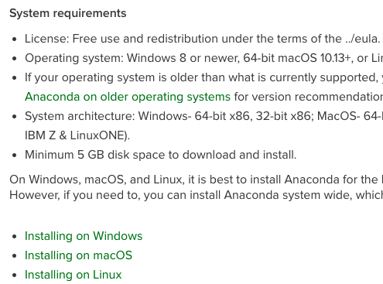
Environmental Setup
Jupyter notebook is a more interactive form of web based notebook for running python codes in blocks
Installation steps :
Utilize link to install Anaconda based on OS of your system (Windows/macOS/Linux)
Once installed then open Anaconda navigator Home page, ref. slide#3
Navigate to environments section using Environments tab link on left side of page, ref. slide#4
Create a new environment “learning” in it for our class lab
Navigate back to Home page
Start a new jupyter instance by clicking on the jupyter Notebook thumbnail
A new jupyter notebook instance would be created on your default webpage, ref. slide#5

Slide 3
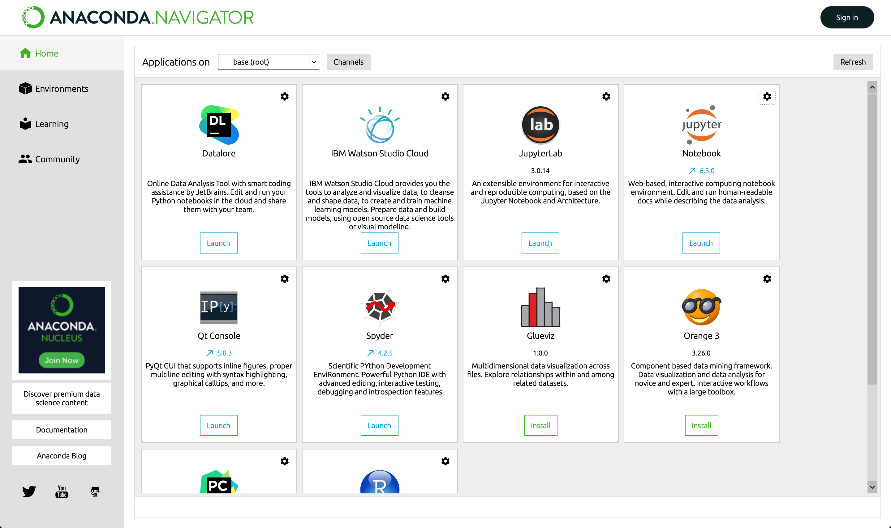

Slide 4
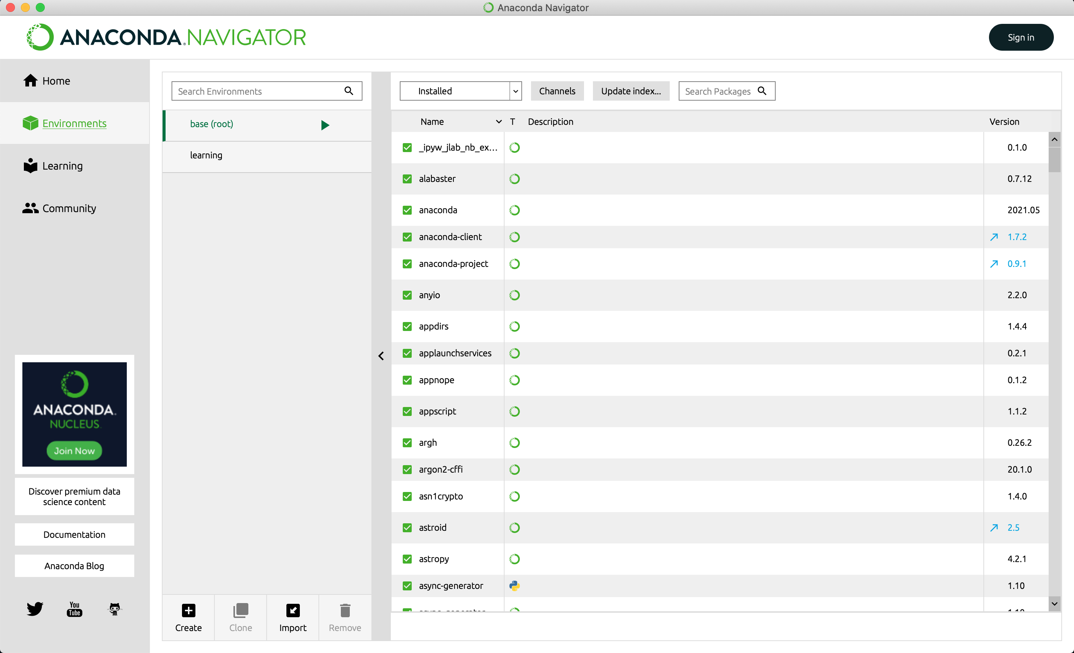

Slide 5
