Slide 1
DATA SCIENCE • MINI PROJECT
STUDENT PERFORMANCE
ANALYSIS SYSTEM
A Data-Driven Approach to Academic Performance Analysis
PRESENTED BY
DEPARTMENT
Satyajeet Singh
Data Science
Academic Session • 2025–2026

Slide 2
01 • OVERVIEW
Project Overview
A practical analytics solution for understanding student performance.
486
TOTAL STUDENTS
91.8%
PASS RATE
84.7%
AVG. ATTENDANCE
73.6
AVG. MARKS
• Analyze academic records using structured data analysis techniques.
• Combine attendance, assignments, internal marks, final marks, department and semester information.
• Identify performance patterns, top performers and students who may need academic support.
• Present findings through professional visualizations and an interactive dashboard.
STUDENT PERFORMANCE ANALYSIS • 2025–2026
02

Slide 3
02 • PROBLEM
Problem Statement
Why a centralized student analytics view is useful.
Fragmented Data
Academic information can exist across multiple records.
Limited Visibility
Marks alone do not explain attendance or subject patterns.
Manual Analysis
Finding trends across hundreds of students takes time.
Decision Support
Teachers need clear indicators for timely academic action.
STUDENT PERFORMANCE ANALYSIS • 2025–2026
03

Slide 4
03 • OBJECTIVES
Project Objectives
What the system is designed to deliver.
01 Clean
Prepare consistent and analysis-ready data.
02 Explore
Discover trends using EDA.
03 Visualize
Convert metrics into clear charts.
04 Monitor
Highlight academic indicators.
05 Report
Present insights through a dashboard.
06 Support
Identify students needing attention.
STUDENT PERFORMANCE ANALYSIS • 2025–2026
04

Slide 5
04 • TECHNOLOGY
Technology Stack
Tools used for data preparation, analysis and presentation.
Python
Core Analytics
Pandas
Data Manipulation
NumPy
Numerical Operations
Matplotlib / Plotly
Visual Analytics
Power BI
Interactive Dashboard
Excel / CSV
Data Source
STUDENT PERFORMANCE ANALYSIS • 2025–2026
05

Slide 6
05 • DATA
Dataset & Key Variables
Realistic dummy / anonymized academic dataset.
Student ID
Name
Gender
Department
Semester
Attendance
Study Hours
Assignment Score
Internal Marks
Final Marks
Grade
STUDENT PERFORMANCE ANALYSIS • 2025–2026
06

Slide 7
06 • WORKFLOW
End-to-End Workflow
From raw records to actionable insights.
01
Data Collection
02
Data Cleaning
03
Preprocessing
04
EDA
05
Visualization
06
Insights
07
Dashboard
08
Report
STUDENT PERFORMANCE ANALYSIS • 2025–2026
07

Slide 8
07 • PREPARATION
Data Cleaning & Preprocessing
Ensuring the dataset is reliable before analysis.
• Check and handle missing values using appropriate rules.
• Identify and remove duplicate student records.
• Validate numeric and categorical data types.
• Standardize column names, formats and value ranges.
• Create derived fields such as grades and performance categories.
STUDENT PERFORMANCE ANALYSIS • 2025–2026
08

Slide 9
08 • ANALYSIS
Exploratory Data Analysis
Core metrics used to understand the dataset.
73.6
Average Marks
84.7%
Average Attendance
91.8%
Pass Rate
98
Highest Score
• Analyze attendance and grade distributions.
• Compare department-wise and subject-wise performance.
• Identify top performers and students requiring academic support.
• Examine relationships between attendance, study behavior and marks.
STUDENT PERFORMANCE ANALYSIS • 2025–2026
09

Slide 10
09 • VISUALS
Data Visualizations
Charts designed to make performance patterns easy to interpret.
Bar Chart
Top 10 Students
Donut Chart
Grade Distribution
Line Chart
Attendance Trend
Scatter Plot
Attendance vs Marks
Histogram
Marks Distribution
Heatmap
Correlation Overview
STUDENT PERFORMANCE ANALYSIS • 2025–2026
10

Slide 11
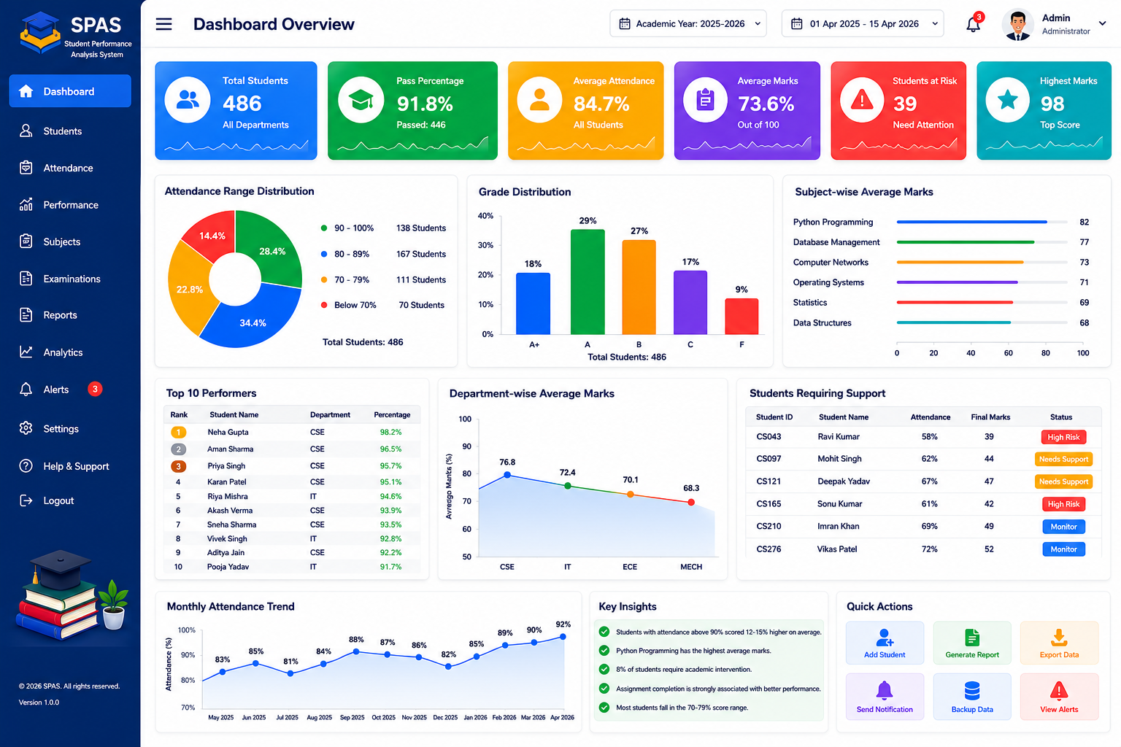
10 • DASHBOARD
Dashboard Preview
A single-screen view of the most important academic indicators.
STUDENT PERFORMANCE ANALYSIS • 2025–2026
11

Slide 12
11 • INSIGHTS
Key Insights
Illustrative findings from the sample dataset.
91.8%
Pass Rate
84.7%
Avg. Attendance
73.6
Avg. Marks
39
Support Flag
• High-attendance students generally show stronger academic outcomes in the sample.
• Python Programming records the highest subject-wise average in the sample.
• Low attendance combined with low marks can be used as a support indicator.
• The dashboard enables faster comparison across departments, grades and student groups.
STUDENT PERFORMANCE ANALYSIS • 2025–2026
12

Slide 13
12 • ROADMAP
Limitations & Future Scope
How the current project can evolve into a production-ready system.
Current Limitations
Future Scope
• Dummy / anonymized dataset
• Historical analysis only
• No predictive model
• Threshold-based support flags
• Real college database integration
• Automated attendance import
• Teacher and student login
• Automated monthly reports
• Optional predictive analytics
STUDENT PERFORMANCE ANALYSIS • 2025–2026
13

Slide 14
13 • CONCLUSION
Conclusion
A concise summary of the project value.
• Student Performance Analysis converts raw academic records into understandable performance insights.
• The workflow combines data cleaning, exploratory analysis, visualization and dashboard reporting.
• The solution can help educators monitor trends and identify students who may require support.
• The architecture can be extended to real institutional data and advanced analytics.
Clear academic visibility through structured analysis.
PROJECT VALUE
DATA
→
INSIGHT
→
ACTION
From data → insight → better academic visibility
STUDENT PERFORMANCE ANALYSIS • 2025–2026
14

Slide 15
STUDENT PERFORMANCE ANALYSIS SYSTEM
THANK YOU
Questions • Discussion • Feedback
Satyajeet Singh
Department of Data Science • 2025–2026
Thank you for your time and attention.

