Slide 1
COMPLEX ENGINEERING ASSIGNMENT
EPISCOPE
Big Data Surveillance, Forecasting and Response-Planning Platform for Seasonal, Tropical and Epidemic Diseases
GROUP: [GROUP NAME / NUMBER - TO BE FILLED]
Prionti Dey - 0222220005101009 | Satyajit Mohajan - 0222220005101010
Pranta Chowdhury - 0222220005101011 | Borshan Karmaker - 0222220005101020
Premier University / Department of CSE

Slide 2
✳ EpiScope
CSE 4345 / RESEARCH QUESTION
What problem are we exploring?
Monitoring, forecasting and planning require different questions - one dashboard should keep them distinct.
Observe
Interpret
Explore
What changed over the latest four weeks?
Which local patterns look unusual?
What if an assumed reduction occurred?
Core research question
Can a reproducible weekly-sentinel demo make early-warning assumptions easier to inspect?
SYNTHETIC DEMONSTRATION · NON-CLINICAL
02 / 10

Slide 3
✳ EpiScope
CSE 4345 / PROCESS DESIGN
From raw counts to interpretable decisions
The platform is organized as independent, testable stages rather than a single hidden prediction function.
01
02
03
04
05
SYNTHETIC DATA
→
VALIDATION
→
SIGNALS
→
FORECAST
→
SCENARIOS
Fixed seed + CSV
Unique keys + types
Anomaly + EWMA
Poisson GLM
Hypothetical ramp
FASTAPI + LIGHTWEIGHT SVG WEB INTERFACE
SYNTHETIC DEMONSTRATION · NON-CLINICAL
03 / 10

Slide 4
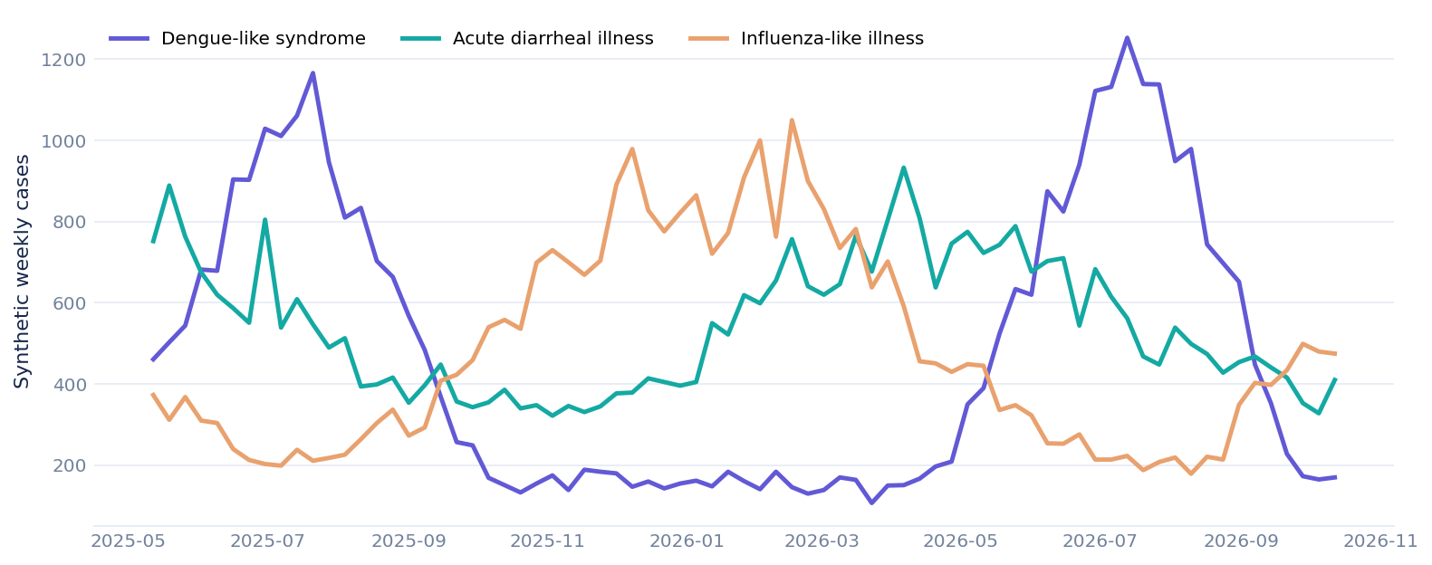
✳ EpiScope
CSE 4345 / DATA ENGINEERING
A reproducible simulated dataset
198 weeks x 8 district labels x 3 syndrome streams = 4,752 aggregate records.
4,752
198
8
3
WEEKLY RECORDS
WEEKS
LOCATIONS
SYNDROME TYPES
Every count and simulated cluster is fictional. Not a Bangladesh disease surveillance source.
SYNTHETIC DEMONSTRATION · NON-CLINICAL
04 / 10

Slide 5
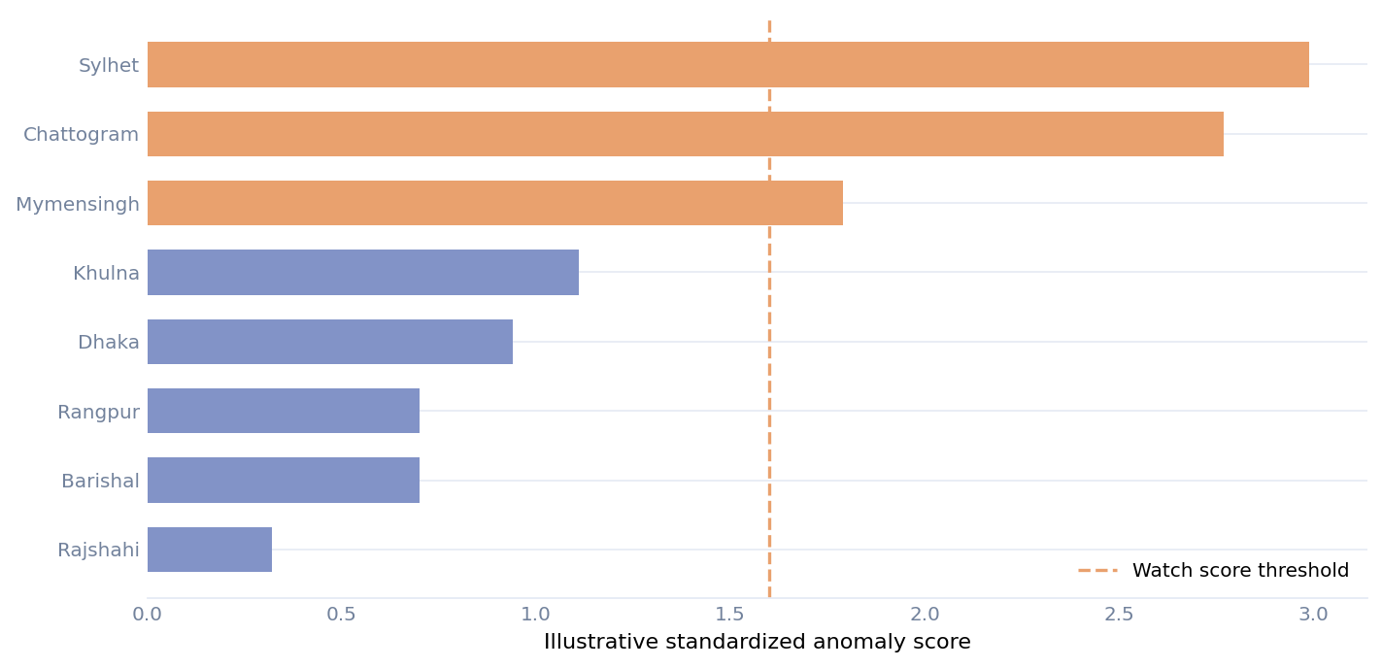
✳ EpiScope
CSE 4345 / DETECTION MODULE
Detect the unusual, explain the reason
Combine recent-vs-historical anomaly scores with four-week momentum. Thresholds are classroom assumptions.
WARNINGS ARE NOT OFFICIAL ALERTS
WATCH
z >= 1.6 AND momentum >= +5%
HIGH
z >= 3.0 AND momentum >= +20%
EWMA alpha = 0.35 for additional trend context
SYNTHETIC DEMONSTRATION · NON-CLINICAL
05 / 10

Slide 6
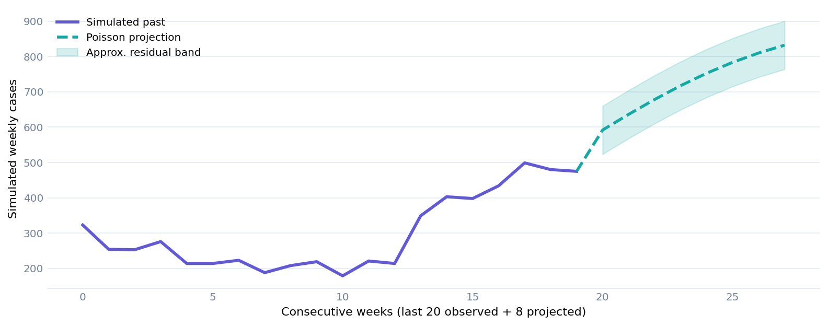
✳ EpiScope
CSE 4345 / FORECAST MODULE
Count-aware weekly forecasting
Fourier seasonality + regularized Poisson GLM; evaluated on 12 held-out weeks.
WHAT THE MODEL SEES
•
Annual cycle (1st + 2nd harmonic)
•
Limited long-run trend
•
Count rather than continuous target
•
52-week-lag naive benchmark
•
Approximate error band
SYNTHETIC DEMONSTRATION · NON-CLINICAL
06 / 10

Slide 7
✳ EpiScope
CSE 4345 / VERIFICATION
Show both success and failure
MAE on the final 12 weeks; a lower value is better, but not every syndrome benefits from the Poisson model.
SYNDROME
POISSON MAE
SEASONAL NAIVE MAE
Dengue-like
68.45
67.92
Diarrheal illness
42.92
46.50
Influenza-like
40.63
58.17
Important: dengue Poisson MAE is slightly WORSE than seasonal naive; there is no universal superiority claim.
SYNTHETIC DEMONSTRATION · NON-CLINICAL
07 / 10

Slide 8
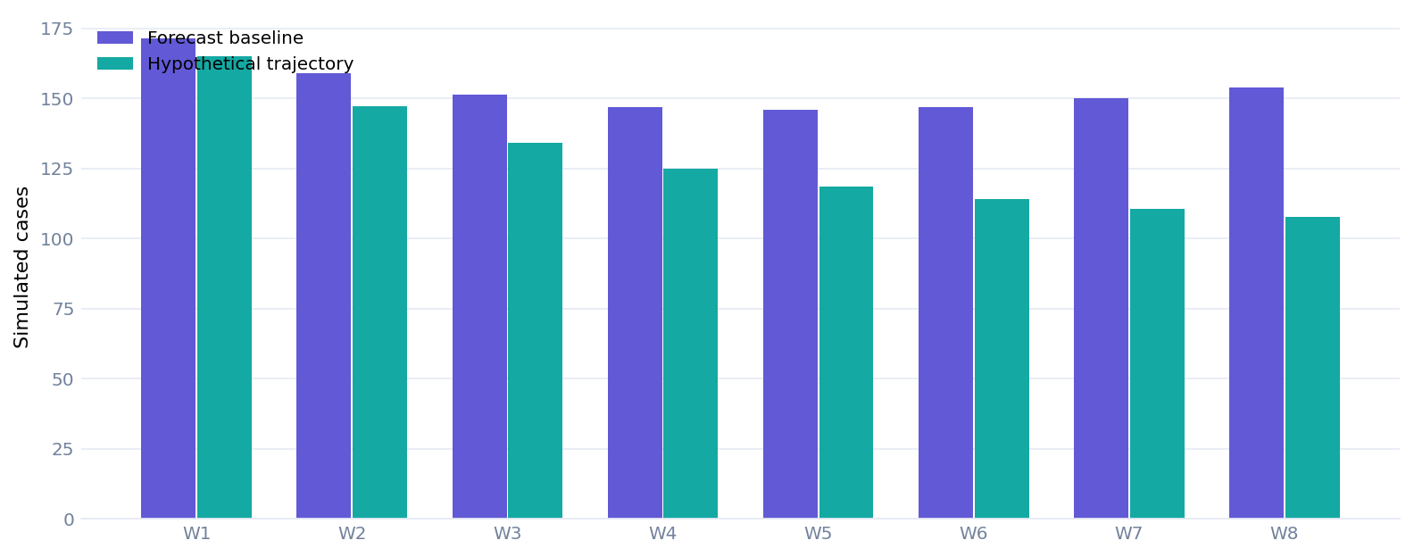
✳ EpiScope
CSE 4345 / RESPONSE STUDIO
Explore a counterfactual - not a promise
An 8-week hypothetical reduction grows linearly from zero to a chosen final percentage.
30%
HYPOTHETICAL REDUCTION BY WEEK 8
Baseline total
1,226
Hypothetical total
1,023
The gap is arithmetic; not a causal evaluation of intervention efficacy.
SYNTHETIC DEMONSTRATION · NON-CLINICAL
08 / 10

Slide 9
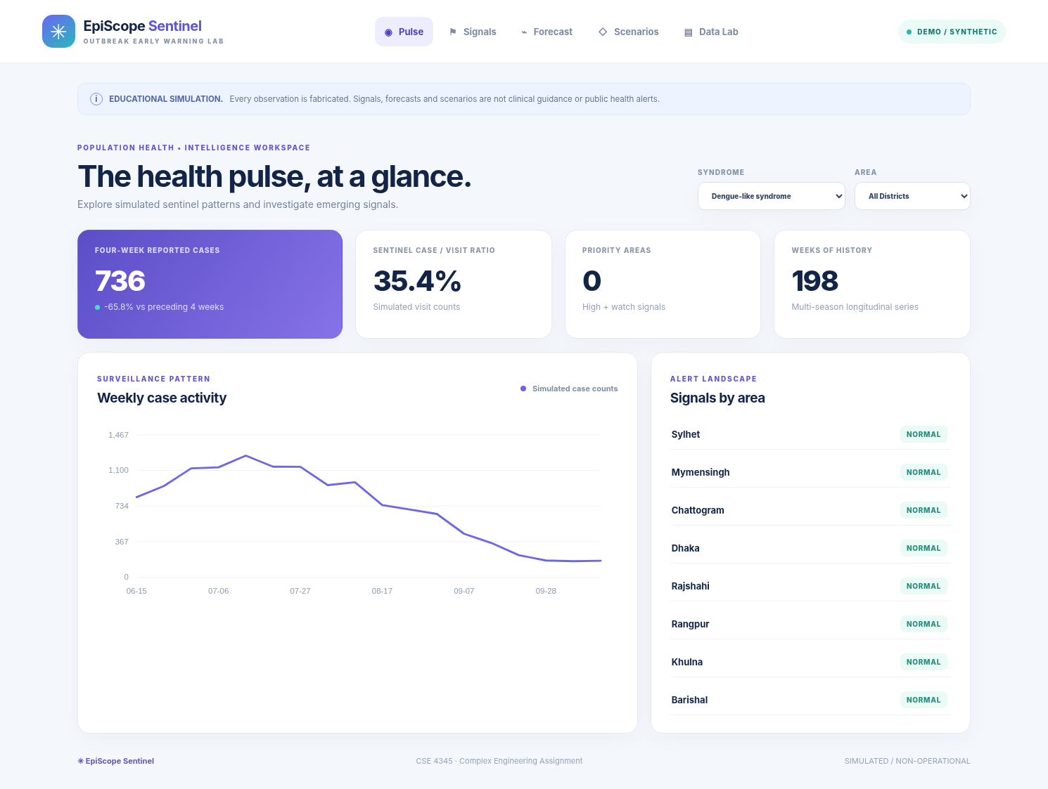
✳ EpiScope
CSE 4345 / SOFTWARE DEMO
A local-first interactive research workspace
Five top-navigation tabs: Pulse, Signals, Forecast, Scenarios and Data Lab.
REST ENDPOINTS
/api/overview
/api/signals
/api/forecast
/api/scenario
/api/quality
/api/export
SYNTHETIC DEMONSTRATION · NON-CLINICAL
09 / 10

Slide 10
✳ EpiScope
CSE 4345 / HANDOVER
Built to demonstrate, tested to explain
An independent proof-of-concept with deliberately transparent assumptions and limitations.
12
5
3
AUTOMATED TESTS PASS
INTERACTIVE VIEWS
PROJECT HANDOVER ITEMS
BEFORE SUBMISSION
GROUP: [GROUP NAME / NUMBER] | GITHUB: [GROUP REPOSITORY URL]
Prionti Dey - 0222220005101009 | Satyajit Mohajan - 0222220005101010
Pranta Chowdhury - 0222220005101011 | Borshan Karmaker - 0222220005101020
H1: Source repository • H2: Ten-page PDF • H3: Shareable video link (add after recording)
SYNTHETIC DEMONSTRATION · NON-CLINICAL
10 / 10

