Slide 1
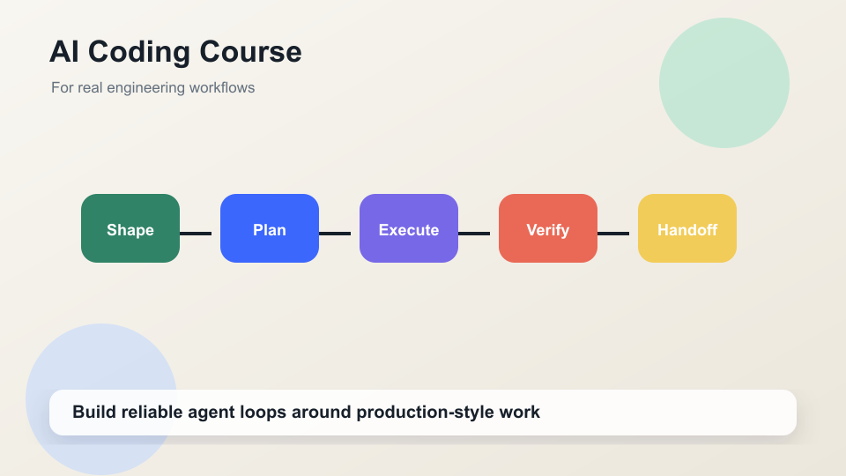
COURSE DECK
AI Coding for Real Engineers
Teach agents as engineering workflow, not magic code generation.
Two-week arc from setup to AFK/HITL workflows
Running sample app: CourseForge
Every day ends with a concrete student artifact
AI Coding Course | CourseForge sample app

Slide 2
WHY THIS MATTERS
The Course Thesis
The winning workflow is the middle path between over-delegating and under-delegating.
Works across terminal, CLI, IDE, and hosted agent harnesses
Delegate bounded work to move faster
Keep product judgment and risk ownership human
Use evidence loops to preserve codebase sense
AI Coding Course | CourseForge sample app

Slide 3
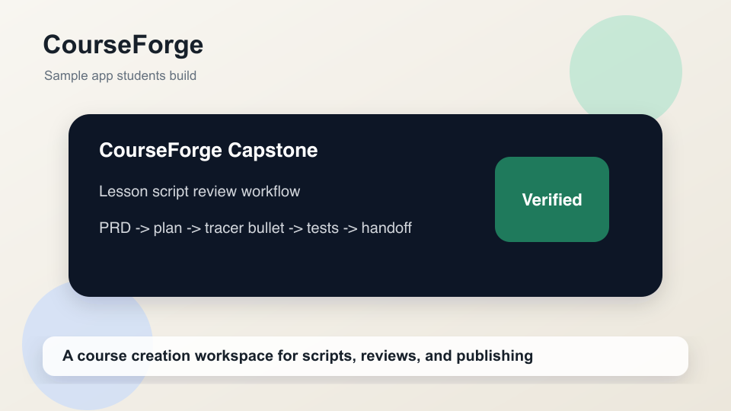
BUILD THREAD
Running Sample App: CourseForge
Students build a production-style course creation workspace in thin slices.
Courses, modules, lessons, scripts
AI writing modes and review states
Publishing tasks, backlog, Kanban, capstone
AI Coding Course | CourseForge sample app

Slide 4
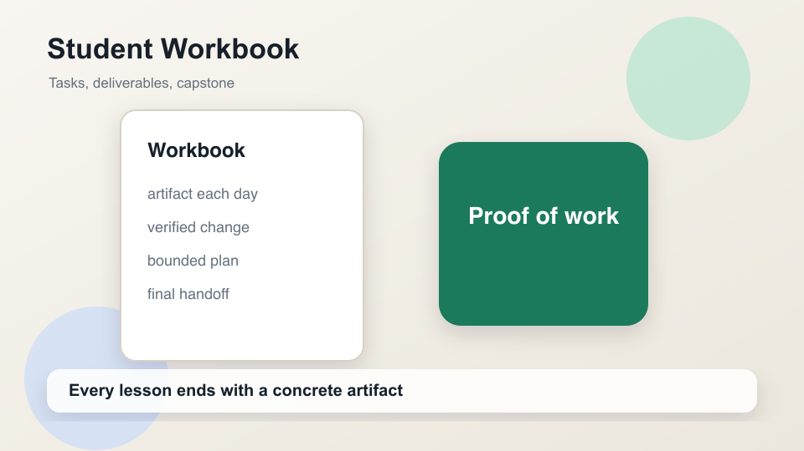
COURSE MAP
Two-Week Learning Arc
Week 1 builds control; Week 2 scales that control across agents and workflows.
Setup
Fundamentals
Steering
Planning
Feedback
AFK/HITL
AI Coding Course | CourseForge sample app

Slide 5
AVAILABLE MAY 18
01 - Before We Start
Orient students around safety, setup, community, and the final workflow.
Set course expectations and Discord norms
Set up repo, migrations, and your chosen harness
Create first setup notes and migration checklist
AI Coding Course | CourseForge sample app

Slide 6
ARTIFACTS
Day 01 Student Tasks
Students leave with a known baseline and a personal AI coding policy.
CourseForge setup notes
Migration safety checklist for ScriptDraft
Office-hours question template
Personal risk statement: what stays human-owned
AI Coding Course | CourseForge sample app

Slide 7
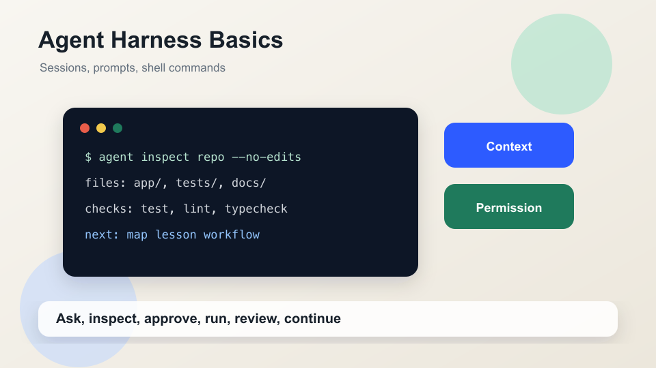
AVAILABLE MAY 18
02 - Getting To Know Your Agent Harness
The agent becomes useful when sessions, prompts, commands, and permissions are explicit.
Manage current repo and session context
Prompt with goal, scope, constraints, done condition
Use shell commands as evidence
AI Coding Course | CourseForge sample app

Slide 8
COURSEFORGE ORIENTATION
Agent Harness Practice
First contact with a repo should be read-only in any tool.
Translate the loop to your chosen harness
Ask the agent to inspect CourseForge without edits
Create a session-start worksheet
Define a permission policy for risky actions
AI Coding Course | CourseForge sample app

Slide 9
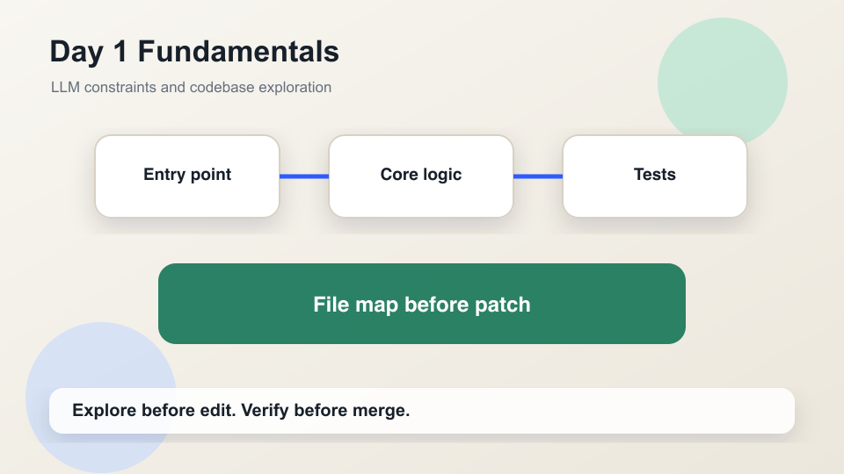
AVAILABLE JUNE 1
03 - Day 1 Fundamentals
Students learn to control LLM uncertainty with exploration, subagents, verification, and handoff.
LLMs are fluent, not automatically correct
Subagents help with bounded side work
Explore the codebase before building features
AI Coding Course | CourseForge sample app

Slide 10
COURSEFORGE FEATURE SLICE
Day 1 Example: Lesson Status Filter
Build one small, verifiable feature after mapping the code path.
Map entry point, core logic, and test location
Add a lesson status filter or duration display
Run one check and write a handoff
AI Coding Course | CourseForge sample app

Slide 11
OPERATING LOOP
Grill, Execute, Clear
The loop converts vague requests into repeatable progress.
Grill: scope, risks, acceptance, unknowns
Execute: one bounded slice
Clear: changed files, checks, risks, next step
AI Coding Course | CourseForge sample app

Slide 12
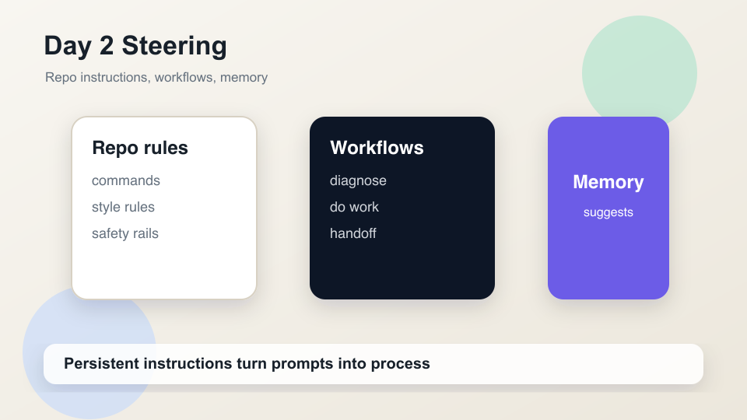
AVAILABLE JUNE 1
04 - Day 2 Steering
Persistent instructions make agent behavior more reliable across sessions.
Write actionable repo instructions
Use progressive disclosure to reduce context noise
Package repeated work as reusable workflows
AI Coding Course | CourseForge sample app

Slide 13
COURSEFORGE CONTROLS
Steering Assets Students Create
The repo starts teaching the agent how work should happen.
Repo instructions with setup, tests, style, safety
Module-specific notes for lessons/scripts
A first workflow candidate: do-work, diagnose, or handoff
AI Coding Course | CourseForge sample app

Slide 14
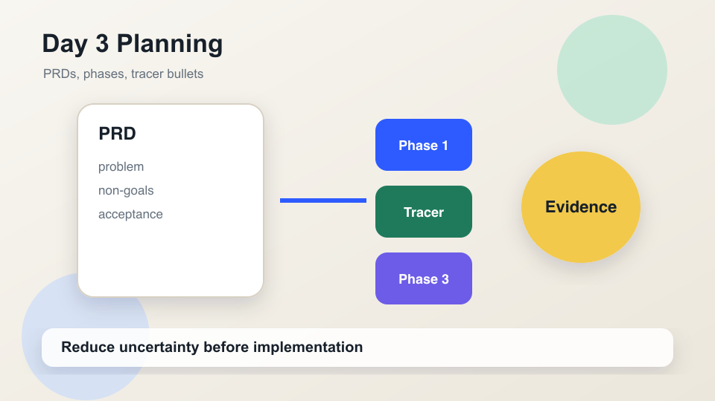
AVAILABLE JUNE 1
05 - Day 3 Planning
Large tasks become safe when they are decomposed into evidence-producing phases.
Write PRDs before implementation
Split work across context windows
Use tracer bullets to prove risky paths
AI Coding Course | CourseForge sample app

Slide 15
COURSEFORGE LARGER FEATURE
Planning Example: AI Writing Assistant
The first phase should prove the integration path, not polish the product.
PRD: hook, recap, exercise, rewrite modes
Tracer bullet: script text -> hook suggestion -> saved draft note
Defer full AI integration until the workflow is proven
AI Coding Course | CourseForge sample app

Slide 16
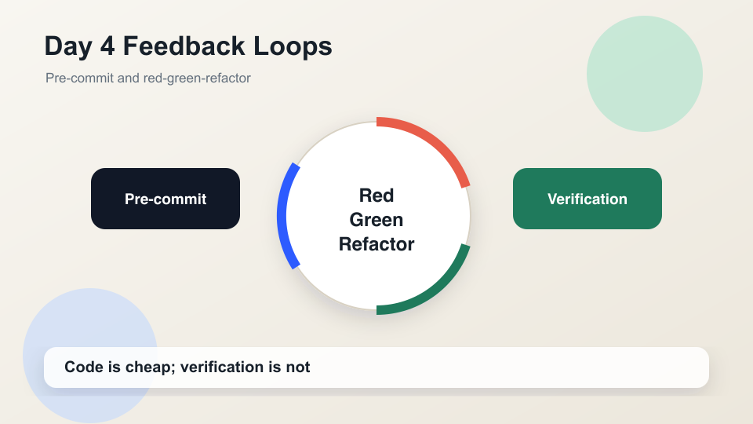
AVAILABLE JUNE 8
06 - Day 4 Feedback Loops
Generated code is cheap; trusted code still needs evidence.
Build a reusable do-work workflow
Use pre-commit for mechanical feedback
Drive behavior with red-green-refactor
AI Coding Course | CourseForge sample app

Slide 17
COURSEFORGE RULE
Feedback Example: Publishing Readiness
A lesson cannot move to recorded unless the latest script draft is approved.
Red: failing status-transition test
Green: minimal guard rule
Refactor: clearer status transition module
AI Coding Course | CourseForge sample app

Slide 18
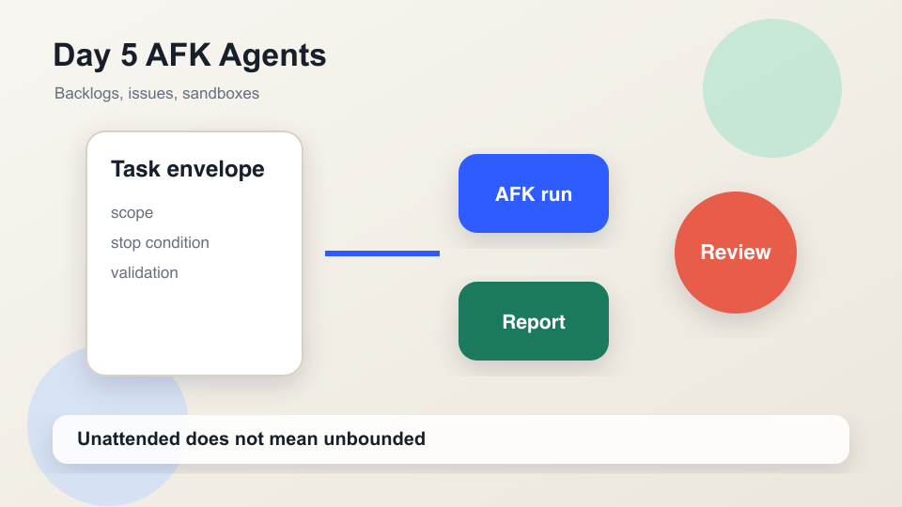
AVAILABLE JUNE 8
07 - Day 5 AFK Agents
AFK work is safe only when the task envelope is stronger than the agent's improvisation.
Sandcastle and sandboxing reduce blast radius
Backlogs queue agent-ready tasks
GitHub Issues make work traceable
AI Coding Course | CourseForge sample app

Slide 19
COURSEFORGE BACKLOG
AFK Candidate Queue
Unattended tasks should be boring, bounded, and verifiable.
Normalize empty-state copy
Generate issue drafts from accepted PRD phases
Update docs after a feature lands
AI Coding Course | CourseForge sample app

Slide 20
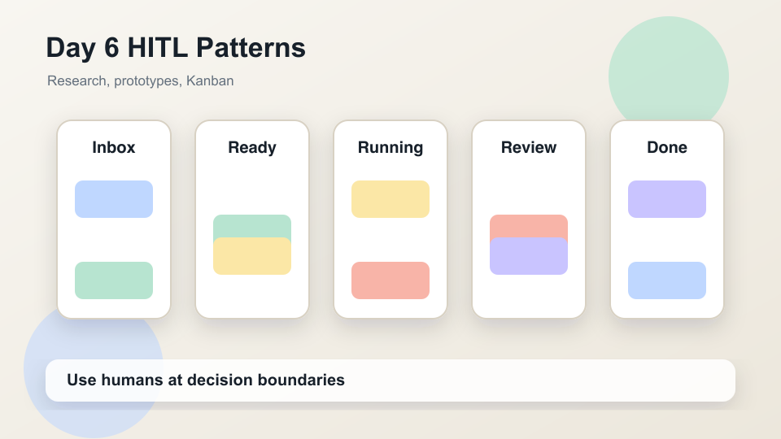
AVAILABLE JUNE 8
08 - Day 6 HITL Patterns
Humans belong at decision boundaries; agents belong on bounded execution paths.
Classify HITL versus AFK tasks
Use research and prototypes before committing
Improve architecture for AI navigability
AI Coding Course | CourseForge sample app

Slide 21
PROTOTYPE BEFORE PRODUCTION
HITL Example: Script Review UI
UI work benefits from concrete options before implementation.
Prototype script review screen
Compare clarity, density, workflow speed, accessibility
Decide keep, change, discard
AI Coding Course | CourseForge sample app

Slide 22
END-TO-END PROOF
Capstone: Lesson Script Review Workflow
Students demonstrate the full workflow from task definition through handoff.
Create and approve lesson script drafts
Block recording until latest draft is approved
Run tests and produce review-ready handoff
AI Coding Course | CourseForge sample app

Slide 23
PROOF OF LEARNING
Workbook Deliverables
The course is complete when students can show artifacts, not just understanding.
One artifact from each module
One verified agent-assisted change
One bounded plan and one trusted AFK task
One final capstone handoff
AI Coding Course | CourseForge sample app

Slide 24
WHAT GOOD LOOKS LIKE
Assessment Rubric
Grade the workflow, not just the code.
Task framing: goal, scope, acceptance
Steering: repo instructions, workflows, memory
Execution: small steps, review gates, verification
Handoff: files, decisions, risks, next steps
AI Coding Course | CourseForge sample app

Slide 25
COURSE CLOSE
Final Takeaway
Choose the lightest workflow that controls the actual risk.
More autonomy requires stronger boundaries
More ambiguity requires more human judgment
Every agent claim should connect to evidence
AI Coding Course | CourseForge sample app

