Slide 1
Two Pointers
By : Shivansh ( CF : shiv_codegen )

Slide 2

Two Pointers
Widely used in Competitive Programming
Optimization Technique
Most Two Pointer problems can be solved using Binary Search
Useful for a lot of array based problems
Super useful for interviews too

Slide 3
Two Pointers
The two pointers algorithm is typically used for finding solutions in pairs using “x pointers”.
Each variable moves in a single direction, and they only traverse the array a single time.
Therefore, time complexity will be O(N+M) where N and M are the time complexities for the two variables.

Slide 4
Two Pointers
Used in problems such as:
Reversing an array/string
Check if array/string is palindrome
Merging two sorted arrays
Problem : Link

Slide 5
Problem 1
Given 2 sorted arrays, merge them into one single array keeping the elements sorted.
1 | 4 | 5 | 9
2 | 3 | 6 | 10
1 | 2 | 3 | 4 | 5 | 6 | 9 | 10

Slide 6
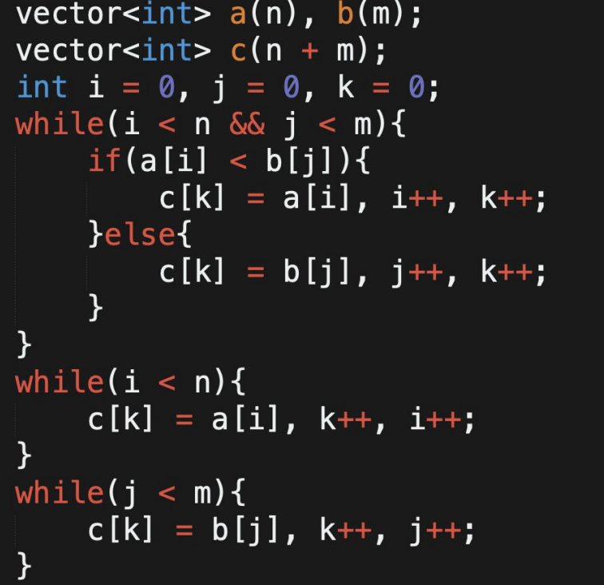
Solution
Maintain 2 Pointers, i and j both starting from the left ends of the arrays
Keep pushing the smaller of the 2 elements from the arrays into the output array.

Slide 7
Problem 2
Given 2 sorted arrays, for each element in 1st array find number of elements smaller than that in the 2nd array.
1 | 4 | 5 | 9
2 | 3 | 6 | 10

Slide 8
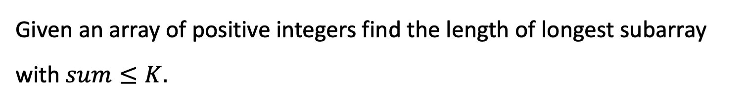
Problem 3
Given an array of positive integers find the length of longest subarray with $sum≤K.$

Slide 9
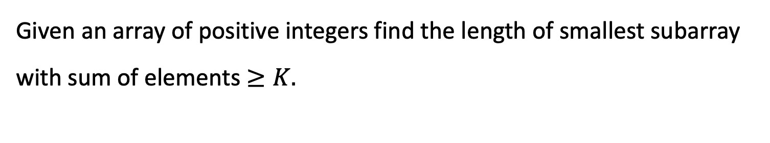
Problem 4
Given an array of positive integers find the length of smallest subarray with sum of elements $≥K.$

