Slide 1
Bit Manipulation
- Srivaths P

Slide 2
Goal
Learn what a number base is.
Understand bit manipulation and its use cases.
Learn tips for bit manipulation.
Learn bitwise operators and their properties.
Learn some common bitwise formulas.
Learn some GNU C++ bitwise functions.
Learn brute-forcing using bitmasks.

Slide 3
Number Base
A number base is the number of unique digits that are used to represent numbers.
For example:
Base 10 (decimal): 123, 4141, 9999999
Base 2 (binary): 1111011, 1000000101101, 100110001001011001111111
Base 16 (hexadecimal): 7b, 102d, 98967f
When there are not enough digits, alphabets are used instead.

Slide 4

Number Base
To read a number “S” in base “N”, we can use the following formula:
$$\sum_{i=0}^{\left|S\right| − 1}{{S_{i}×N}^{i}}$$

Slide 5
What is Bit Manipulation?
Anything that involves using the digits (bits) of the binary form of a number is bit manipulation.
Usage of operators such as NOT, OR, AND, XOR, LSHIFT, RSHIFT, etc. count as bit manipulation.
We need to figure out how to utilize the above operators with our algorithm to solve a problems.

Slide 6
Where is Bit Manipulation used?
Problems may or may not directly involve bit manipulation.
Some problems use bitwise operators in the problem statement itself, whereas some problems might use bit manipulation indirectly.
For example, if the problem involves powers of 2, it might be related to binary. Similarly, powers of other numbers might be in their own base.

Slide 7
How to approach Bit Manipulation problems?
“When solving a bitwise problem, think in bitwise”
My mentor, 2020
When solving a problem that uses addition, multiplication, etc. we use decimal, which is the appropriate base for us.
When solving a problem that uses a bitwise operator, we need to use binary, which is the appropriate base.

Slide 8
Miscellaneous
To print a binary number, we can use Make sure “size” is not too large.
Set bit means that the bit is 1. Unset bit means that the bit is 0.
Use as many parentheses as possible when using bit operations.
The following bitwise operators are the fastest operators in C++. They are faster than even basic arithmetic operators.
cout << bitset<size>(n) << endl;

Slide 9

Bitwise Operators - NOT
The NOT operator (“~”) flips every bit of the given number. For example: $\sim 12 = −13$
A | Result
1 | 0
0 | 1

Slide 10
Bitwise Operators - OR
The OR operator (“|”) takes every corresponding bit of the two numbers and checks whether atleast one of them is set.
A | B | Result
1 | 1 | 1
1 | 0 | 1
0 | 1 | 1
0 | 0 | 0

Slide 11
Bitwise Operators - AND
The AND operator (“&”) takes every corresponding bit of the two numbers and checks whether both of them is set.
A | B | Result
1 | 1 | 1
1 | 0 | 0
0 | 1 | 0
0 | 0 | 0

Slide 12
Bitwise Operators - XOR
The XOR operator (“^”) takes every corresponding bit of the two numbers and checks whether exactly one of them is set.
A | B | Result
1 | 1 | 0
1 | 0 | 1
0 | 1 | 1
0 | 0 | 0

Slide 13
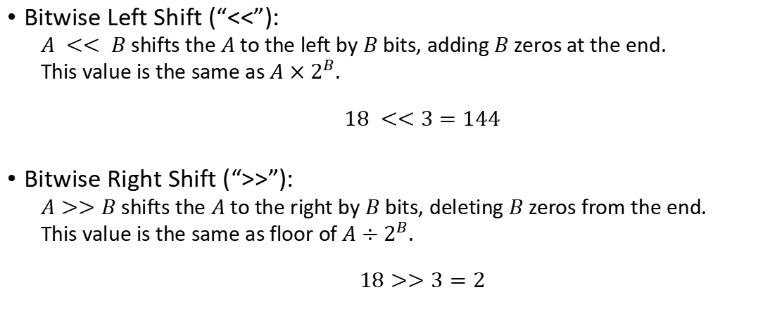
Bitwise Operators - Misc
Bitwise Left Shift (“<<”):
$A << B$ shifts the $A$ to the left by $B$ bits, adding $B$ zeros at the end.
This value is the same as $A×2^{B}$.
$$18 <<3=144$$
Bitwise Right Shift (“>>”):
$A>>B$ shifts the $A$ to the right by $B$ bits, deleting $B$ zeros from the end.
This value is the same as floor of $A÷2^{B}$.
$$18>>3=2$$

Slide 14
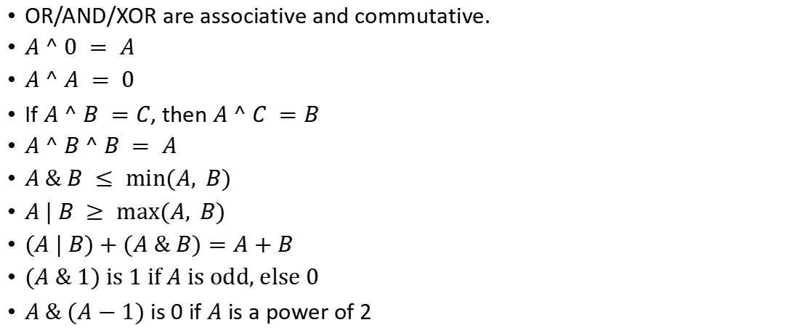
Basic Properties
OR/AND/XOR are associative and commutative.
$A ^ 0 = A$
$A ^ A = 0$
If $A ^ B =C$, then $A ^ C =B$
$A ^ B ^ B = A$
$A \& B ≤ min⁡(A, B)$
$A | B ≥ max⁡(A, B)$
$(A | B)+(A \& B)=A+B$
$(A \& 1)$ is 1 if $A$ is odd, else 0
$A \& (A−1)$ is 0 if $A$ is a power of 2

Slide 15
More on Bitwise Operators
More properties:
https://stackoverflow.com/questions/12764670/are-there-any-bitwise-operator-laws
Useful tricks and formulas:
https://www.geeksforgeeks.org/bitwise-hacks-for-competitive-programming/
https://www.geeksforgeeks.org/bit-tricks-competitive-programming/
https://www.geeksforgeeks.org/bits-manipulation-important-tactics/
https://www.geeksforgeeks.org/builtin-functions-gcc-compiler/

Slide 16
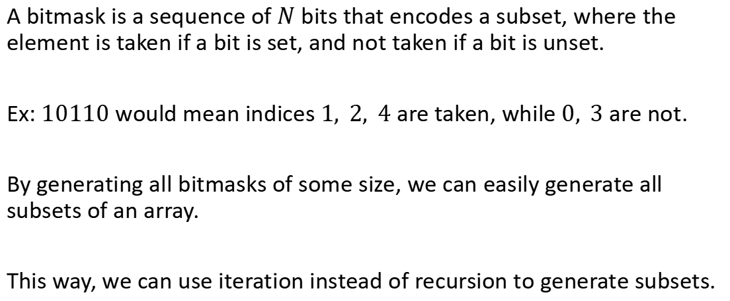
Bitmasking
A bitmask is a sequence of $N$ bits that encodes a subset, where the element is taken if a bit is set, and not taken if a bit is unset.
Ex: $10110$ would mean indices $1, 2, 4$ are taken, while $0, 3$ are not.
By generating all bitmasks of some size, we can easily generate all subsets of an array.
This way, we can use iteration instead of recursion to generate subsets.

Slide 17
Bitmasking – Brute Force Code
for (int mask = 0; mask < (1 << n); mask++) { for (int i = 0; i < n; i++) if ((mask >> i) & 1) cout << a[i] << " "; cout << endl; }

Slide 18
Bitwise function in C++
__builtin_popcount: Finds number of set bits.
__builtin_clz: Finds number of leading 0s (clz = Count Leading Zeros)
__builtin_ctz: Finds number of trailing 0s (clz = Count Trailing Zeros)
https://gcc.gnu.org/onlinedocs/gcc/Other-Builtins.html
NOTE: Use ll suffix when appropriate

Slide 19
Problems
https://www.codechef.com/problems/BINADD
https://www.codechef.com/submit/XORMUL

Slide 20
Resources
Number base:
https://brilliant.org/wiki/number-base/
Bit manipulation:
https://codeforces.com/blog/entry/73490 (highly recommended)
https://www.hackerearth.com/practice/basic-programming/bit-manipulation/basics-of-bit-manipulation/tutorial/
Bitsets:
https://www.youtube.com/watch?v=jqJ5s077OKo

Slide 21
Resources
On bitwise operators:
https://medium.com/biffures/bits-101-120f75aeb75a
https://medium.com/biffures/part-2-the-beauty-of-bitwise-and-or-cdf1d8d87891
https://medium.com/biffures/part-3-or-and-20ccc9938f05
https://medium.com/biffures/part-4-bitwise-patterns-7b17dae3eee0

