Slide 1
Advanced Binary Search
- Srivaths P
Profiles: https://sriv.bio.link/

Slide 2
Binary Search
Binary search is a searching algorithm for a sorted collection of data.
It divides the range to search by half every iteration.
Time complexity: O(logn)
Takes ~20 iterations to search 10⁶ elements

Slide 3
Implementation
Finds the last index of target
int search(vector<int> a, int target) { int left = 0, right = a.size() - 1; while (left < right) { int mid = (left + right + 1) / 2;
if (a[mid] <= target) left = mid; if (a[mid] > target) right = mid - 1; } return (a[left] == target) ? left : -1; }

Slide 4
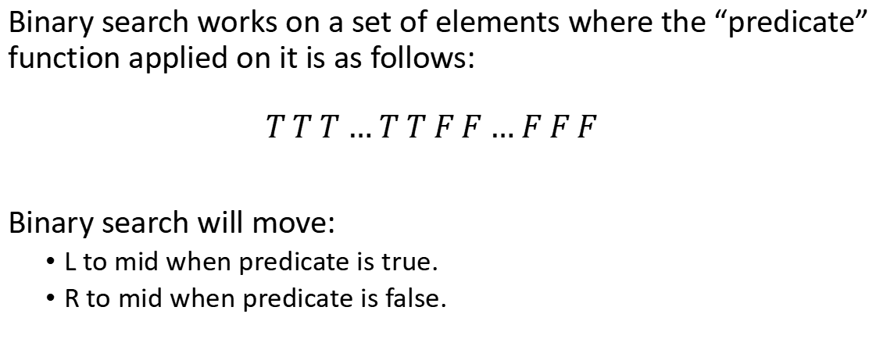
Binary Search Conditions
Binary search works on a set of elements where the “predicate” function applied on it is as follows:
$$T T T … T T F F … F F F$$
Binary search will move:
L to mid when predicate is true.
R to mid when predicate is false.

Slide 5
Alternative Binary Search
int l = min-1, r = max+1; while (r-l > 1) { int m = (l + r) / 2; if (predicate(m)) l = m; else r = m; } // l is the last true // r is the first false

Slide 6
Points to Note
When L = R-1, check if (L+R)/2 should be floored or ceiled. It might be an infinite loop otherwise.
Make sure your boundaries are correct.
You can use L + (R-L)/2 to avoid errors/overflows in some cases where L+R exceeds the integer limit.
If you ever need to run binary search on an infinite list, you can use LLONG_MAX or some other appropriate value as the upper-bound.

Slide 7
Problems:
https://leetcode.com/problems/find-peak-element/
https://www.spoj.com/problems/AGGRCOW/

Slide 8
Binary Search on Answer
On a problem where we the binary search is applied on the answer, it is a “Binary Search on Answer” problem.
Generally, binary search is performed on the answer, and then tested to see if it is valid or not.
A simple binary search on answer problem would be finding the square root of a number using binary search.

Slide 9
Interactive Problems:
In interactive problems, you get answers for your queries. Output a query, and an input will be given as the answer.
There will be a limit to the number of queries you can make.
Also note the format of the queries and use it properly.
Remove fastio and use endl when solving interactive problems.

Slide 10
Problems:
https://codeforces.com/contest/1480/problem/C
https://codeforces.com/problemset/problem/679/A
https://codeforces.com/contest/1486/problem/C2

Slide 11
Thanks for watching!
https://forms.gle/XqM12QZop38UpM7s6

