Slide 1
Recursion and Backtracking
Shivansh (CF : shiv_codegen)

Slide 2
Goal:
Understand recursion
Understand applications of recursion
Learn how to brute-force using recursion
Assess time complexity of recursive algorithms
Use backtracking for efficient brute-force

Slide 3
Recap on Functions
A function is a block of code which runs the code inside with the parameters it is given.
Syntax:
int add(int a, int b) { return a + b; }

Slide 4
What is Recursion?
Recursion happens when a function calls itself on a different set of input parameters.
Used when the solution for current problem involves first solving a smaller sub-problem.
Example: factorial(N) = factorial(N-1) * N

Slide 5
Recursive Function
A function that calls itself is a recursive function
Example:
The above function will find the sum from 0 to the given parameter.
int sum_0_to_n(int n) {
if (n <= 0) return 0;
return sum_0_to_n(n-1) + n;
}

Slide 6
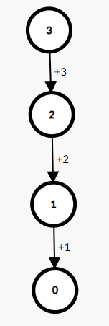
Recursive Tree
A recursive tree is similar to a “mind map” of the function call. Each node/vertex is the function call. Value inside the node is the parameter.
Recursive tree of previous example for n = 3
Recursive trees are useful to help us understand how the function acts.

Slide 7
Basic Structure of a Recursive Function
Parameters to start the function
Appropriate base case(s) to end the recursion
Recursively solve the sub-problems
Process the result and return the value

Slide 8
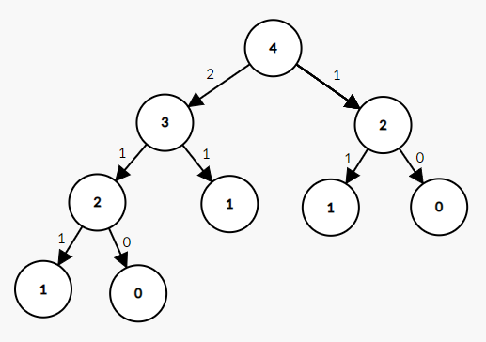
Tougher example:
Recursive tree:
Fibonacci function:
int fib(int n) { if (n == 0) return 0; if (n == 1) return 1; return fib(n-1) + fib(n-2); }

Slide 9
When do we need recursion?
Recursion is usually used in complex situations where iteration is not feasible.
Brute-force
Backtracking
Dynamic Programming
Graph/Tree Problems
Etc.

Slide 10
Quiz 1
Write a recursive function to calculate the factorial of a number
Write an infinite recursive function that prints the number of times it has run so far.
Print a number in binary recursively

Slide 11
Using Recursion to Brute-Force
We can use recursion to go through every possible sub-problem. Also useful when going through every combination/subset of a list.
Examples:
Print all binary strings of a given length.
Print all subsets of a given vector.

Slide 12
Time complexity of Recursive Brute-Force
Can be calculated as the number of recursive calls multiplied by additional complexity of the function.
Can also be thought of as sum of time complexity of each layer of the recursive tree.

Slide 13
Example functions:
void recurse(int n) { if (n == 0) return; recurse(n-1); }
void recurse(int n) { if (n == 0) return; recurse(n-1); recurse(n-1); }
void recurse(int n) { if (n == 0) return; recurse(n/2); recurse(n/2); }
void recurse(int n) { if (n == 0) return; recurse(n/2); }

Slide 14
Quiz 2
Print all N numbers such that each value can be from 0 to K.
Given N coins, print all the values you can make with some combination of coins and sum <= given K.
What is the time complexity of:
void f(int n) { if (n == 0) return; if (n % 2 == 0) f(n/2); if (n % 2 == 1) f(n-1); }

Slide 15
Backtracking
Backtracking is brute-force recursion, but
Backtracking will stop at the first instance where some given condition is not fulfilled.
The time complexity is similar to brute-force, but when applied, it much faster.

Slide 16
Backtracking
Given N coins, print all the values you can make with some combination of coins as long as the sum does not exceed K.
Brute-force will go till the last possible index, and then check if the sum does not exceed K.
Backtracking will stop at the first index where the sum exceeds K.

Slide 17
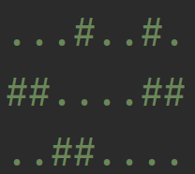
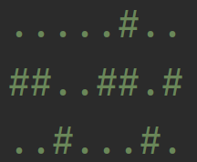
Backtracking problem
You are in a maze of size N x M. You can move up, down, left, or right.
“#” means there’s a wall, “.” means it’s empty.
Check if there’s a path from (1, 1) to (N, M)
Examples:

Slide 18
Resources
https://bit.ly/39lNlVT (very detailed explanation)
https://codeforces.com/blog/entry/92031 (advanced)

