Slide 1

RESEARCH ORIENTED PROJECT-1 Review-1
AN OPTIMIZED MODEL TO CREATE TEAMS
IN FANTASY CRICKET
SATYAJIT PATEL 23MAS10009
GUIDE: DR. ABHA SHARMA

Slide 2

INTRODUCTION
Fantasy sports are online games in which people create a team of imaginary players from these sports.
Statistics are used to determine how effective teams are created based on performance in actual games.
This statistical performance is converted into points and used to reward managers in a point-based league.
Various point systems can be made up by a league commissioner to manage the league and points can be calculated using computers tracking actual results of the professional sport.
Each can register individual teams and then compete to see who wins by earning the maximum fantasy cricket points and thereby the league.
These leagues are very popular during major Twenty20s like IPL T20 and Big Bash T20 Matches.

Slide 3
PROBLEM STATEMENT
A fantasy team can have any type of players within the maximum wage, however there are limitations on how often batsmen, bowlers, and all-rounders a team can have.
Selecting 11 players from a pool of two is of extreme difficulty.
Each pool consists of approximately 14 players.
This proposed system produces all possible teams and/or optimal no of teams within the budget caps. Players must be selected within the caps, and a particular number of batsmen, bowlers and allrounders are selected.
The proposed system main aim is to create P no of teams with maximum coverage of players and/or coverage of all players from the player's list and the no of teams should contain a maximum no of top performers in a given list of players from the post-match analysis.
The prime objective in fantasy cricket is to score as many points as possible against one's opponent.

Slide 4
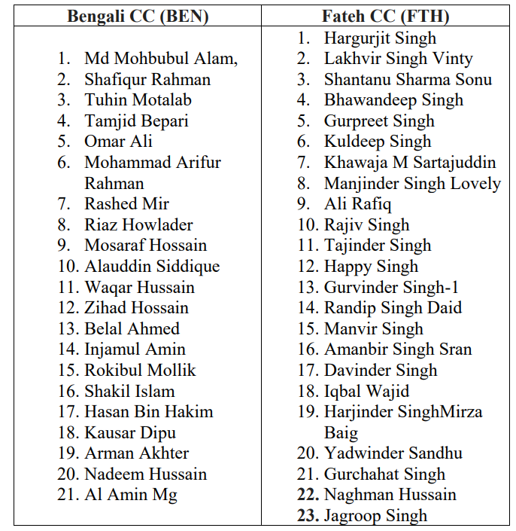
Literature Review
An optimized model is a method to create fantasy cricket teams. The algorithm repeatedly modifies the players in a team to create multiple teams. At each iteration, the model creates new teams and uses them to produce further new teams. Over the successive iterations or a few iterations, new teams become best compared with the teams created manually by users.
Here Vinod babu polinati from article in SSRN Electronic Journal January 2021 has applied the proposed system to the match between Bengali CC VS Fateh CC, Feb 10 2021, Match 15 , Olympic Ground, Barcelona, European Cricket Series - ECS T10, Barcelona. An optimized model of creating fantasy cricket teams is as follows.

Slide 5
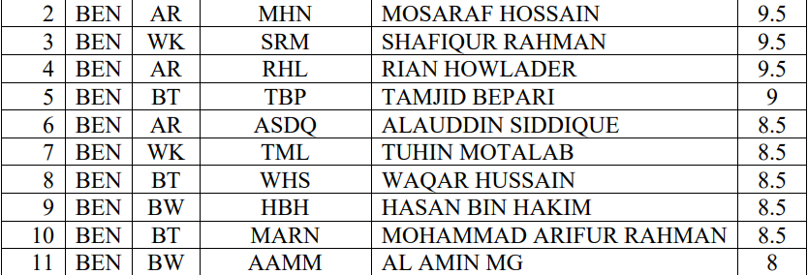
Here Vinod babu polinati has taken Probable 11 from each squad is taken from previous match. The Equivalent player's list along with credits are created and maintained by the league commissioner. The League Commissioner is responsible to update the performance of the players by increasing or decreasing the credits of the individual players and mapping the real player's score to the points system.
The player's list from League Commissioner ( For convenience short names are used in paper), is as follows:

Slide 6
Objective
So, previously mentioned method is more complex and highly time taking and could be affected by human error because we have to enter data manually.
On the other hand, the method which I will proposed in following research paper is more continent, consumes less amount of time with accurate data. The reason being is in this method the data is provided in database in prior.

Slide 7
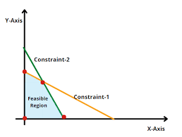
METHODOLOGIES
Linear Programming in Operations Research is one of the scientific techniques that is used to get an optimum solution to the given business problem by taking resource scarcity and constraints into account.
PuLP is an open-source linear programming (LP) package which largely uses Python syntax and comes packaged with many industry-standard solvers.
It also integrates nicely with a range of open source and commercial LP solvers

Slide 8

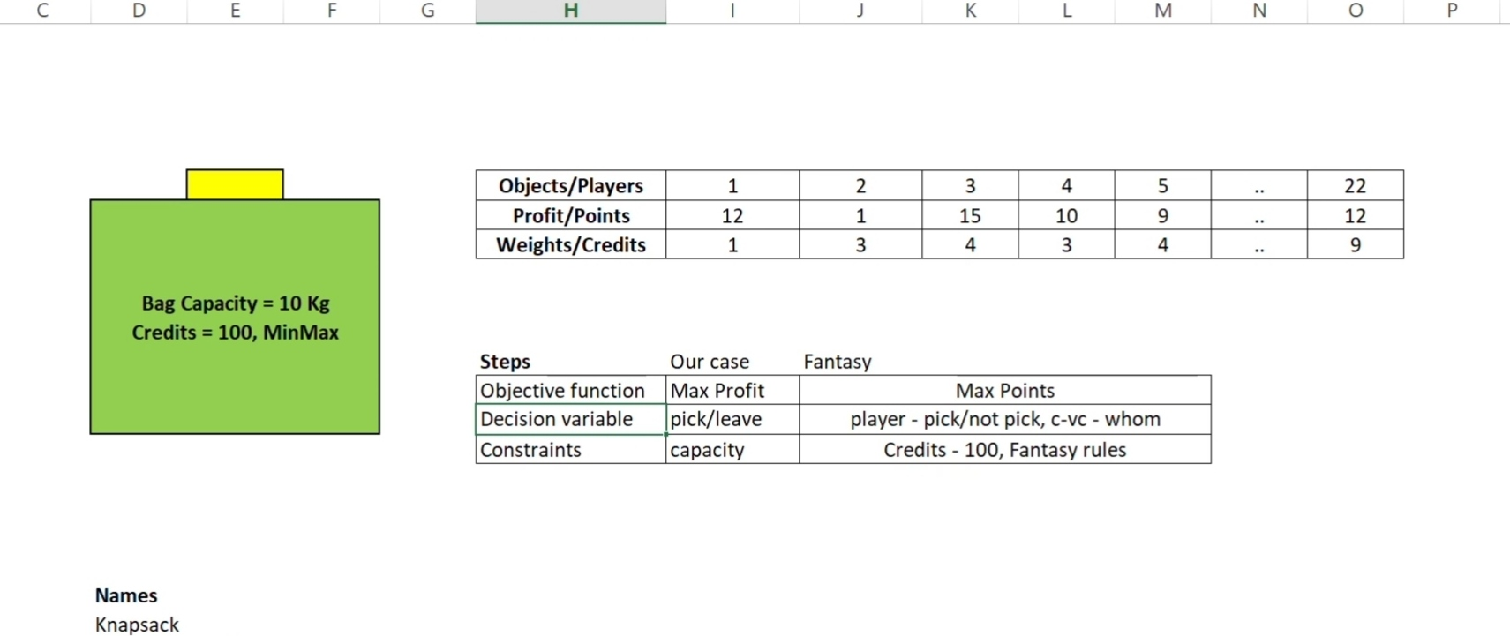
EXAMPLE
The above mapping illustrates how each of the basic components of linear programming can be linked to a simple example and to this case study of generating a fantasy team.

Slide 9
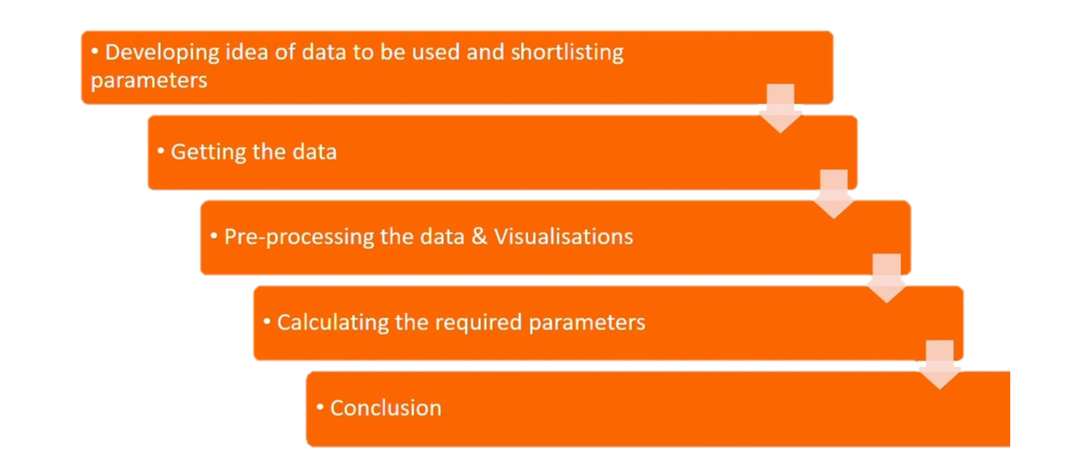
FLOW CHART

Slide 10
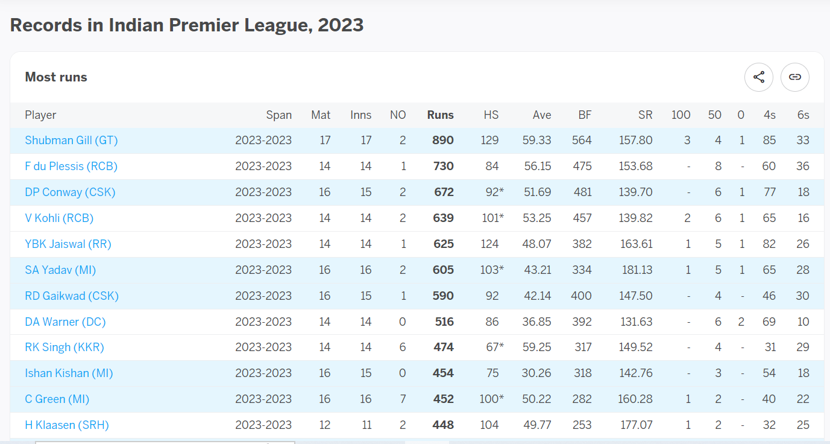
Sample Data

Slide 11
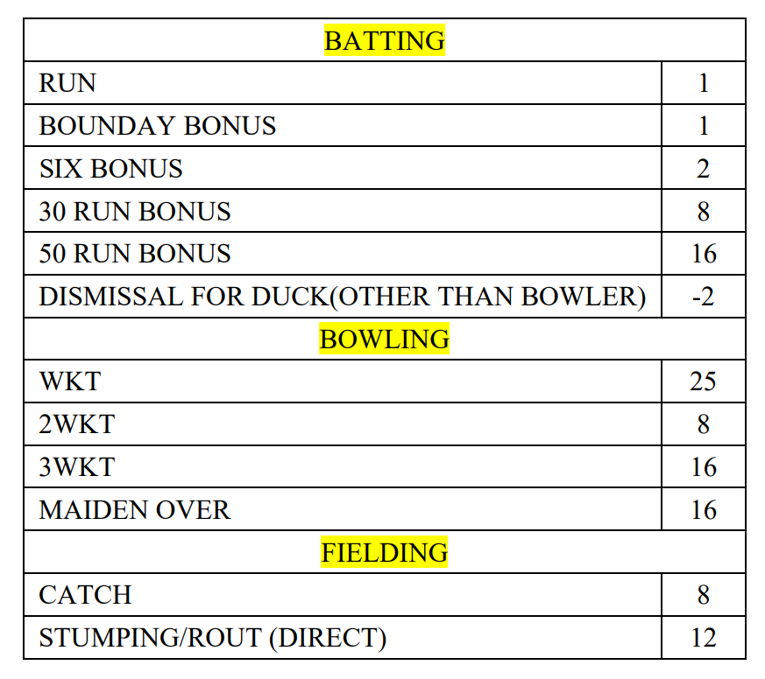
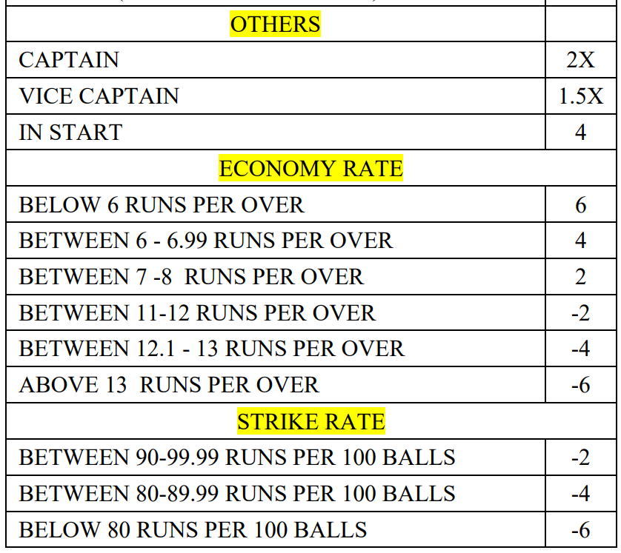
RULES AND EVALUATIONS

Slide 12
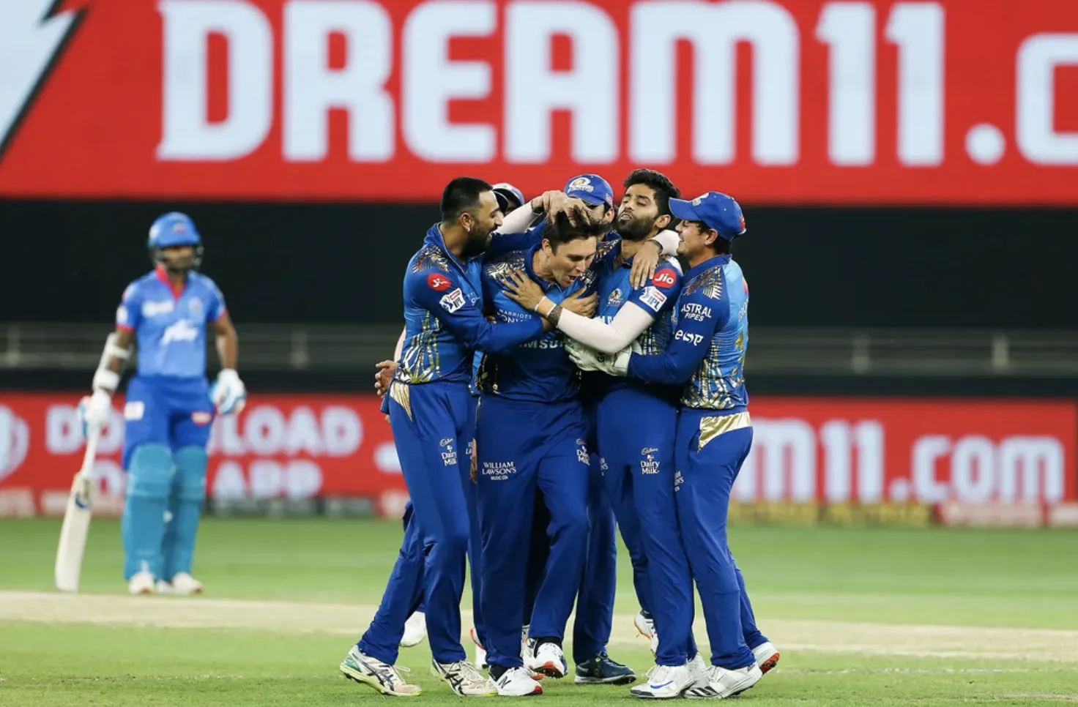
CONCLUSION AND FUTURE WORKS
Choosing Captain and Vice Captain plays a crucial role in putting your team to leaderboard as dream11 points earned by them are multiplied.
If they are not selected correctly, there is very little chance your team will score good.
Separate models could be created to predict these better.
IPL is an annual event and there is a gap of 10 months in between, players performances and forms change, also lot of other factors which we could have considered such as player’s performances in other T20 games, weather, pitch conditions, Age of player (Remembering seeing MS Dhoni exhausted for the 1st time after taking double run), etc.
The current approach is more suitable for tournaments where player rank is an aggregate of a single tournament’s performance.

Slide 13
REFERENCES
Lakshmi Ajay
·
Published in
Towards Data Science
Fantasy Cricket — Application of Linear Programming, Published in Towards Data Science,
Link : https://towardsdatascience.com/creating-a-fantasy-cricket-team-application-of-linear-programming-4b60c261702d
Dream11 Team Predictor with Python and Machine Learning. Published in Analytics Vidhya
Link : https://medium.com/analytics-vidhya/dream11-team-predictor-with-python-and-machine-learning-f0dfce1489eb
Base Paper Article in SSRN Electronic Journal · January 2021, DOI: 10.2139/ssrn.3853704
https://www.researchgate.net/publication/351983079_An_optimized_model_to_create_teams_in_fantasy_cricket
ESPN crick info link :
https://www.espncricinfo.com/records/tournament/indian-premier-league-2023-15129

Slide 14
THANK YOU

