Slide 1

PREPARED BY: SATYAJIT PATEL GUIDED BY: DR. abha sharma
RESEARCH ORIENTED PROJECT
REVIEW 2
AN OPTIMIZED MODEL TO CREATE TEAMS
IN FANTASY CRICKET

Slide 2
Index:
Introduction
Problem statement
Literature Review & objective
Methodologies & analysis
dataset
output
reference

Slide 3
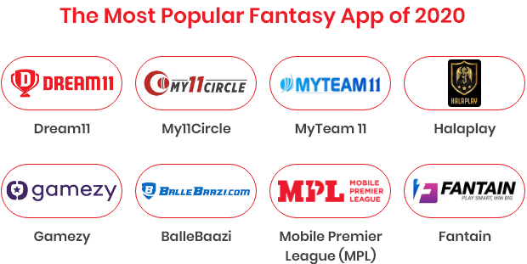
Fantasy sports are online games in which people create a team of imaginary players from these sports.
Statistics are used to determine how effective teams are created based on performance in actual games.
This statistical performance is converted into points and used to reward managers in a point-based league.
Various point systems can be made up by a league commissioner to manage the league and points can be calculated using computers tracking actual results of the professional sport.
Each can register individual teams and then compete to see who wins by earning the maximum fantasy cricket points and thereby the league.
These leagues are very popular during major Twenty20s like IPL T20 and Big Bash T20 Matches.
Introduction

Slide 4
Introduction
Problem statement
Literature Review & objective
Methodologies & analysis
dataset
output
reference

Slide 5
Problem statement
A fantasy team can have any type of players within the maximum wage, however there are limitations on how often batsmen, bowlers, and all-rounders a team can have.
Selecting 11 players from a pool of two is of extreme difficulty.
Each pool consists of approximately 14 players.
This proposed system produces all possible teams and/or optimal no of teams within the budget caps. Players must be selected within the caps, and a particular number of batsmen, bowlers and allrounders are selected.
The proposed system main aim is to create P no of teams with maximum coverage of players and/or coverage of all players from the player's list and the no of teams should contain a maximum no of top performers in a given list of players from the post-match analysis.
The prime objective in fantasy cricket is to score as many points as possible against one's opponent.

Slide 6
Introduction
Problem statement
Literature Review & objective
Methodologies & analysis
dataset
output
reference

Slide 7
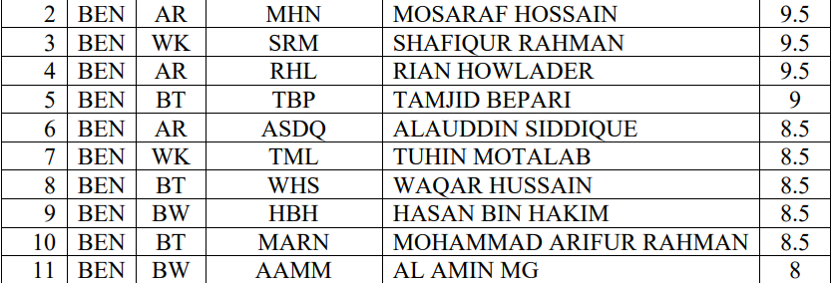
[2] Here Vinod babu polinati has taken Probable 11 from each squad is taken from previous match. The Equivalent player's list along with credits are created and maintained by the league commissioner. The League Commissioner is responsible to update the performance of the players by increasing or decreasing the credits of the individual players and mapping the real player's score to the points system.
The player's list from League Commissioner ( For convenience short names are used in paper), is as follows:
Literature Review & objective
So, [2] and [4] mentioned method is more complex and highly time taking and could be affected by human error because they had to enter the data manually. On the other hand, the method which I will propose in following research paper is more convenient, and consumes less amount of time with accurate real time data. The reason being is in this method the data is provided in database in prior.

Slide 8
Introduction
Problem statement
Literature Review & objective
Methodologies & analysis
dataset
output
reference

Slide 9
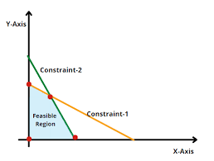
The main keys of this project are:
Web Scraping to collect the data.
A little Data Cleaning.
Optimization using Linear Programming.
Linear Programming : It’s a scientific techniques that is used to get an optimum solution to the given business problem by taking some constraints into account.
PuLP : It’s is an open-source linear programming (LP) package which largely uses Python syntax and comes packaged with many industry-standard solvers.
It also integrates nicely with a range of open source and commercial LP solvers.
Pandas : It’s is an open-source library in Python that is made mainly for working with relational or labeled data both easily and intuitively.
A user gets to build his own team for an upcoming match. From 2 teams, a team of 11 players need to be selected subject to budget and player constraints. Every player has an associated cost. The Dream11 also imposes restrictions on number of batsmen, bowlers, all-rounders and wicket-keepers
Methodologies & analysis

Slide 10
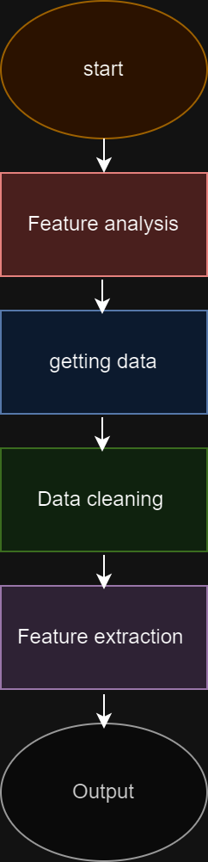
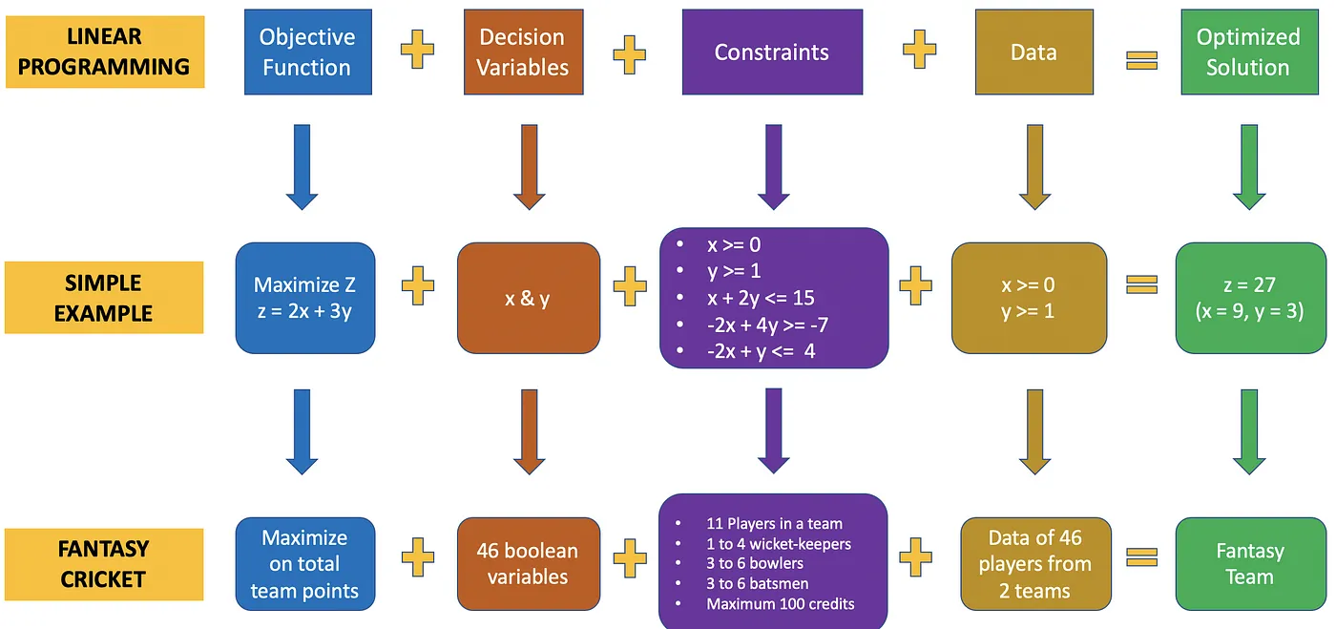
Methodologies & Analysis
Maximize the points
24 Boolean variable
Data of 24 player
The above mapping illustrates how each of the basic components of linear programming can be linked to a simple example and to this case study of generating a fantasy team.

Slide 11
Introduction
Problem statement
Literature Review & objective
Methodologies & analysis
dataset
output
reference

Slide 12
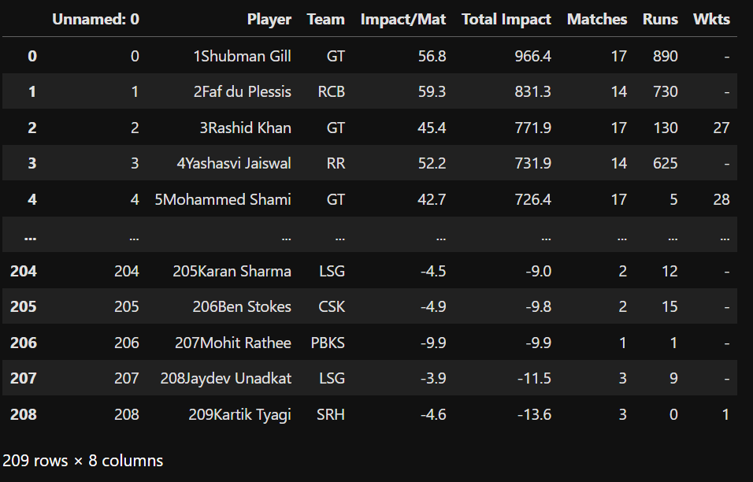
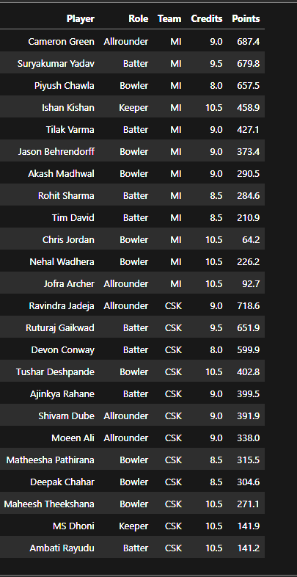
dataset
The player details are created in a CSV file through web scrape which is read into a pandas data frame.
The data can be hand-curated if required for this sample 2 teams.

Slide 13
Introduction
Problem statement
Literature Review & objective
Methodologies & analysis
dataset
output
reference

Slide 14
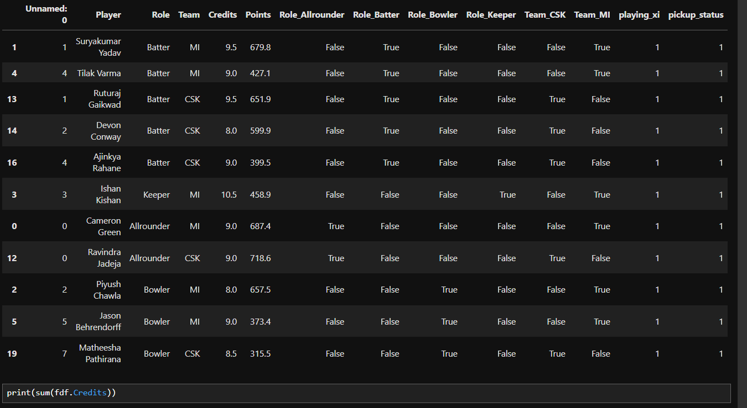
output

Slide 15
Introduction
Problem statement
Literature Review & objective
Methodologies & analysis
dataset
output
reference

Slide 16
[1]. H. Ahmad et al. “Prediction of Rising Stars in the Game of Cricket” in IEEE ACCESS DOI
10.1109/ACCESS.2017.2682162 volume5, 2017 pg4104-412
[2]. Faez Ahmed et al. Multi-objective optimization and decision making approaches to cricket team selection, Applied Soft Computing 13 (2013) 402–414, 1568-4946/Published by Elsevier B.V.
[3]. Fantasy Cricket — Application of Linear Programming, A step-by-step guide using Python(PuLP package), Lakshmi Ajay, Article in medium.com.
[4]. Saurav Singla et al, Integer Optimisation for Dream 11 Cricket Team Selection, International Journal of Computer Sciences and Engineering, November 2020 DOI: 10.26438/ijcse/v8i11.16.
reference

Slide 17


