Slide 1
1. Introduction
The goal of this project is to create a real-time chat application using serverless architecture. We’ll leverage AWS services such as AWS CloudFormation, AWS Lambda, Amazon API Gateway, and Amazon DynamoDB to build a scalable and efficient chat system.
2. Architecture Overview
Our chat application will consist of the following components:
WebSocket API:
We’ll use Amazon API Gateway to create a WebSocket API. This API will handle client connections and route requests to Lambda functions.
AWS Lambda Functions:
Update Connections: A Lambda function that updates client connections in DynamoDB.
Send Messages: A Lambda function responsible for sending messages to connected clients.
Amazon DynamoDB:
We’ll store client IDs in a DynamoDB table. Each connected client will have a unique ID, which serves as the table’s partition key.

Slide 2
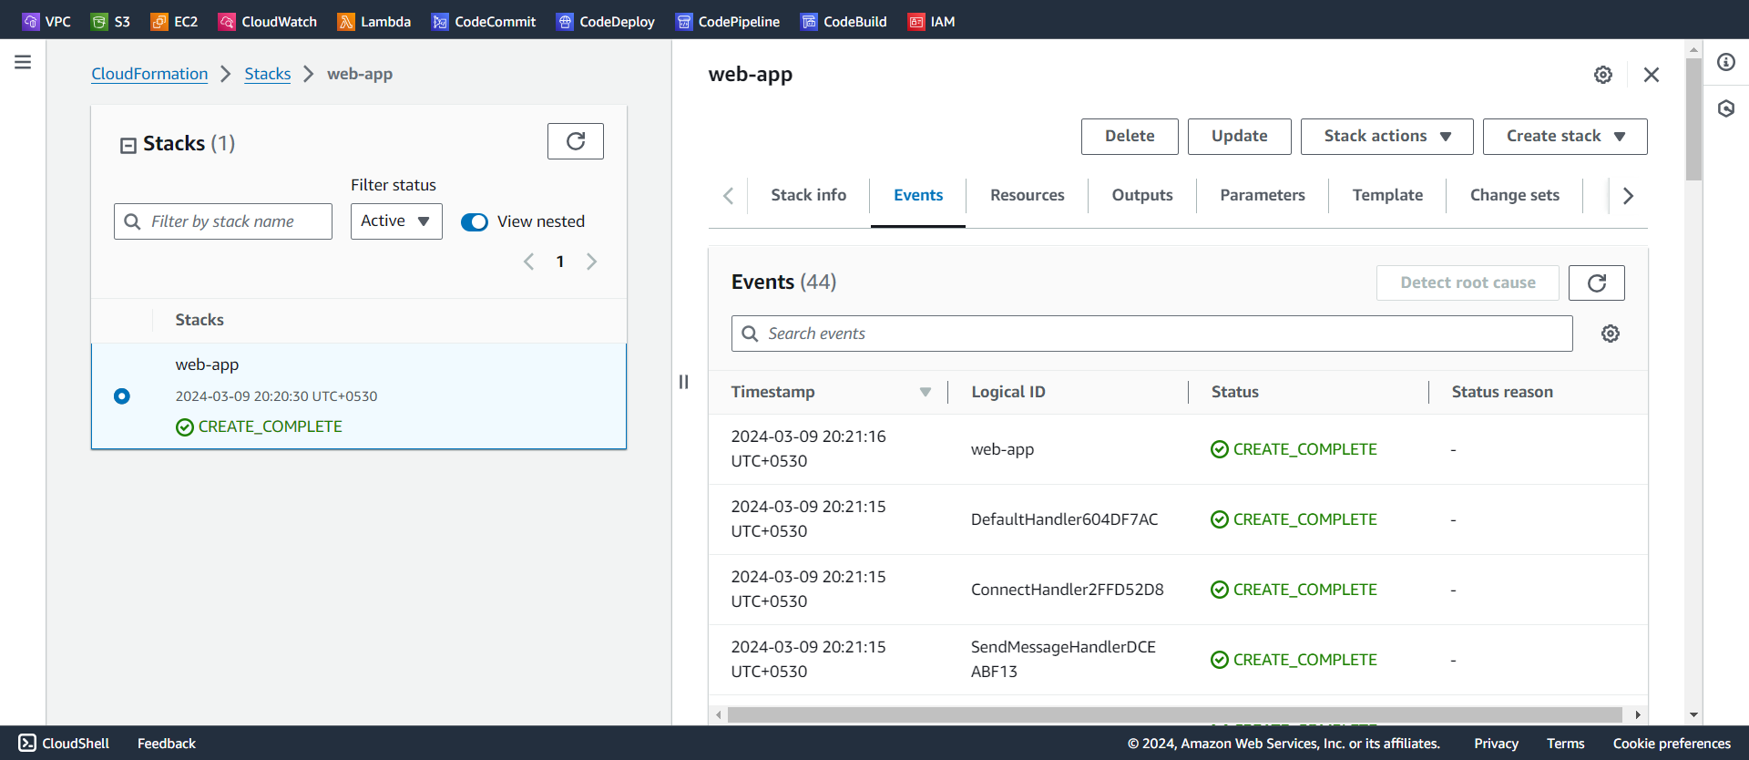
3. Implementation Steps
Step 1: Create Lambda Functions and DynamoDB Table
Open the AWS CloudFormation console.
Choose Create stack and select With new resources(standard).
Upload the template that you have created.
Specify a Stack name.
Acknowledge that AWS CloudFormation can create IAM resources in your account.
Choose Create stack. Wait for the stack to complete provisioning.

Slide 3
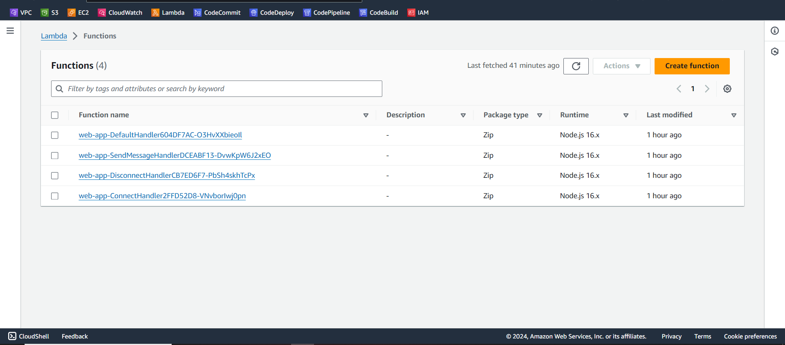
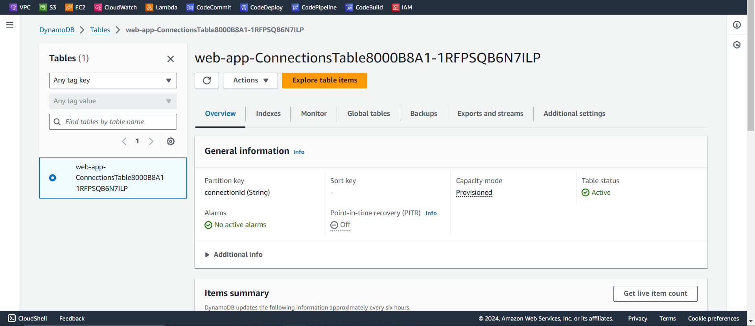

Slide 4
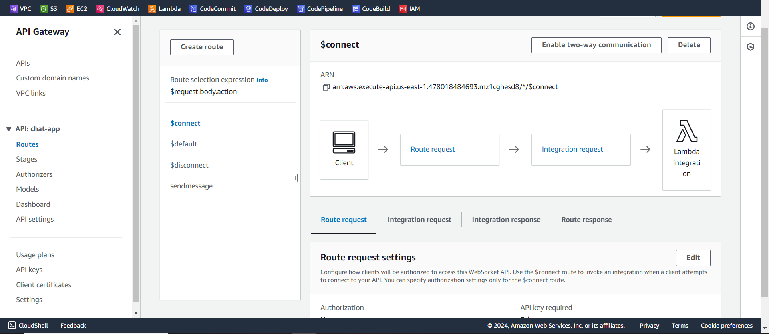
Step 2: Create a WebSocket API
Open API Gateway console.
Choose Create API and select WebSocket API.
Enter an API name.
Set the Route selection expression to request.body.action. This determines the route invoked when a client sends a message.

Slide 5
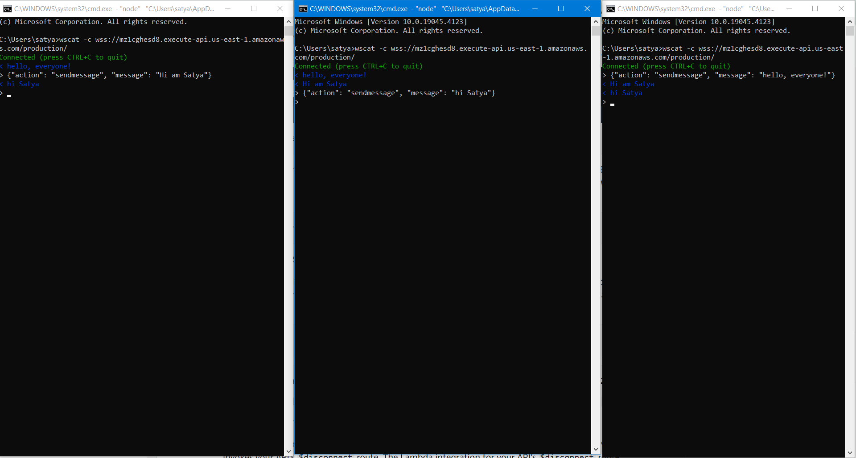
Step 3: Test Your API
Use tools like wscat or any terminal to connect to your WebSocket API and send messages. Verify that messages are sent and received.

Slide 6
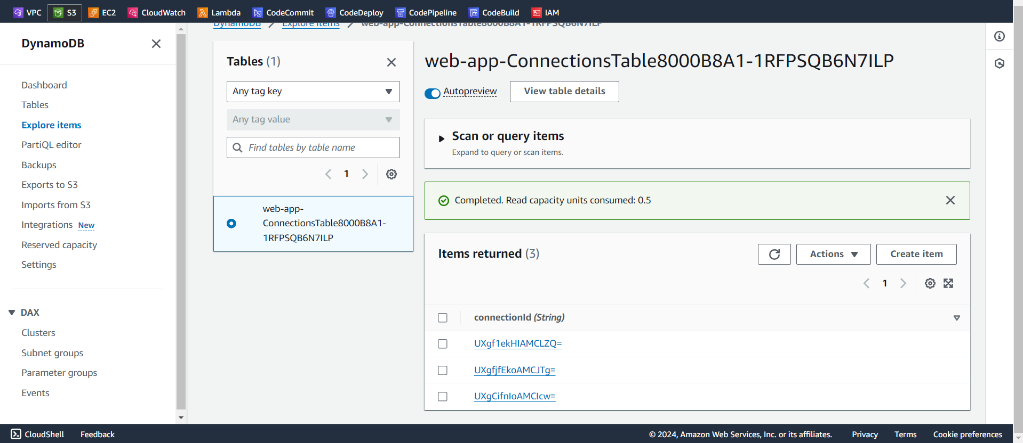
4. Conclusion
Building a serverless chat application using AWS services provides scalability, cost-effectiveness, and real-time capabilities. By following this architecture, you can create robust chat systems for various use cases.

