Slide 1
RUAS IC 2019 Phase 2 Evaluation
Title : Project Asclepius
Theme: Integrated Healthcare Informatics
Application No: RUASIC/19/45
Mentor : Mr. Y. Venkatanatha Sarma
Team Leader: Shyamant Ajit Achar
Institute: RUAS, RIT

Slide 2
Introduction
Category
Context
Problem statement
Applied ML & AI in the field of medicine and image scanning.
Breast cancer is cancer that develops from breast tissue. Mammograms are usually used to determine the existence of malignant tissues.
To come up with a modern-technology driven solution to early stage breast cancer detection, revolutionizing the way cancer is currently detected.

Slide 3
Challenges deep-dive
Challenge 1
Challenge 2
Challenge 3
Extensive Research
At least a minimum of 5 best research papers were filtered out and thoroughly understood. Links are mentioned in the references.
Develop a model & Implement
After writing the code, we had to ensure that in the fully working model, everything had to work seamlessly well
Follow up & scalability
Several maintenance and scalability checks were performed in order to make certain of it usability.

Slide 4
Abstract
Lesion and its contours are prominent signatures to determine malignancy in mammograms. Detection of the masses and their spread in mammogram is important for radiologists. It is also important to detect the shape of the contour or boundary to delineate malignant and benign lesions as malignant lesions have speculated or ill defined boundary and benign mass have smooth boundary. Automatic detection of boundary helps the doctors in analyzing the lesion in less time and prevents unnecessary biopsies.

Slide 5
Fabrication
Python, Jupyter Notebook codes which apply several filters and narrow down on the suspicious zone. The zone is then marked in red, which is your output.
Input:- DCM Image
Output:- Enhanced & Demarcated cyst region with cancer detection result
Artificial Intelligence Machine Learning

Slide 6
Simulation & Demonstration
User loads image onto portal and the software handles the rest
The software primarily carries out 4 filters on the image, namely A. Homomorphic filter A1. High pass filter B. Top Hat transform C. Bottom Hat transform D. CLAHE
3. The output image is enhanced, and the lesion is spotted and classified
4. Further assessment is thus performed based on these results, serving as validations for manual analysis.

Slide 7
Flowchart x2
START
END
Dir. of Sales
K-Means Clustering
Masking
Geometric features
END
START
Thresholding
Border Extraction
Binary Morphology
Morphological gradient
Border Object Removal

Slide 8
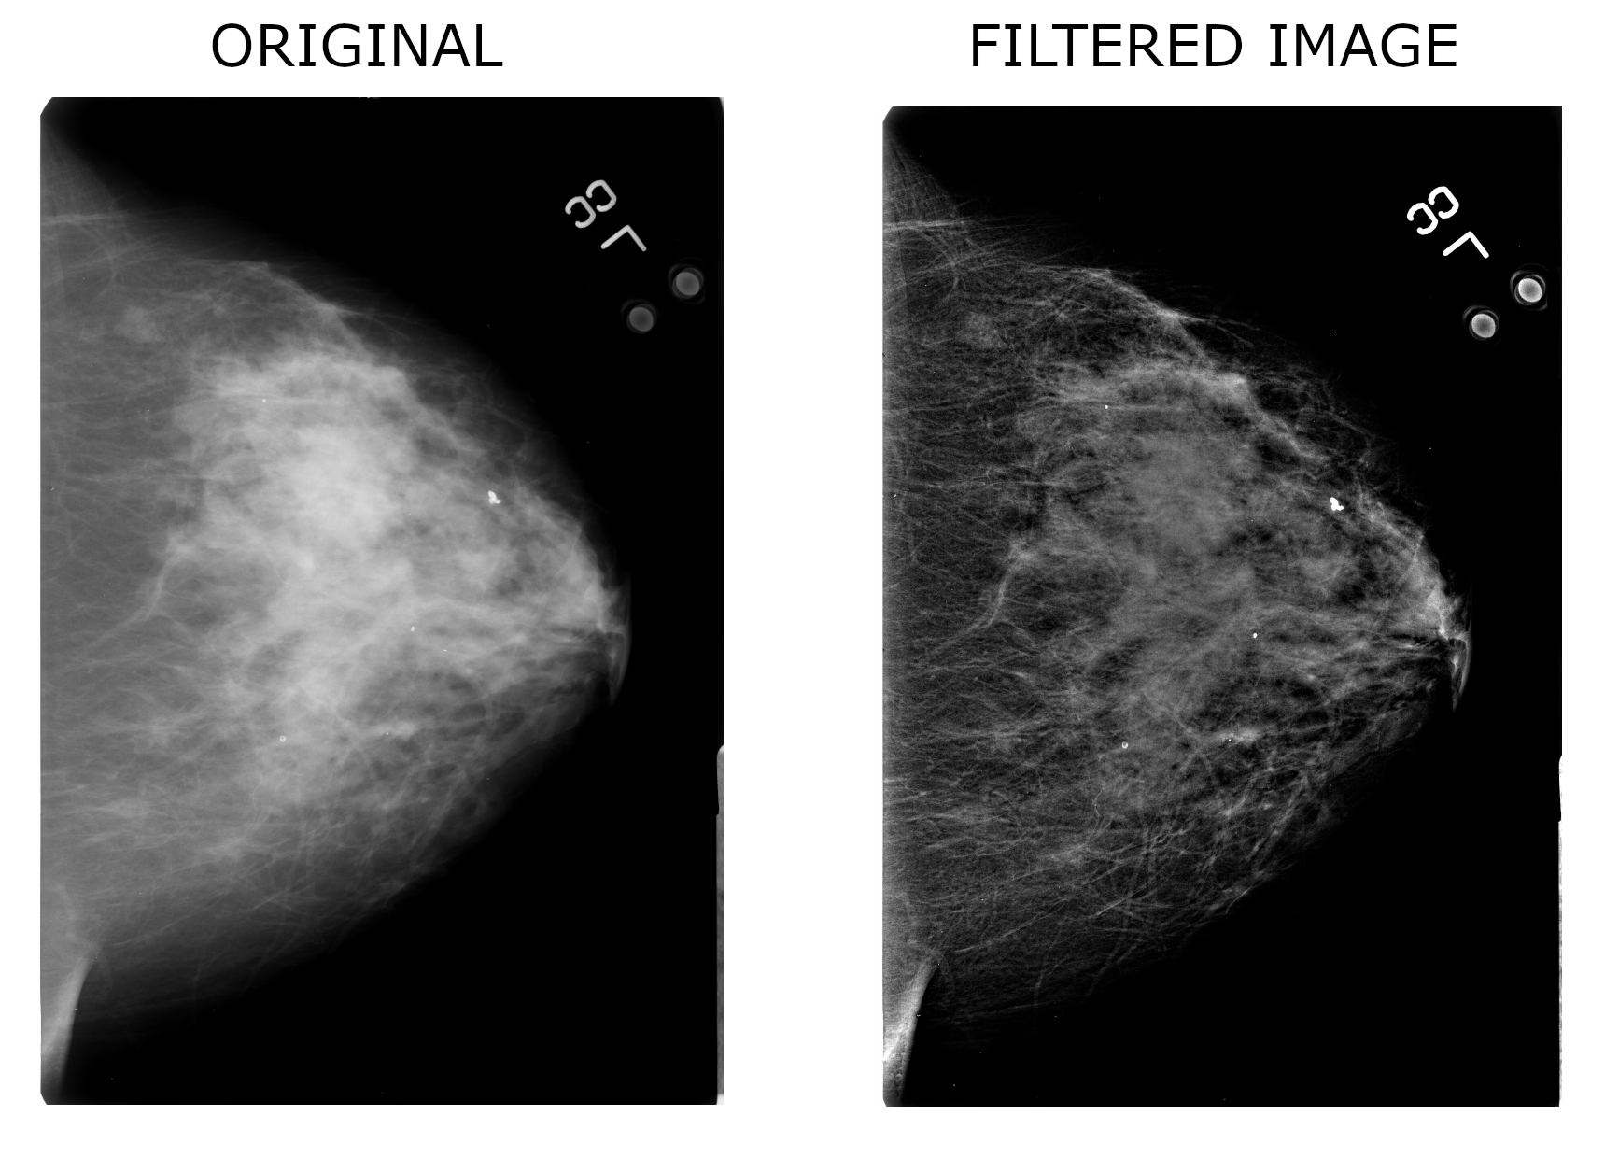
As you can see, the output image on the right is much enhanced, revealing minute details which can’t normally be seen through the naked eye. This will thus greatly improve the positive cancer detection rate if implemented as per necessary requirements. Extensive research is still ongoing in this respect.

Slide 9
Applications & Future Prospects
To emerge as a software development company looking at further products improving on healthcare among other things.
To continually develop on existing products by applying the “Incremental development model” for application production and development, simultaneously taking user feedback.
Reach out to hospitals to test and use our product.
max growth

Slide 10
Budget
It becomes necessary here to mention that an exact detailed budget would be not practical to come up with, however, a rough estimate of the total amount may be ascertained.
Resources & Requirements
Internet for software updates
GPU (Moderately Powerful CPU)
Python Interpreter
DCM mammogram images
Total Cost:- 10,000 INR (initial stage funding)
This amount would mainly be spent in reimbursement, as a lot of processing power and time has gone into making this project possible. Apart from that, there will be a lot of overhead costs like government approvals, travel, documentation etc. which hasn’t been included in this budget for now .

Slide 11
Findings and Conclusion
Through the various step processes of RUASIC 2018-19 we have faced a lot of challenges and have relentlessly worked in order to make our product as perfect as possible. Initiatives have been planned to be taken up to make sure this product reaches the desired market ASAP.
Findings
It is impossible to accurately predict whether a lesion is cancerous or benign, but if this process can be automated with a high degree of accuracy, then we could be looking upon a brilliant solution.
After an FNAC test, when results lie in the range of C2 to C4, nothing can be conclusively said about the nature of the lesion. Biopsy is thus suggested in such cases.
Biopsies are time intensive tests.
Conclusion
Our product will thus aim to replace manual methods of inspection and prevent the need for unnecessary biopsies to be conducted, thus saving on the patients time and money.

