Slide 1
Data Transfer Operations
Microprocessor and Assembly Programming Laboratory
CSC214A
Laboratory 1

Slide 2
Theoretical Background
Registers
General purpose - Eight 32-bit registers used for storing working data
Segment - Six 16-bit registers used for handling memory access
Instruction pointer - A single 32-bit register pointing to the next instruction code to execute

Slide 3
Theoretical Background
Registers
Floating-point data - Eight 80-bit registers used for floating-point arithmetic data
Control - Five 32-bit registers used to determine the operating mode of the processor
Debug - Eight 32-bit registers used to contain information when debugging the processor

Slide 4
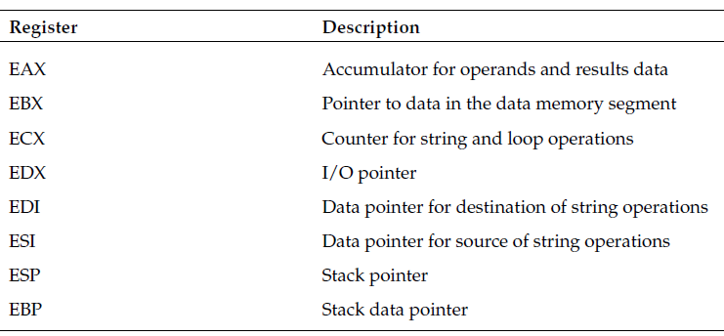
Theoretical Background
General-purpose registers

Slide 5
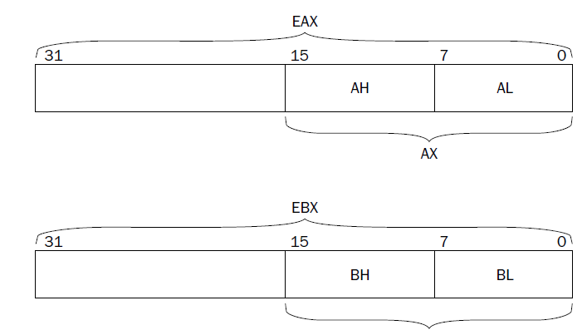
Theoretical Background
By using AX, the lower 16 bits of the EAX register are used
By using AL, the lower 8 bits of the EAX register are used
By using AH the next 8 higher bits after AL

Slide 6
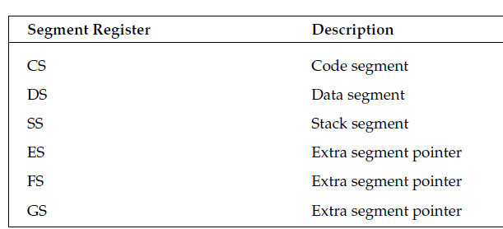
Theoretical Background
Segment Registers

Slide 7
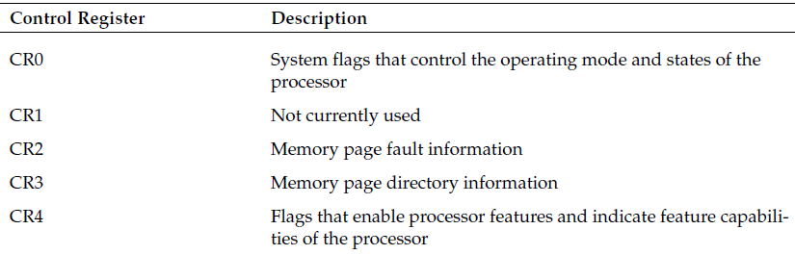
Theoretical Background
Control Registers

Slide 8
Defining data
long testvalue = 150; | testvalue: .long 150
char message[22] = {“This is a test message”}; | message: .ascii “This is a test message”
float pi = 3.14159; | pi: .float 3.14159
Int value = 10; | value: .int 10

Slide 9
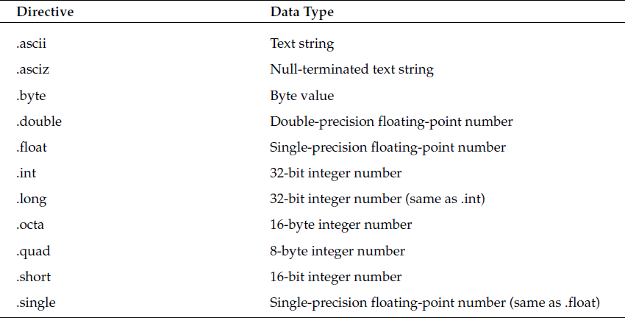
Theoretical Background

Slide 10
Theoretical Background
All assembly language programs have at least three sections that must be declared:
A data section
A bss section
A text section

Slide 11
Template for Assembly Language Programs
.section.data
< initialized data here>
.section .bss
< uninitialized data here>
.section .text
.globl _start
_start:
<instruction code goes here>

Slide 12
Aim
To develop assembly language program to perform data transfer operations on different data.

Slide 13
Expected Outcomes
At the end of this lab students will be able to
Define data of different data types
Perform data transfer operations
Create a simple assembly language program
Use GAS assembler
Understand GNU debugger

Slide 14
Example
The basic format of the MOV instruction is as follows:
movx source, destination
where x can be the following:
l for a 32-bit long word value
w for a 16-bit word value
b for an 8-bit byte value

Slide 15
Example
Moving immediate data:
movl $0, %eax | moves the value 0 to the EAX register ( 32 bit register)
movl $0x80, %ebx | moves the hexadecimal value 80 to the EBX register
movl $100, height | moves the value 100 to the height memory location
movb $10,%al | Moves the value 10 to register al (8-bit register)
movw $10,%ax | Moves the value 10 to register ax (16-bit register)

Slide 16
Example
Moving data between registers
movl %eax, %ecx | move 32-bits of data from the EAX register to the ECX register
movw %ax, %cx | move 16-bits of data from the AX register to the CX register
Moving data values from memory to a register
movl value, %eax | Moving data from variable named value to the register eax
Moving data values from a register to memory
movl %ecx, value | Moving data from the 32-bit register ecx to the variable value

Slide 17
Example
# movtest1.s – An example of moving data from memory to a register
.section .data
value:
.int 1
.section .text
.globl _start
_start:
nop
movl value, %ecx
movl $1, %eax
movl $0, %ebx
int $0x80

Slide 18
Example
To compile: as -gstabs filename.s –o filename.o
To link: ld filename.o –o filename
To run: gdb –q filename
To set BreakPoint: break filename.s:linenumber
To execute: run
To examine the registers: print $registernumber

Slide 19
Expected Output
$ as -gstabs -o movtest1.o movtest1.s
$ ld -o movtest1 movtest1.o
$ gdb -q movtest1
(gdb) break *_start+1
Breakpoint 1 at 0x8048075: file movtest1.s, line 10.
(gdb) run
Starting program: /home/rich/palp/chap05/movtest1
Breakpoint 1, _start () at movtest1.s:10
10 movl (value), %ecx
Current language: auto; currently asm
(gdb) print/x $ecx
$1 = 0x0
(gdb) next
11 movl $1, %eax
(gdb) print/x $ecx
$2 = 0x1
(gdb) info registers // to get information about all registers when the program is running

Slide 20
Expected Documentation Detail
Algorithm
Write and explain how to perform the given data transfer operations
Presentation of Results
Present the screenshots with explanation
Refer Expected output slide
Analysis and Discussions
Compare your experience on Assembly language programming with C programming language and discuss the differences
Assembly language is a low level language and dependent on the system architecture but in case of C, it can be ported to various platforms

Slide 21
Expected Documentation Detail
Conclusions
Based on your work and analysis provide a summary and conclusions drawn from the analysis here
The assembly code for one architecture can not port to another architecture with out radical rewrite of the code
Comments
Limitations of Experiments
Is the experiment and the delivery in lab session complete to achieve the objectives? What else can be done to improve the experiment.

Slide 22
Expected Documentation Detail
Comments
Limitations of Results
Are the results of the experiment restricted? How can they be overcome
Learning happened
What did you learn
Performing data transfer operation using Immediate, Register and Direct addressing modes
Recommendation
Based on your understanding and analysis, what do you recommend. Do you have any recommendations to overcome limitations of the experiment?

