Slide 1
Arithmetic Operations
Microprocessor and Assembly Programming Laboratory
CSC214A
Laboratory 2

Slide 2
Theoretical Background
Instruction | Explanation
addb $10, %al | adds the immediate value 10 to the 8-bit AL register
addw %bx, %cx | adds the 16-bit value of the BX register to the CX register
addl data, %eax | adds the 32-bit integer value at the data label to EAX
addl %eax, %eax | adds the value of the EAX register to itself

Slide 3
Theoretical Background
Defines two 64-bit integer values:
data1:
.quad 7252051615
data2:
.quad 5732348928
output:
.asciz “The result is %qd\n”

Slide 4
Theoretical Background
The 64-bit values are loaded into the EAX:EBX and ECX:EDX register pairs using indexed addressing:
movl data1, %ebx
movl data1+4, %eax
movl data2, %edx
movl data2+4, %ecx
The low 32-bits of the data1 value are loaded into the EBX register, and the high 32-bit value is loaded into the EAX register. The same procedure is used to load the data2 value into the ECX:EDX register pair.
The addition is performed in two instructions:
addl %ebx, %edx
adcl %eax, %ecx

Slide 5
Theoretical Background
The ADC instruction can be used to add two unsigned or signed integer values, along with the value contained in the carry flag from a previous ADD instruction.
The SBB instruction utilizes the carry and overflow flags in multibyte subtractions to implement the borrow feature across data boundaries.
The INC and DEC instructions are used to increment (INC) and decrement (DEC) an unsigned integer value.
dec destination
inc destination
The format for the MUL instruction is mul source
The format of the DIV instruction is div divisor

Slide 6
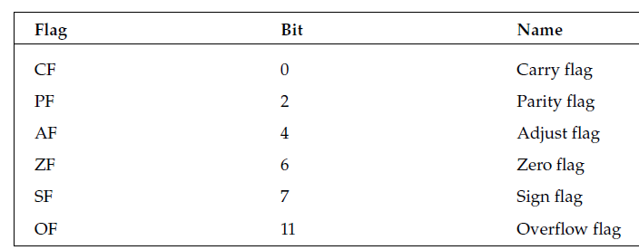
Theoretical Background
Status flags
The status flags are used to indicate the results of a mathematical operation by the processor.

Slide 7
Aim
To develop assembly language program to perform all arithmetic operations

Slide 8
Expected Outcomes
At the end of this lab students will be able to
Identify the appropriate assembly language instruction for the given arithmetic operations
Perform all arithmetic operations using assembly language instructions
Understand different data types and memory used
Get familiar with assembly language program by developing simple programs

Slide 9
Example
addtest1.s - An example of the ADD instruction
.section .data
data:
.int 40
.section .text
.globl _start
_start:
nop
movl $0, %eax
movl $0, %ebx
movl $0, %ecx
movb $20, %al
addb $10, %al
movsx %al, %eax
movw $100, %cx
addw %cx, %bx
movsx %bx, %ebx
movl $100, %edx
addl %edx, %edx
addl data, %eax
addl %eax, data
movl $1, %eax
movl $0, %ebx
int $0x80

Slide 10
Expected Output
(gdb) print $eax
$1 = 70
(gdb) print $ebx
$2 = 100
(gdb) print $ecx
$3 = 100
(gdb) print $edx
$4 = 200
(gdb) x/d &data
0x804909c <data>: 110
(gdb)

Slide 11
Expected Documentation Detail
Algorithm
Write and explain the arithmetic instructions to perform all the given assignment statements
E.g Subtraction, signed and unsigned multiplication, signed and unsigned division, increment and decrement
Presentation of Results
Present the screenshots with explanation
Refer Expected output slide
Analysis and Discussions
Compare your experience on Assembly language programming with C programming language and discuss the differences
Assembly language is a low level language and dependent on the system architecture but in case of C, it can be ported to various platforms

Slide 12
Expected Documentation Detail
Conclusions
Based on your work and analysis provide a summary and conclusions drawn from the analysis here
The assembly code for one architecture can not port to another architecture with out radical rewrite of the code
Comments
Limitations of Experiments
Is the experiment and the delivery in lab session complete to achieve the objectives? What else can be done to improve the experiment.

Slide 13
Expected Documentation Detail
Comments
Limitations of Results
Are the results of the experiment restricted? How can they be overcome
Learning happened
What did you learn
Recommendation
Based on your understanding and analysis, what do you recommend. Do you have any recommendations to overcome limitations of the experiment?

