Slide 1
Controlling Execution Flow using Conditional Instructions
Microprocessor and Assembly Programming Laboratory
CSC214A
Laboratory 5

Slide 2
Theoretical Background
Unconditional Branches
When an unconditional branch is encountered in the program, the instruction pointer is automatically routed to a different location.
Three types of unconditional branches:
Jumps
Calls
Interrupts

Slide 3
Theoretical Background
The jump instruction uses a single instruction code:
jmp location
where location is the memory address to jump to. In assembly language, the location value is declared as a label within the program code.

Slide 4
Theoretical Background
The call instruction has two parts. The first part is the actual CALL instruction, which requires a single operand, the address of the location to jump to:
call address
The address operand refers to a label in the program, which is converted to the memory address of the first instruction in the function.
The second part of the call instruction is the return instruction. This enables the function to return to the original part of the code, immediately after the CALL instruction. The return instruction has no operands, just the mnemonic RET.

Slide 5
Theoretical Background
The third type of unconditional branch is the interrupt.
An interrupt is a way for the processor to “interrupt” the current instruction code path and switch to a different path.
Interrupts come in two varieties:
Software interrupts
Hardware interrupts

Slide 6
Theoretical Background
Conditional Branches
There are many bits in the EFLAGS register, but the conditional branches are only concerned with five of them:
Carry flag (CF) - bit 0 (lease significant bit)
Overflow flag (OF) - bit 11
Parity flag (PF) - bit 2
Sign flag (SF) - bit 7
Zero flag (ZF) - bit 6

Slide 7
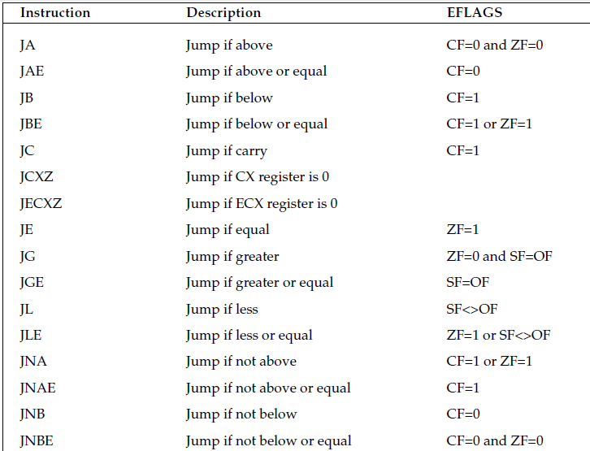
Theoretical Background

Slide 8
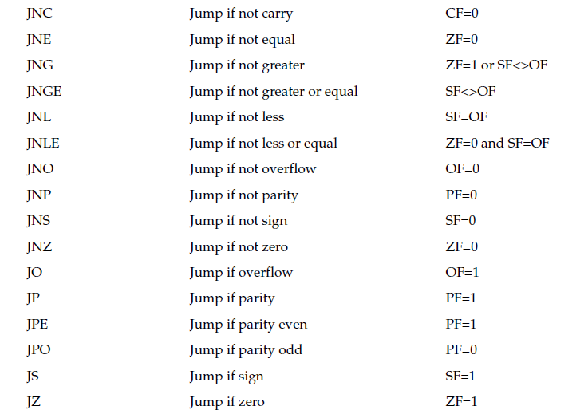
Theoretical Background

Slide 9
Aim
To develop assembly language program to perform control flow operations using conditional instructions.

Slide 10
Expected Outcomes
At the end of this lab students will be able to
Identify the appropriate assembly language instruction for the given conditional operations
Perform all conditional operations using assembly language instructions
Get familiar with assembly language program by developing simple programs

Slide 11
Example
# jumptest.s – An example of the jmp instruction
.section .text
.globl _start
_start:
nop
movl $1, %eax
jmp overhere
movl $10, %ebx
int $0x80
overhere:
movl $20, %ebx
int $0x80

Slide 12
Expected Output
$ as -o jumptest.o jumptest.s
$ ld -o jumptest jumptest.o
$ ./jumptest
$ echo $?
20

Slide 13
Example
add $8, %esp # should clear up stack
call overhere
pushl $3
pushl $output
call printf
add $8, %esp # should clear up stack
pushl $0
call exit
overhere:
pushl %ebp
calltest.s - An example of using the CALL instruction
.section .data
output:
.asciz “This is section %d\n”
.section .text
.globl _start
_start:
pushl $1
pushl $output
call printf

Slide 14
Example
.section .text
.globl _start
_start:
nop
movl $15, %eax
movl $10, %ebx
cmp %eax, %ebx
jge greater
movl $1, %eax
int $0x80
greater:
movl $20, %ebx
movl $1, %eax
int $0x80

Slide 15
Expected Documentation Detail
Algorithm
Write and explain algorithms to perform the given operations
Presentation of Results
Present the screenshots with explanation
Refer Expected output slide
Analysis and Discussions
Compare your experience on Assembly language programming with C programming language and discuss the differences
Assembly language is a low level language and dependent on the system architecture but in case of C, it can be ported to various platforms

Slide 16
Expected Documentation Detail
Conclusions
Based on your work and analysis provide a summary and conclusions drawn from the analysis here
The assembly code for one architecture can not port to another architecture with out radical rewrite of the code
Comments
Limitations of Experiments
Is the experiment and the delivery in lab session complete to achieve the objectives? What else can be done to improve the experiment.

Slide 17
Expected Documentation Detail
Comments
Limitations of Results
Are the results of the experiment restricted? How can they be overcome
Learning happened
What did you learn
Recommendation
Based on your understanding and analysis, what do you recommend. Do you have any recommendations to overcome limitations of the experiment?

