Slide 1
Sorting
Microprocessor and Assembly Programming Laboratory
CSC214A
Laboratory 8

Slide 2
Theoretical Background
Conditional Branches
There are many bits in the EFLAGS register, but the conditional branches are only concerned with five of them:
Carry flag (CF) - bit 0 (lease significant bit)
Overflow flag (OF) - bit 11
Parity flag (PF) - bit 2
Sign flag (SF) - bit 7
Zero flag (ZF) - bit 6

Slide 3
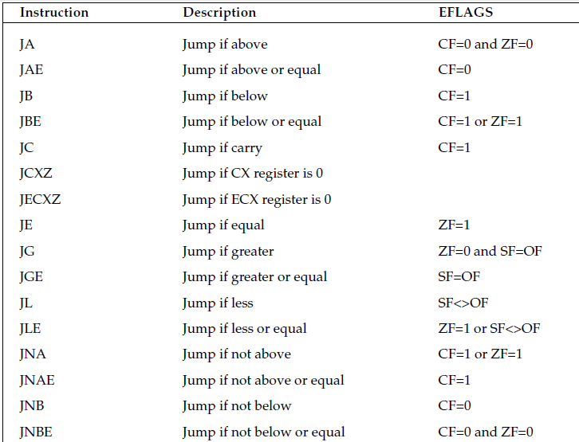
Theoretical Background

Slide 4
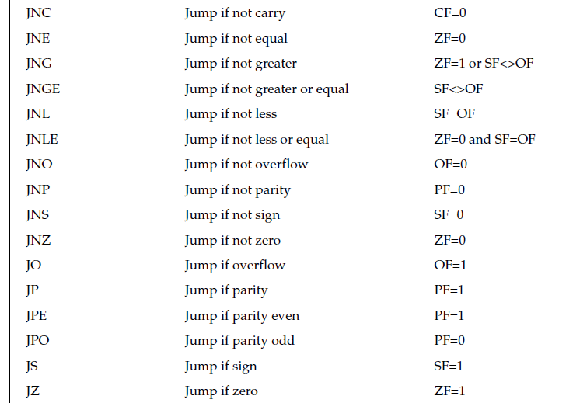
Theoretical Background

Slide 5
Aim
To develop assembly language program to perform sorting using nested loop structures

Slide 6
Expected Outcome
At the end of this lab, the student will be able to
use nested loops in assembly
perform sorting in ascending/ descending order
Build complex looping logic in assembly language

Slide 7
Expected Documentation Detail
Algorithm
Write and explain algorithms to perform the given sorting operations
Presentation of Results
Present the screenshots with explanation
Refer Expected output slide
Analysis and Discussions
Compare your experience on Assembly language programming with C programming language and discuss the differences
Assembly language is a low level language and dependent on the system architecture but in case of C, it can be ported to various platforms

Slide 8
Expected Documentation Detail
Conclusions
Based on your work and analysis provide a summary and conclusions drawn from the analysis here
The assembly code for one architecture can not port to another architecture with out radical rewrite of the code
Comments
Limitations of Experiments
Is the experiment and the delivery in lab session complete to achieve the objectives? What else can be done to improve the experiment.

Slide 9
Expected Documentation Detail
Comments
Limitations of Results
Are the results of the experiment restricted? How can they be overcome
Learning happened
What did you learn
Recommendation
Based on your understanding and analysis, what do you recommend. Do you have any recommendations to overcome limitations of the experiment?

