Slide 1
Finite State Machines in Games
Slides by: Jarret Raim

Slide 2
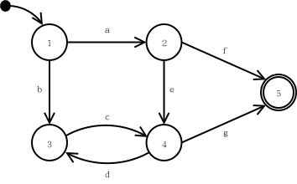
FSM’s in Theory
Simple theoretical construct
  Set of states (S)
  Input vocabulary (I)
  Transitional function T(s,i)
A way of denoting how an object can change its state over time.

Slide 3
FSM’s in Practice
Each state represents some desired behavior.
The transition function T resides across all states.
  Each state “knows” how to transition to other states.
Accepting states (those that require more input) are considered to be the end of execution for an FSM.
Input to the FSM continues as long as the game continues.

Slide 4
FSM’s in Games
Character AI can be modeled as a sequence of mental states.
World events can force a change in state.
The mental model is easy to grasp, even for non-programmers.
Monster In Sight
Gather
Treasure
Flee
No Monster
Fight
Monster Dead
Cornered

Slide 5
FSM Example
Attack
E,~D
States
  E: enemy in sight
  S: hear a sound
  D: dead
Events
  E: see an enemy
  S: hear a sound
  D: die
Action performed
  On each transition
  On each update in some states (e.g. attack)
~E
D
E
E
Inspect
~S
Patrol
E
S
D
~E
Spawn
D
S
D
Problem: Can’t go directly from attack to patrol. We’ll fix this later.

Slide 6
FSM Implementation - Code
Simplest method
After an action, the state might change.
Requires a recompile for changes
No pluggable AI
Not accessible to non-programmers
No set structure
Can be a bottleneck.
void RunLogic( int *state ) {
switch( *state ) {
case 0: //Wander
Wander();
if( SeeEnemy() )
*state = 1;
if( Dead() )
*state = 2;
break;
case 1: //Attack
Attack();
*state = 0;
if( Dead() )
*state = 2;
break;
case 3: //Dead
SlowlyRot()
break;
}

Slide 7
FSM Implementation - Macro
Forces structure
Shallow learning curve
More readable
  Removes clutter by using macros.
Easily debugged
  Allows focus on important code.
bool MyStateMachine::States( StateMachineEvent event,
int state );
{
BeginStateMachine
State(0)
OnUpdate
Wander();
if( SeeEnemy() ) SetState(1);
if( Dead() ) SetState(2);
State(1)
OnUpdate
Attack();
SetState(0);
if( Dead() ) SetState(2);
State(2)
OnUpdate
RotSlowly();
EndStateMachine
}

Slide 8
FSM Implementation – Data Driven
Developer creates scripting language to control AI.
Script is translated to C++ or bytecode.
Requires a vocabulary for interacting with the game engine.
A ‘glue layer’ must connect scripting vocabulary to game engine internals.
Allows pluggable AI modules, even after the game has been released.

Slide 9
FSM Processing
Polling
  Simple and easy to debug.
  Inefficient since FSM’s are always evaluated.
Event Driven Model
  FSM registers which events it is interested in.
  Requires complex Observer model in engine.
  Hard to balance granularity of event model.
Multithreaded
  Each FSM assigned its own thread.
  Requires thread-safe communication.
  Conceptually elegant.
  Difficult to debug.
  Can be made more efficient using microthreads.

Slide 10
Game Engine Interfacing
Simple hard coded approach
  Allows arbitrary parameterization
  Requires full recompile
Function pointers
  Pointers are stored in a singleton or global
  Implementation in DLL
    Allows for pluggable AI.
Data Driven
  An interface must provide glue from engine to script engine.
Engine
AI
Engine
AI
DLL
Byte Code
S. Interface
Compiler
Engine
AI

Slide 11
Optimization – Time Management
Helps manage time spent in processing FSM’s.
Scheduled Processing
  Assigns a priority that decides how often that particular FSM is evaluated.
  Results in uneven (unpredictable) CPU usage by the AI subsystem.
    Can be mitigated using a load balancing algorithm.
Time Bounded
  Places a hard time bound on CPU usage.
  More complex: interruptible FSM’s

Slide 12
Optimization – Level of Detail
It’s ok to cut corners if the user won’t notice.
Each level of detail will require programmer time.
The selection of which level to execute can be difficult.
Many decisions cannot be approximated.

Slide 13
FSM Extensions
Extending States
  Adding onEnter() and onExit() states can help handle state changes gracefully.
Stack Based FSM’s
  Allows an AI to switch states, then return to a previous state.
  Gives the AI ‘memory’
  More realistic behavior
  Subtype: Hierarchical FSM’s

Slide 14
FSM Example
Original version doesn’t remember what the previous state was.
One solution is to add another state to remember if you heard a sound before attacking.
~S
Attack-P
E,S,~D
Attack
E,~D
~E
S
D
E
D
~E
E
E
Inspect
~S
Patrol
E
S
D
~E
Spawn
D
S
D

Slide 15
FSM Example
Attack-ES
E,-D,S,-L
Worst case:
Each extra state variable can add 2^{n} extra states
  n = number of existing states
Attack-E
E,-D,-S,-L
S
Retreat-S
-E,-D,S,L
-S
L
L
-L
E
-E
E
Wander-L
-E,-D,-S,L
E
-L
Retreat-ES
E,-D,S,L
-L
E
L
-S
-L
L
Retreat-E
E,-D,-S,L
Wander
-E,-D,-S,-L
-E
-E
E
D
D
Chase
-E,-D,S,-L
D
D
Using a stack would allow much of this behavior without the extra states.
Spawn
D
(-E,-S,-L)
S

Slide 16
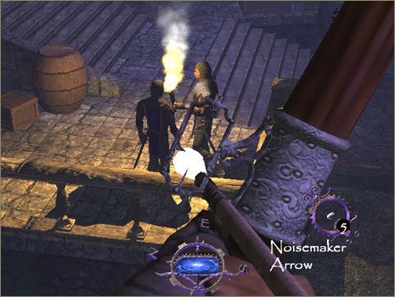
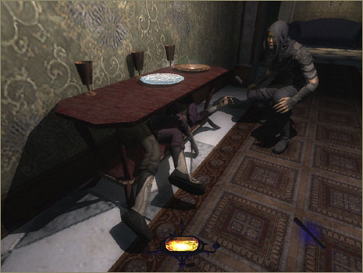
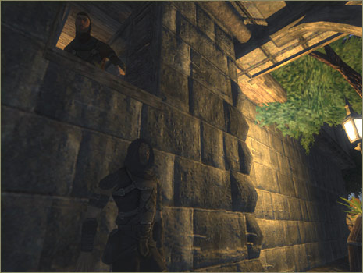
Stack FSM – Thief 3
Stack allows AI to move back and forth between states.
Leads to more realistic behavior without increasing FSM complexity.

Slide 17
Hierarchical FSMs
Expand a state into its own sub-FSM
Some events move you around the same level in the hierarchy, some move you up a level
When entering a state, have to choose a state for it’s child in the hierarchy
  Set a default, and always go to that
  Random choice
  Depends on the nature of the behavior

Slide 18
Hierarchical FSM Example
Attack
Wander
~E
Pick-up
Powerup
E
Chase
~S
S
Start
Spawn
Turn Right
D
~E
Note: This is not a complete FSM
  All links between top level states still exist
  Need more states for wander
Go-through
Door

Slide 19
Non-Deterministic Hierarchical
FSM (Markov Model)
Adds variety to actions
Have multiple transitions for the same event
Label each with a probability that it will be taken
Randomly choose a transition at run-time
Markov Model: New state only depends on the previous state
Attack
Approach
.3
Aim &
Slide Right
& Shoot
.3
Start
.3
.4
.3
Aim &
Slide Left
& Shoot
.4
Aim &
Jump &
Shoot
Notes:
If two arcs are two, pick according to probability

Slide 20


More FSM Extensions
Fuzzy State Machines
  Degrees of truth allow multiple FSM’s to contribute to character actions.
Multiple FSM’s
  High level FSM coordinates several smaller FSM’s.
Polymorphic FSM’s
  Allows common behavior to be shared.
  Soldier -> German -> Machine Gunner

Slide 21
Polymorphic FSM Example
Soldier
Rifleman
Machine Gunner
Officer
American
German
American
German
American
German
British
Soviet
British
Soviet
British
Soviet

Slide 22
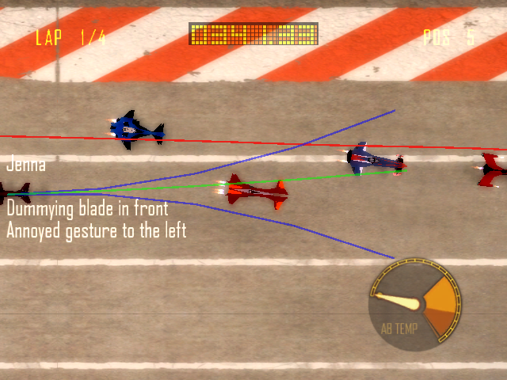
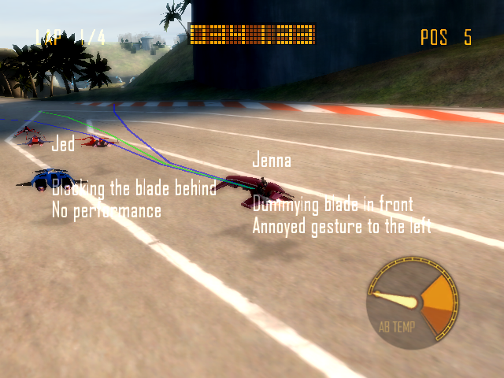
Debugging FSM’s
Offline Debugging
  Logging
  Verbosity Levels
Online Debugging
  Graphical representation is modified based on AI state
  Command line to modify AI behavior on the fly.

Slide 23
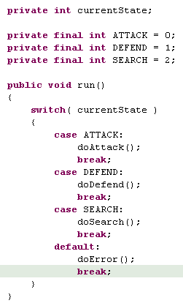
Case Study: Robocode
First determine what states are needed
  Attack, Evade, Search, etc.
Code up the FSM transition function.
  Include an error state that is noticeable.
Setup debugging.
  Verbosity levels are a must.

Slide 24
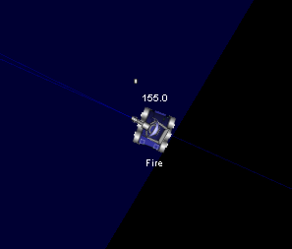
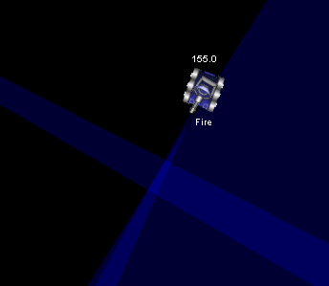
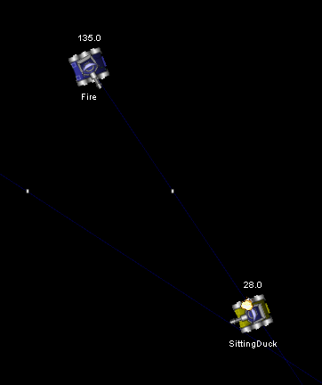
Case Study: Robocode
Defend
Search
Implement and test each state separately.
A test bot AI might help test single behaviors. (see Target bot)
Attack

Slide 25
Defense and Firing Power
Enable your bot to dodge incoming fire.
Every 20 ‘ticks’ reverse direction.
Adds a circle strafe.
Selects a bullet power based on our distance away from the target
void doMovement()
{
if (getTime()%20 == 0)
{
direction *= -1; setAhead(direction*300);
}
setTurnRightRadians( target.bearing + (PI/2));
}
void doFirePower()
{
firePower = 400/target.distance;
}

Slide 26
Searching
Reducing the scanner arc allows you to fire faster.
If a target hasn’t been seen recently, spin.
Scan where the target is.
‘Wobble’ to make sure to find the target.
void doScanner() {
double radarOffset;
if(getTime() - target.ctime > 4)
radarOffset = 360;
else
radarOffset = getRadarHeadingRadians() - absbearing(getX(),getY(),target.x,target.y);
if( radarOffset < 0 )
radarOffset -= PI/8;
else
radarOffset += PI/8;
setTurnRadarLeftRadians(NormaliseBearing(radarOffset));
}

Slide 27
References
AI Game Programming Wisdom
University of Wisconsin presentation
Robocode Website

