Slide 1
Employee Management System
TEAM NAME: DROP TABLE DB_LAB;

Slide 2
Team Members
Shikhar Singh (17ETCS002168)
Samhitha R (17ETCS002156)
Shoban Dinesh (17ETCS002174)
S P Anusha (17ETCS002150)
Satyajit Ghana (17ETCS002159)

Slide 3
Functional Requirements
The system should allow the manager and the employee to login
The system should allow the manager to add employees and details to the database
The system should allow the manager to modify employee details
The system should allow the manager to assign projects to the employees
The system should allow the manager to add and manage departments
The system should allow the manager to manage employee logistics

Slide 4
Requirement Tag | FR1
Requirement Description | The system should allow the manager and the employee to login
Dependent on Requirements | None
User/System interacting with the requirement | Manager
Requirement Tag | FR2
Requirement Description | The system should allow the manager to add employees and details to the database
Dependent on Requirements | FR1
User/System interacting with the requirement | Manager

Slide 5
Requirement Tag | FR3
Requirement Description | The system should allow the manager to modify employee details
Dependent on Requirements | FR1, FR2
User/System interacting with the requirement | Manager
Requirement Tag | FR4
Requirement Description | The system should allow the manager to assign projects to the employees
Dependent on Requirements | FR1, FR3
User/System interacting with the requirement | Manager

Slide 6
Requirement Tag | FR5
Requirement Description | The system should allow the manager to add and manage departments.
Dependent on Requirements | FR1
User/System interacting with the requirement | Manager
Requirement Tag | FR6
Requirement Description | The system should allow the manager to manage employee logistics
Dependent on Requirements | FR1, FR2
User/System interacting with the requirement | Manager

Slide 7
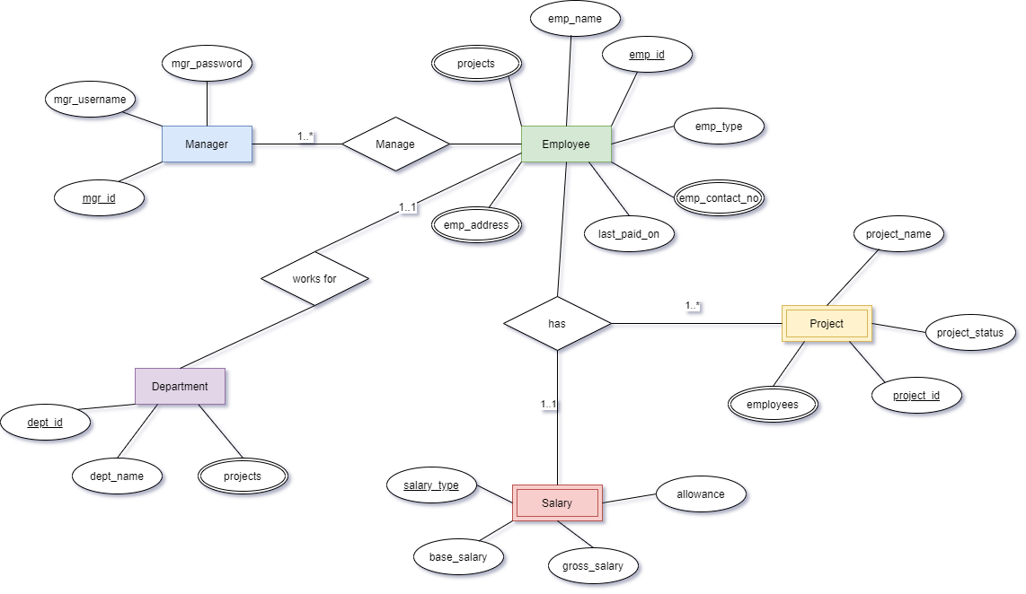
ER-Diagram

