Slide 1
Lecture 11 Introduction to ARM Processor Architecture
CSC208A-Computer Organization and Architecture
B. Tech. 2016
Course Leader:
Chaitra S.
Naveeta

Slide 2
Objectives
At the end of this lecture, students will be able to
Distinguish between embedded processors and application processors manufactured by ARM
Describe the major features of the ARM architecture such as instruction sets, memory, interrupt control and exception handling
Explain the cache hierarchy of ARM processors and list its features

Slide 3
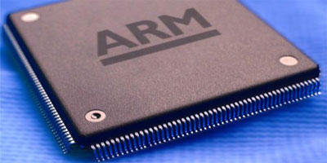
Contents
Embedded and Application Processors
Development of the ARM Architecture
Registers and Processor Modes
ARM Instruction Sets
Exception handling
Memory
Cache
Interrupt Controller

Slide 4
History
ARM(Advanced RISC Machines) processors, was 1st developed at Acron Computer Ltd of Cambridge, England between 1983 and 85.
The concept of RISC was introduced in 1980 at Stanford and Berkley.
ARM limited was formed in 1990
ARM Core
the processor core which they have licensed to a number of other manufactures to made variety of chips around that same processor core.
Licensed to partners to develop and fabricate new micro-controllers
Soft-core

Slide 5
Arm Architecture
Based upon RISC Architecture with enhancements to meet requirements of embedded applications
A large uniform register file
Load-store architecture, where data processing operations operate on register contents only
Uniform and fixed length instructions
32 bit processor
Instructions are 32 bit long
Good Speed / Power Consumption Ratio
High Code Density

Slide 6
Enhancement to Basic RISC Features
Control over ALU and shifter for every data processing operations to maximize their usage.
Auto increment and auto decrement addressing modes to optimize program loops. This is not very common with RISC processors.
Load and store multiple instructions to maximize data throughput.
Conditional execution of instruction to maximize execution throughput.

Slide 7
Arm Architecture Versions
Version 1(1983-85)
26 bit addressing, no multiply or co-processor
Version 2(1st commercial chip)
Include 32 bit result multiply instruction or co-processor
Version 3
32 bit addressing, virtual memory support
Version 4
Add signed, unsigned half-word and signed byte load and store instructions
Version 4T
16 bit Thumb compressed form of instruction introduced

Slide 8
Architecture Versions
Version 5T
Superset of 4T adding new instruction
Version 5TE
Add signal processing extension
Examples:
ARM 6 : V3
ARM 7 : V3, ARM 7TDMI : V4T
Strong ARM : V4
ARM 9E-S : V5TE

Slide 9
Cont..
TDMI
T: Thumb, 16-bit instruction set
D: on-chip Debug support, enabling the processor to halt in response to a debug request
M: enhanced Multiplier, yield a full 64-bit result, high performance
I: EmbeddedICE hardware
Von Neumann architecture
3-stage pipeline

Slide 10
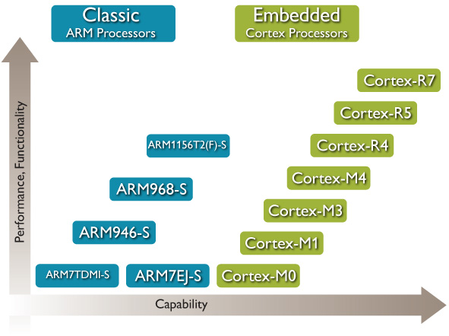
Embedded Processors

Slide 11
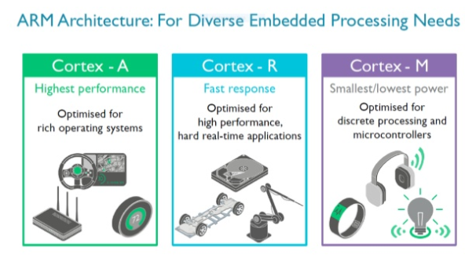
Cont..

Slide 12
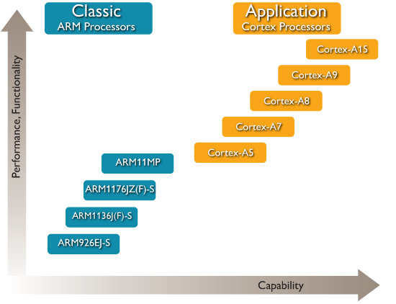
Application Processors

Slide 13
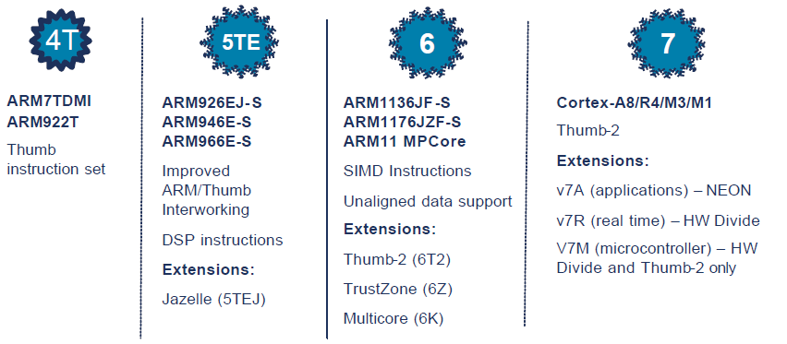
Development of the ARM Architecture
Processor Architecture = Instruction Set + Programmer’s model
Note: Implementations of the same architecture can be very different
ARM7TDMI - architecture v4T. Von Neuman core with 3 stage pipeline
ARM920T - architecture v4T. Harvard core with 5 stage pipeline and MMU

Slide 14
ARM Architecture Profiles
Application profile (ARMv7-A → e.g. Cortex-A8)
Memory management support (MMU)
Highest performance at low power
Influenced by multi-tasking OS system requirements
TrustZone and Jazelle-RCT for a safe, extensible system
Real-time profile (ARMv7-R → e.g. Cortex-R4)
Protected memory (MPU)
Low latency and predictability ‘real-time’ needs
Evolutionary path for traditional embedded business
Microcontroller profile (ARMv7-M → e.g. Cortex-M3)
Lowest gate count entry point
Deterministic and predictable behaviour a key priority
Deeply embedded use

Slide 15
Overview : Core Data Path
Data items are placed in register file
No data processing instructions directly manipulate data in memory
Instruction typically use two source registers and single result or destination registers
A barrel shifter on the data path which can preprocess data before it enters ALU
Increment/decrement logic can update register content for sequential access independent of ALU.

Slide 16
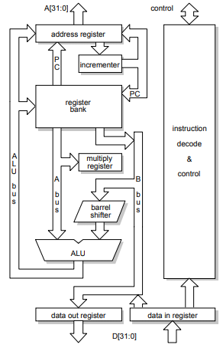
Basic ARM Organization
Register Bank
2 read ports, 1 write ports, access any register
1 additional read port, 1 additional write port for r15 (PC)
Barrel Shifter
Shift or rotate the operand by any number of bits
ALU
Address register and incrementer
Data Registers
Hold data passing to and from memory
Instruction Decoder and Control

Slide 17
Cont..
The register bank is connected to the ALU by two data parts one is A bus, another is B bus and this B bus goes via the Barrel shifter.
ALU, Barrel shifter are combinational circuit, so all operations carries out can take place in one cycle itself and that actually splits up to the operation execution speed.
PC is part of the register bank and that can generate the address. So register banks can be used for generation & manipulation of address. Incremental block decrement or increment the register values independent of the ALU. In fact the PC value can be incremented and put back to the registers.
Instruction decode & control provides a control signal and what you have shown here is this is a basic block where my

Slide 18
Cont..
Address bus is 0 to 31 means it is a 32 bit and data buses are also 32 bits, so it is a 32 bit processor. It can operate on 32 bit operands and the addresses that it generates are also 32 bit.
Since registers can handle data and address in a symmetric fashion it is very easy to handle same number of bits for address and data and use the similar kind of operations for manipulating addresses and data in the registers.
Registers
General purpose registers hold either data or address
All registers are of 32 bits
In user mode 16 data registers and 2 status registers which are visible

Slide 19
Cont..
Data Registers : r0 to r15
3 registers perform special function they are r13, r14 and r15.
r13 is a stack pointer, so this stack pointer refers to the entry point on the stack and this is critical for implementation of a stack in the memory.
r14 is a link register (where return address is put whenever a subroutine is called)
r15 is the program counter (the current instruction what is being executed will be pointed to by the content of r15)
Depending on the context, registers r13 and r14 can also be used as GPR(general purpose registers)
In addition there are 2 status registers.
CPSR current program status register and
SPSR what is called saved program status register.
Status of the current execution is being captured here. In fact this status can include status of the program as well as that of the processor.

Slide 20
Data Sizes and Instruction Sets
When processor is executing in ARM state
All instructions are 32 bit wide
All instructions are 32 bit word aligned
When used in relation to the ARM:
Half-word means 16 bits (two bytes)
Word means 32 bits (four bytes)
Double-word means 64 bits (eight bytes)
Most ARMs implement two instruction sets
32-bit ARM Instruction Set
16-bit Thumb Instruction Set
Latest ARM cores introduce a new instruction set Thumb-2
Provides a mixture of 32-bit and 16-bit instructions
Maintains code density with increased flexibility
Jazelle-DBX cores can also execute Java bytecode

Slide 21
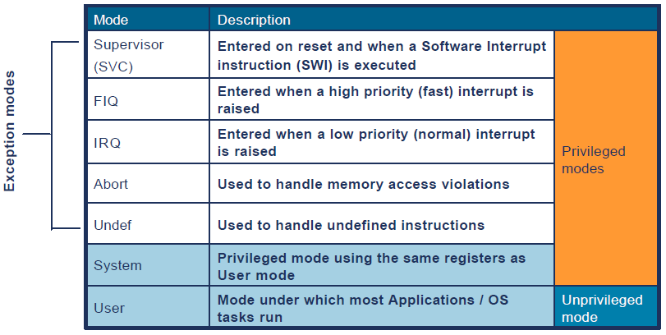
Processor Modes
The ARM has seven basic operating modes:
Each mode has access to own stack and a different subset of registers
Some operations can only be carried out in a privileged mode

Slide 22
ARM Register Set
User mode
IRQ
FIQ
Undef
Abort
SVC
r0
ARM has 37 registers, all 32-bits long A subset of these registers is accessible in each mode
Note: System mode uses the User mode register set.
r1
r2
r3
r4
r5
r6
r7
r8
r8
r9
r9
r10
r10
r11
r11
r12
r12
r13 (sp)
r13 (sp)
r13 (sp)
r13 (sp)
r13 (sp)
r13 (sp)
r14 (lr)
r14 (lr)
r14 (lr)
r14 (lr)
r14 (lr)
r14 (lr)
r15 (pc)
cpsr
spsr
spsr
spsr
spsr
spsr
Current mode
Banked out registers

Slide 23

Program Status Registers
T bit
T = 0: Processor in ARM state
T = 1: Processor in Thumb state
J bit
J = 1: Processor in Jazelle state
Mode bits
Specify the processor mode
Interrupt Disable bits
I = 1: Disables IRQ
F = 1: Disables FIQ
E bit
E = 0: Data load/store is little-endian
E = 1: Data load/store is big-endian
A bit
A = 1: Disable imprecise data aborts
Condition code flags
N = Negative result from ALU
Z = Zero result from ALU
C = ALU operation Carried out
V = ALU operation oVerflowed
Sticky Overflow flag - Q flag
Indicates if saturation has occurred
SIMD Condition code bits – GE[3:0]
Used by some SIMD instructions
IF THEN status bits – IT[abcde]
Controls conditional execution of Thumb instructions

Slide 24
ARM Instruction Set
The ARM Architecture is a Load/Store architecture
No direct manipulation of memory contents
Memory must be loaded into the CPU to be modified, then written back out
Cores are either in ARM state or Thumb state
This determines which instruction set is being executed
An instruction must be executed to switch between states
The architecture allows programmers and compilation tools to reduce branching through the use of conditional execution
Method differs between ARM and Thumb, but the principle is that most (ARM) or all (Thumb) instructions can be executed conditionally

Slide 25
Data Processing Instructions
These instructions operate on the contents of registers
They DO NOT affect memory
Syntax:
<Operation>{<cond>}{S} {Rd,} Rn, Operand2
Examples:
ADD r0, r1, r2 ; r0 = r1 + r2
TEQ r0, r1 ; if r0 = r1, Z flag will be set
MOV r0, r1 ; copy r1 to r0
 | arithmetic |  |  |  | logical |  | move
manipulation (has destination register) | ADD | ADC | SUB | SBC RSB RSC | AND | EOR | MOV
comparison (set flags only) | CMN (ADDS) |  | CMP (SUBS) |  | TST (ANDS) | TEQ (EORS)

Slide 26
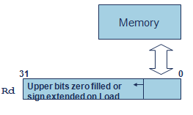
Single Access Data Transfer
Use to move data between one or two registers and memory
LDRD STRD Double-word
LDR STR Word
LDRB STRB Byte
LDRH STRH Half-word
LDRSB Signed byte load
LDRSH Signed half-word load
Syntax:
LDR{<size>}{<cond>} Rd, <address>
STR{<size>}{<cond>} Rd, <address>
Example:
LDRB r0, [r1] ; load bottom byte of r0 from the ; byte of memory at address in r1

Slide 27
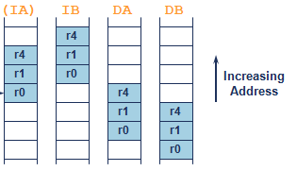
Multiple Register Data Transfer
These instructions move data between multiple registers and memory
Syntax
<LDM|STM>{<addressing_mode>}{<cond>} Rb{!}, <register list>
4 addressing modes
Increment after/before
Decrement after/before
Also
PUSH/POP, equivalent to STMDB/LDMIA with SP! as base register
Example
LDM r10, {r0,r1,r4} ; load registers, using r10 base
PUSH {r4-r6,pc} ; store registers, using SP base

Slide 28
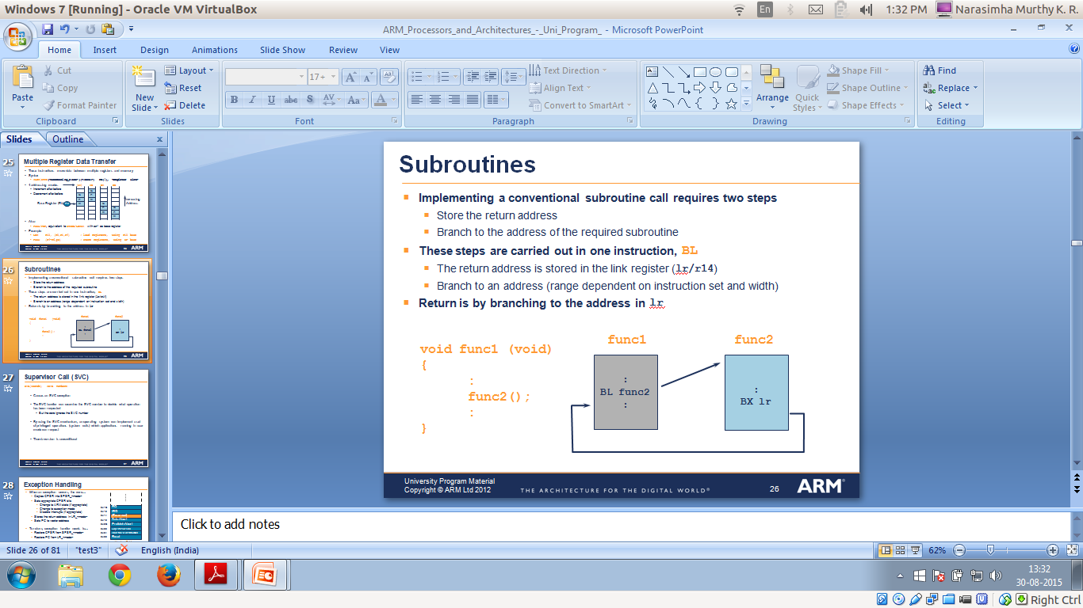
Subroutines
Implementing a conventional subroutine call requires two steps
Store the return address
Branch to the address of the required subroutine
These steps are carried out in one instruction, BL
The return address is stored in the link register (lr/r14)
Branch to an address (range dependent on instruction set and width)
Return is by branching to the address in lr

Slide 29
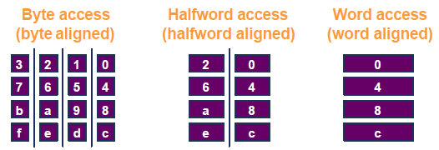
Data Alignment
Prior to architecture v6 data accesses must be appropriately aligned for access size
Unaligned addresses will produce unexpected/undefined results
Unaligned data can be accessed using multiple aligned accesses combined with shift/mask operations

Slide 30
Exception Handling
1. Save processor status
Copies CPSR into SPSR_<mode>
Stores the return address in LR_<mode>
Adjusts LR based on exception type
2. Change processor status for exception
Mode field bits
ARM or Thumb state
Interrupt disable bits (if appropriate)
Sets PC to vector address
3. Execute exception handler
<users code>
4. Return to main application
Restore CPSR from SPSR_<mode>
Restore PC from LR_<mode>
1 and 2 performed automatically by the core
3 and 4 responsibility of software

Slide 31
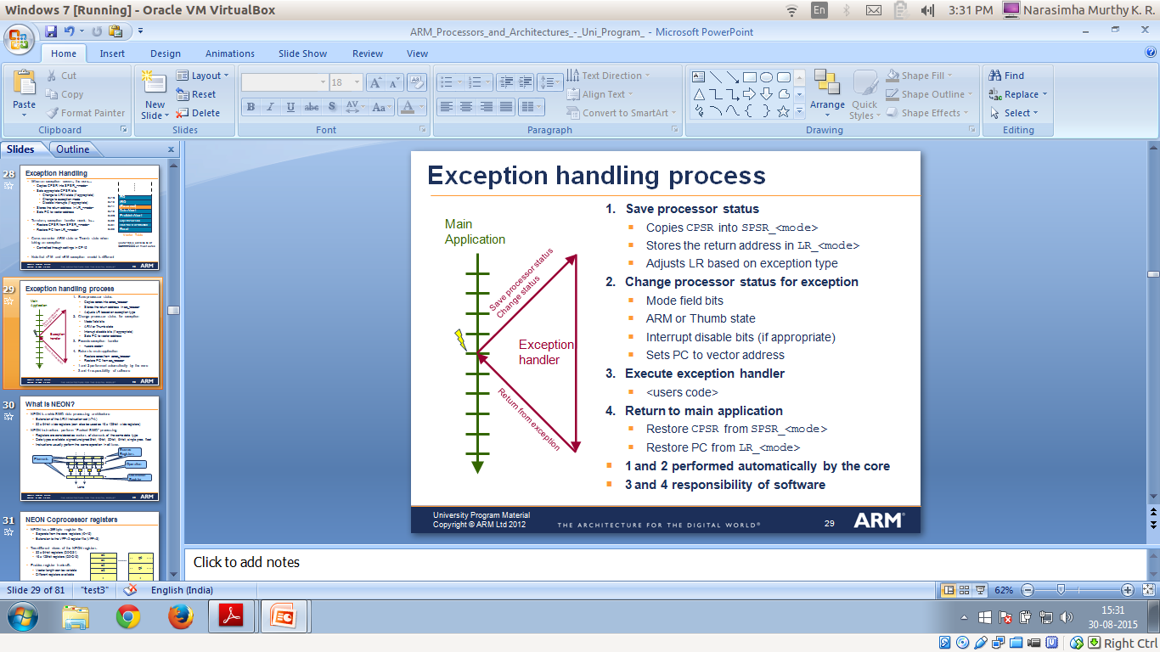
Exception Handling

Slide 32
Memory Types
Each defined memory region will specify a memory type
The memory type controls the following:
Memory access ordering rules
Caching and buffering behaviour
There are 3 mutually exclusive memory types:
Normal
Device
Strongly Ordered
Normal and Device memory allow additional attributes for specifying
The cache policy
Whether the region is Shared
Normal memory allows you to separately configure Inner and Outer cache policies

Slide 33
L1 and L2 Caches
Typical memory system can have multiple levels of cache
Level 1 memory system typically consists of L1-caches, MMU/MPU and TCMs
Level 2 memory system depends on the system design
Memory attributes determine cache behavior at different levels
Controlled by the MMU/MPU
Inner Cacheable attributes define memory access behavior in the L1 memory system
Outer Cacheable attributes define memory access behavior in the L2 memory system and beyond
Before caches can be used, software setup must be performed

Slide 34
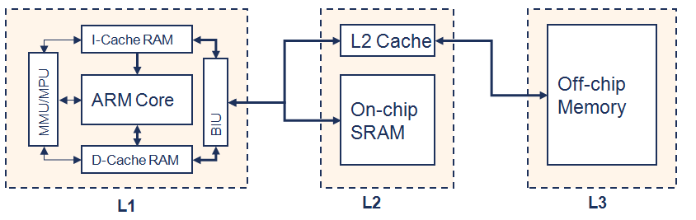
L1 and L2 Caches

Slide 35
ARM Cache Features
Harvard Implementation for L1 caches
Separate Instruction and Data caches
Cache Lockdown
Prevents line Eviction from a specified Cache Way
Pseudo-random and Round-robin replacement strategies
Unused lines can be allocated before considering replacement

Slide 36
ARM Cache Features
Non-blocking data cache
Cache Lookup can hit before a Linefill is complete (also checks Linefill buffer)
Streaming, Critical-Word-First
Cache data is forwarded to the core as soon as the requested word is received in the Linefill buffer
Any word in the cache line can be requested first using a ‘WRAP’ burst on the bus
ECC or parity checking

Slide 37
32KB ARM Cache
Cache has 8 words of data in each line
Each cache line contains Dirty bit(s)
Indicates whether a particular cache line was modified by the ARM core
Each cache line can be Valid or invalid
An invalid line is not considered when performing a Cache Lookup

Slide 38
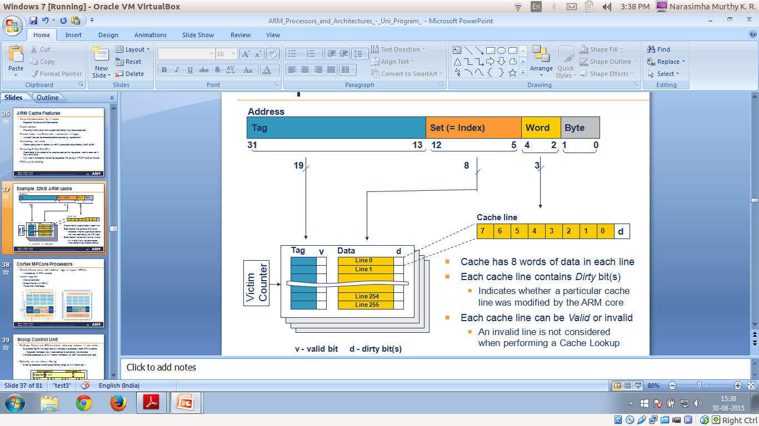
32KB ARM Cache

Slide 39
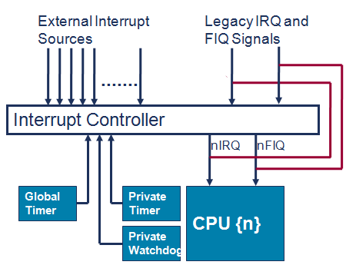
Interrupt Controller
MPCore processors include an integrated Interrupt Controller (IC)
Implementation of the Generic Interrupt Controller (GIC) architecture
The IC provides:
Configurable number of external interrupts (max 224)
Interrupt prioritization and pre-emption
Interrupt routing to different cores
Enabled per CPU
When not enabled, that CPU will use legacy nIRQ[n] and nFIQ[n] signals

Slide 40
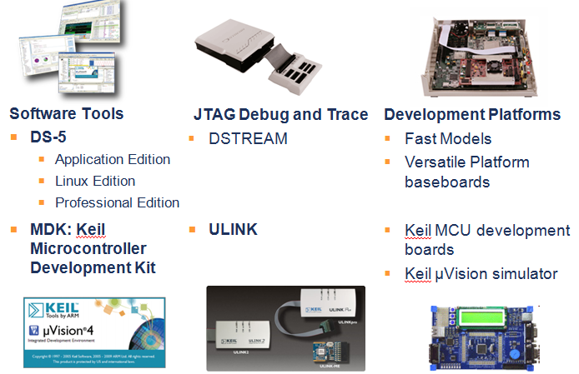
ARM Software Development Tools

Slide 41
Summary
Processor Architecture = Instruction Set + Programmer’s model
Most ARMs implement two instruction sets
The ARM has seven basic operating modes
The ARM instruction set architecture allows programmers and compilation tools to reduce branching through the use of conditional execution
Prior to architecture v6 data accesses must be appropriately aligned for access size
MPCore processors include an integrated Interrupt Controller (IC)
https://www.youtube.com/watch?v=GLSPub4ydiM

