Slide 1
UDS Diagnostics and Automated Test Generation Assistant
Cited diagnostic answers, validated requests and test cases for ECU testing, running fully on a local machine
Case Study 5 | Automotive Engineering AI
Notes:
Case Study 5 from the Automotive Engineering AI case study document: a local assistant that helps test engineers interpret diagnostic specifications, construct valid requests, generate test cases and validate expected ECU responses.

Slide 2
Problem statement
Hand-writing UDS diagnostic tests is slow, inconsistent and thin on negative cases.
1
Interpret
ISO 14229 together with OEM-specific and ECU-specific behaviour.
2
Construct
Request bytes by hand, and work out the session and security prerequisites.
3
Predict
Positive and negative responses, then translate the intent into automation scripts.
Source: Case Study 5, section 1. More services, subfunctions, identifiers and variants mean more inconsistency and error risk.
Notes:
The business problem as the case study states it: engineers interpret ISO 14229 with OEM and ECU specifics, build request bytes by hand, work out session and security prerequisites, predict positive and negative responses and then script them.

Slide 3




Objective
Less interpretation effort
Consistent test scenarios
Spend less time reading the diagnostic specification by hand.
Positive and negative cases generated the same way every time.
Validated structures
Requirements to tests, faster
Check requests and expected responses against the rules, not by eye.
Turn a plain-English requirement into an executable test template.
Source: Case Study 5, section 2 (Project Objective).
Notes:
The four objectives of Case Study 5, in our wording. Each maps to a part of the system: Ask and the request checker (interpretation and validation), the template-based generator (consistency and speed).

Slide 4
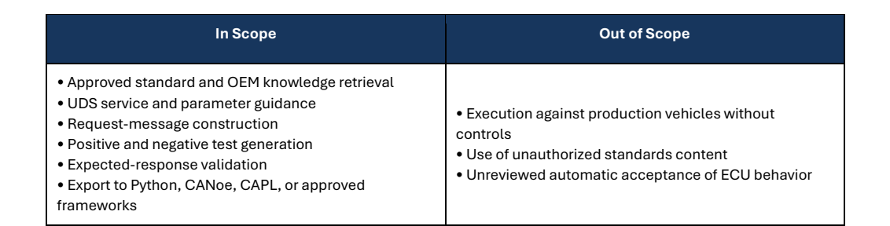
Scope
Our boundary follows it: a synthetic ECU simulator only, human review before any run, no production vehicle.
Source: Case Study 5, section 3 (Scope).
Notes:
The scope table is copied from the case study. We stay inside it: nothing runs on a production vehicle, all knowledge is own-words or synthetic, and ECU behaviour is never accepted automatically without review.

Slide 5




Methodology
Language model
Rules engine
Engineer
Words only.
Parses the requirement.
Picks approved templates.
Writes the explanation.
Every byte.
Builds each request and response.
One cited order of negative responses.
Checked against an independent simulator.
Final say.
Review gate before any run.
Approved tests only by default.
Every decision in an audit trail.
Runs locally: Ollama (qwen2.5 3B) on the GPU, ChromaDB with BGE embeddings, FastAPI. Answers and tests carry citations.
Notes:
The design principle: the language model handles language only, code handles correctness. That is why a small local 3B model is enough. The next slide shows the pipeline step by step.

Slide 6
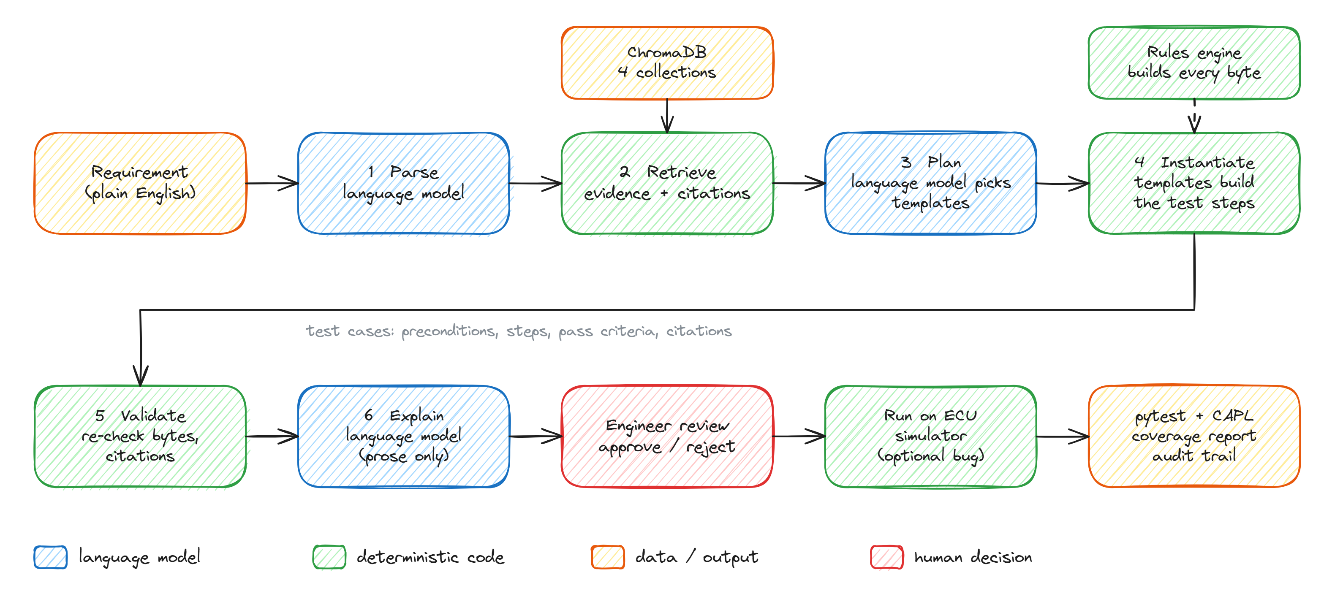
Pipeline
Notes:
Walk through left to right: requirement, parse (language model), retrieve evidence from four local collections, plan (language model picks templates), instantiate (templates and the rules engine build every byte), validate, explain (prose only), engineer review, run on the simulator with an optional injected bug, then export pytest and CAPL, a coverage report and an audit trail.

Slide 7






Limitations
Synthetic data
No document ingestion
One author, one contract
A fictional body control module and OEM guideline. No real ECU, CANoe or vehicle.
The spec is hand-structured YAML. PDF, ODX and CDD files are not read.
Rules engine, simulator and gold tests share a source, so agreement is not independent proof.
Small blind samples
Small model variance
Not yet measured
15 bugs, 25 questions, 16 requirements. One case moves a score by several points.
Which tests get planned varies between runs. Requirement parsing F1 is 62%.
Manual test-design time baseline. CAPL export never run in CANoe.
Notes:
Be upfront: the numbers that follow are measured on synthetic data in one run with a small local model. Validity and clean-pass are high by construction because the rules engine builds the bytes; the independent evidence is the blind sets.

Slide 8
Results: tests generated
79
100%
100%
384/384
tests generated from 15 requirements
valid requests (237/237)
pass on the clean simulator (79/79)
citations resolve to a real source
Test types: positive 26 | negative 31 | session 5 | security 8 | timing 9
Spec items covered: 36 of 46 by the generated tests, 46 of 46 by the 1200-test conformance sweep.
Reuse: 79 of 79 tests built from 27 approved templates; the language model never writes a byte.
Synthetic Body Control Module spec; one run on a local 3B model (git 8427c50). Validity and clean-pass are high by construction, because the rules engine builds the bytes.
Notes:
These come from the evaluation report of one run. The independent evidence is on the next slide: bugs injected into a simulator and caught or missed by the tests, and blind questions and requirements written without seeing the templates.

Slide 9
Results: defects, questions and understanding
Blind bugs caught (of 15)
19/21
questions answered correctly (90%), with correct citations
3/4
unanswerable questions correctly refused
62%
F1 identifying the services, DIDs and routines in 16 plain-English requirements
Blind sets written without seeing the templates: 15 bugs, 25 questions, 16 requirements. Tool time is about 20 s per requirement; the manual baseline is not yet measured.
Notes:
The sweep is a requirement-independent conformance suite of 1200 tests; together with the generated tests it catches 9 of 15 blind bugs, so six remain missed. Question answering: 19 of 21 correct with citations, 3 of 4 unanswerable questions refused. Requirement understanding is the weakest result.

