Slide 1
Known Issue Encyclopedia
Team Name: SFS HACKERS
Team Members: Rahul Rai, Satyabrata Choudhury, Rohith K

Slide 2
Why Known Issue Encyclopedia:
• Most issue discussion is one-2-one: Team is not aware of those issues
• Resolution of issues is captured in mail only: There is no database
• Provide opportunity to share

Slide 3
How KIE will help:
• Have a database of issues and resolution
• To resolve issues quickly
• Less number of invalid CR
• To improve team competency and productivity

Slide 4
Solution Design
Post an issue in the web-based tool
After an Issue is posted mail alert is sent to all Team members in the project. Email trigger can be controlled.
Three ways of searching an Issue can be done
Based on Issue Id
Based on Component
Based on Keyword
Displays all issues and its details posted by user
Any team member can provide comment to the issue posted. After Comment a Mail is triggered to Team members.
Owner of the issue must close the issue once the solution is found. On Closing the issue, a Mail will be Triggered to Team.
In future, team members can check this web-based tool for the solution if the issue was already posted by another team member.

Slide 5
Snapshots…

Slide 6
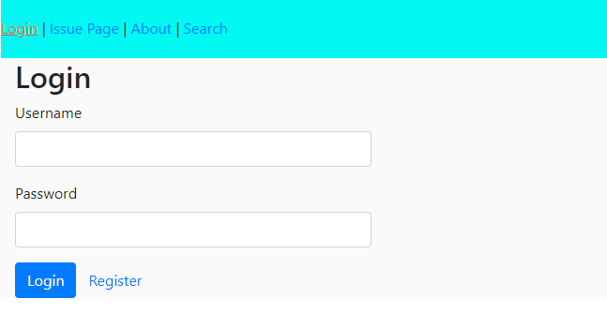
Login Page:

Slide 7
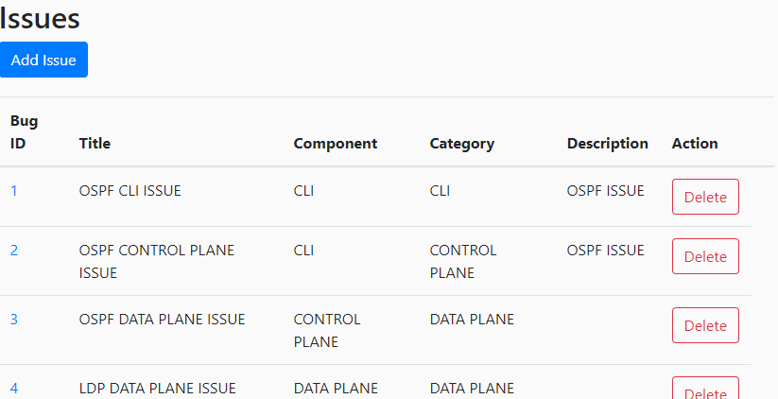
Issue Page:

Slide 8
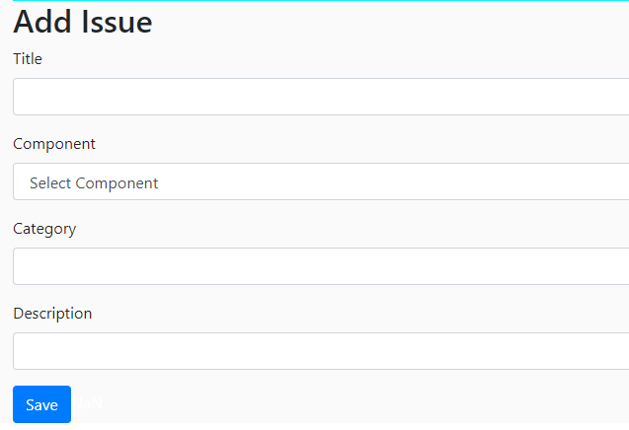
Add Issue Page:

Slide 9
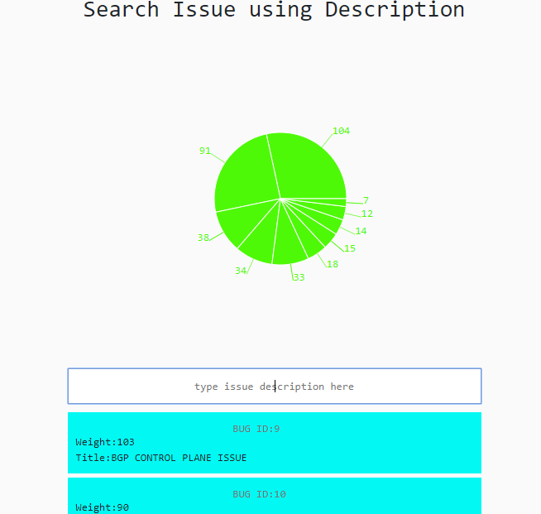
Search Page:

Slide 10
Thank you !!!

