Slide 1
01
ODOO ERP
Functional Project & Business Workflow
Company Setup • Contacts • Inventory • Sales • Employees • CRM
Project demonstrated using SC Trading
SETUP
MASTER DATA
CRM
SALES
Prepared by Satyaki Chakraborty
Odoo Functional Learning & Practical Assessment

Slide 2
Project Scope & End-to-End Process
02
The project demonstrates a connected Odoo business workflow from setup to quotation.
1
2
3
4
5
6
7
Company Setup
Contacts & Partners
Products & Inventory
Employee & Teams
CRM Lead
Opportunity
Quotation / Sales
Master Data
Inventory
Company, customers, suppliers, products and employees
Product type, stock tracking, pricing and taxes
CRM
Sales
Lead creation, qualification and conversion to opportunity
Quotation creation with quantities, prices and GST
Odoo Functional Project
Satyaki Chakraborty

Slide 3
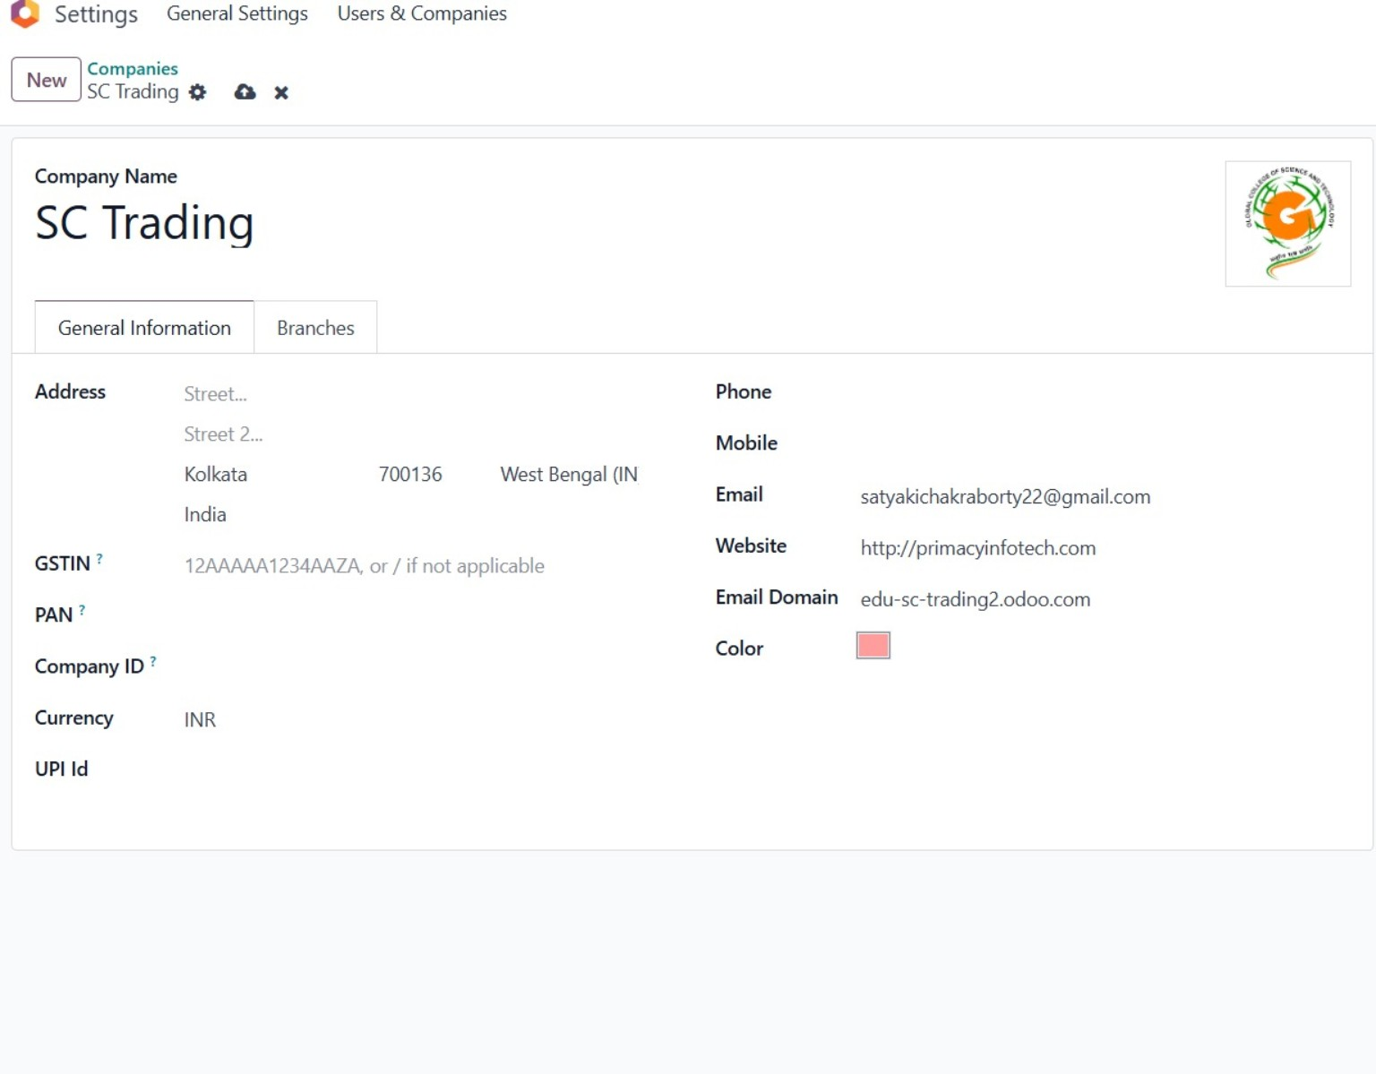
Step 1: Company Setup – SC Trading
03
Screenshot 1 of 10
Work Done
• Created the company profile for SC Trading.
• Configured business location, currency and company details.
• Added company logo and basic communication information.
• Prepared the company environment for the remaining Odoo modules.
SCREENSHOT 01 / 10
Odoo Functional Project
Satyaki Chakraborty

Slide 4
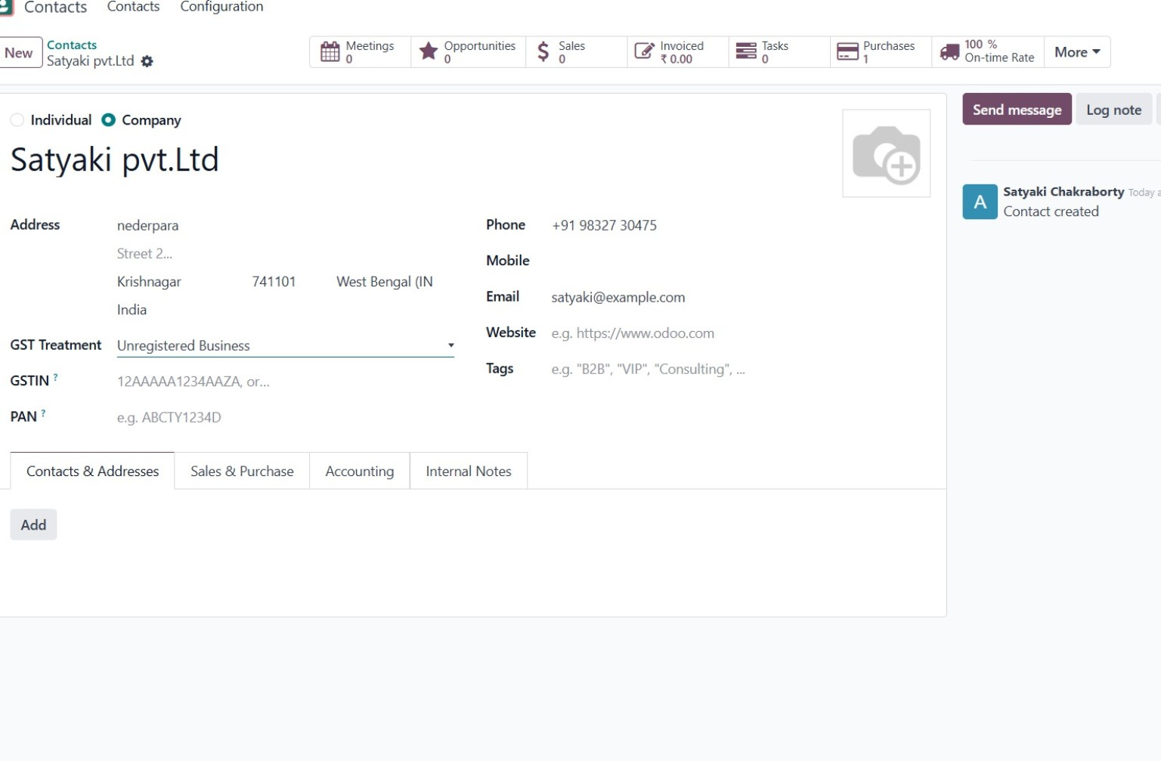
Step 2: Customer Contact – Satyaki Pvt. Ltd
04
Screenshot 2 of 10
Work Done
• Created a customer/company contact: Satyaki Pvt. Ltd.
• Added address, phone and email information.
• Set GST Treatment as an unregistered business for the demo.
• Established the customer master record for CRM and Sales.
SCREENSHOT 02 / 10
Odoo Functional Project
Satyaki Chakraborty

Slide 5
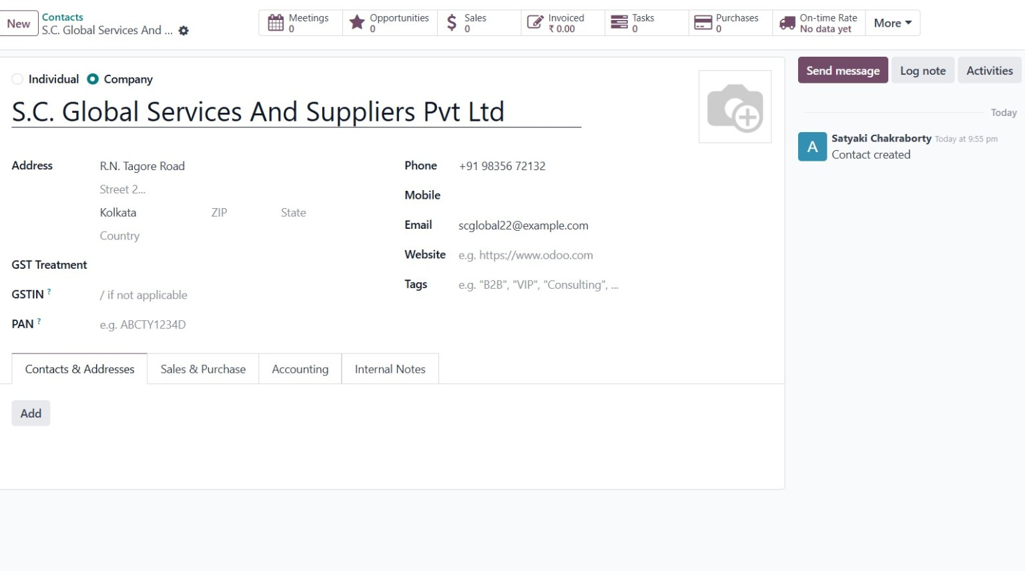
Step 3: Supplier Contact – S.C. Global Services and Suppliers Pvt. Ltd
05
Screenshot 3 of 10
Work Done
• Created a supplier/vendor contact.
• Entered supplier address, phone and email details.
• Prepared the supplier master data for purchasing activities.
• Demonstrates separation of customer and supplier records.
SCREENSHOT 03 / 10
Odoo Functional Project
Satyaki Chakraborty

Slide 6
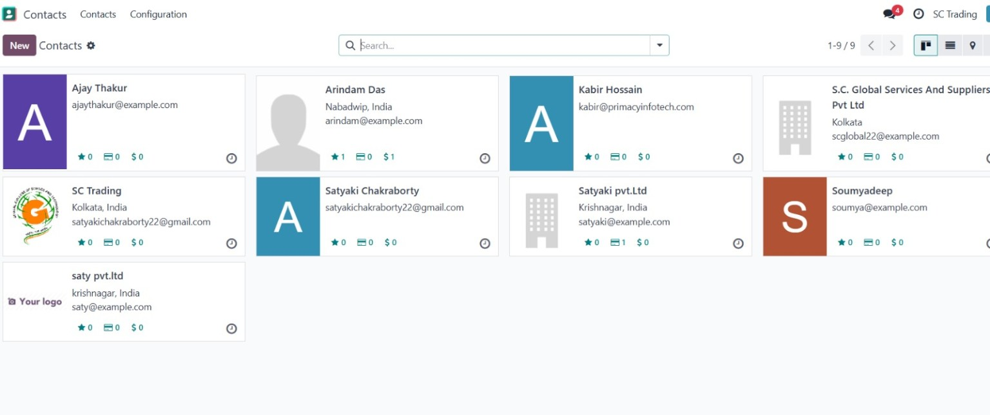
Step 4: Contacts Directory
06
Screenshot 4 of 10
Work Done
• Reviewed the complete Contacts master list.
• Maintained individual and company records in one centralized place.
• Contacts are available for Sales, CRM and Purchase workflows.
• Used Odoo's search/list interface to manage business partners.
SCREENSHOT 04 / 10
Odoo Functional Project
Satyaki Chakraborty

Slide 7
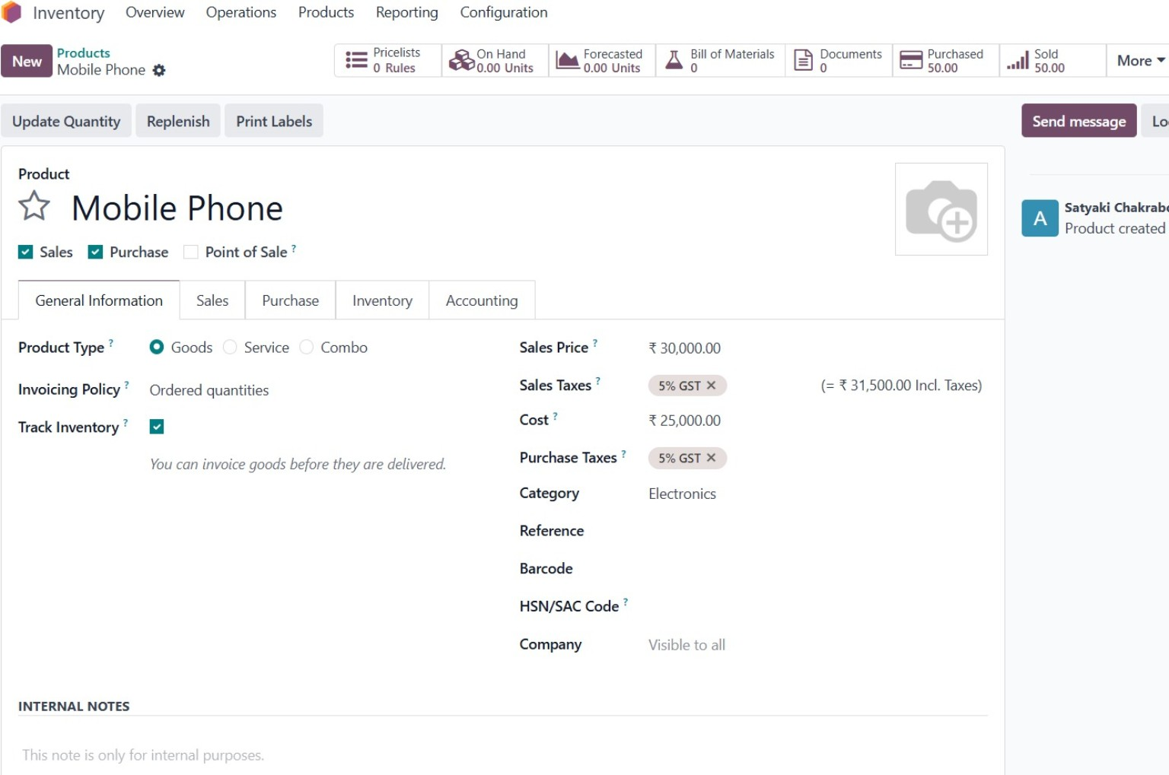
Step 5: Product Master – Mobile Phone
07
Screenshot 5 of 10
Work Done
• Created the Mobile Phone product as a storable good.
• Enabled Sales and Purchase operations and inventory tracking.
• Set sales price at ₹30,000 and cost at ₹25,000.
• Applied 5% GST for sales and purchase and assigned the Electronics category.
SCREENSHOT 05 / 10
Odoo Functional Project
Satyaki Chakraborty

Slide 8
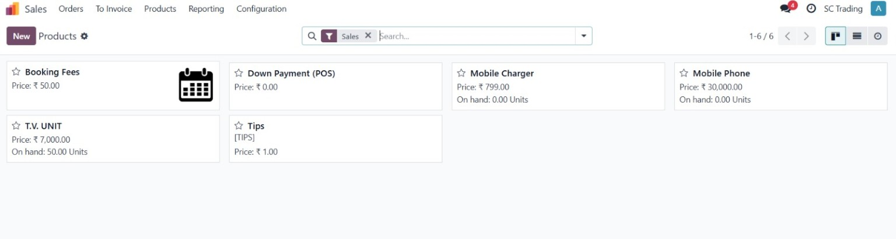
Step 6: Sales Product Catalogue
08
Screenshot 6 of 10
Work Done
• Created and reviewed the Sales product catalogue.
• Configured products such as Mobile Phone, Mobile Charger and T.V. UNIT.
• Set product prices and monitored on-hand quantities.
• Prepared the catalogue for quotation and sales transactions.
SCREENSHOT 06 / 10
Odoo Functional Project
Satyaki Chakraborty

Slide 9
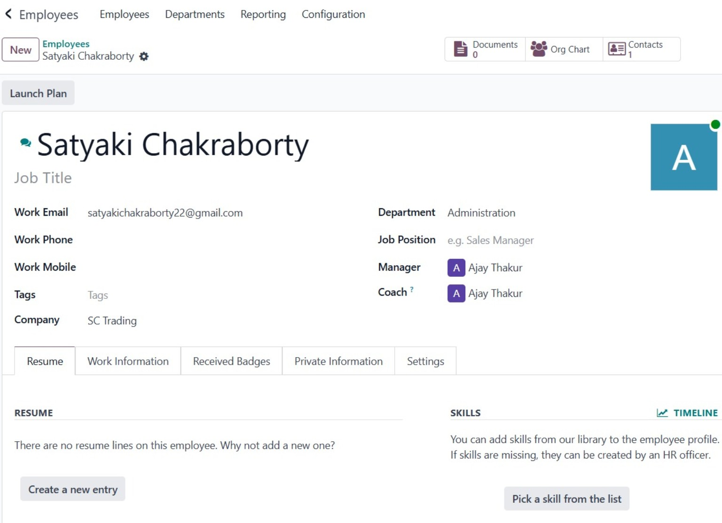
Step 7: Employee Master – Satyaki Chakraborty
09
Screenshot 7 of 10
Work Done
• Created an employee profile for Satyaki Chakraborty.
• Assigned the employee to the Administration department.
• Configured manager/coach relationships.
• Used the employee master to maintain HR information and skills.
SCREENSHOT 07 / 10
Odoo Functional Project
Satyaki Chakraborty

Slide 10
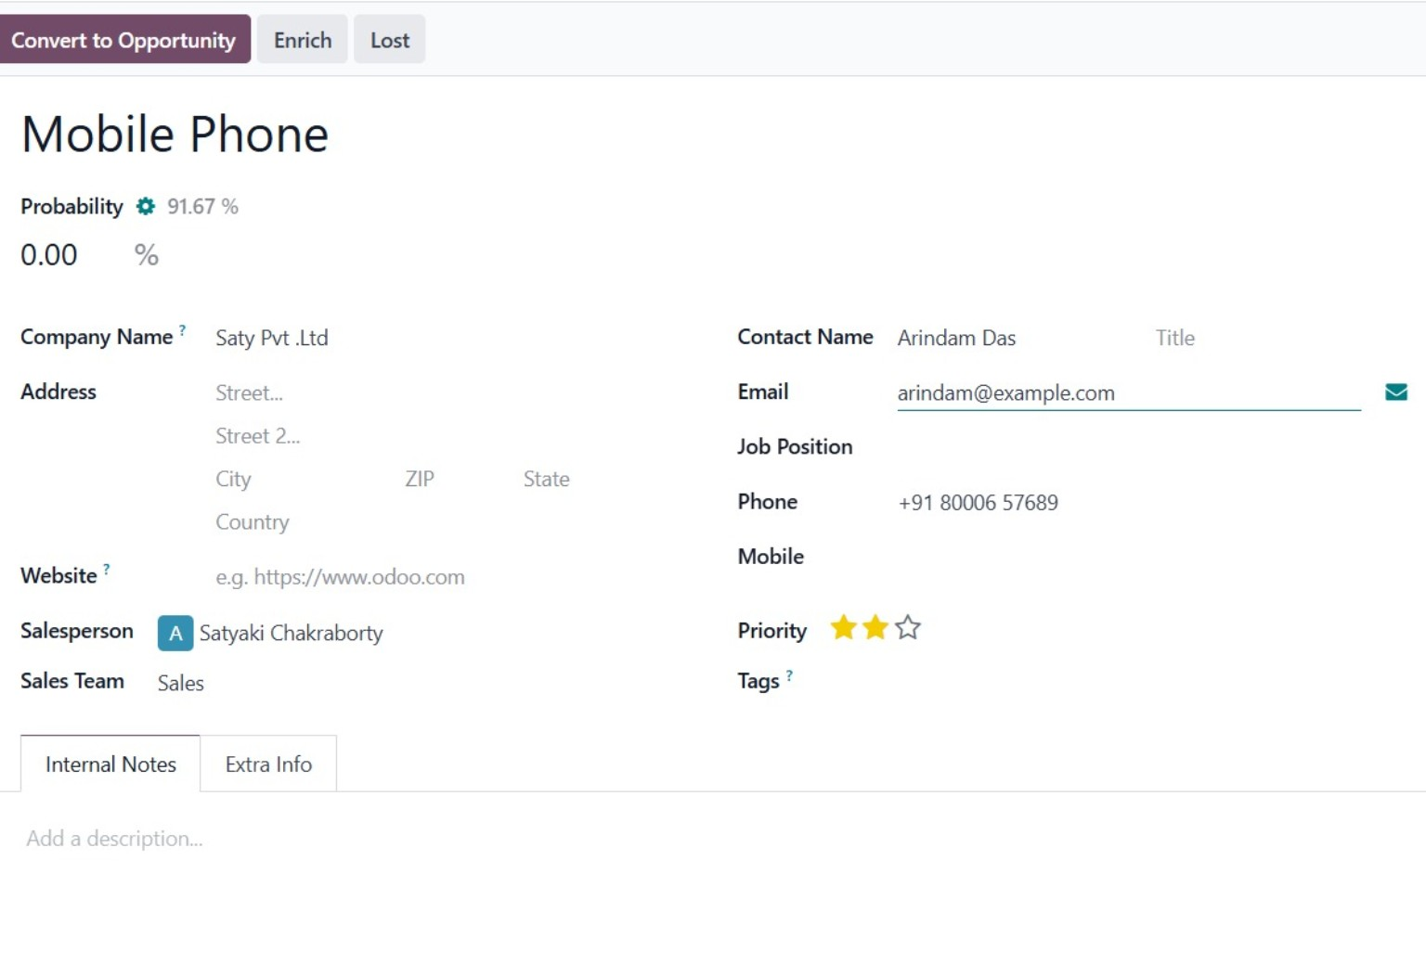
Step 8: CRM Lead – Mobile Phone
10
Screenshot 8 of 10
Work Done
• Created a CRM lead for a Mobile Phone requirement.
• Captured customer information and contact details.
• Assigned the lead to Satyaki Chakraborty and the Sales team.
• Recorded probability and priority to support lead qualification.
SCREENSHOT 08 / 10
Odoo Functional Project
Satyaki Chakraborty

Slide 11
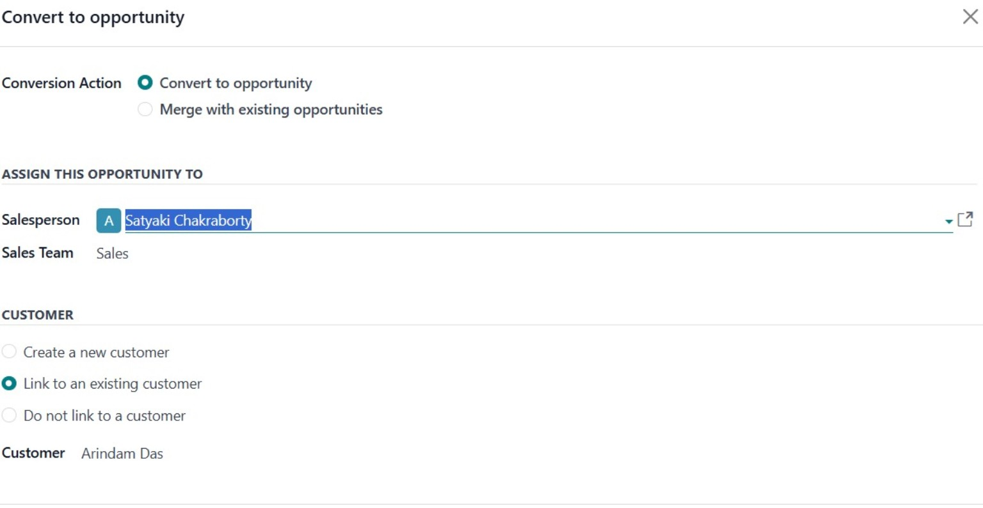
Step 9: Lead Conversion – Opportunity
11
Screenshot 9 of 10
Work Done
• Converted the qualified CRM lead into an opportunity.
• Assigned the opportunity to the Salesperson and Sales team.
• Linked the opportunity to the existing customer Arindam Das.
• This connects lead qualification with the sales pipeline.
SCREENSHOT 09 / 10
Odoo Functional Project
Satyaki Chakraborty

Slide 12
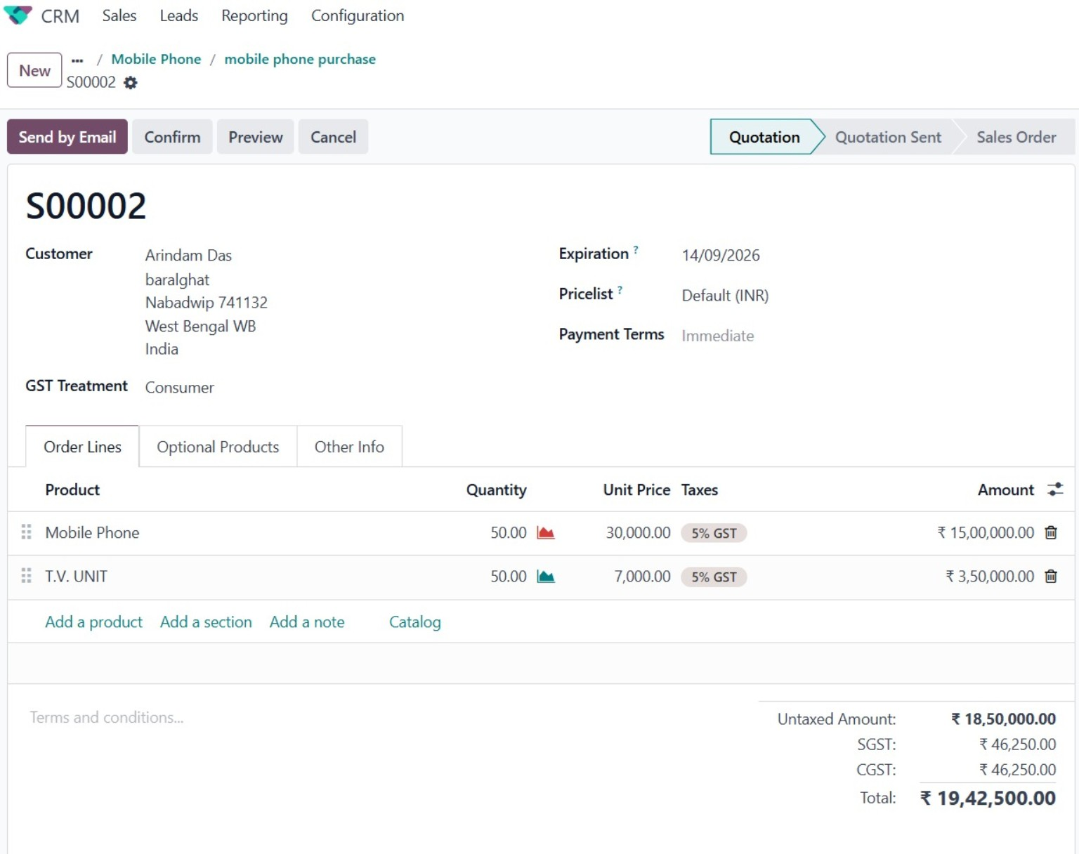
Step 10: Sales Quotation – Mobile Phone Purchase
12
Screenshot 10 of 10
Work Done
• Created quotation S00002 for customer Arindam Das.
• Added Mobile Phone and T.V. UNIT as order lines.
• Used quantity 50 for each product in the demonstrated quotation.
• Applied 5% GST and generated the quotation total automatically.
SCREENSHOT 10 / 10
Odoo Functional Project
Satyaki Chakraborty

Slide 13
Business Process Demonstrated
13
How the modules and records connect in the completed Odoo project.
Company
Partners
Products
CRM
Sales
SC Trading business setup
→
Customer + Supplier
→
Mobile Phone T.V. UNIT + others
→
Lead → Opportunity
→
Quotation S00002
Key Learning
• Master data must be created before transactional workflows.
• CRM connects customer requirements with the sales pipeline.
• Product configuration controls pricing, inventory tracking and taxes.
• Odoo automatically carries configured information into quotations.
Odoo Functional Project
Satyaki Chakraborty

Slide 14
Project Outcomes & Conclusion
14
Functional skills demonstrated through the practical Odoo project.
01
Company & Configuration
Set up the company environment and basic business information.
02
Master Data Management
Created and organized customers, suppliers, products and employee records.
03
Inventory & Product Control
Configured products, stock tracking, prices, categories and GST.
04
CRM & Sales Workflow
Created a lead, converted it to an opportunity and prepared a quotation.
05
Integrated ERP Understanding
Understood how Odoo modules share common business data.
Conclusion: The project demonstrates a complete Odoo functional workflow from setup and master data to CRM and sales quotation.
Odoo Functional Project
Satyaki Chakraborty

