Slide 1

Advancing Biometric Authentication: A Framework for Template Reconstruction Attack Detection
PRESENTED BY
K. Babinadh - AP22110010314
Y. Teja - AP22110010409
D. Satya Koushik - AP22110010454
M. Nithin Sai - AP22110010406
UNDER SUPERVISION
Dr. Dilip Kumar Vallabhadas

Slide 2
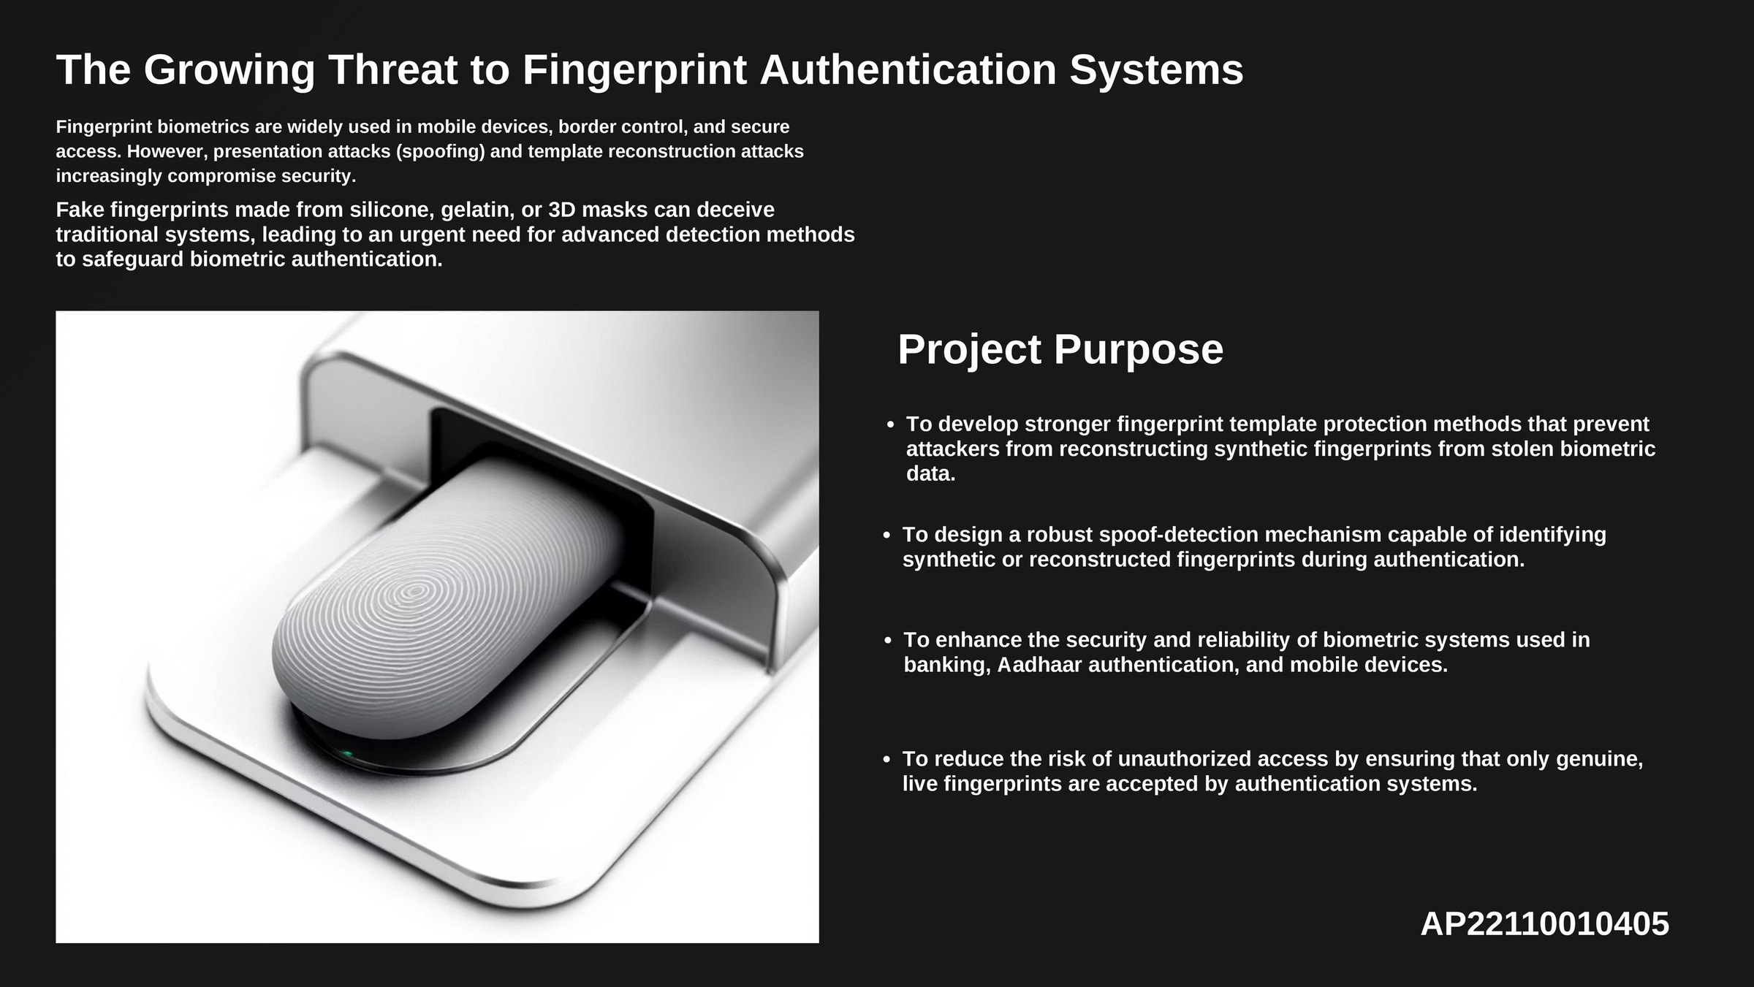

Slide 3
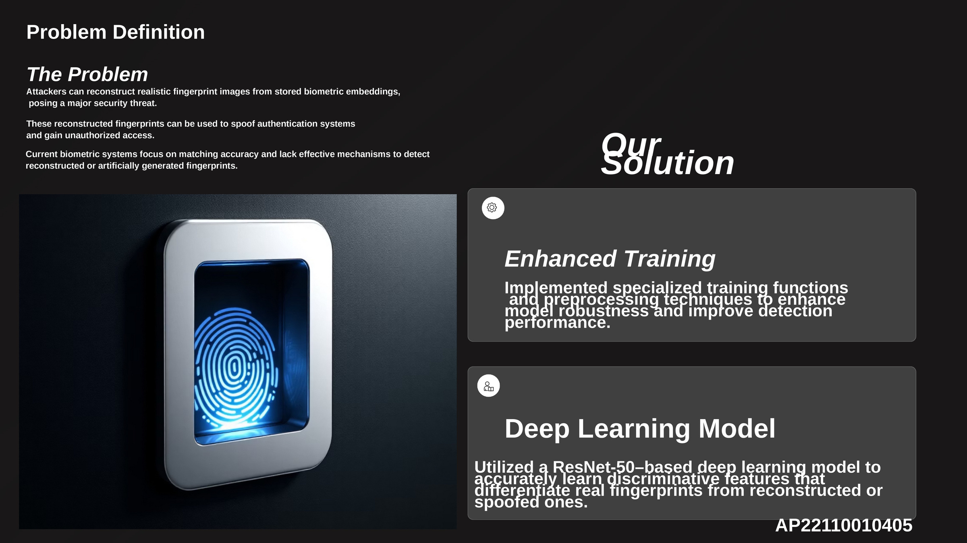
Our Solution

Slide 4
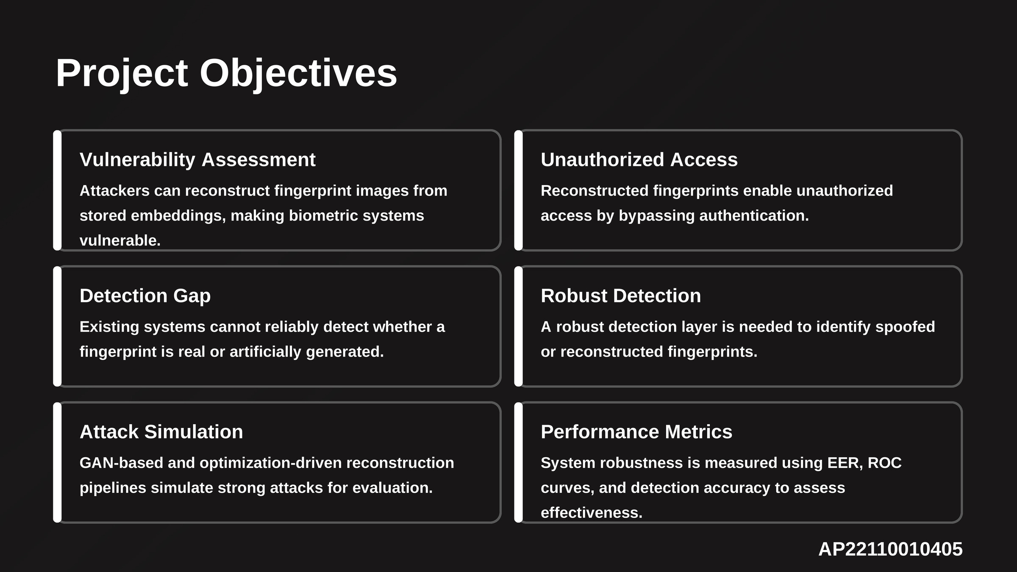

Slide 5
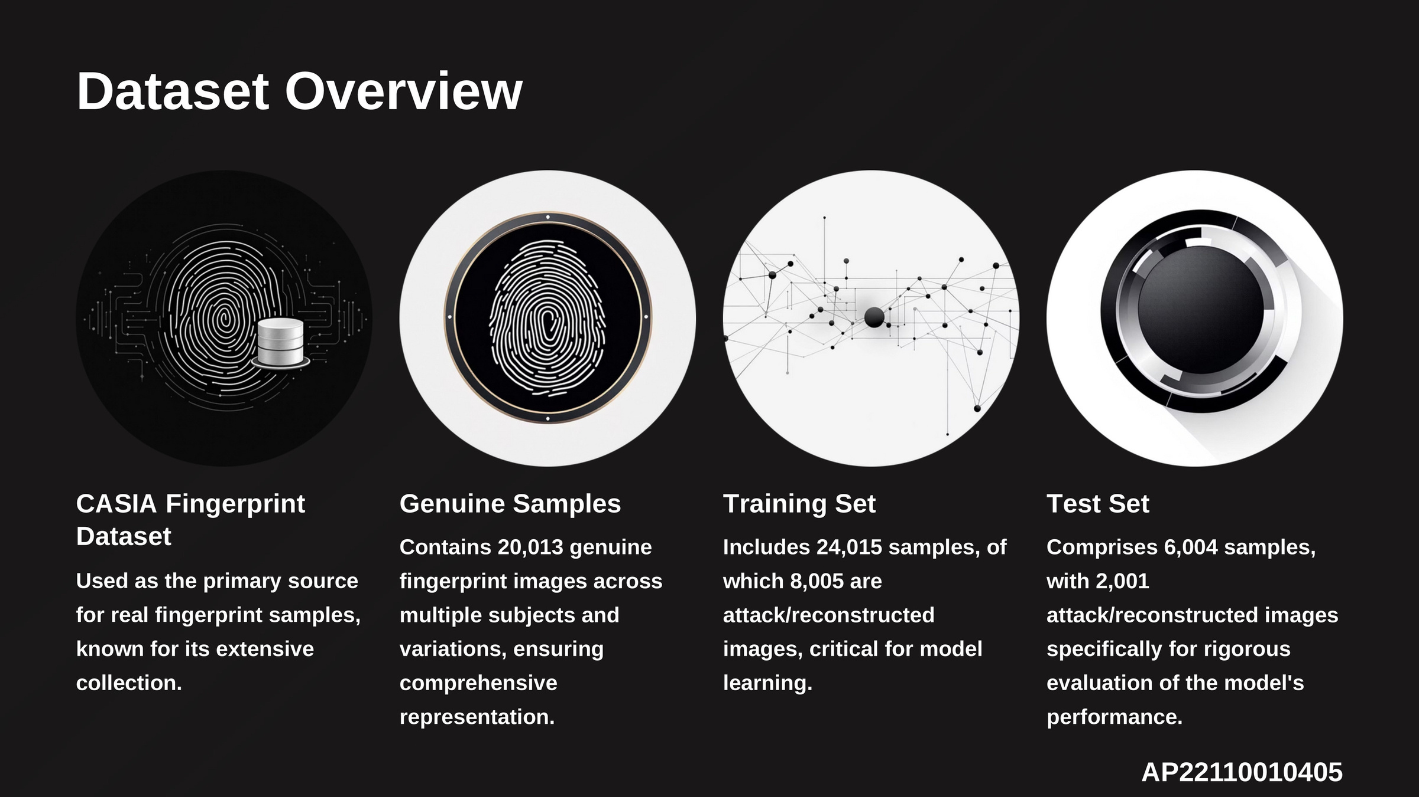

Slide 6
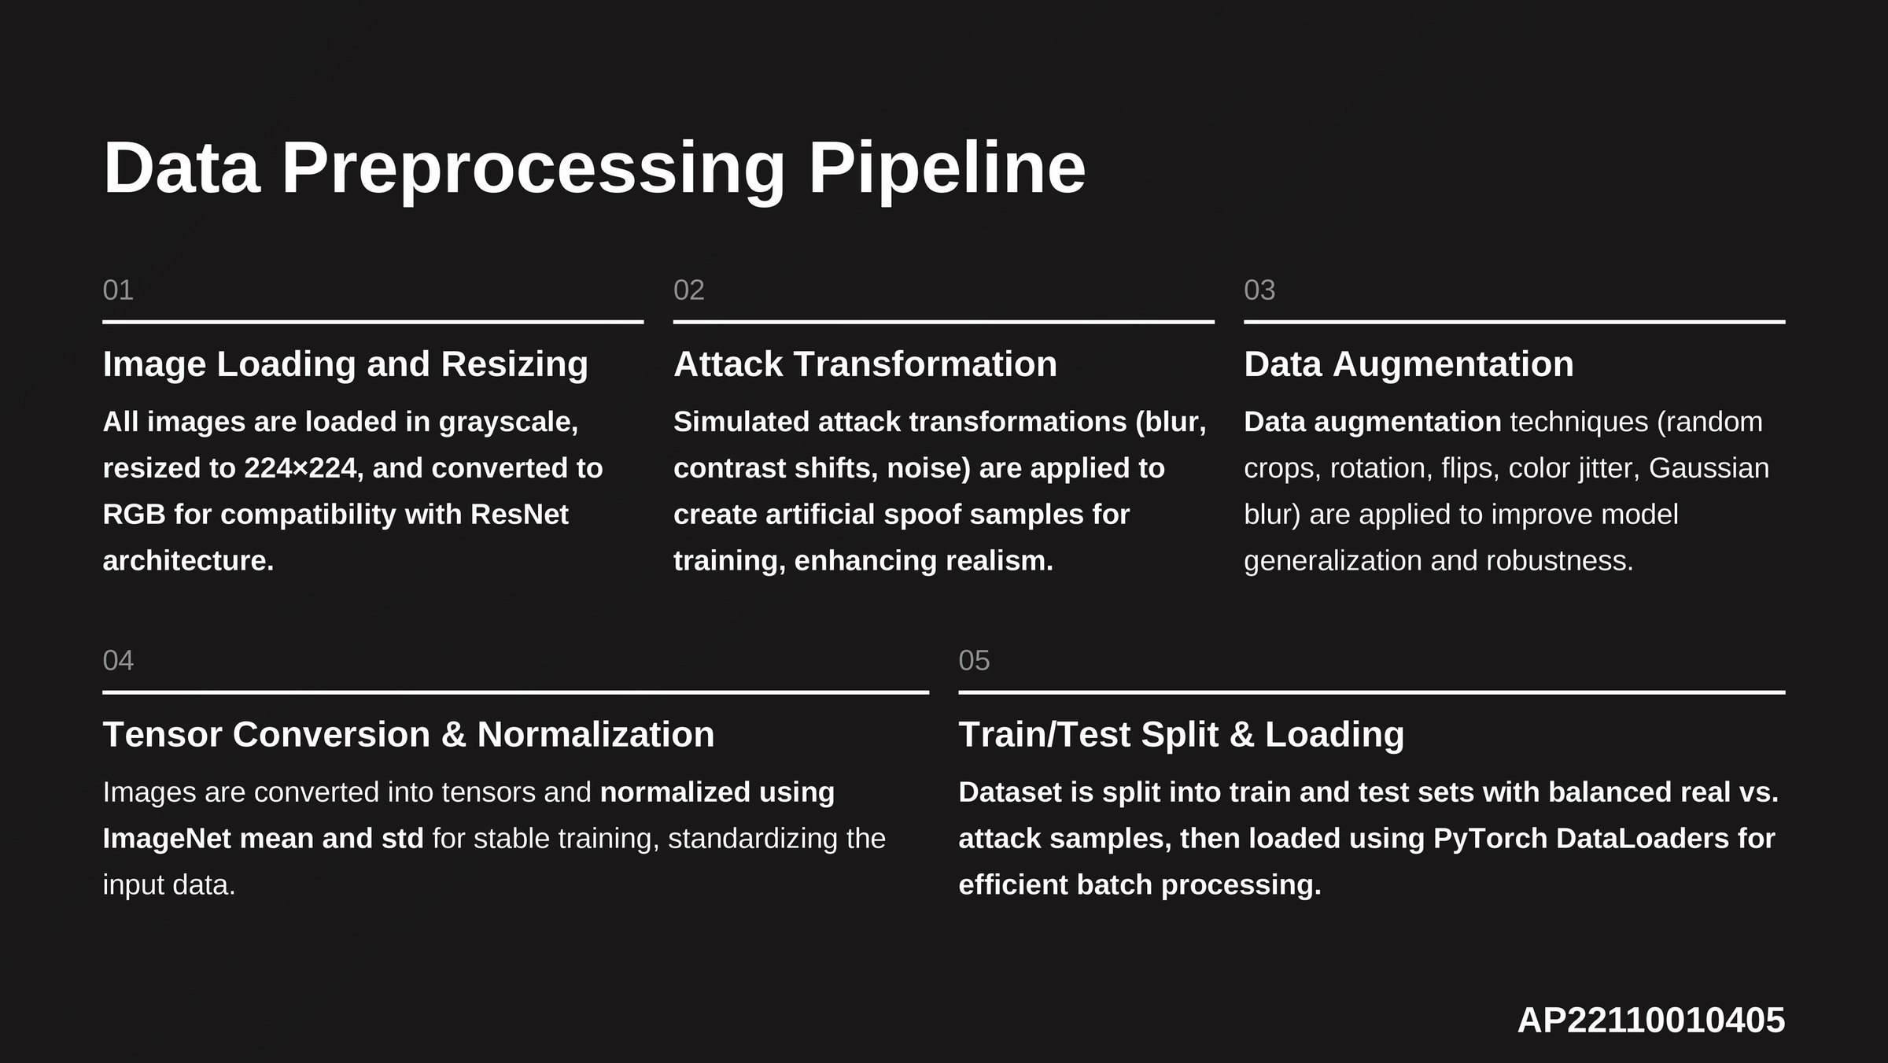

Slide 7
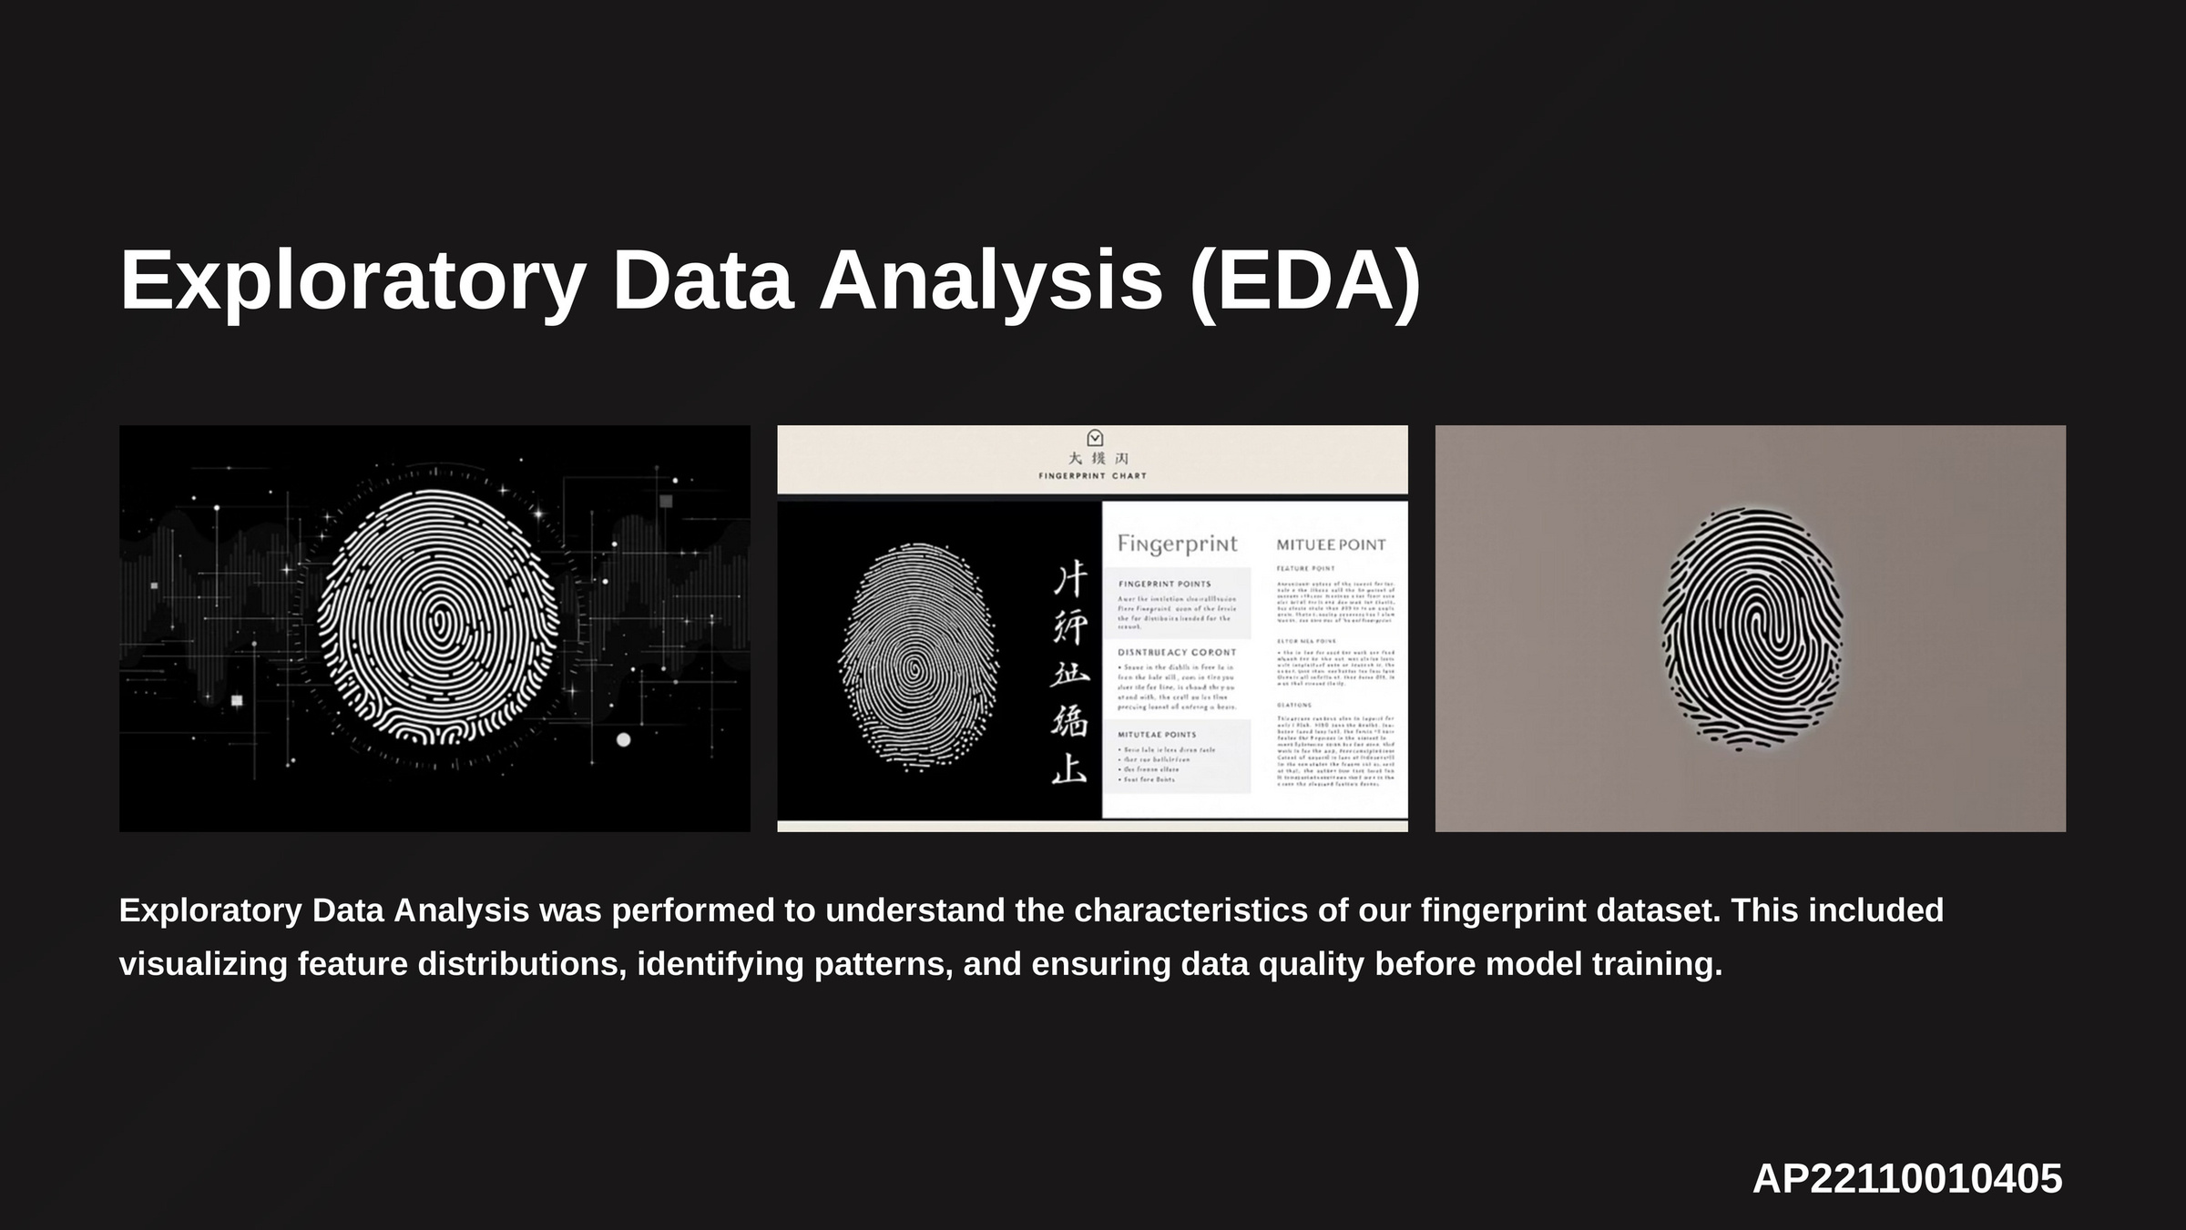

Slide 8
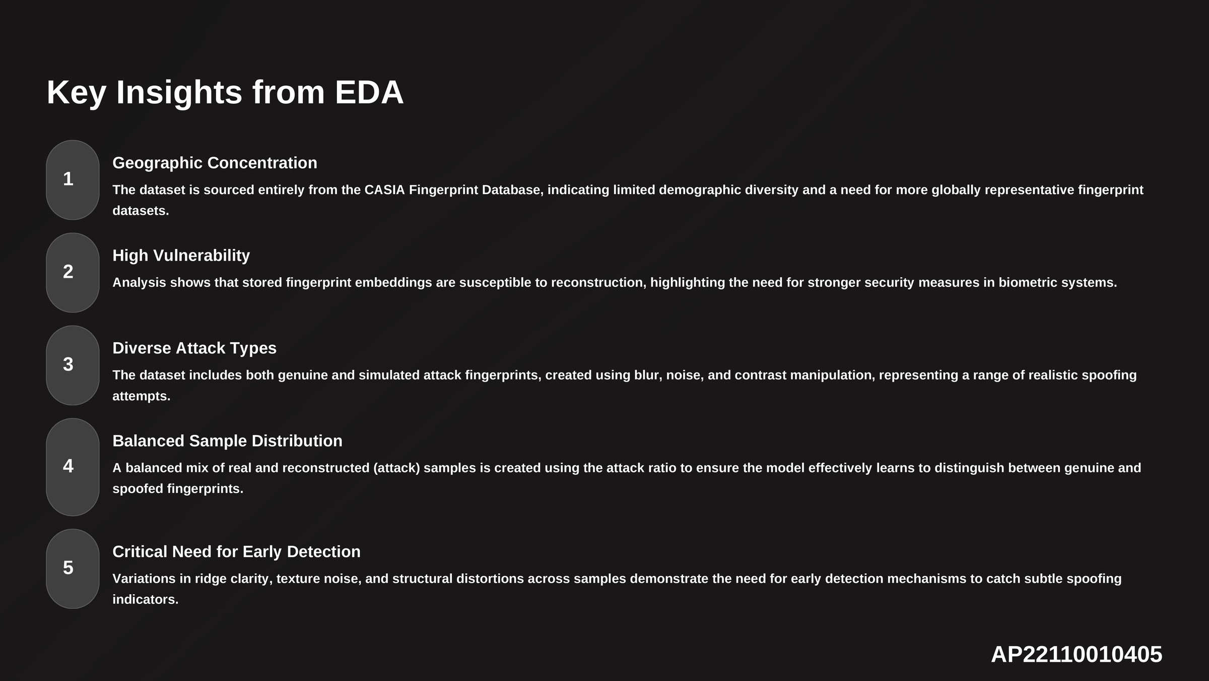

Slide 9
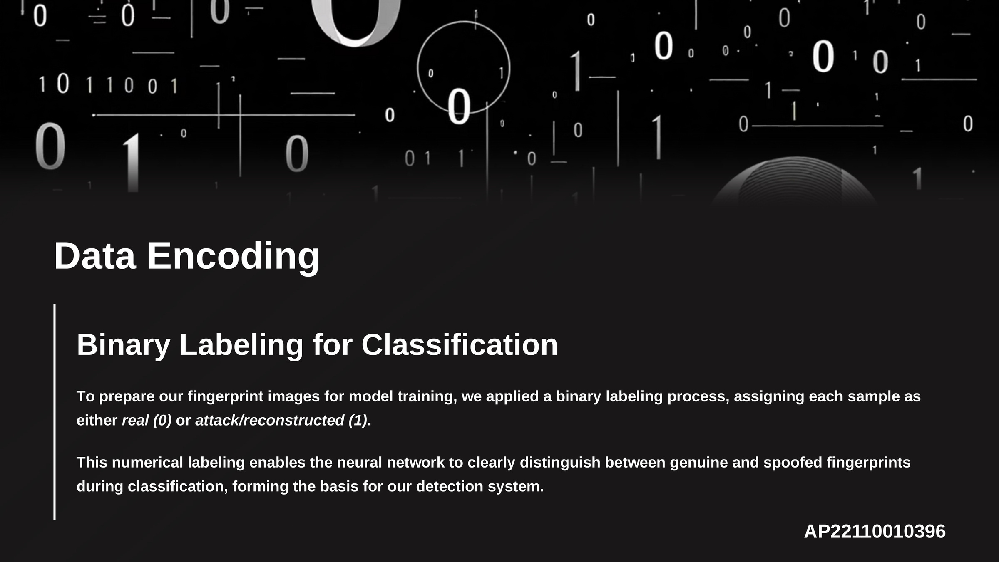

Slide 10
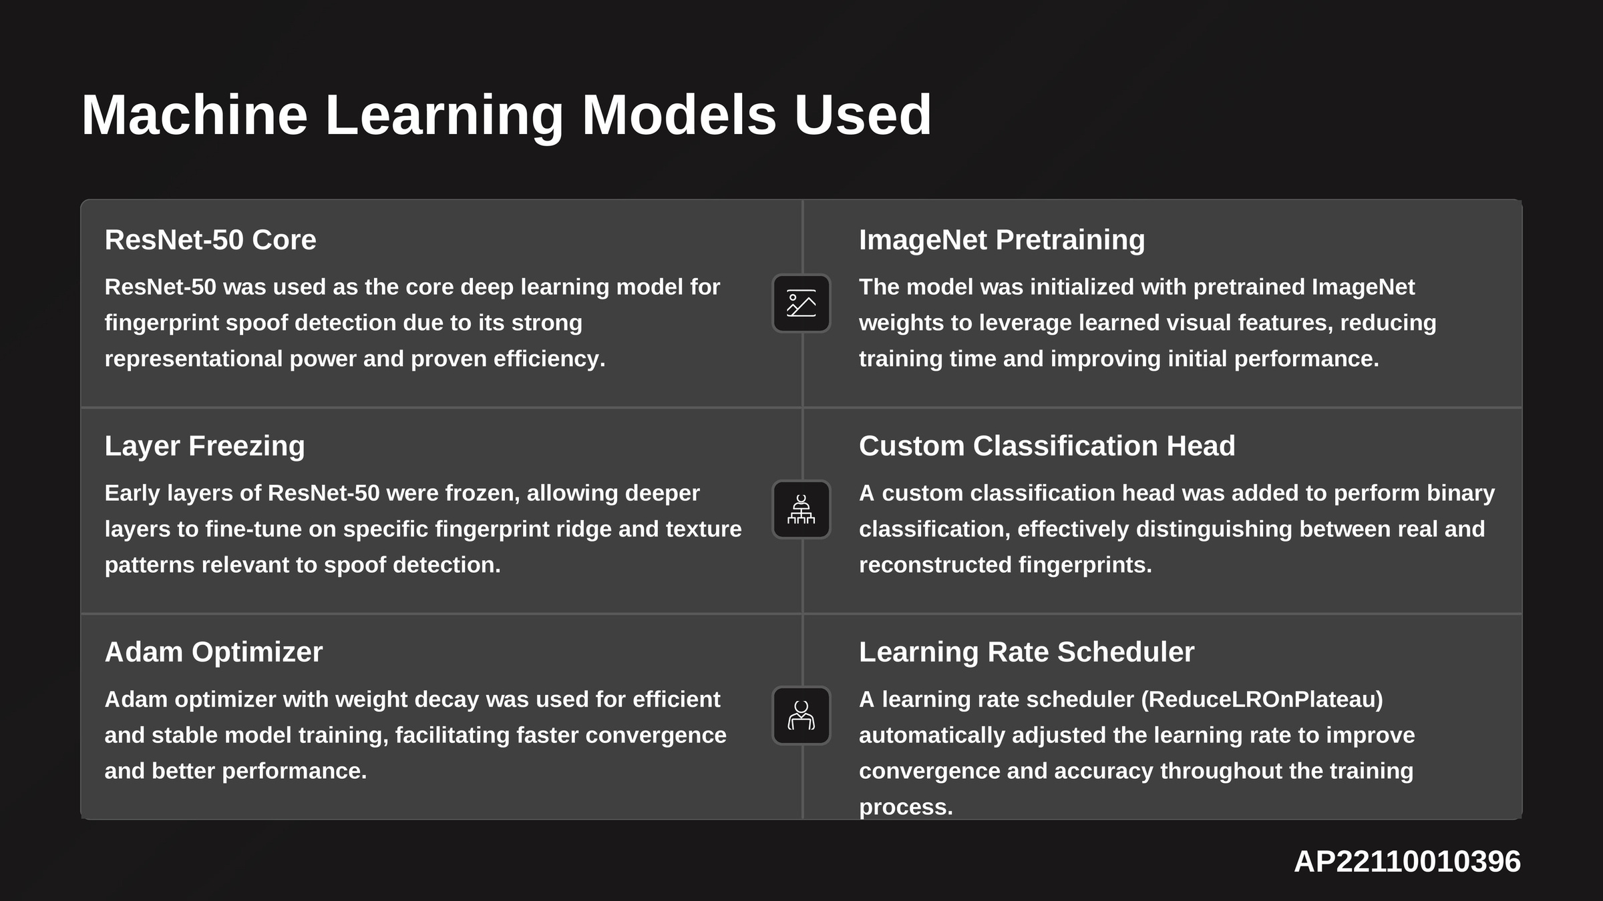

Slide 11
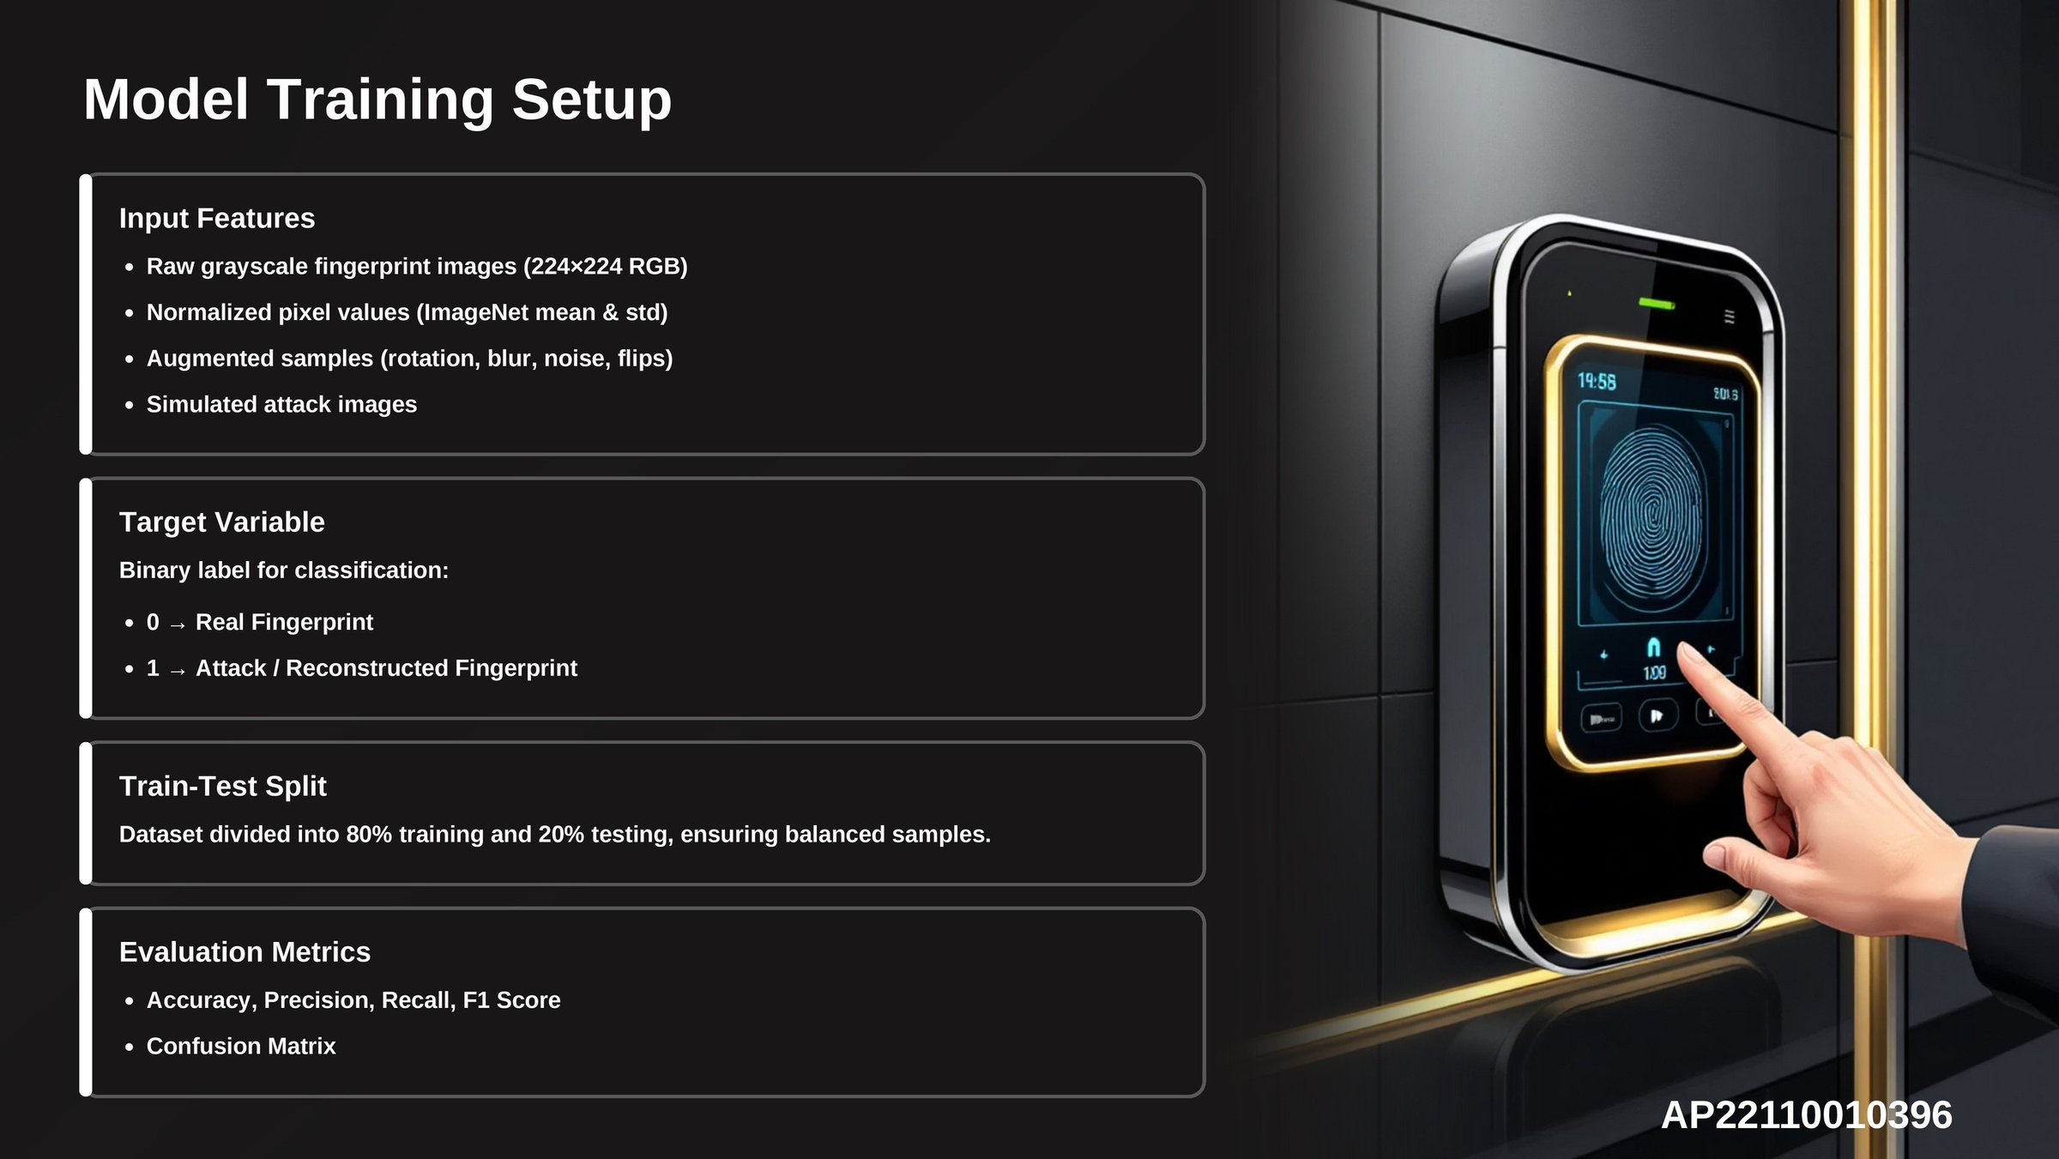

Slide 12
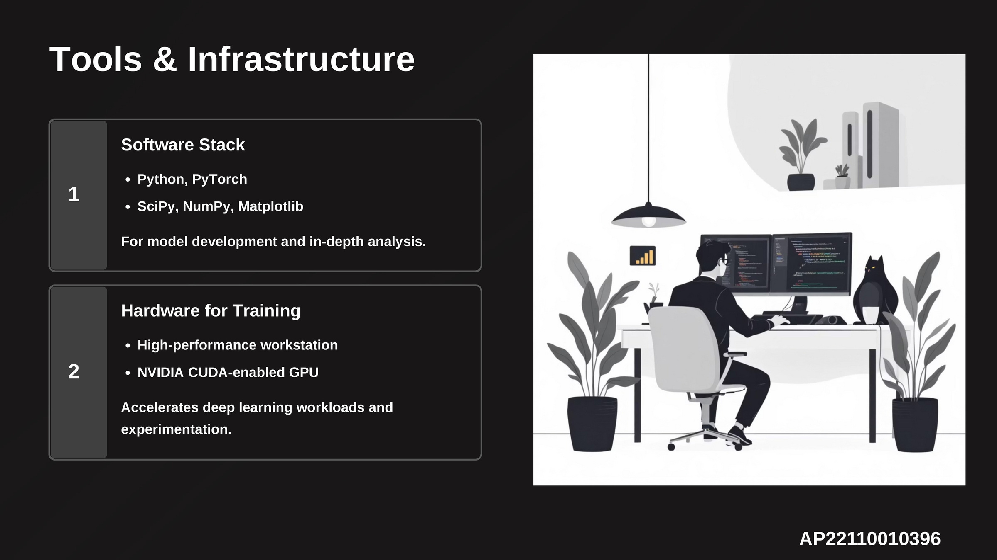

Slide 13
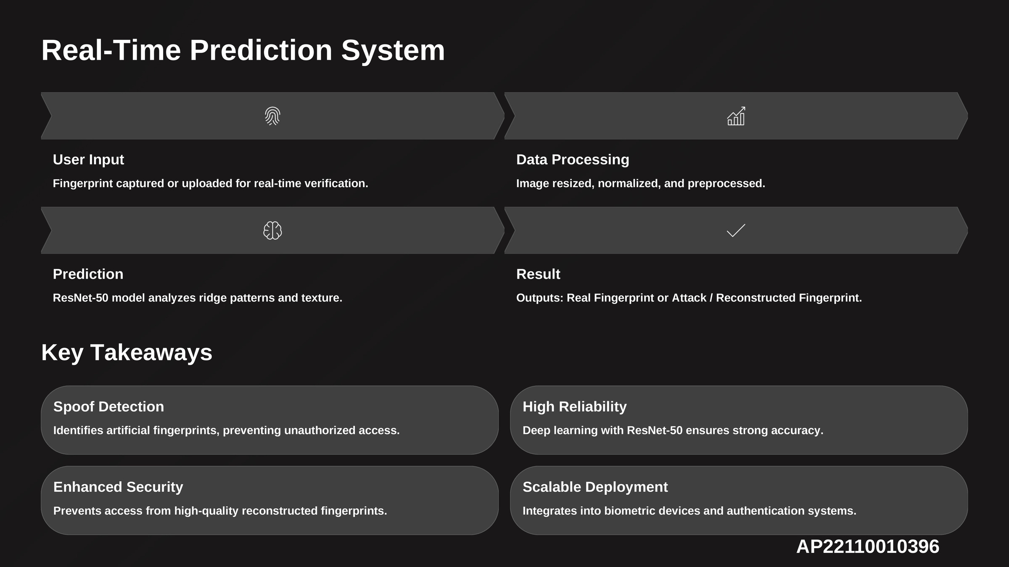

Slide 14
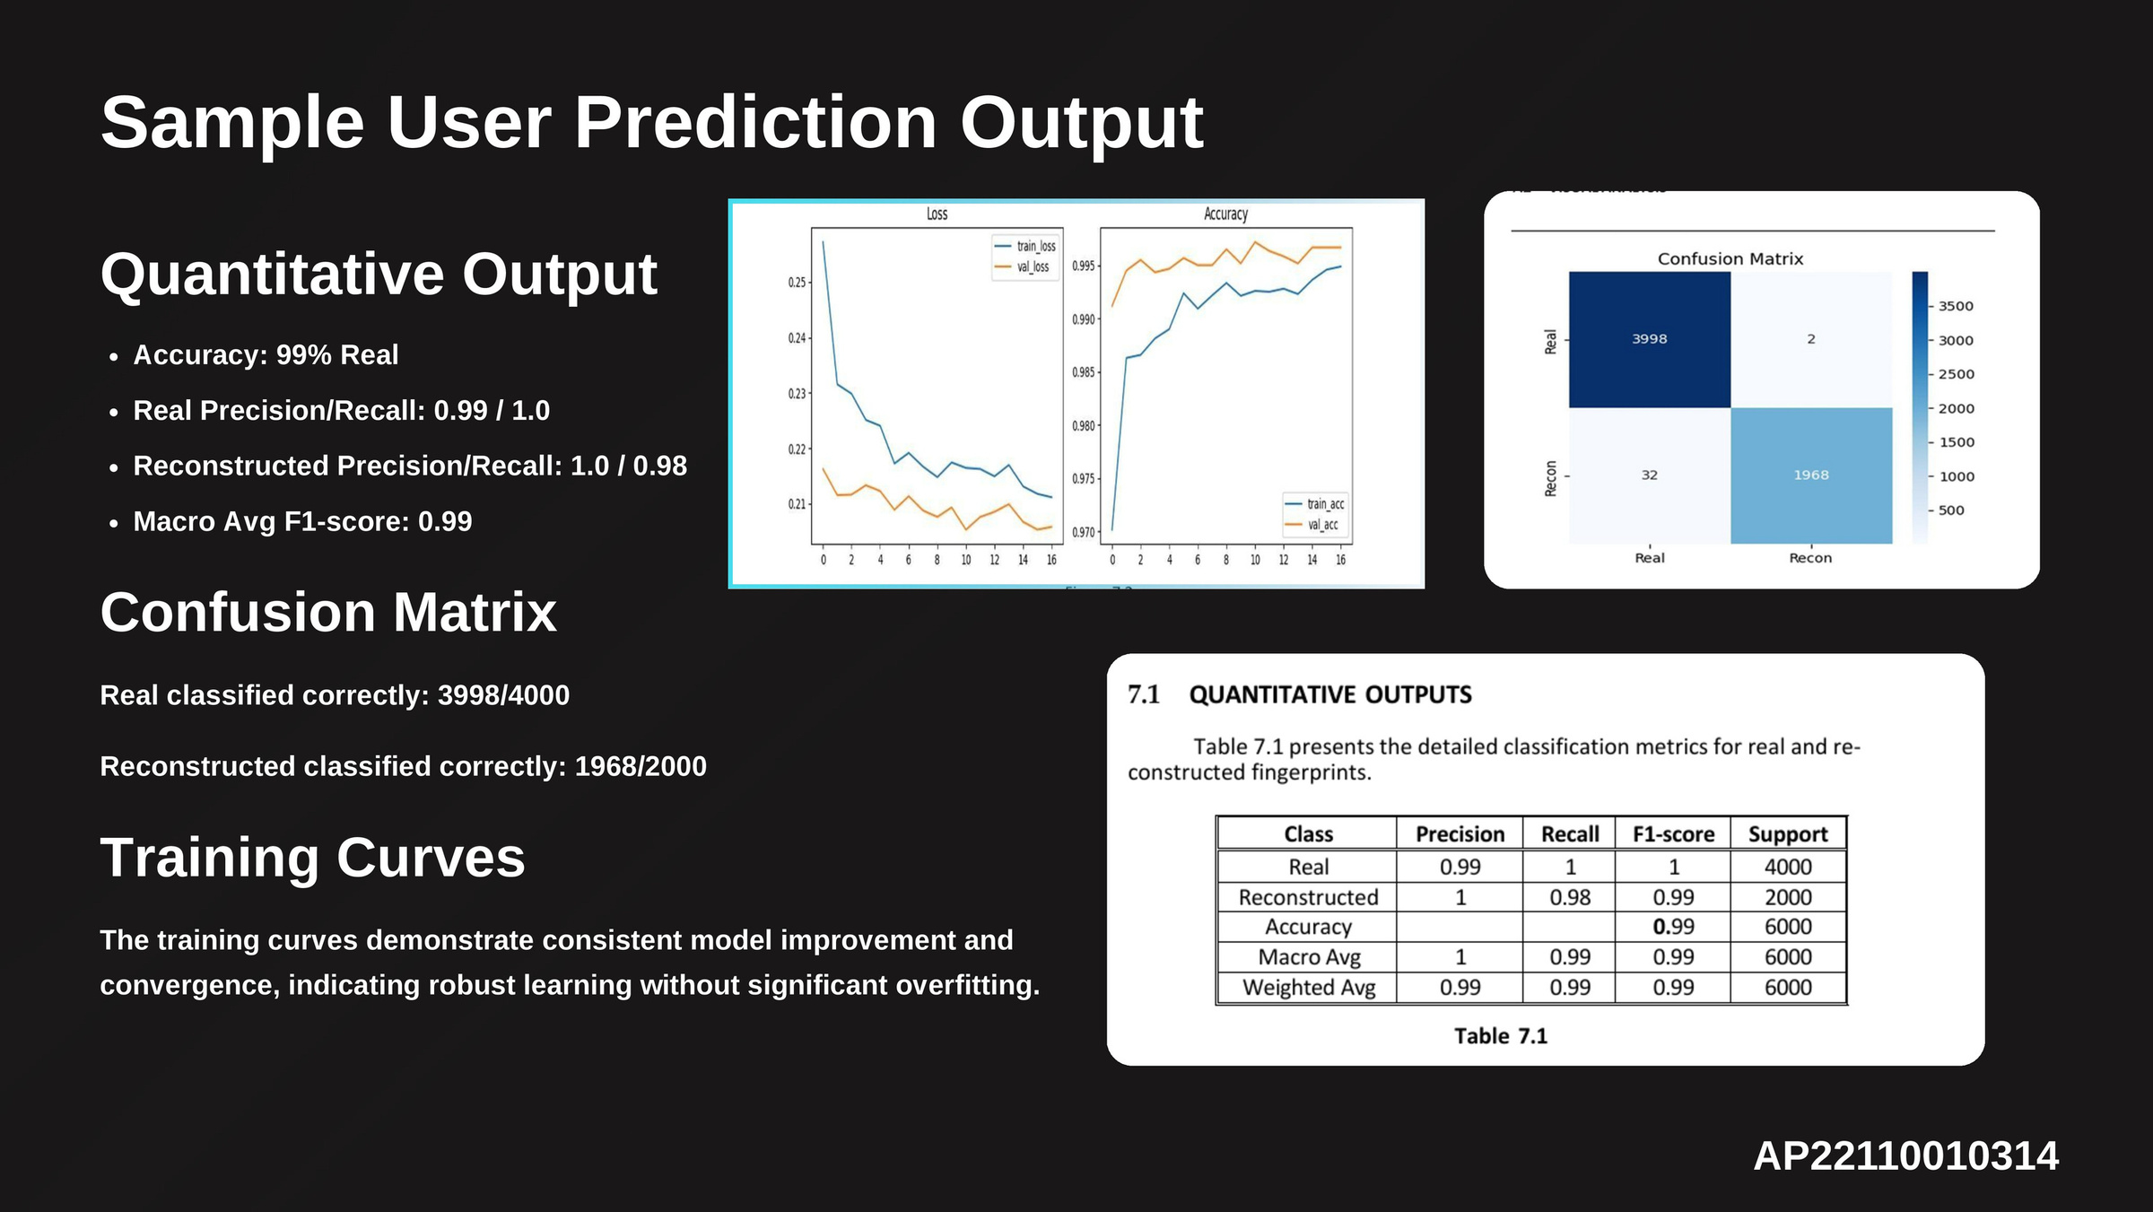

Slide 15
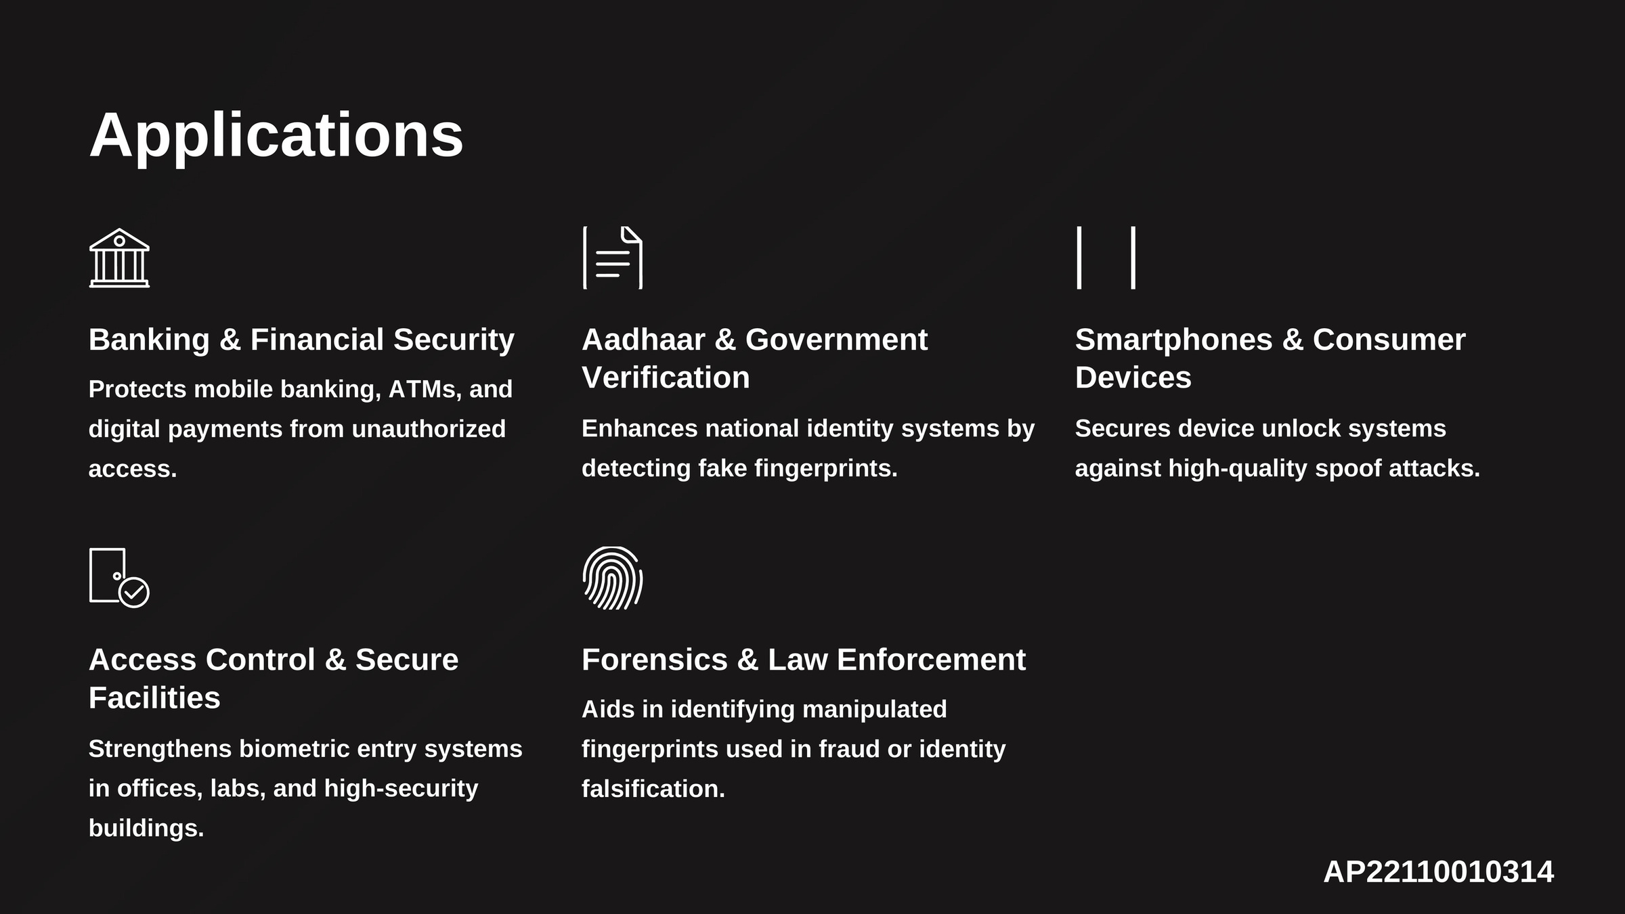

Slide 16
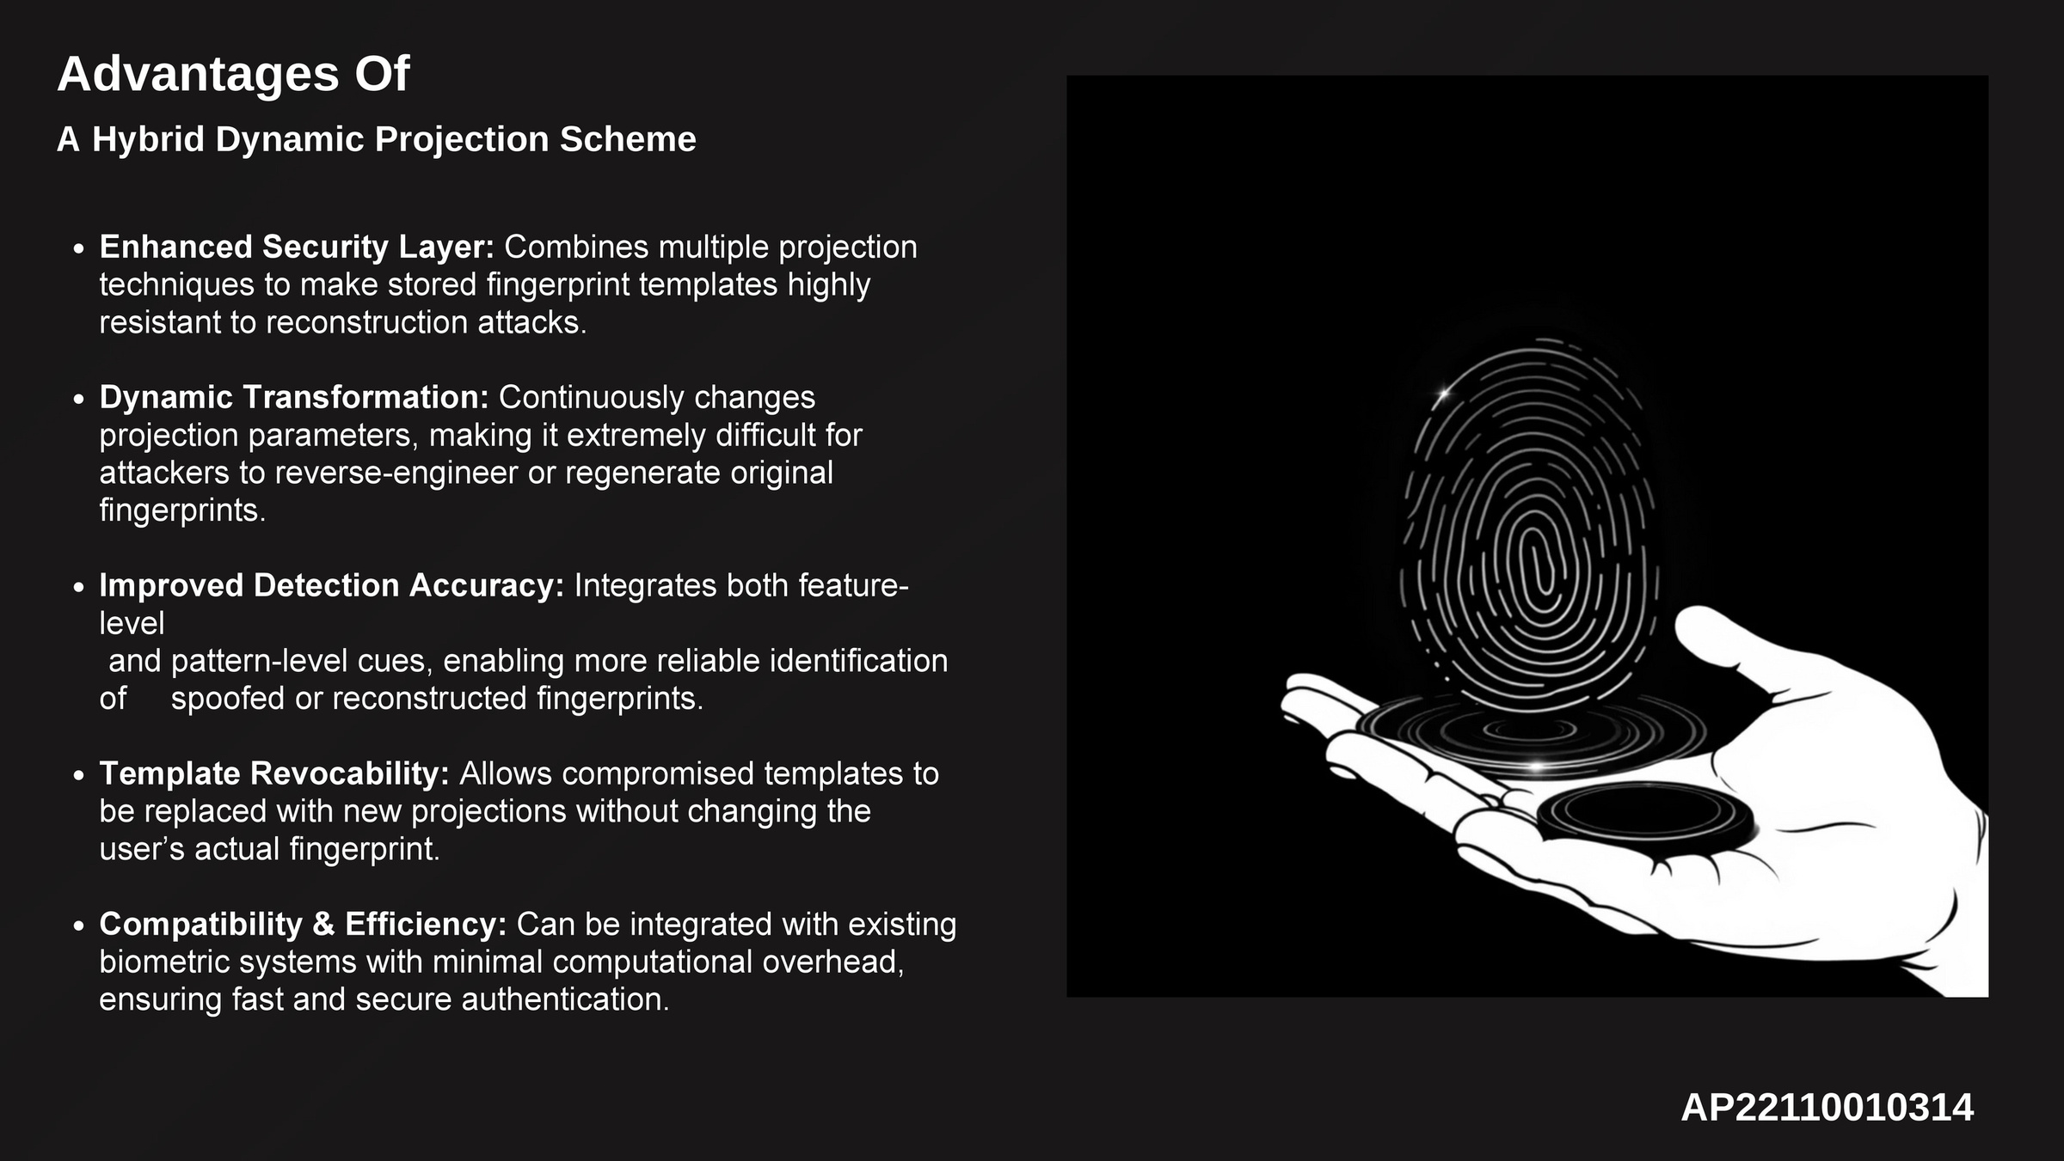

Slide 17
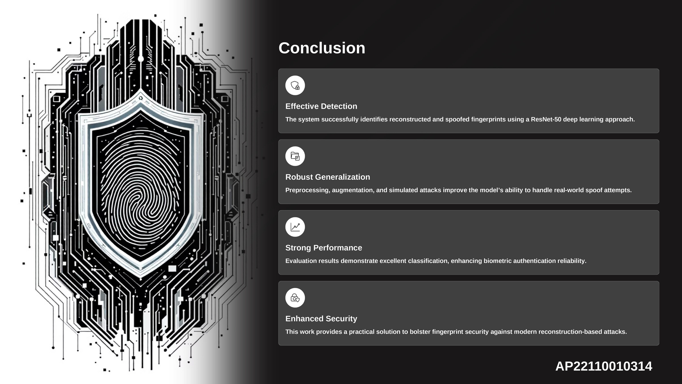

Slide 18


