Slide 1
COMPLETE GUIDE TO INSTALLING & USING KUBERNETES

Slide 2
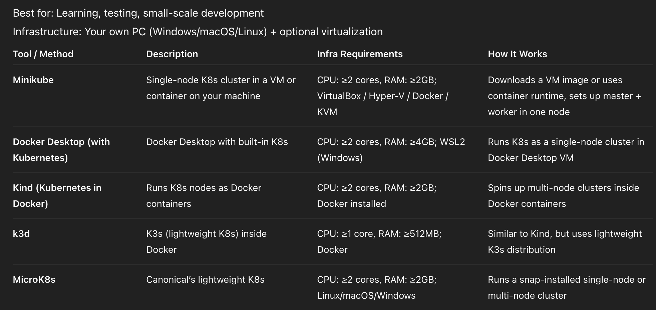
Local Development Approaches

Slide 3
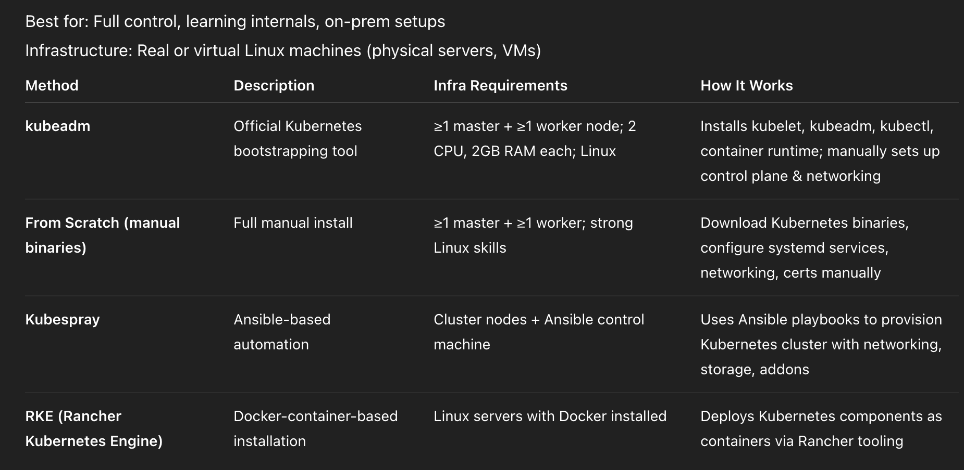
Traditional / Bare-Metal Approaches

Slide 4
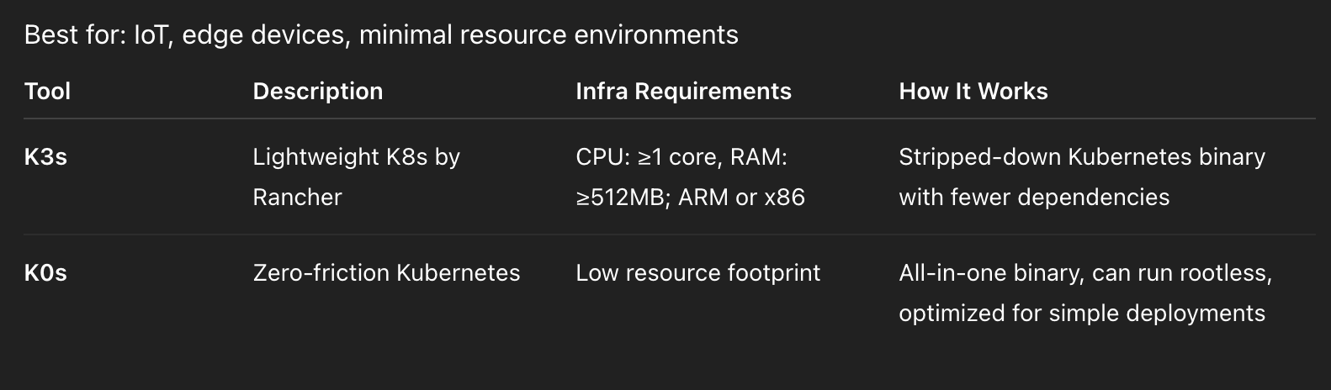
Lightweight & Edge-Oriented Distributions

Slide 5
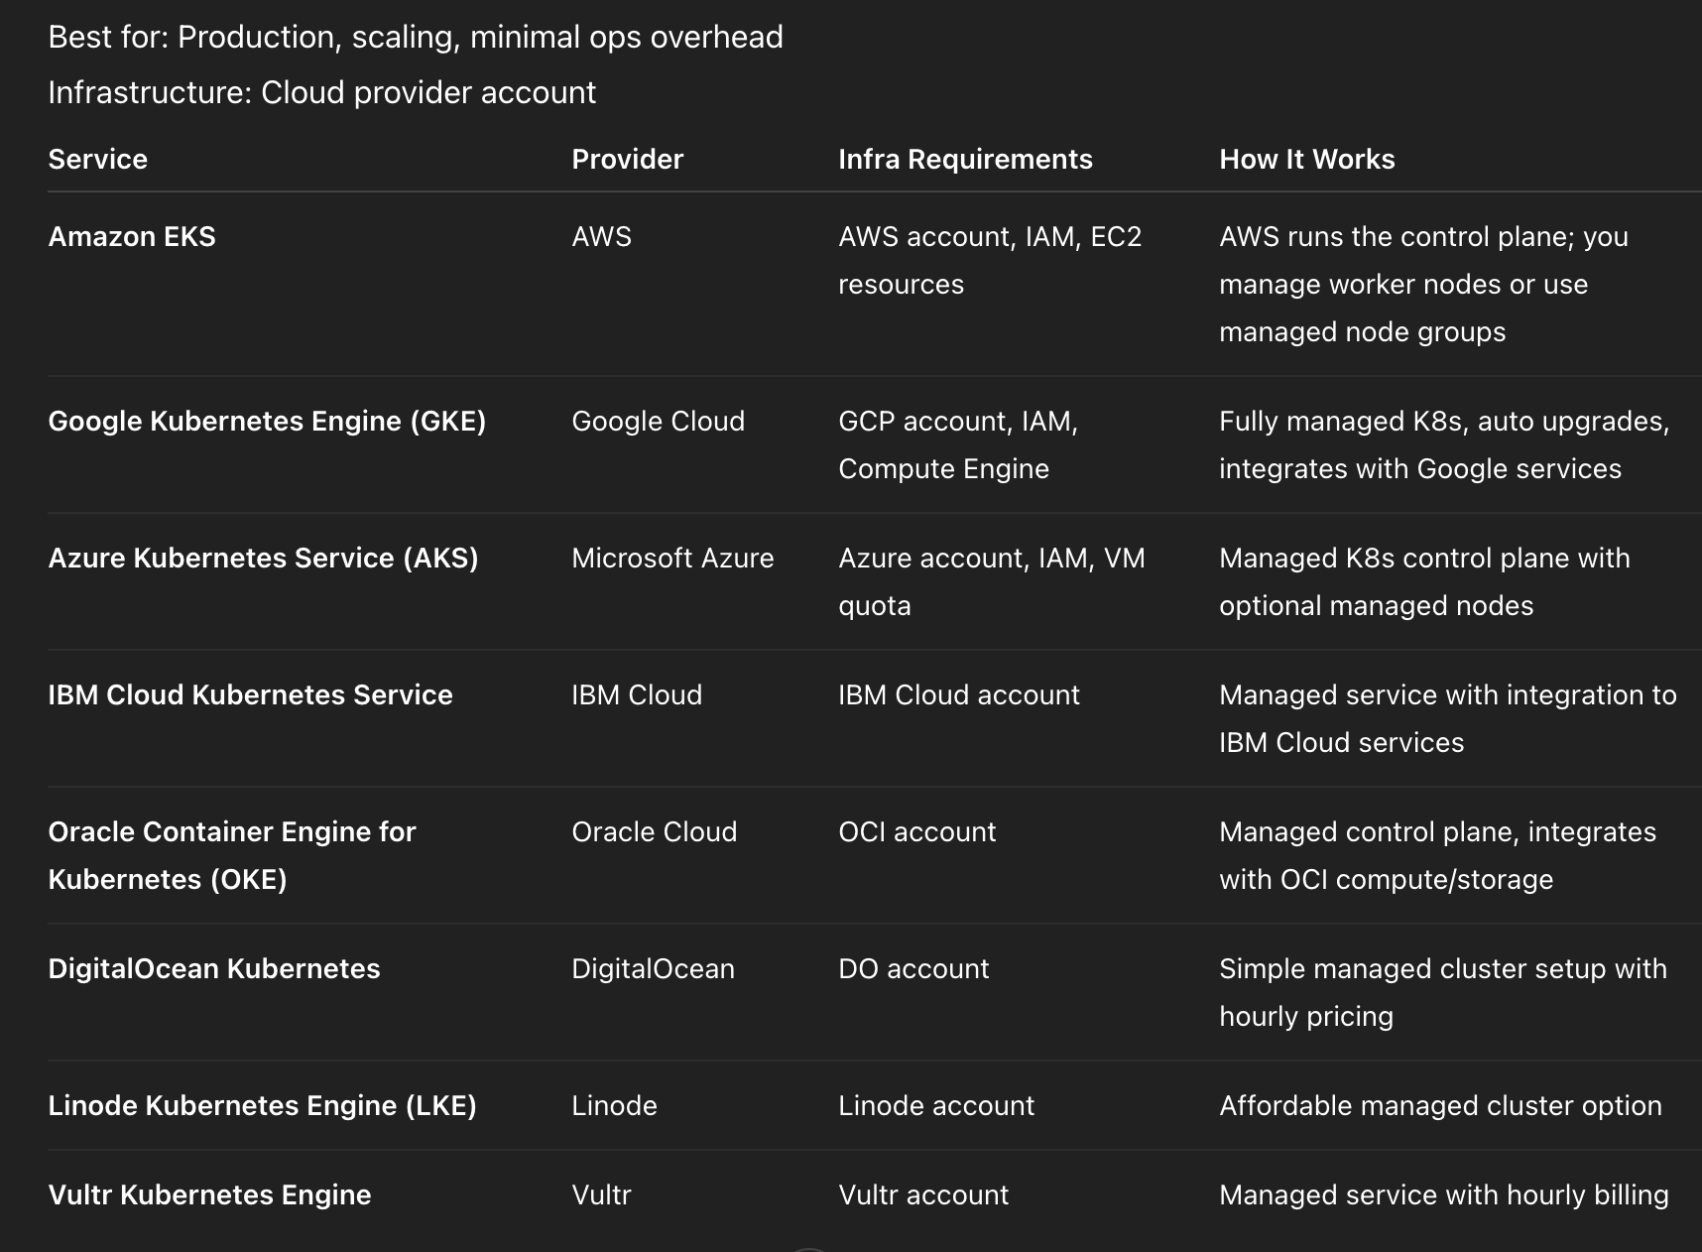
Cloud-Managed Kubernetes Services

Slide 6
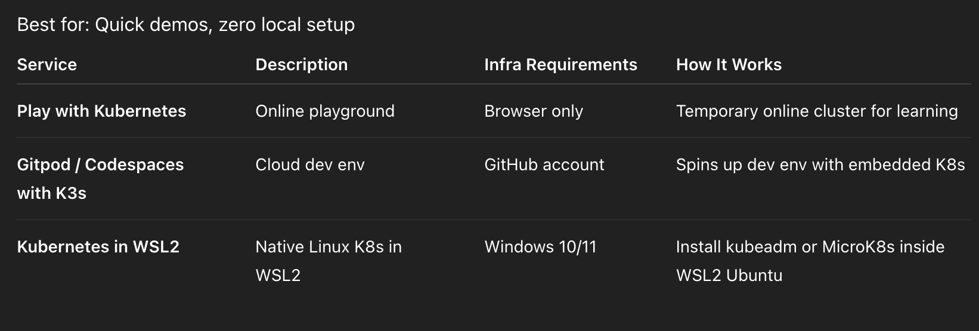
Special Cases / Hosted Solutions

Slide 7
