Slide 1
Unit -1 Introduction to Kubernetes

Slide 2
Unit-1 Topics
Introduction to Kubernetes :
Containerization,
Tools for Containerization,
Kubernetes Overview,
Kubernetes Concept,
Use of Kubernetes,
Kubernetes Master-Slave Architecture.

Slide 3
Prerequisits Link
https://devopscube.com/learn-kubernetes-complete-roadmap/?ref=devopscube.com

Slide 4
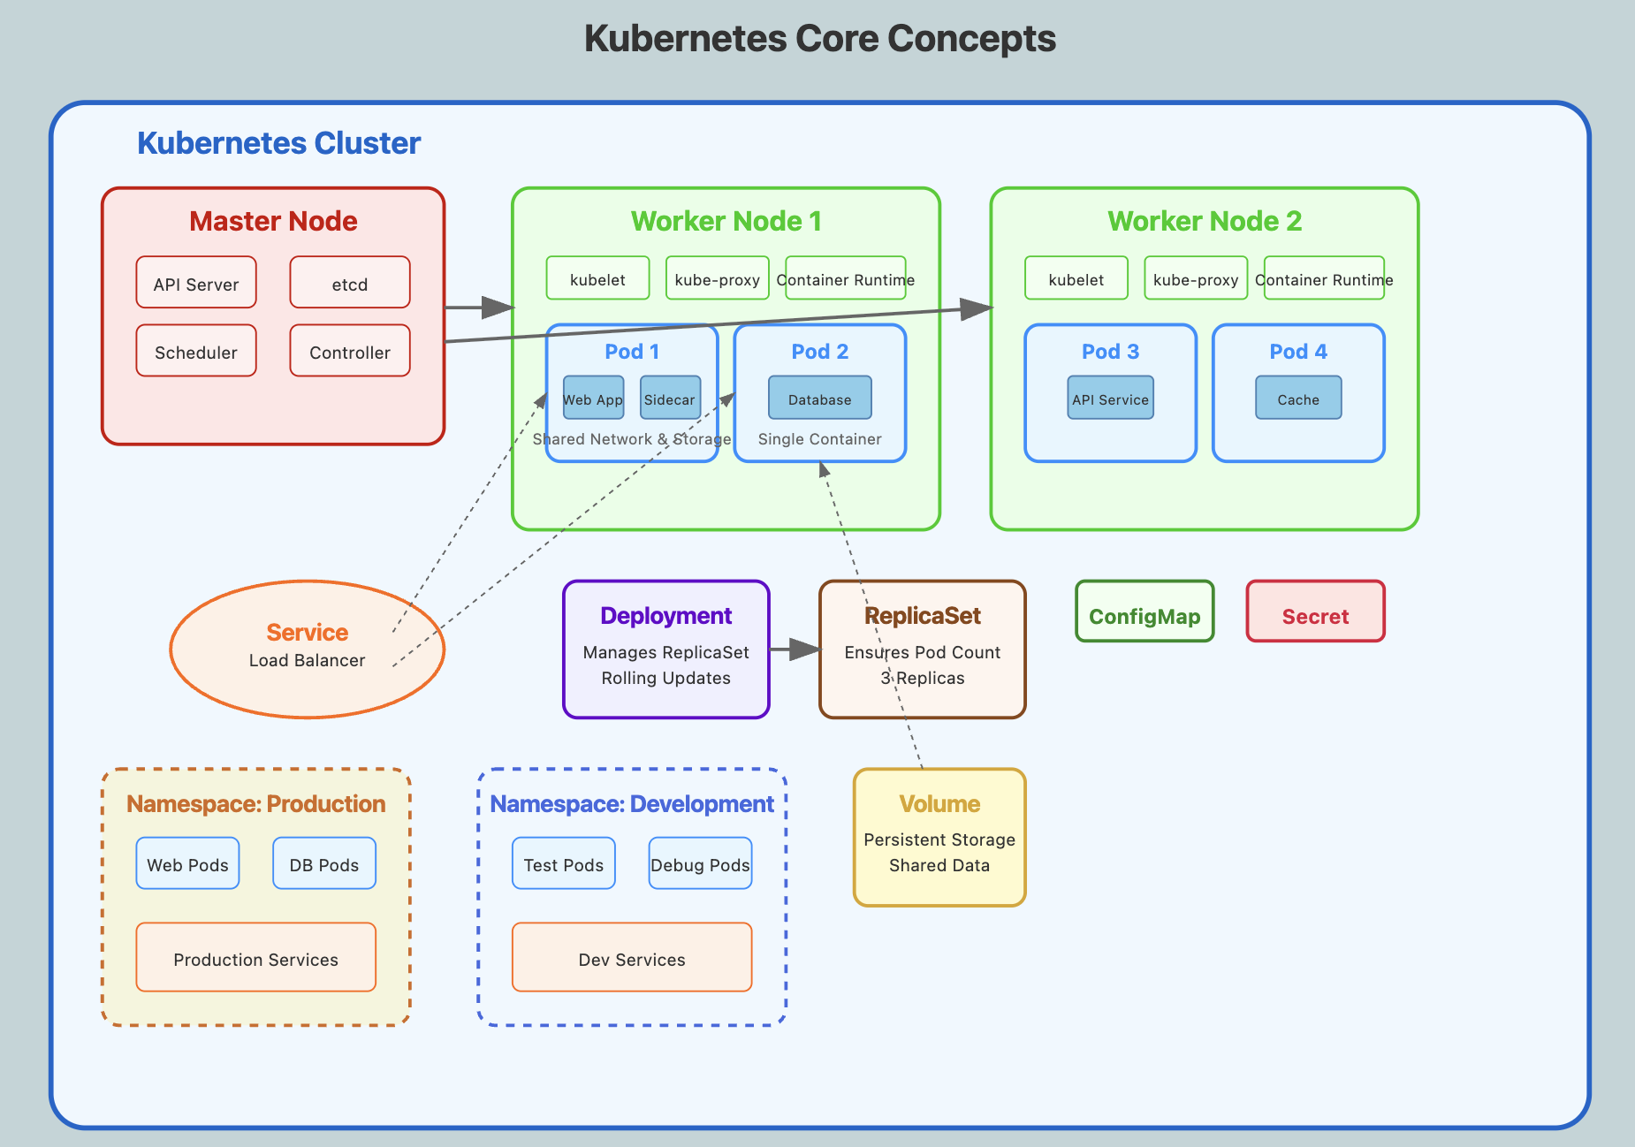

Slide 5
Pod - The Atomic Unit
Apartment Analogy: Think of a Pod like a shared apartment:
Multiple containers (roommates) share the same network (WiFi) and storage (kitchen)
They can communicate easily (localhost)
They're scheduled together (same building)
If the apartment is destroyed, all roommates are affected
Pod Characteristics:
Shared Network: All containers in a pod share the same IP address
Shared Storage: Containers can share volumes for data exchange
Lifecycle: Containers in a pod are created and destroyed together
Communication: Containers communicate via localhost
Scheduling: Pod is the unit of scheduling, not individual containers

Slide 6
Real-World Pod Examples:
1. Web Application Pod:
Main container: Web server (nginx)
Sidecar container: Log collector (fluentd)
Shared volume: Log files
Use case: Web server writes logs, sidecar ships them to central logging
2. Database Pod:
Main container: Database (PostgreSQL)
Init container: Database migration scripts
Shared volume: Database data
Use case: Init container prepares database before main container starts

Slide 7
Service - The Network Abstraction
Restaurant Phone Number Analogy:
Service = Restaurant phone number (stable, doesn't change)
Pods = Chefs (can change, but customers don't care which chef cooks)
Load balancing = Host assigns customers to available chefs
Service Types:
ClusterIP: Internal communication within cluster
NodePort: Exposes service on each node's IP at a static port
LoadBalancer: Exposes service externally using cloud provider's load balancer
ExternalName: Maps service to external DNS name

Slide 8
Deployment vs ReplicaSet
ReplicaSet: "I want exactly 3 copies of my application running"
Ensures specified number of pod replicas are running
Replaces failed pods automatically
Basic scaling capabilities
Deployment: "I want 3 copies, and when I update, do it gradually without downtime"
Manages ReplicaSets
Provides rolling updates and rollbacks
Declarative updates for applications
Deployment history and revision management

Slide 9
Real Scenario: E-commerce Site During Black Friday
Normal traffic: 3 pod replicas handle regular load
Traffic spike detected: Deployment scales to 10 replicas automatically
New version ready: Rolling update replaces pods one by one
Issue detected: Rollback to previous version instantly
Traffic normalizes: Scale back to 3 replicas to save resources

Slide 10
Other Key Concepts
Namespace
Virtual clusters within a physical cluster
Resource isolation and organization
Example: separate namespaces for production, staging, development
ConfigMap and Secret
ConfigMap: Non-sensitive configuration data
Secret: Sensitive information (passwords, tokens, keys)
Both can be mounted as volumes or environment variables
Volume
Provides persistent storage for pods
Types: emptyDir, hostPath, persistentVolume, cloud storage
Survives container restarts within a pod

Slide 11
Kubernetes Use Cases
Traditional Monolith Problems:
Large codebase: Single application becomes massive and hard to maintain
Single point of failure: One bug can crash entire application
Scaling inefficiency: Must scale entire application even if only one component needs resources
Technology lock-in: Entire application must use same technology stack
Team dependencies: Teams must coordinate changes to shared codebase

Slide 12
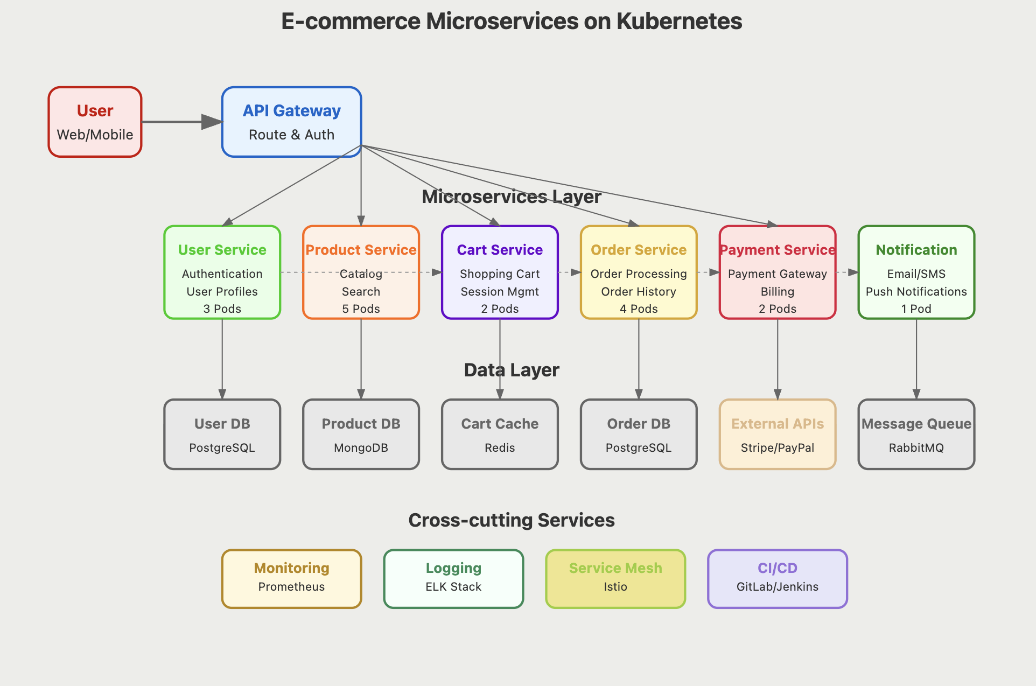
Microservices Architecture

Slide 13
Use Cases
1. Microservices Architecture
Break monolithic applications into smaller services
Independent scaling and deployment
Better fault isolation
2. CI/CD Pipeline Integration
Automated testing environments
Blue-green deployments
Canary releases

Slide 14
3. Multi-Cloud Deployments
Run applications across different cloud providers
Avoid vendor lock-in
Disaster recovery
4. Auto-scaling
Horizontal Pod Autoscaler (HPA)
Vertical Pod Autoscaler (VPA)
Cluster Autoscaler
5. Resource Optimization
Efficient resource utilization
Cost optimization
Performance improvement

Slide 15
6.Industry Adoption
Netflix: Manages thousands of microservices
Uber: Handles massive scale operations
Airbnb: Manages complex deployment pipeline
Spotify: Handles music streaming infrastructure

Slide 16
Benefits Demonstrated:
Independent Scaling:
Product service gets more resources during sales events
Technology Diversity:
Each service uses the best technology for its needs
Team Autonomy:
Each team owns their service's complete lifecycle
Fault Isolation:
Payment service issues don't crash the product catalog
Independent Deployment:
Teams can deploy updates without coordinating

Slide 17
Real-World Implementation Benefits
Netflix Case Study:
Before Kubernetes: Monolithic application, took hours to deploy changes
After Kubernetes: 1000+ microservices, deploy hundreds of times per day
Auto-scaling: Automatically handles traffic spikes (new movie releases)
Fault tolerance: If one service fails, others continue working

Slide 18
High Availability and Disaster Recovery
Multi-Region Setup:
Primary Region: Main production cluster
Secondary Region: Backup cluster with data replication
Automatic Failover: Traffic switches to backup region during outages
Data Consistency: Database replication ensures data availability
Self-Healing Capabilities:
Pod Failures: Automatically restart failed containers
Node Failures: Reschedule pods to healthy nodes
Service Failures: Remove unhealthy endpoints from load balancing
Resource Exhaustion: Automatically scale resources or evict low-priority pods

