Slide 1
Unit -1 Introduction to Kubernetes

Slide 2
Unit-1 Topics
Introduction to Kubernetes :
Containerization,
Tools for Containerization,
Kubernetes Overview,
Kubernetes Concept,
Use of Kubernetes,
Kubernetes Master-Slave Architecture.

Slide 3
Prerequisits Link
https://devopscube.com/learn-kubernetes-complete-roadmap/?ref=devopscube.com

Slide 4
Architecture
Kubernetes is a distributed system.
Meaning, it has multiple components spread across different servers over a network.
These servers could be Virtual machines or bare metal servers. We call it a Kubernetes cluster.

Slide 5
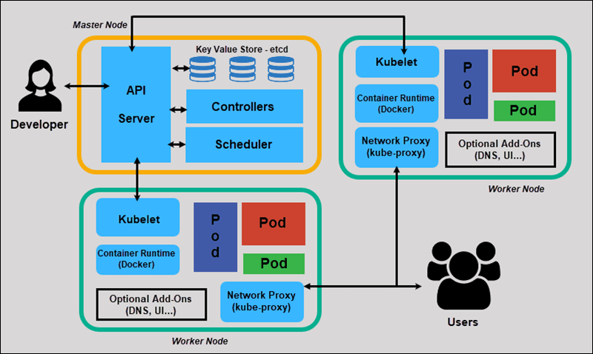
https://mohan08p.medium.com/simplified-kubernetes-architecture-3febe12480eb

Slide 6
Four basic components of the master node(control plane):
API server
Scheduler
Controller manager
etcd

Slide 7
Three basic components of the Worker Node(Data plane)
Kubelet
Kube-proxy
Container runtime

Slide 8
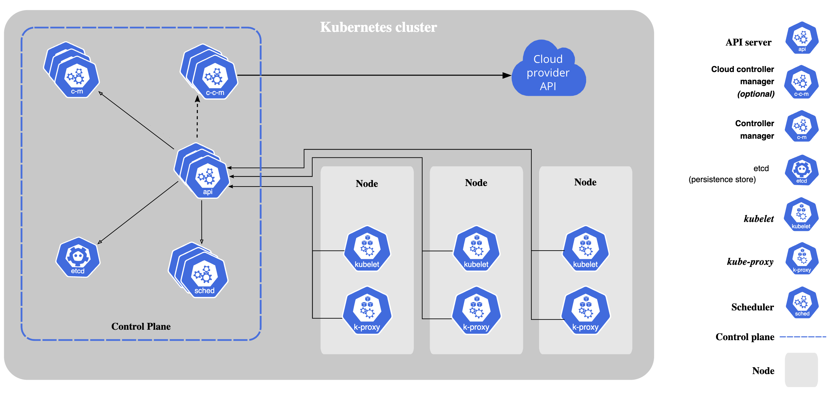
Architecture Components
https://kubernetes.io/docs/concepts/overview/components/

Slide 9
API Server (kube-apiserver)
Central management entity
Handles all REST operations
Frontend to Kubernetes control plane
Validates and configures API objects
Functions:
Authentication and authorization
Request validation
Resource version management
Cluster state management

Slide 10
etcd
Consistent and highly-available key-value store
Stores all cluster data
Source of truth for cluster state
Distributed across multiple nodes for HA
Key Features:
Strong consistency
High availability
Secure communication
Watch functionality

Slide 11
Controller Manager (kube-controller-manager)
Runs controller processes
Monitors cluster state
Makes changes to achieve desired state
Key Controllers:
Node Controller: Monitors node health
Replication Controller: Maintains pod replicas
Endpoints Controller: Manages service endpoints
Service Account Controller: Creates default accounts

Slide 12
Scheduler (kube-scheduler)
Assigns pods to nodes
Considers resource requirements
Implements scheduling policies
Scheduling Process:
1. Filtering: Find suitable nodes
2. Scoring: Rank filtered nodes
3. Selection: Choose best node
4. Binding: Assign pod to node

Slide 13
Worker Node (Slave) Components
kubelet
Primary node agent
Manages pods and containers
Monitors pod health
Reports node status to master
Responsibilities:
Pod lifecycle management
Container health checks
Resource monitoring
Volume mounting

Slide 14
kube-proxy
Network proxy running on each node
Maintains network rules
Enables service communication
Functions:
Load balancing
Service discovery
Network rule management
Traffic forwarding

Slide 15
Container Runtime
Runs containers
Supports multiple runtimes
Supported Runtimes:
Docker
containerd
CRI-O
Kata Containers

Slide 16
Architecture Flow
1. User Request: kubectl sends request to API server
2. Authentication: API server validates user credentials
3. Authorization: Check user permissions
4. Validation: Validate request format and constraints
5. Storage: etcd stores the desired state
6. Controller Action: Controllers detect changes and act
7. Scheduling: Scheduler assigns pods to nodes
8. Execution: kubelet creates containers on nodes
9. Monitoring: Components report status back

Slide 17
Detailed Architecture
https://devopscube.com/kubernetes-architecture-explained/#control-plane

