Slide 1
Unit - 2 Deployment of Kubernetes

Slide 2
Unit -2 Syllabus
Deployment of Kubernetes :
Installing Kubernetes
Steps for Kubernetes Master
Steps for Kubernetes Slave
Kubectl Commands.

Slide 3
Kubernetes
Kubernetes (K8s) is a system for running and managing containerized applications across multiple machines.
It:
Automatically schedules containers to run on available nodes
Handles scaling up/down
Restarts containers if they fail
Exposes them to the network (via Services, Ingress, LoadBalancers)

Slide 4
Key Kubernetes Terms
Cluster → The whole setup (control plane + worker nodes)
Control Plane (Master) → Decides where and how apps run
Worker Nodes → Run your applications (Pods)
Pod → Smallest deployable unit in Kubernetes, usually 1+ containers
Service → Network endpoint for accessing Pods
Ingress → Routes external HTTP/HTTPS traffic to Services

Slide 5
System Requirements
These vary depending on the method you choose.
A) Local Single-Node Cluster (Docker Desktop, Minikube, Kind)
OS: Windows 10/11, macOS, or Linux
CPU: ≥ 2 cores
RAM: ≥ 4 GB
Disk Space: 20 GB
Extras:
Docker installed
Virtualization enabled in BIOS (if using Minikube VM driver)

Slide 6
B) Multi-Node Cluster with kubeadm (VirtualBox, VMs, Bare Metal)
Master Node:
CPU: ≥ 2 cores
RAM: ≥ 2 GB (4 GB recommended)
Disk: ≥ 20 GB
Worker Node(s):
CPU: ≥ 1 core
RAM: ≥ 2 GB
Disk: ≥ 20 GB
Network:
Nodes must be able to talk to each other on Kubernetes ports
(6443 for API server, 10250–10259 for kubelet, etc.)
OS: Ubuntu 20.04+/Debian/CentOS (Linux)
Extras: container runtime (Docker/containerd)

Slide 7
C) Cloud-Managed Kubernetes (EKS, GKE, AKS)
Just need:
Cloud account
IAM/permissions to create clusters
No control plane resource requirements (provider manages it)
You still need EC2/VM specs for worker nodes (usually ≥ 2 vCPU, 4GB RAM)

Slide 8
Installation Options (Beginner-Friendly Order)
Easiest for learning → Docker Desktop (enable Kubernetes) or Minikube
Understand internals → kubeadm on Linux VMs
Production-grade → Cloud-managed services (EKS, GKE, AKS)

Slide 9
Installation
Using Minikube :
https://minikube.sigs.k8s.io/docs/start/?arch=%2Fmacos%2Farm64%2Fstable%2Fbinary+download
Windows : using choco
choco install kubernetes-cli
choco install minikube

Slide 10
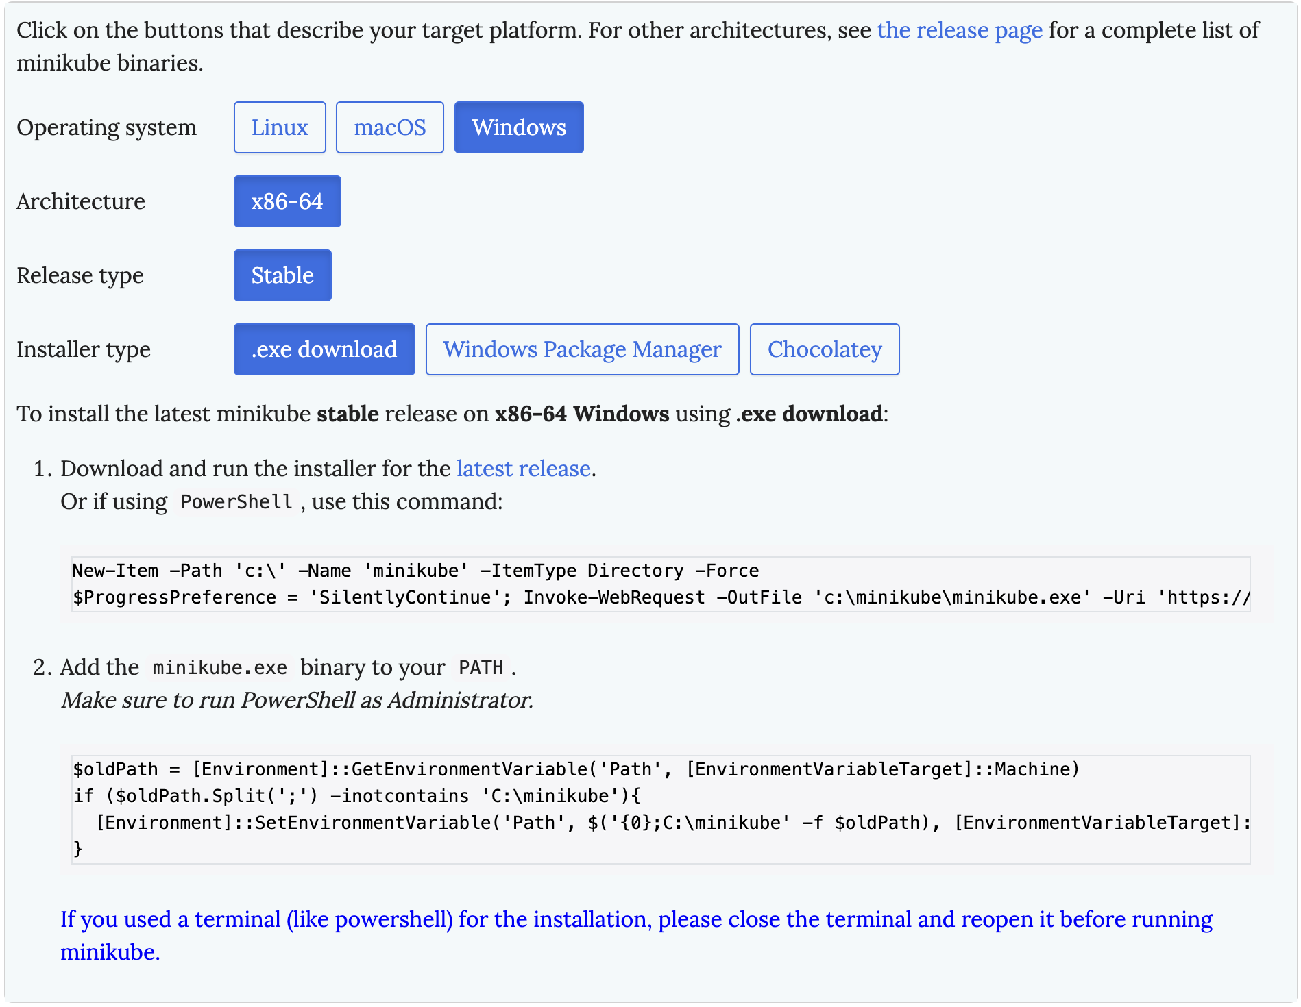
Windows :using exe

Slide 11
Mac
brew install kubectl
brew install minikube
Verify Installation:
kubectl version --client
minikube version

Slide 12
Understanding Kubernetes Master in Minikube
minikube start
minikube status
kubectl get nodes
kubectl get nodes -o wide
kubectl describe node minikube
What is a Kubernetes Master?
The master node (control plane) manages the cluster and makes decisions about scheduling, scaling, and maintaining desired state. In Minikube, these components run as pods within the single node.

Slide 13
View all system pods (these are the master components)
kubectl get pods -n kube-system
# Get detailed information about each component
kubectl describe pod etcd-minikube -n kube-system
kubectl describe pod kube-apiserver-minikube -n kube-system
kubectl describe pod kube-controller-manager-minikube -n kube-system
kubectl describe pod kube-scheduler-minikube -n kube-system
Check cluster info:
kubectl cluster-info
View kubeconfig:
kubectl config view

Slide 14
Get Current-Context:
kubectl config current-context
Access the master node directly:
minikube ssh
exit

Slide 15
Understanding Kubernetes Worker in Minikube
What is a Kubernetes Worker?
Worker nodes run application pods and are managed by the master.
In Minikube, worker components run alongside master components on the same node.
Delete existing cluster
minikube delete

Slide 16
# Start multi-node cluster
minikube start --nodes 3
# Verify multiple nodes
kubectl get nodes
Add worker nodes to existing cluster:
# Start with single node
minikube start
# Add worker nodes
minikube node add --worker
# List all nodes
minikube node list
kubectl get node
Add worker with specific name :
minikube node add --worker --name=worker-1

Slide 17
Manage individual worker nodes:
# Get detailed information about worker nodes
kubectl describe node minikube-m02
# View node labels
kubectl get nodes --show-labels
Delete nodes:
minikube node delete minikube-m02
# Delete multiple nodes at once
minikube node delete minikube-m02 minikube-m03
SSH into node:
minikube ssh -n minikube-m02

Slide 18
Create Multiple Clusters with Minikube
Create :
minikube start -p cluster1
Create customised cluster :
minikube start -p cluster3 --nodes=2 --driver=docker --kubernetes-version=v1.32.0
List all clusters:
minikube profile list
Switch Between Clusters
minikube profile cluster2
kubectl get nodes

Slide 19
Delete a Cluster:
minikube delete -p cluster2

