Slide 1

Helmet & Safety Vest Detection Solution
1. Image Collection
2. Image Annotation
3. Image Pre-processing & Augmentation
Customer Attendance DB – historic images
Labelling the images
Resizing, Orienting, Color Correction
Alter rotation, brightness, scale
Testing data
Combine
Split
Open-source labelled image dataset
Training data
Training data
Testing data
4. ML Model Design
5. Model training, evaluation and optimization
Model configuration and Architecture design
Train the Model
Evaluate performance of the model
Tune the configuration
Hyperparameter tuning
Performance metrics
6. Model API creation and deployment
7. Validate safety wear for employee
POST API to detect helmet and safety vest and update store and send notification
POST API to detect helmet and safety vest and return JSON result
POST API to detect helmet and safety vest and return BASE64 image
Rider photo during Attendance
API Gateway
Attendance Image Repository
Data Store
Notification Services
Customer Systems – not in our development scope

Slide 2
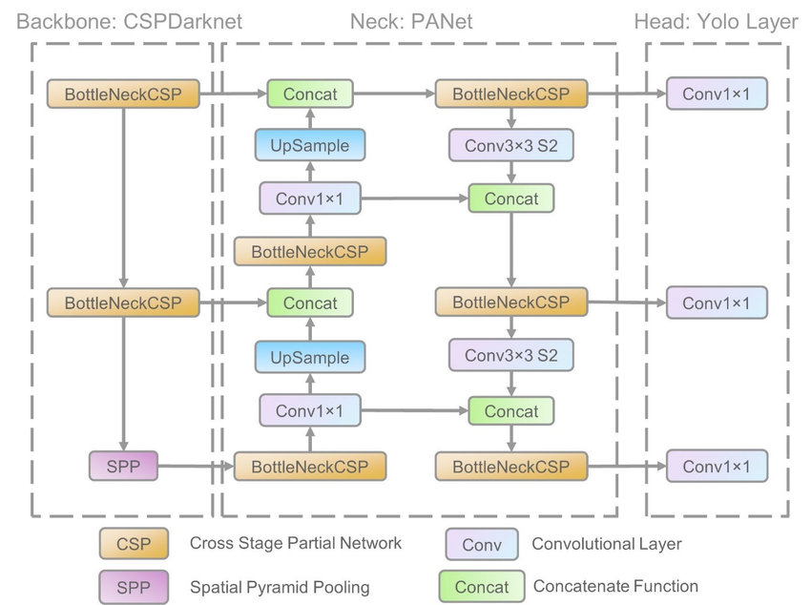
1. Two wheeler rider safety 1.a, 1.b – Use of Helmet, Safety jacket/illuminated Strip while driving Solution Option 1 – DL Based Image Processing Technique
Requirement is to check for Use of helmet while driving and Use of Safety jacket/illuminated strip on helmet while driving
Solution Option 1 - DL based image processing technique
A data set of images with and without helmet is required to train the model
Open-source datasets are available - can they be used? Open Images DataSet
Images to be augmented - flip (horizontal), rotation (between -15degrees and +15degrees) and brightness (between -25% and +25%)
YOLOv5 based solution
https://towardsdatascience.com/the-practical-guide-for-object-detection-with-yolov5-algorithm-74c04aac4843
https://towardsdatascience.com/first-helmet-detector-using-yolov5-2eceab034c4b

Slide 3
Reference Links
https://betterprogramming.pub/machine-learning-model-api-using-yolov5-with-fast-api-192f1290a982 - API and deployment of the model
https://towardsdatascience.com/how-to-train-a-custom-object-detection-model-with-yolo-v5-917e9ce13208 - Labelling images and creating custom data set and YOLOv5 Algo

