Slide 1


Introduction to Power BI
Power BI is a powerful business analytics tool that allows you to visualize and share insights from your organization's data. It helps in creating interactive reports and dashboards, providing a 360-degree view of the business.
by satyam bidve

Slide 2
Why We Need Power BI and the Problems It Solves
Power BI is a powerful business intelligence tool that solves several key problems in data analysis and reporting. It provides organizations with the ability to:
Consolidate and analyze data from multiple sources in one place
Create interactive visualizations and dashboards for data exploration
Generate insightful reports and share them with stakeholders
Perform advanced analytics and predictive modeling
Gain real-time insights into business performance
By addressing these challenges, Power BI enables businesses to make data-driven decisions, identify trends and patterns, and drive overall growth and efficiency.

Slide 3

Why Power BI?
1
Data-driven Decisions
Power BI enables data-driven decision-making by providing insights into various aspects of business operations.
2
Advanced Features
Unlike other tools, Power BI comes with advanced features for data visualization and analysis.
3
Importance of Data
Data is crucial for business success, and Power BI simplifies the process of deriving insights from it.

Slide 4
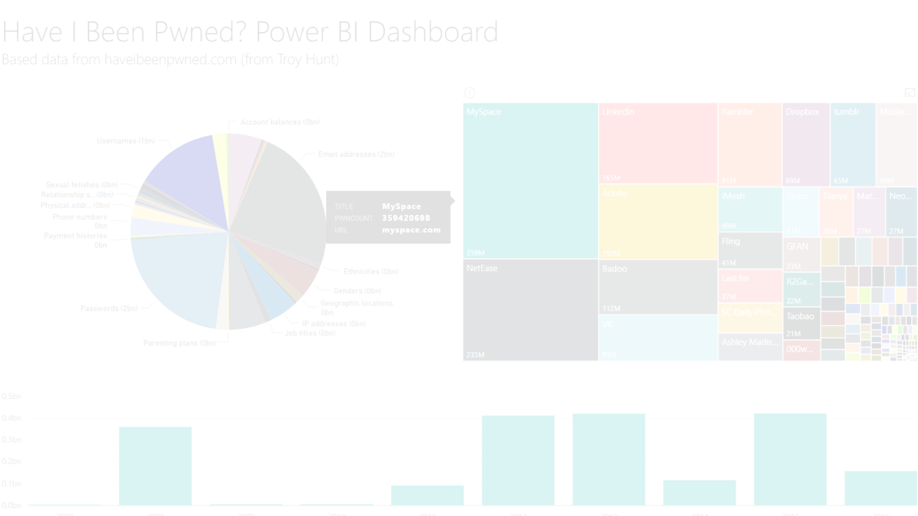
Download and Installation
1
Download Process
Go to the official website and download the installation file for Power BI.
2
Installation Steps
Run the downloaded file and follow the installation wizard to set up Power BI on your system.
3
Ready to Use
Once installed, Power BI is ready to be used for data analysis and visualization.

Slide 5

UI and Features
User Interface
Power BI offers an intuitive and user-friendly interface, making it easier to navigate and work with data.
Graphical Advancements
It provides graphically advanced features for creating impactful and visually appealing reports
and dashboards.

Slide 6
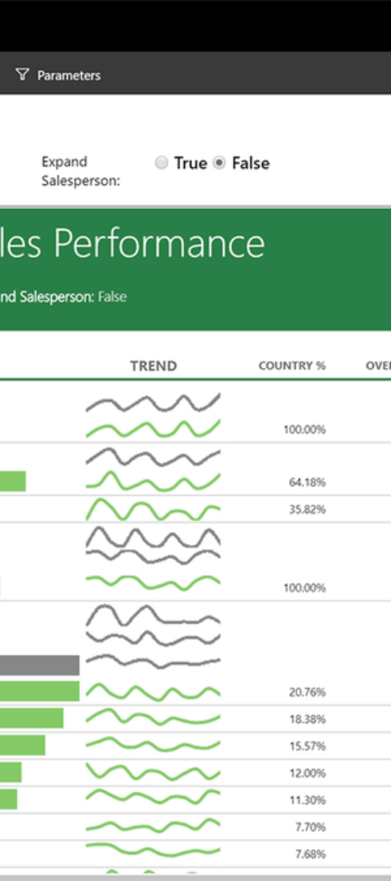
Power BI Architecture
Process Overview
Key Tools
Power BI architecture involves various tools and services working together to handle data processing and visualization.
Tools like Power BI Desktop, Mobile App, Power BI Services, and Power BI Server play crucial roles in the architecture.
Functionality
These tools together enable efficient data collection, processing, and sharing within the organization.

Slide 7
How it Works
1
Data Collection
Power BI gathers data from various sources such as databases, spreadsheets, and cloud services.
Data Transformation
2
The collected data is cleaned, transformed, and prepared for analysis using Power Query.
3
Data Modeling
Power BI creates a data model by defining relationships and hierarchies between different tables.
Report Creation
4
Users design reports and visualizations using the Power BI Desktop tool.
5
Data Publishing
Reports and dashboards are published to the Power BI service, allowing users to access them from anywhere.
Data Refresh
6
The data is regularly refreshed to ensure the reports and visualizations are up to date.
7
Data Sharing
Users can share reports and dashboards with others, enabling collaboration and data-driven decision making.
With these steps, Power BI enables organizations to gain valuable insights from their data and make informed decisions.

Slide 8
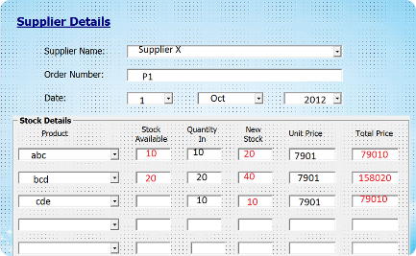
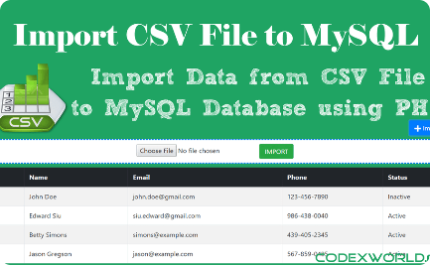

Importing Data from Various Sources
From Excel
From Database
From Webpages
Power BI allows seamless importing of data from Excel spreadsheets, making it easy to work with existing data.
Data from databases like MS-SQL can be directly imported into Power BI for analysis.
Web data can be extracted and integrated into Power BI for comprehensive analysis and visualization.

Slide 9




Visual Data Revision
Understanding Data
Insightful Analysis
Effective Reporting
Power BI helps in gaining a deeper understanding of organizational data through visual representations.
It enables insightful analysis of data, allowing users to make informed decisions based on the available information.
Reporting using Power BI ensures clear and impactful communication of key insights derived from the data.

Slide 10

Data Visualization Impact
1
Enhanced Insights
Power BI enables users to gain enhanced insights into the data through interactive and visually appealing dashboards.
Efficient Decision Making
2
It facilitates efficient decision-making by presenting complex data in a simplified and understandable manner.
3
Improved Communication
It improves communication within the organization by effectively sharing data insights across the teams.

Slide 11

Summarizing Power BI
Benefits of Power BI
Endless Possibilities
Power BI offers a wide range of benefits, including advanced data visualization and insightful analysis.
With its diverse functionality, Power BI opens up endless possibilities for data analysis and decision-making.
Empowered Decision Making
It empowers businesses to make informed decisions based on accurate, real-time data insights.

Slide 12
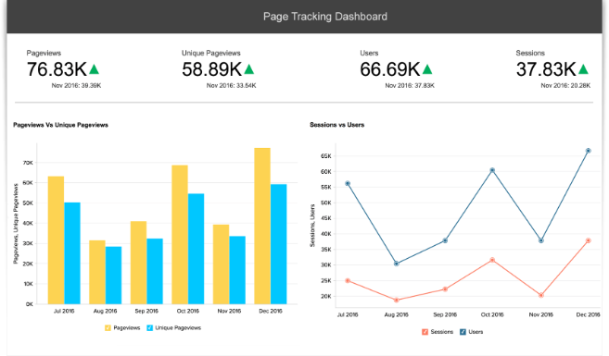
Conclusion
Power BI stands as a testament to the evolution of business intelligence, offering a dynamic platform that empowers organizations to harness the full potential of their data.

