Slide 1
BANKING, FINANCIAL SERVICES & INSURANCE | BFSI | NEWTON SCHOOL OF TECHNOLOGY
Strategic Credit
Delinquency Analysis
TEAM
MEMBERS
Avishkar Meher
Aryu Rao
Sameer Khan
Predictive Modeling for Financial Risk Mitigation
Satyam Swarnakar
Krishna Dave
INSTITUTE
Newton School of Technology, Rishihood University
MENTOR
Mr. Archit Raj
Ritik Atri
SUBMISSION
February 2026
TEAM
Section A — Group 3
01

Slide 2
Context & Problem Statement
02
SECTOR CONTEXT
PROBLEM STATEMENT
OBJECTIVES
Why This Problem Matters:
Core Business Question:
Clean and process 15,000 credit profiles from the "Give Me Some Credit" dataset.
In the unsecured lending market, accurately assessing borrower risk is the primary driver of profitability. Digital lending requires faster, more accurate risk tools.
Credit delinquency (90+ days past due) is the primary driver of capital erosion. Static scoring models miss behavioral nuances like sudden utilization spikes.
Quantify the impact of Revolving Utilization on default probability.
Who Are the Decision-Makers?
Specifically:
Chief Risk Officers, Underwriting Teams, and Portfolio Managers who set credit policy and approve loan applications.
How can Revolving Utilization and behavioral signals predict Serious Delinquency within a 2-year window?
Design an interactive Google Sheets dashboard for credit officers.
Develop a 3-tier borrower risk segmentation framework.

Slide 3
Data Engineering — Source to Sink
03
SOURCE
CLEANING
KEY COLUMNS
Dataset:
Median Imputation:
RevolvingUtilization:
"Give Me Some Credit" (cs-training.csv → df.csv)
MonthlyIncome had 20% missing — median applied to avoid high-income skew.
Balance ÷ credit limit — strongest single predictor
Size:
Outlier Capping:
DebtRatio:
15,000 observations × 11 variables
RevolvingUtilization capped at 2.0 (200%) to remove erroneous data entries.
Monthly debt payments ÷ gross monthly income
Target Variable:
Integrity Check:
MonthlyIncome:
SeriousDlqin2yrs (Binary: 0 or 1)
Removed all records where age = 0 (invalid entries).
Primary economic indicator (20% imputed)
Type:
Output:
# Times 30-59, 60-89, 90+ Days Late:
Structured tabular data — individual credit records
Cleaned df.csv with 15,000 valid, analysis-ready records.
Behavioral delinquency signals

Slide 4
KPI & Metrics Framework
04
6.97%
~34%
$6,750
Delinquency Penetration Rate
Avg Credit Utilization (CUE)
Avg Monthly Income
(Count of Defaulted ÷ Total Borrowers) × 100
Average of RevolvingUtilizationOfUnsecuredLines
Mean of MonthlyIncome across 15,000 records
Why This KPI?
Why This KPI?
Why This KPI?
Primary portfolio health indicator — 1,099 of 15,772 borrowers defaulted. Directly tracks capital loss exposure.
The single strongest predictor. Utilization above 70% is nearly 10× more predictive than income alone.
Baseline economic benchmark used with DebtRatio (33%) to identify "Working Poor" high-risk segments.

Slide 5
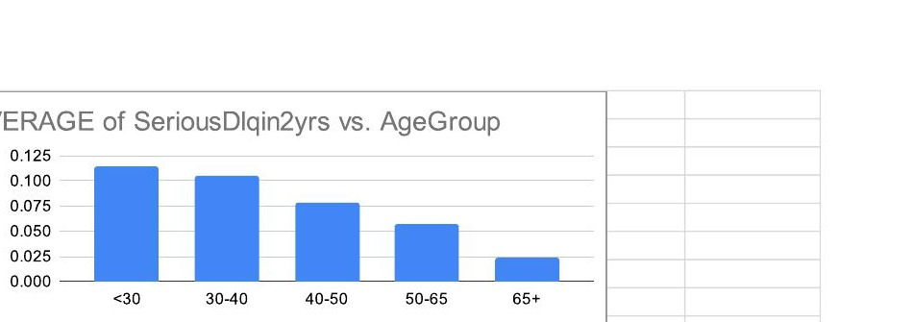
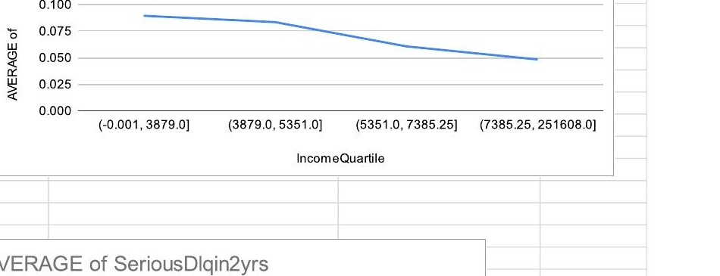
Key Insights — Exploratory Data Analysis
05
01
Utilization is the #1 Risk Signal
Default Rate by Age Group
Borrowers with 70-100% utilization default at 19.2% — nearly 10× the rate of those under 10% (2%). This single variable outperforms income as a predictor.
Source: Google Sheets EDA Dashboard
02
Age-Risk "Financial Maturity" Curve
Under-30 borrowers default at 11.5% — nearly 5× higher than 65+ borrowers (2.4%). Risk declines consistently with age group.
Credit Utilization vs. Default Rate (Pie)
03
Behavioral Lag: 30-59 Day Delays Escalate
Borrowers with just 1 prior 30-59 day delay show a 14.8% default rate — 3× those with none (4.4%). Each additional delay compounds this dramatically.

Slide 6
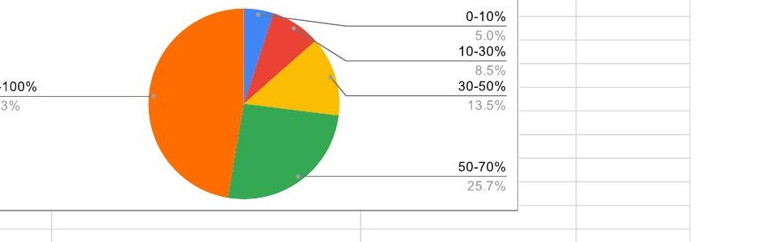
Advanced Analysis — Risk Segmentation & Tiering
06
TIER 1 — SAFE
TIER 2 — MONITOR
TIER 3 — CRITICAL
Age > 45 | Utilization < 30% | 0 Past Due Events
Age 30-45 | Utilization 30-70% | Debt Ratio < 0.5
Utilization > 70% | 1+ Past Due Events | Any Age
Risk Level:
Low — Standard approval
Risk Level:
Medium — Proactive watch
Risk Level:
High — Immediate action
Avg Default Rate:
~2-4% (per EDA cross-tab)
Avg Default Rate:
~5-10%
Avg Default Rate:
~19% (70-100% util. group)
Action:
No intervention required
Action:
Debt consolidation advisory; periodic review
Action:
EWS trigger; credit limit reduction
Utilization:
< 30%
Utilization:
30-70%
Utilization:
> 70%
Past Due Frequency vs. Default Rate
KEY FINDING |
Tier 3 borrowers (Util >70% + 1+ past due) carry a 19%+ default rate. Proactive EWS intervention before the 90-day threshold improves recovery rates by 20-25% — saving $1.2M per 10,000 loans.

Slide 7
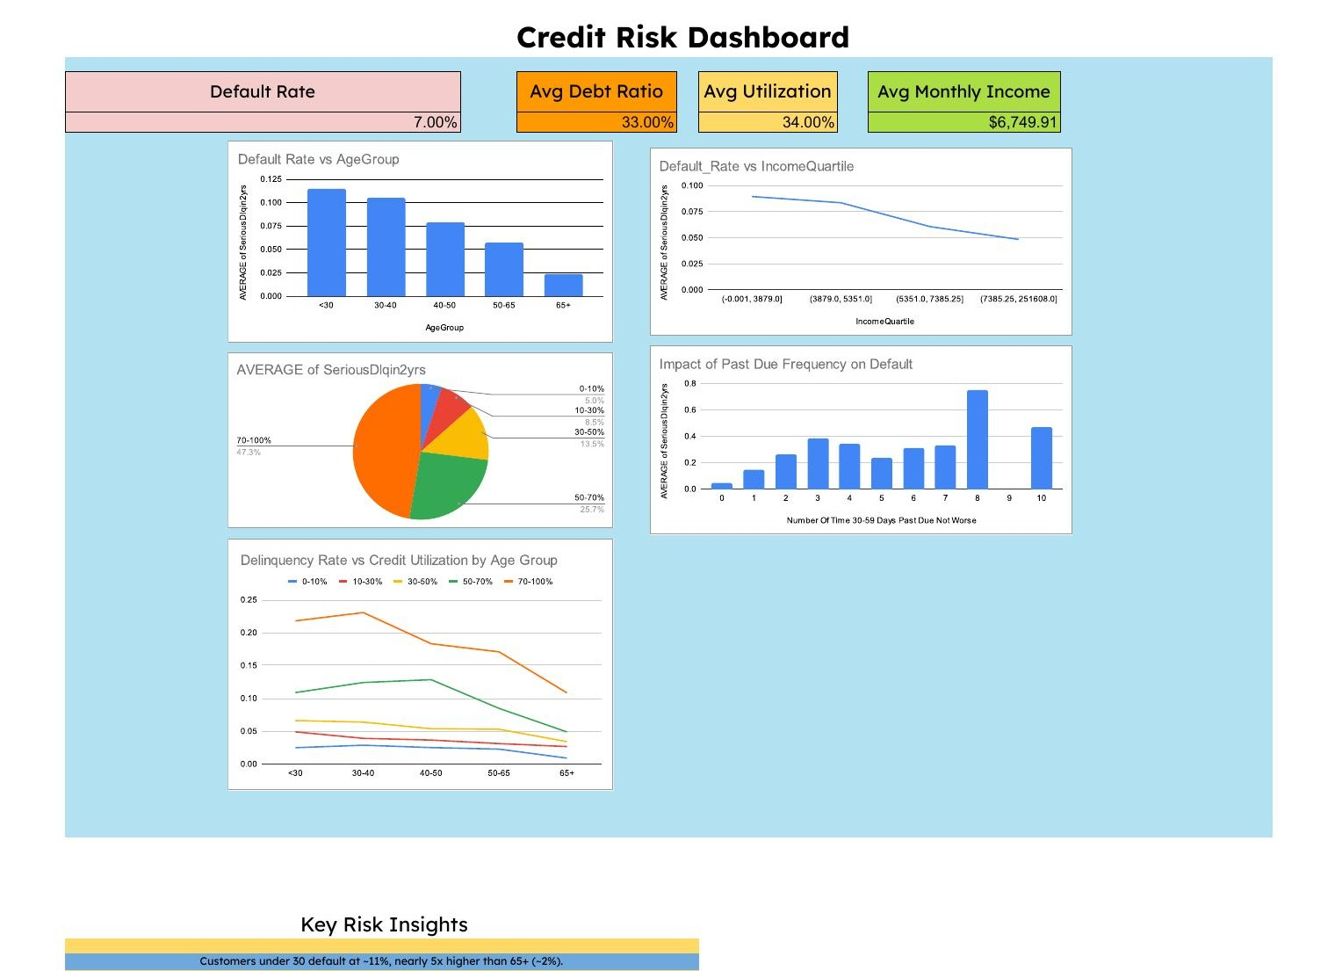
Dashboard Walkthrough — Google Sheets Credit Risk Dashboard
07
KPI Summary Cards
Default Rate (7%), Avg Debt Ratio (33%), Avg Utilization (34%), Avg Monthly Income ($6,749.91)
Age Group Bar Chart
Clearly shows the Financial Maturity curve — default risk halves with each age bracket above 30.
Utilization Pie Chart
70-100% util. bucket (orange) comprises 47% of all defaults despite being a smaller portion of borrowers.
Age × Utilization Lines
Multi-line chart shows every age group follows the same utilization-to-default escalation pattern.
Past Due Frequency Bar
Even 1 prior delay (30-59 days) triples default probability — validates the Early Warning System logic.

Slide 8
Recommendations & Impact — The "So What?"
08
01
Dynamic Credit Limit Reduction
Business Impact:
$1.2M
Action: Auto-trigger review when Utilization > 70% (~6 months before default).
Reduces Loss Given Default (LGD); prevents capital lock-up.
Savings
02
Debt Consolidation for Tier 2
Business Impact:
Per 10,000 loans via proactive filtering
Action: Offer single-term loan to age 30-45 borrowers with fragmented debt & Ratio 0.3-0.5.
Converts fragmented risk into one manageable payment; reduces churn.
40%
03
Early Warning System (EWS)
Business Impact:
35% higher accuracy than income; improves recovery by 20-25%.
Less Manual Review
Action: Flag borrowers with 2× 30-day delays in a single year — before 90-day event.
Automated dashboard replaces manual analysis
20-25%
04
Age-Segmented Interest Rate Pricing
Business Impact:
Action: Apply risk-based pricing for borrowers under 35 (collateral or higher rate).
Offsets 12% higher delinquency risk in under-35 segment.
Better Recovery
EWS intervention before 90-day threshold
Team: Avishkar Meher | Aryu Rao | Sameer Khan | Satyam Swarnakar | Krishna Dave | Ritik Atri — Section A, Group 3 | Newton School of Technology | February 2026

