Slide 1



Satellite Image Enhancement using (CLAHE)
By
          BT23ECI029: Harsh Yadav
          BT23ECI033: Sandesh Singh
          BT23ECI034: Satyam Gupta
          BT23ECI047: Krish Singh
          BT23ECI049: Nitesh Raghuwanshi
Under the Guidance of: Tapan Jain

Slide 2
Introduction
Satellite images often suffer from low contrast, haze, and poor illumination.
This affects their usability in remote sensing and geospatial analysis.
To overcome this, CLAHE (Contrast Limited Adaptive Histogram Equalization) is used to enhance local contrast.
It makes hidden details like terrain, vegetation, and water bodies more visible.

Slide 3
Literature Review
Enhance visual quality of satellite images.
Improve local contrast without amplifying noise.
Reveal hidden surface and texture details.
Preprocess satellite data for classification and analysis.

Slide 4
What is CLAHE?
CLAHE (Contrast Limited Adaptive Histogram Equalization) is an advanced image enhancement method.
It divides an image into small regions (tiles) and applies local histogram equalization.
The “contrast limit” prevents over-amplification of noise.

Slide 5
Methodology / Workflow
Input: Raw satellite image
Convert: RGB → LAB color space
Apply CLAHE: on L (lightness) channel
Apply RGB Equalization: to normalize tone
Merge: Channels and reconstruct final image
Output: Enhanced satellite image

Slide 6
Conclusion
CLAHE improves local contrast while preserving fine details.
It is an effective preprocessing step for remote sensing and environmental analysis.
The enhanced images provide more meaningful visual information for further interpretation or model training.

Slide 7
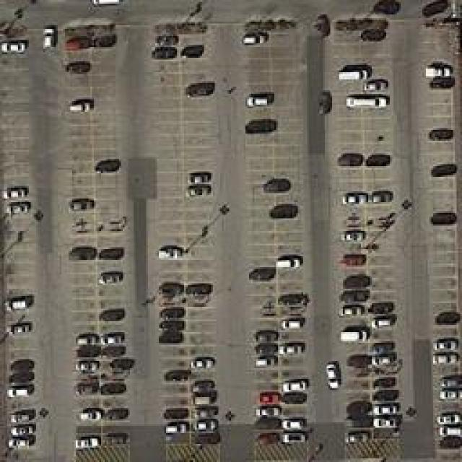
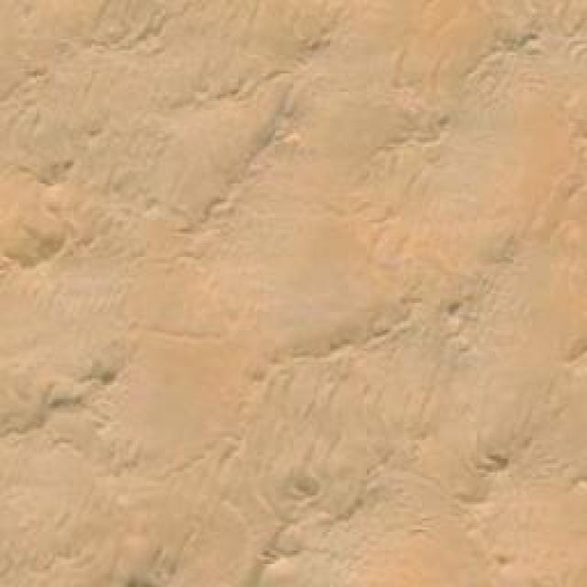
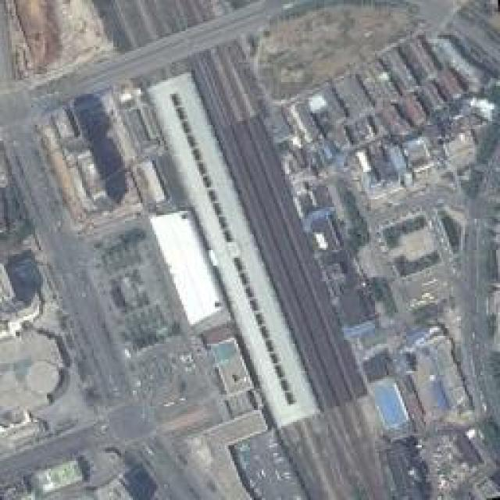
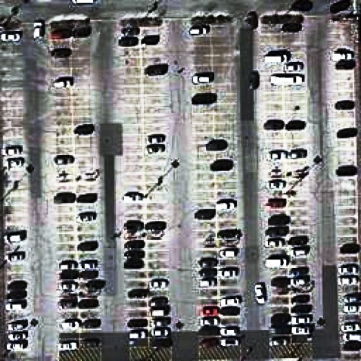
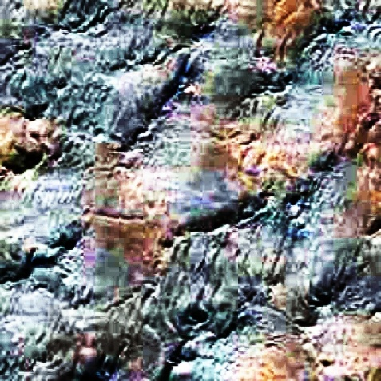
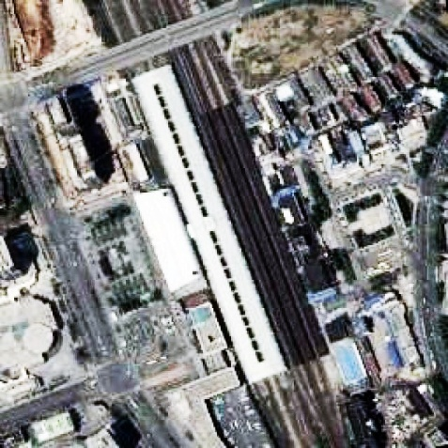
Results

Slide 8

16

