Slide 1

SMART INDIA HACKATHON 2026
TITLE PAGE
Problem Statement ID – SIH26173
Problem Statement Title- iTantra – Indian Multilingual TTS & STT Aided Neural Transceiver Radio Access for low bitrate links
Theme- Disaster Management / Miscellaneous
PS Category- Software
Team ID- ______
Team Name- Null Pointers

Slide 2
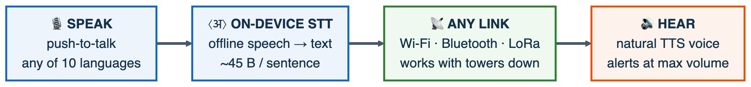
IDEA TITLE
Null
Pointers
iTantra: any Android phone becomes an offline semantic transceiver — speech → on-device STT (10 languages) → ~45-byte text over any surviving link → natural speech at the far end. Voice that travels as text: 165–251× less bandwidth than cellular voice.
USP
1. Text is the codec — 165–251× smaller
2. VarnaCode — built for Indic scripts
3. Evaluation Mode — rubric on stage
4. ₹1,650 LoRa bridge — link made real
5. 100% offline Bhashini-lineage AI
The Problem We Solve
1. Towers die in disasters: Cyclone Amphan downed ~7,000 of 14,167 WB cell towers; networks at 65–70% capacity for days (COAI).
2. Text alerts miss the vulnerable: rural female literacy ~50.6% — silent SMS structurally under-reaches the disaster-prone belts.
3. Language exclusion: ~90% of rural India communicates only in its mother tongue, across 22 scheduled languages.
4. Voice is too heavy for weak links: raw voice is 64,000 bps; even NATO’s MELPe battlefield codec needs 600 bps.
How iTantra Solves It
1. On-device STT: AI4Bharat IndicConformer int8 (MIT) ×9 Indic + English — measured RTF 0.055–0.119, fully offline.
2. Pause-aware sentences: Silero VAD chunks speech into sentences mid-hold, streamed as they form.
3. VarnaCode: Indic-script entropy coding, measured 4.6–5.3 bits/char — a spoken sentence in ~45 bytes = one LoRa frame.
4. Natural voice out: AI4Bharat FastPitch + Piper TTS (MIT), measured RTF 0.049; eSpeak-NG fallback — never silent.
5. Alert mode: priority frames auto-play at max volume, non-interruptible, with a place-name pronunciation lexicon.
6. Walkie-talkie loop: two phones, push-to-talk: STT mode ↔ TTS mode; app off = normal phone (the PS verification loop).
7. Any bearer: Wi-Fi (NSD+TCP) · Bluetooth RFCOMM · ₹1,650 ESP32-LoRa bridge (km-range, IN865 license-free).
8. Live Evaluation Mode: the app measures its own CER/RTF/latency — measured Hindi round-trip CER 1.6%.

Slide 3
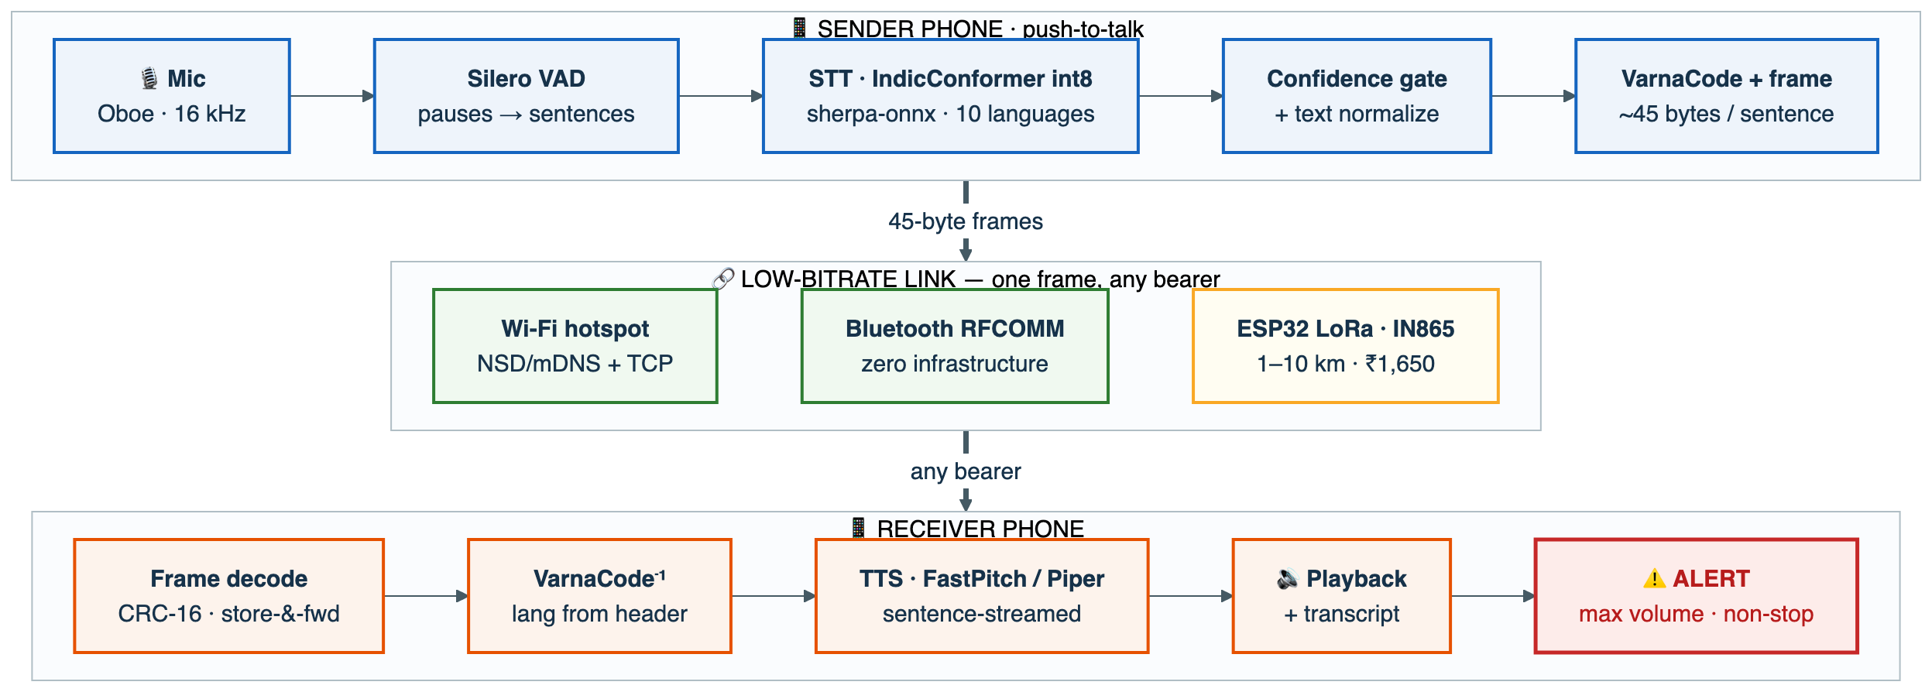
TECHNICAL APPROACH
Null
Pointers
Technologies
• Native Kotlin + Jetpack Compose — foreground service (mic) + audio-focus discipline for Android 14+; APK spine 878 KB, 7 JUnit tests green.
• sherpa-onnx (Apache-2.0): one JNI surface for STT + TTS + VAD — 14.5k★, actively maintained.
• STT: IndicConformer int8 ONNX (MIT) ×9 languages + English; desktop RTF 0.055–0.119 measured.
• TTS: Piper VITS ×6 + AI4Bharat FastPitch ONNX ×4, RTF 0.049 measured; eSpeak-NG fallback.
• Silero VAD (~2 MB) sentence chunking · Oboe (AAudio) 16 kHz low-latency audio.
• Transports: NSD/mDNS + TCP · Bluetooth RFCOMM · ESP32+SX127x LoRa (IN865, 1% duty).
• Protocol: VarnaCode + iTantra Frame [lang·priority·seq·CRC-16] — Kotlin↔Python byte-identical, 143 assertions.
• Compliance: 100% open-source (NC & proprietary SDKs excluded) · zero network calls.
Methodology: P0 desktop twin measured first (CER/RTF/compression) → P1–P2 Android spine + Hindi loop → P3 ten languages + alerts → P4 Evaluation Mode → P5 LoRa + AES-GCM.
Proposed Tech Stack
Kotlin + Compose
sherpa-onnx
IndicConformer int8
Piper / FastPitch
Silero VAD
Oboe audio
NSD + BT RFCOMM
ESP32 LoRa · IN865
Measured tonight — desktop CPU, real models
STT RTF 0.055–0.119 · TTS RTF 0.049 · Hindi round-trip CER 1.6% / WER 7.1%
VarnaCode 4.6–5.3 bits/char (hi·bn·ta·te·en) · 143 protocol assertions · Kotlin↔Python byte-identical

Slide 4
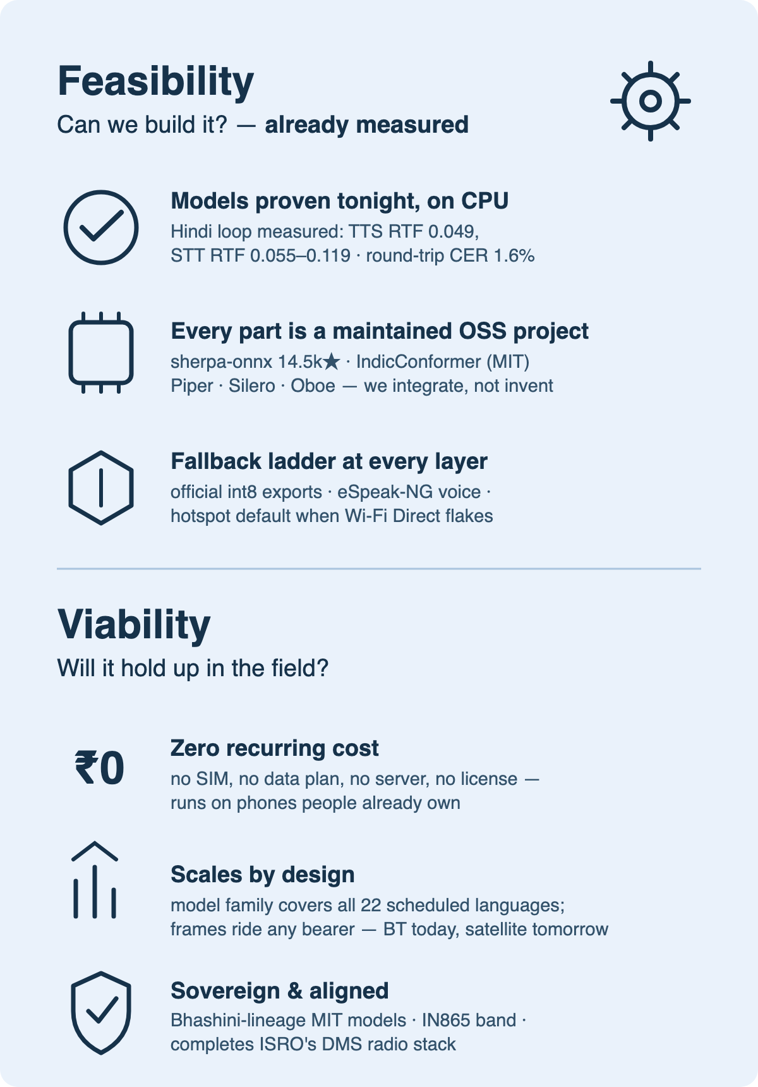
FEASIBILITY AND VIABILITY
Null
Pointers
1. On-device speed on budget phones
Problem: phone RTF unproven; figures are desktop/ARM-proxy. Approach: P0 measured desktop RTF 0.049–0.119 (8–20× real-time headroom); int8 ladder + smaller voices if a budget phone runs tight.
2. Community ONNX conversions
Problem: sherpa-onnx IndicConformer wrappers are community-made. Approach: Per-language QA budgeted; hard fallback = ONNX Runtime Mobile on AI4Bharat’s official int8 export.
3. TTS export for 4 languages
Problem: Gujarati, Kannada, Tamil, Odia lack ready ONNX voices. Approach: Same FastPitch→ONNX recipe as NVIDIA Riva; scoped to 4; eSpeak-NG keeps every language audible meanwhile.
4. Wi-Fi Direct is OEM-flaky
Problem: pairing silently fails on some vendor skins. Approach: Not on the critical path: hotspot + NSD + TCP default, Bluetooth RFCOMM backup, Wi-Fi Direct = stretch.
5. Android background-audio policy
Problem: where stale sample apps die (fg-service types, focus). Approach: Built fresh and first: fg service + audio focus already in the P1 spine — compiling, tested.
6. STT errors become spoken misinformation
Problem: a mis-recognition would be confidently re-spoken. Approach: Confidence gate (“repeat that?”), transcript on both screens, pronunciation lexicon for alerts.

Slide 5
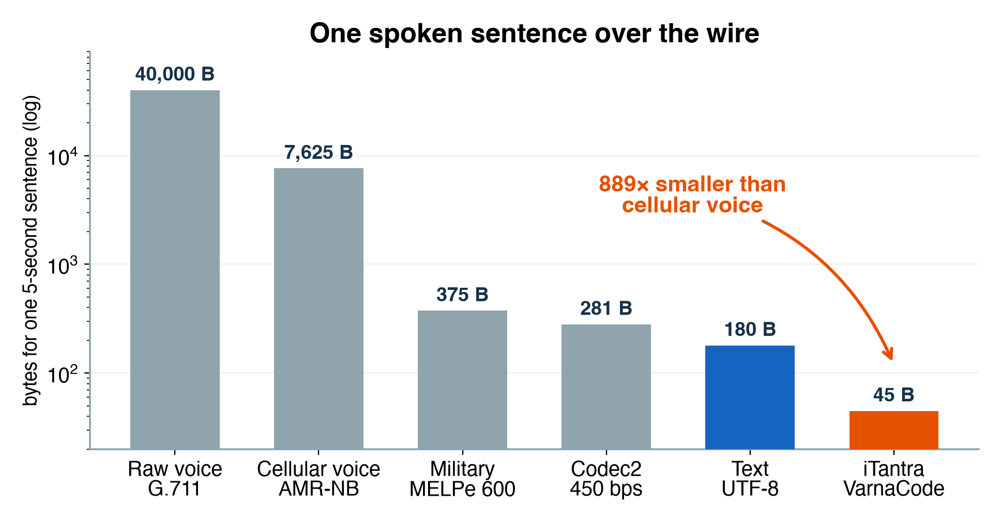
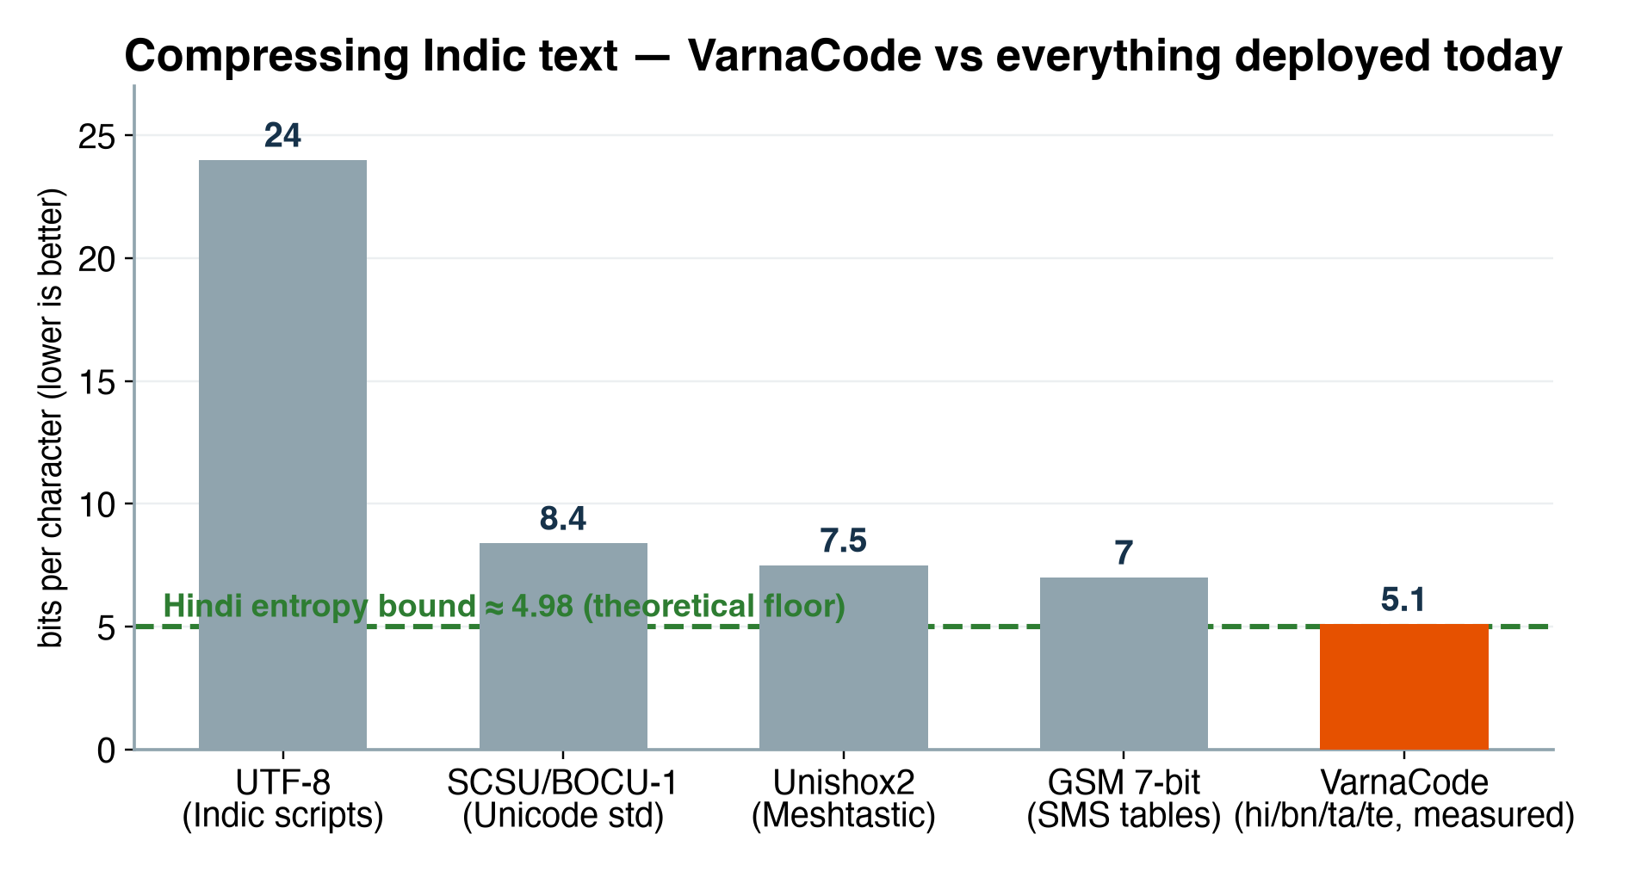
IMPACT AND BENEFITS
Null
Pointers
Potential Impacts
• Last-mile inclusion: voice-native two-way comms reach the ~50% of rural women and 1-in-3 rural Indians whom text alerts miss — in their own language.
• Completes ISRO’s disaster stack: the multilingual voice layer for GSAT mobile-radio / VSAT–SDMA low-bitrate links (DMS programme).
• Resilience economics: existing phones + ₹1,650 LoRa node vs ₹8,000–25,000 hardware walkie-talkie pairs.
• Research → reality: a deployable Indian instance of 6G semantic communication.
Benefits
• Social: literacy-independent; 10 languages ≈ 85%+ of India; voice serves visually-impaired, transcript serves hearing-impaired.
• Economic: zero recurring cost — no SIM, no data plan, no server; open-source, procurement-friendly.
• Strategic: sovereign stack — Indian models (Bhashini/AI4Bharat), Indian band plan (IN865), no foreign cloud.
• Environmental / operational: int8-efficient; LoRa nodes run days on a power bank — works on solar in a blackout.

Slide 6
RESEARCH AND REFERENCES
Null
Pointers
1. Cyclone Amphan outage: ~7,000/14,167 WB towers down; 65–70% capacity for days (COAI). deccanherald.com
2. The bitrate math: MELPe 600 bps (STANAG 4591) & Codec2 450 bps vs speech-as-text ≈107 bps. melp.org · github.com/drowe67/codec2
3. Semantic communications survey: Qin, Tao, Lu, Tong & Li, 2021. arxiv.org/abs/2201.01389
4. DeepSC-ST: recognition-domain speech transceiver, IEEE Trans. Wireless Comm. 2023. doi.org/10.1109/TWC.2023.3240969
5. STT over low-rate links: up to 94% latency reduction vs compressed audio (2025). researchgate.net/394380603
6. IndicConformer (AI4Bharat): MIT, 22 languages, official int8 ONNX; Hindi WER 13.2 (Vaani). huggingface.co/ai4bharat
7. AI4Bharat Indic-TTS: FastPitch + HiFi-GAN, MIT, 13 Indic languages. arxiv.org/abs/2211.09536
8. CER, not WER, for Indic ASR: WER over-punishes agglutinative languages. arxiv.org/abs/2203.16601
9. J-Alert (Japan): national TTS-spoken disaster alerts in 5 languages. wikipedia.org/wiki/J-Alert
10. IN865 LoRa: 865–867 MHz license-free, 1% duty, 30 dBm — km-range at ₹1,650/node. ensembletech.in
11. Project repository: app + firmware + evaluation harness + license audit (link added on submission).
Everything above is reproducible: private repo — 143 protocol assertions · measured CER 1.6% Hindi loop · compiling Android APK (878 KB) — built before submission, not promised.

