Slide 1



SMART INDIA HACKATHON 2026
Null Pointers
TITLE PAGE
Problem Statement ID – SIH26173
Problem Statement Title- iTantra – Indian Multilingual TTS & STT Aided Neural Transceiver Radio Access for low bitrate links
Theme- Disaster Management
PS Category- Software
Team ID- ______
Team Name- Null Pointers

Slide 2
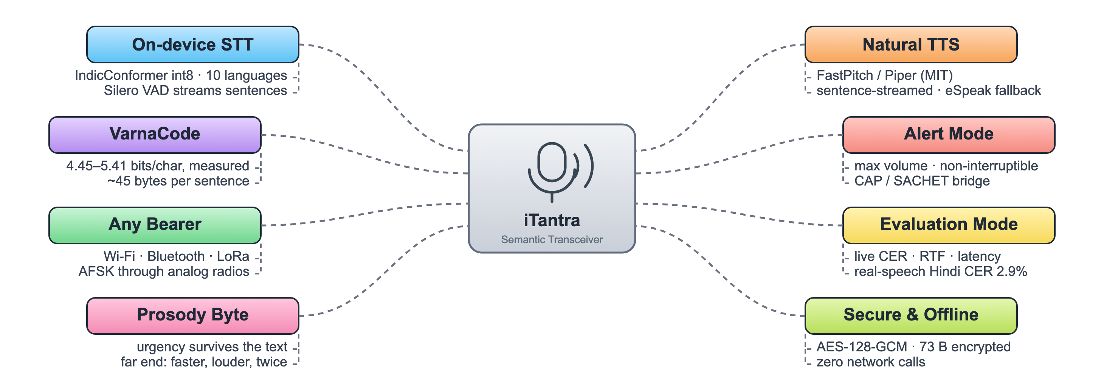
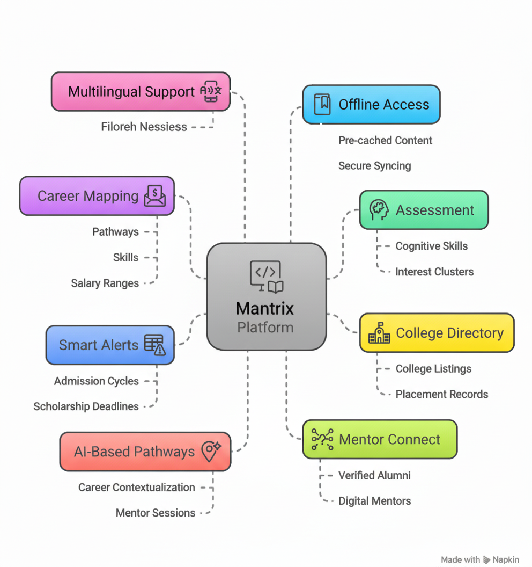
IDEA TITLE
Null Pointers
iTantra, our offline semantic transceiver, turns any Android phone into a 10-language walkie-talkie: speech becomes ~45-byte text, crosses any surviving link — Wi-Fi, Bluetooth, LoRa, even an analog radio — and is spoken again at the far end.
Challenges in a Disaster:
Towers Die First: Cyclone Amphan downed ~7,000 of 14,167 WB cell sites; networks ran at 65–70% for days.
Text Alerts Miss the Vulnerable: rural literacy 73%, rural women ~51% — silent SMS under-reaches the exposed.
Language Exclusion: ~90% of rural India speaks only its mother tongue, across 22 languages.
Voice Is Too Heavy for Weak Links: raw voice is 64 kbps; even NATO's MELPe codec needs 600 bps.
How iTantra Provides Solutions
On-device STT: IndicConformer int8 (MIT) ×9 + English; Silero VAD streams sentences mid-hold; fully offline.
VarnaCode: Indic text at 4.45–5.41 bits/char (measured) — a sentence in ~45 bytes, one LoRa frame.
Natural Voice Out: AI4Bharat FastPitch + Piper TTS (MIT), sentence-streamed; eSpeak-NG fallback.
Alert Mode: priority frames auto-play at max volume, non-interruptible, with a place-name lexicon.
Any Bearer: Wi-Fi (NSD+TCP) · Bluetooth RFCOMM · ₹1,650 ESP32 LoRa · AFSK through any analog radio.
Prosody Byte: 1 byte of urgency — panic is spoken fast, loud and twice at the far end.
Evaluation Mode: the app measures its own CER, RTF and latency on stage — real-speech Hindi CER 2.9%.
USP
Text Is the Codec
VarnaCode Compression
Voice via Any Radio
Live Evaluation Mode
Offline & Open-Source

Slide 3
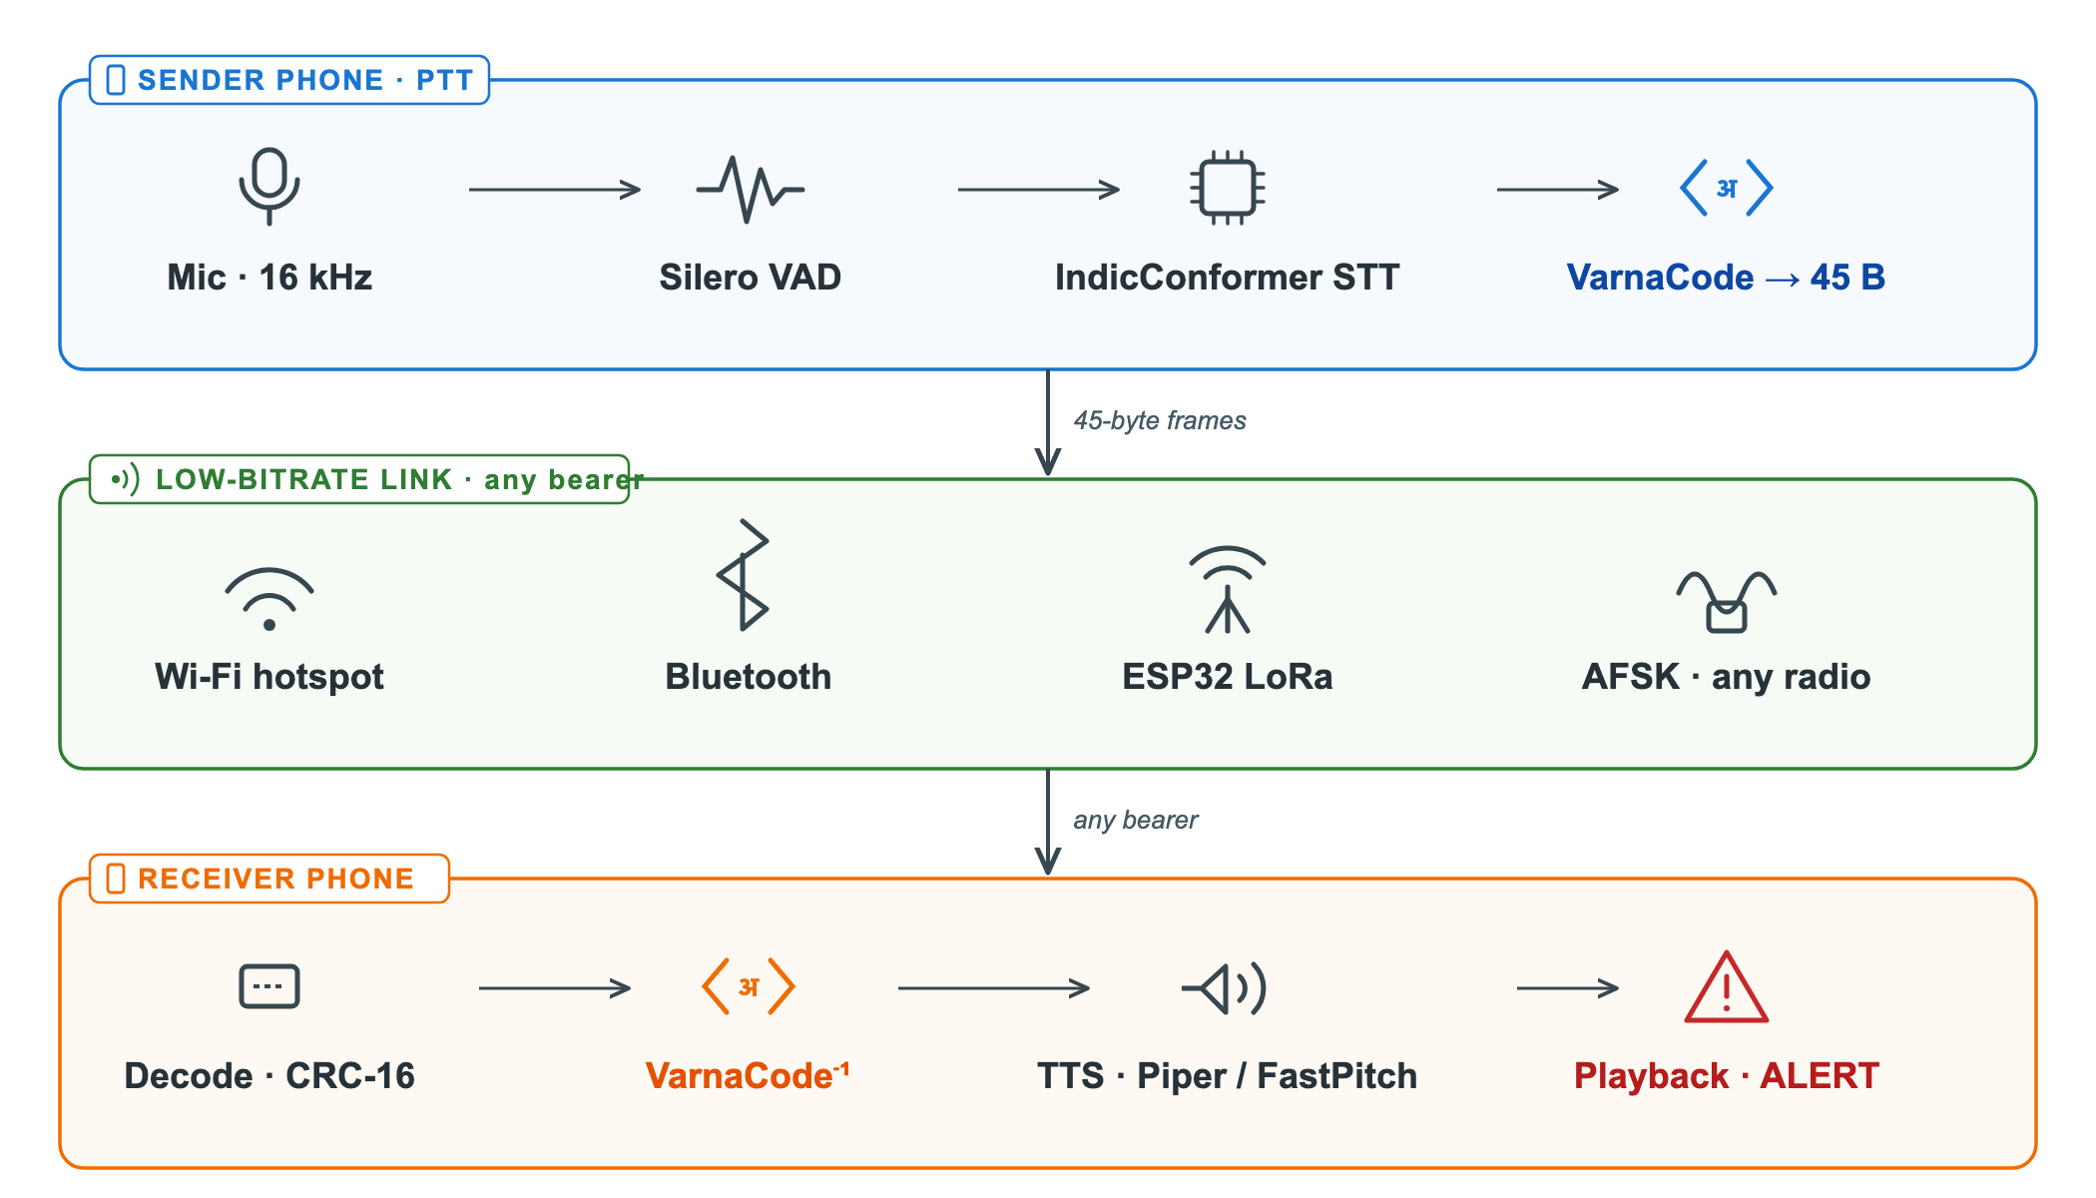
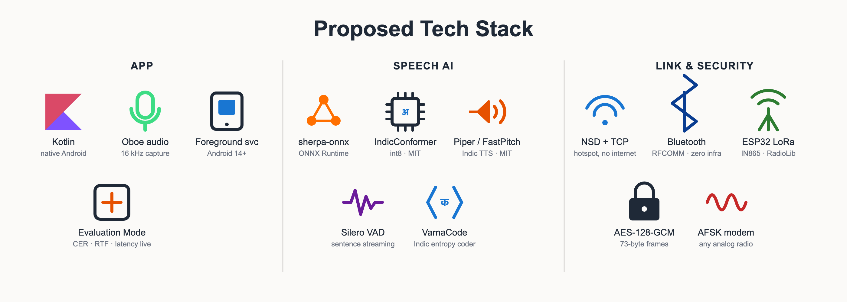
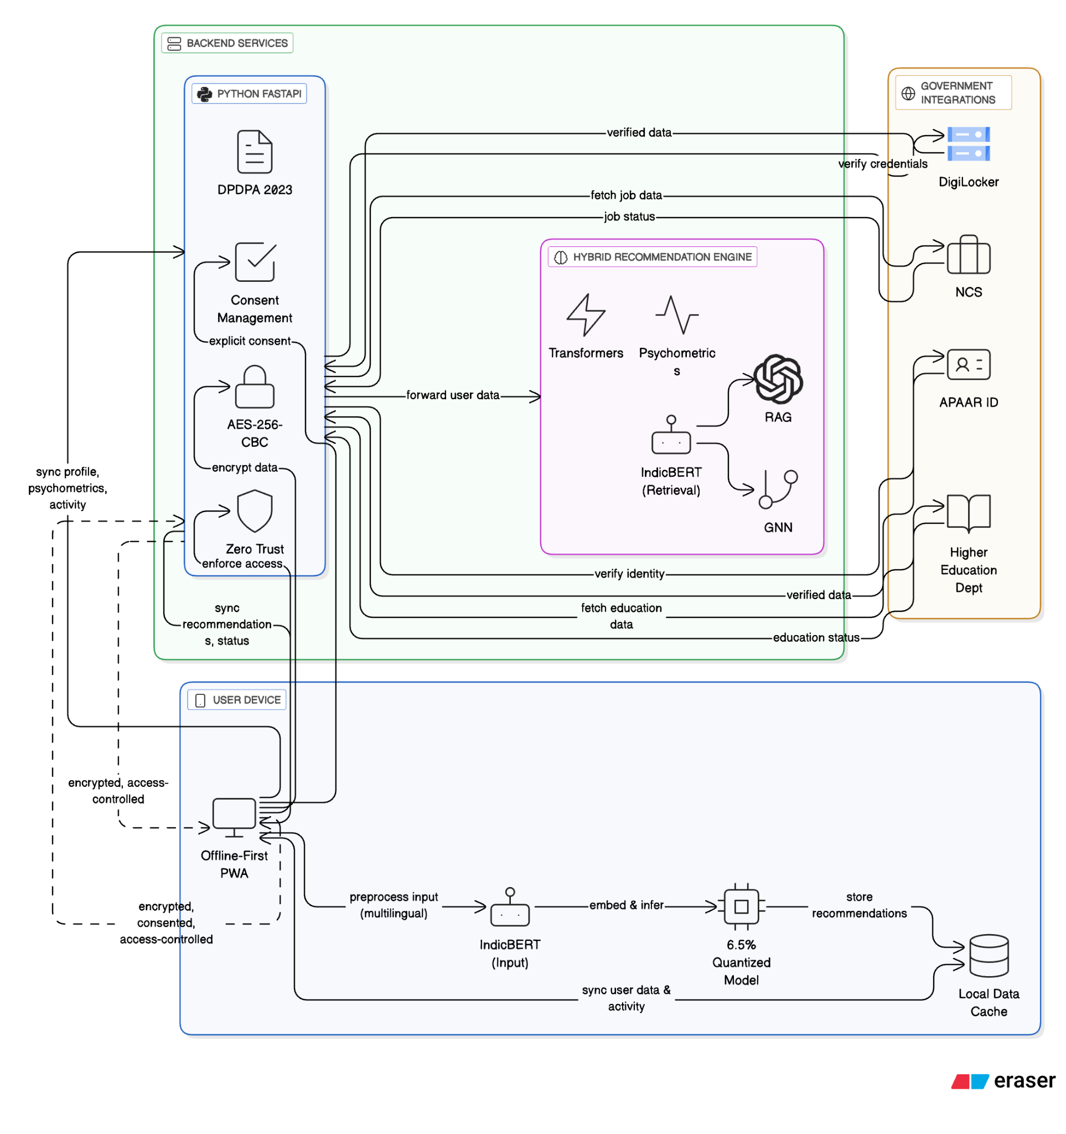
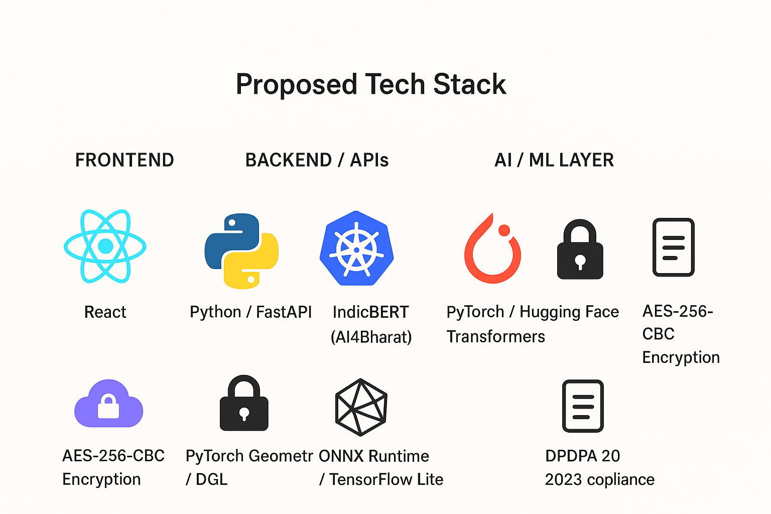
TECHNICAL APPROACH
Null Pointers
Semantic Transceiver Pipeline: Mic → Silero VAD → IndicConformer STT → VarnaCode → 45-byte frame → any bearer → VarnaCode⁻¹ → FastPitch / Piper TTS, on one sherpa-onnx runtime.
Native Kotlin App: foreground service + audio focus (Android 14+), Oboe 16 kHz capture, 54 MB APK with the full speech runtime; ~200 MB language packs.
VarnaCode + Frame Protocol: corpus-trained Indic Huffman coder; frames carry lang · priority · seq · CRC-16, optional AES-128-GCM and a prosody byte; Kotlin ↔ Python ↔ C byte-identical.
Pluggable Bearers: NSD + TCP over hotspot, Bluetooth RFCOMM, ESP32-LoRa bridge (IN865, 1% duty guard) and a Bell-202 AFSK modem for analog radios.
Measured, Not Estimated: real-speech CER hi 2.9% / bn 4.0% / te 7.8%, RTF 0.06; int8 packs 140 MB; 222 protocol assertions; two-phone loop proven.
Open-Source & Offline: MIT/Apache Bhashini-lineage models, zero network calls; proprietary SDKs and NC-licensed models excluded.

Slide 4
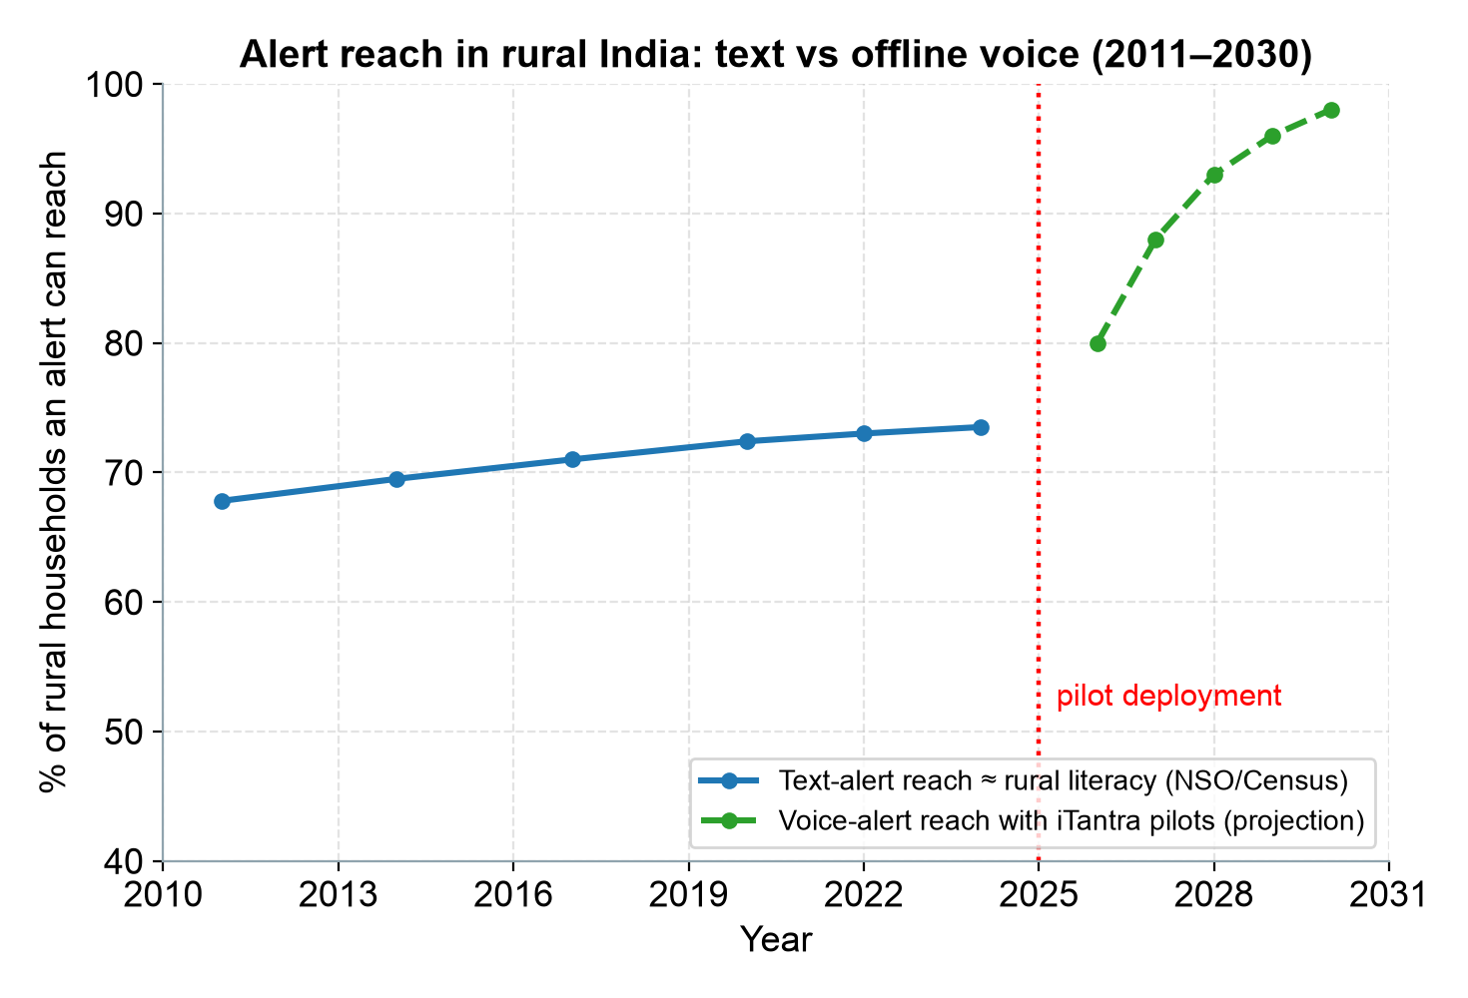
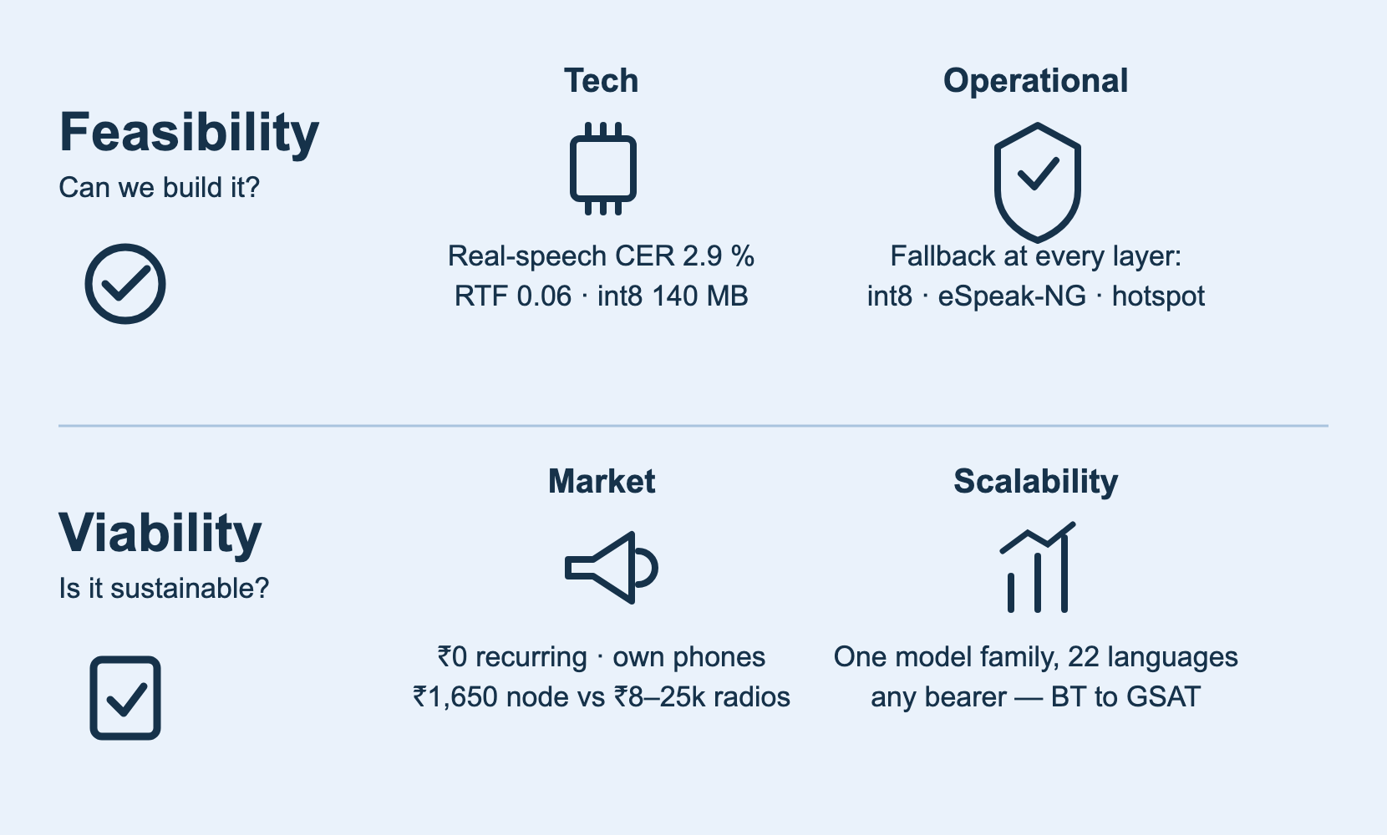
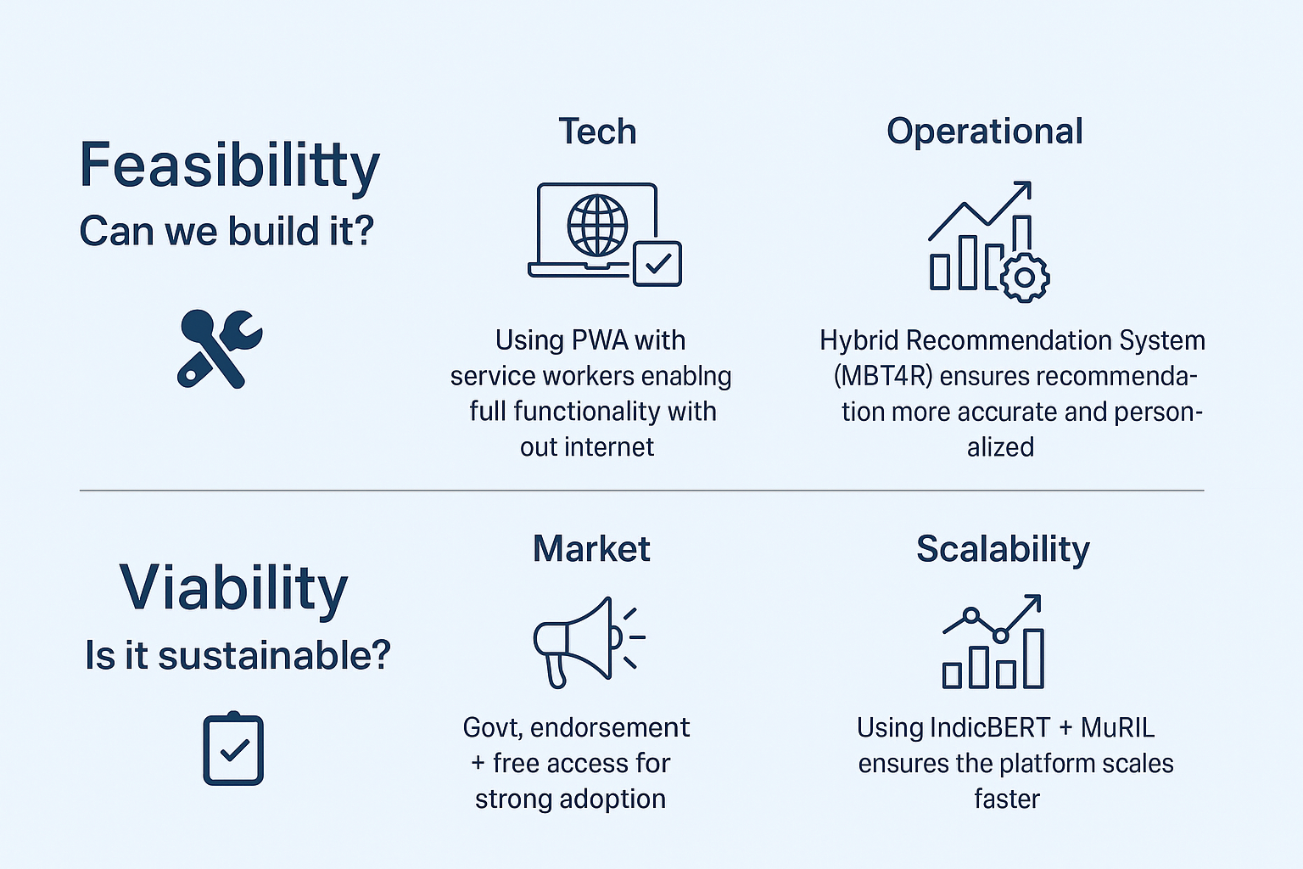
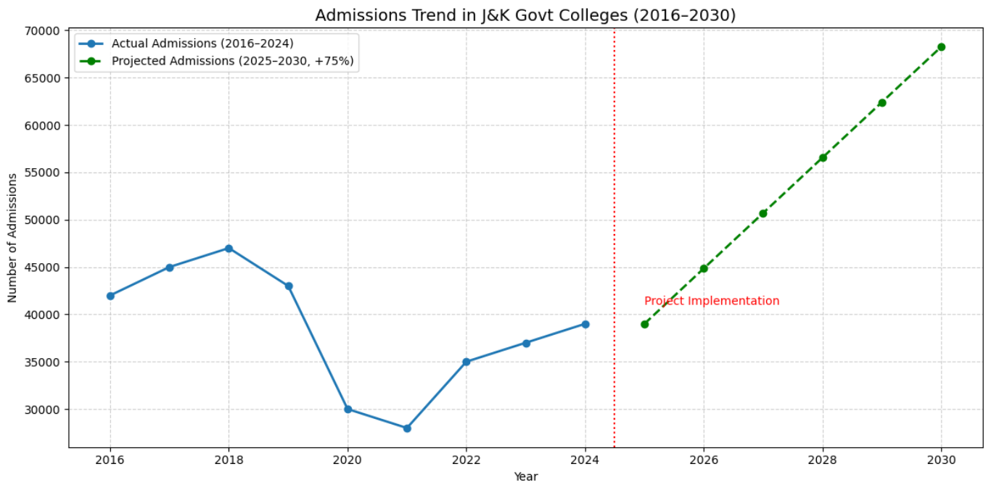
FEASIBILITY AND VIABILITY
Null Pointers
Tech Feasibility : On-Device Speed
Problem: budget phones may run slower than our desktop numbers.
Approach: int8 models (measured RTF 0.06) + streaming decode; Conformers already run RTF 0.19 on wearables.
Operational Feasibility: Model Availability
Problem: community ONNX conversions of IndicConformer are unofficial.
Approach: our converter fixes 12 languages' ONNX metadata; fallback = AI4Bharat's official int8 export.
Market (Demand & Adoption)
Problem: hardware walkie-talkies cost ₹8,000–25,000 and speak one language.
Approach: phones people already own + a ₹1,650 LoRa node; pilot with a coastal district committee.
Financial (Cost vs Revenue)
Problem: free tools die when funding dries up.
Approach: zero recurring cost (no SIM, server, licence); NDMA/SDMA procurement; open-source self-hosting.
Growth and Potential
Problem: 22 languages and many bearers to cover.
Approach: one model family covers all 22; frames ride any bearer — Bluetooth today, GSAT tomorrow.
Bridging the Trust Gap
Problem: a mis-recognition could become spoken misinformation.
Approach: confidence gate, transcript on both screens, alert pronunciation lexicon, encrypted frames.

Slide 5
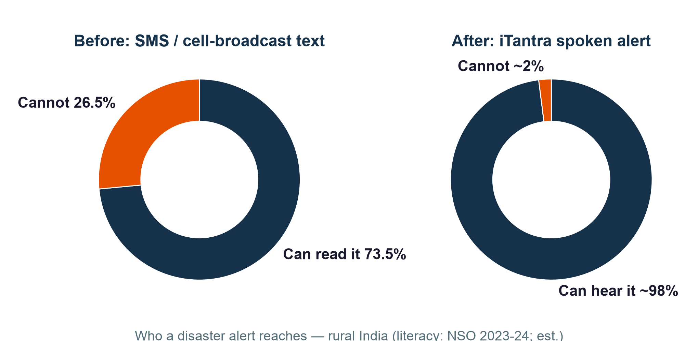
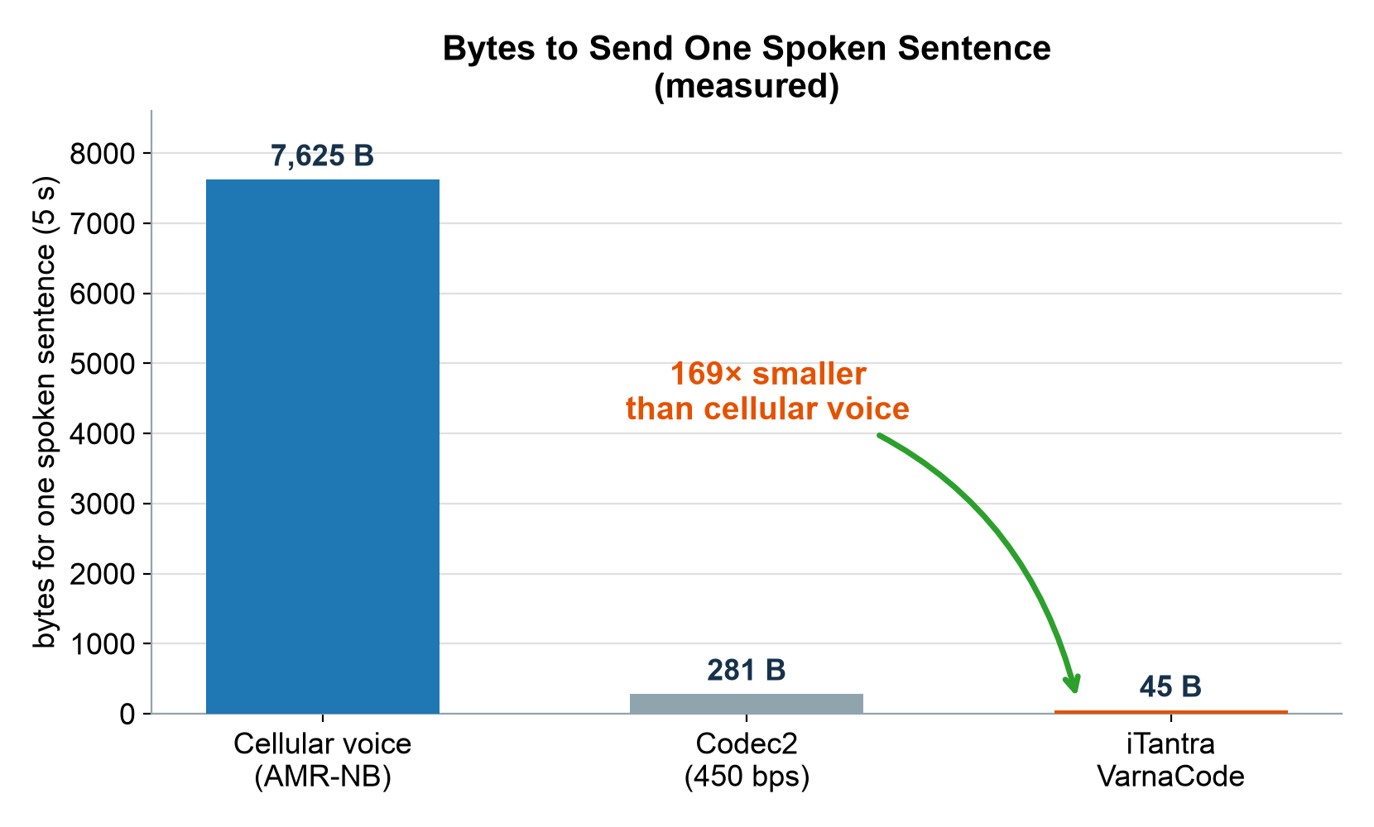
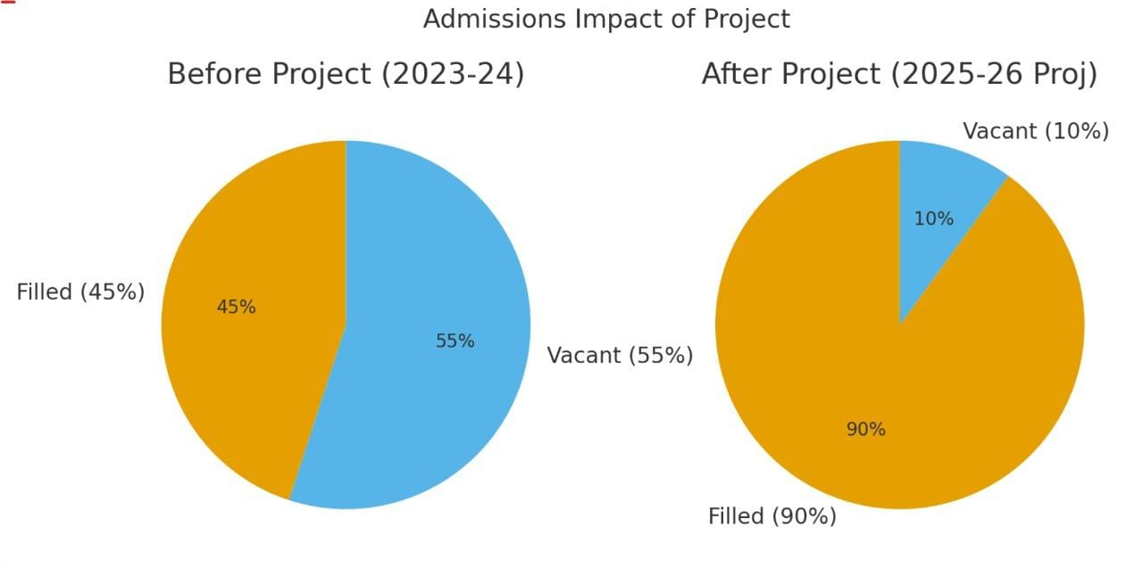
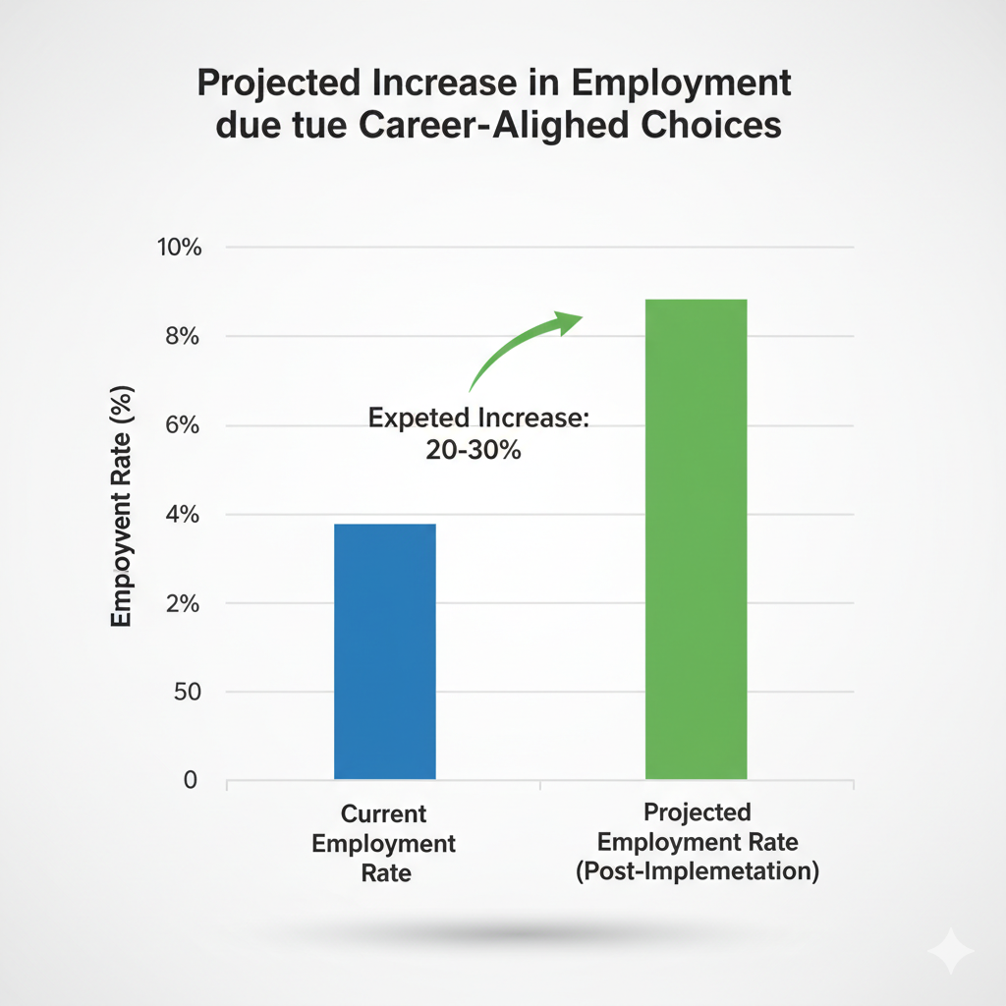
IMPACT AND BENEFITS
Null Pointers
Potential Impacts
Last-Mile Inclusion: voice-native two-way comms reach the ~50% of rural women and 1-in-4 rural Indians whom text alerts miss — in their own language.
Completes ISRO's Disaster Stack: the multilingual voice layer for GSAT mobile-radio and VSAT–SDMA low-bitrate links.
Two-Way Beats Broadcast: Kerala 2018 — 40+ ham operators aided 2,000+ people when towers died; iTantra puts that on every phone.
Research → Reality: a deployable Indian instance of 6G semantic communication — transmit the meaning, not the bits.
Benefits
Literacy-Independent: 10 languages ≈ 85% of India; voice serves the visually impaired, transcript serves the hearing impaired.
Zero Recurring Cost: no SIM, data plan or server; open-source, procurement-friendly for states and NGOs.
Sovereign Stack: Indian models (Bhashini / AI4Bharat), Indian band plan (IN865), no foreign cloud.
Resilient: int8-efficient; LoRa nodes run days on a power bank — deployable on solar in a total blackout.

Slide 6
RESEARCH AND REFERENCES
Null Pointers
Project Repository : Kotlin app + ESP32 firmware + evaluation harness (private; jury access on submission). LINK
Cyclone Amphan Outage: ~7,000 of 14,167 WB towers down; networks at 65–70% capacity for days (COAI).LINK
The Bitrate Math: MELPe 600 bps (NATO STANAG 4591) and Codec2 450 bps vs speech-as-text ≈ 107 bps.LINK
Semantic Communications Survey: Qin, Tao, Lu, Tong & Li, 2021 — transmit meaning, not bits.LINK
DeepSC-ST: speech transceiver transmitting recognition-domain features, IEEE Trans. Wireless Comm. 2023.LINK
STT over Low-Data-Rate Links: up to 94% latency reduction vs compressed audio (2025).LINK
IndicConformer (AI4Bharat): MIT, all 22 Indian languages, official int8 ONNX; Hindi WER 13.2 (Vaani).LINK
AI4Bharat Indic-TTS: FastPitch + HiFi-GAN, MIT, 13 Indic languages.LINK
CER, not WER, for Indic ASR: WER disproportionately punishes agglutinative languages.LINK
WEA Message-Length Study (2024): 360-char alerts no better than 90-char — validates the 45-byte design.LINK
IN865 LoRa Legality: 865–867 MHz licence-free, 1% duty, 30 dBm — km-range at ₹1,650/node.LINK

