Slide 1
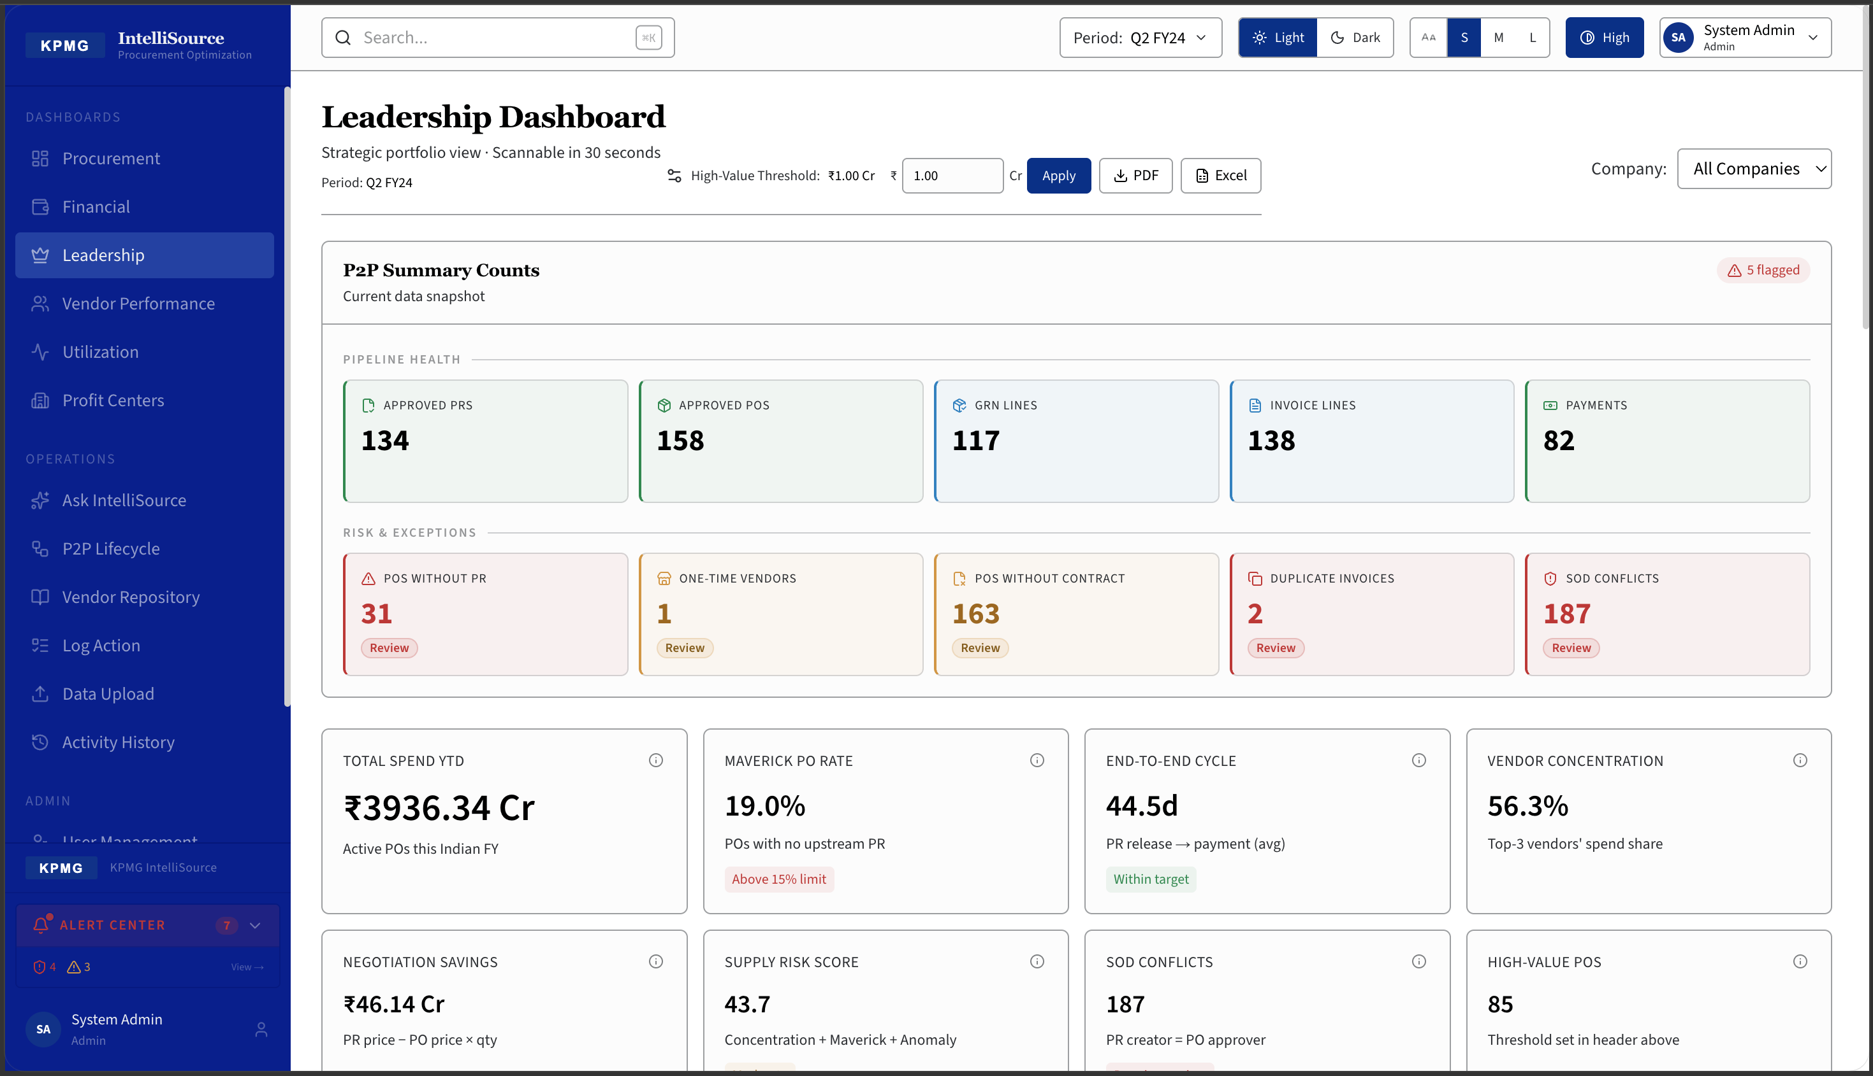
KPMG
India | Procurement Advisory
IntelliSource
SAP Procurement Intelligence Platform
₹3,936 Cr Spend Visibility
187 SOD Conflicts Detected
5 Role-Specific Dashboards
44.5 Days End-to-End P2P
Application Demo | Q2 FY2024
CONFIDENTIAL

Slide 2
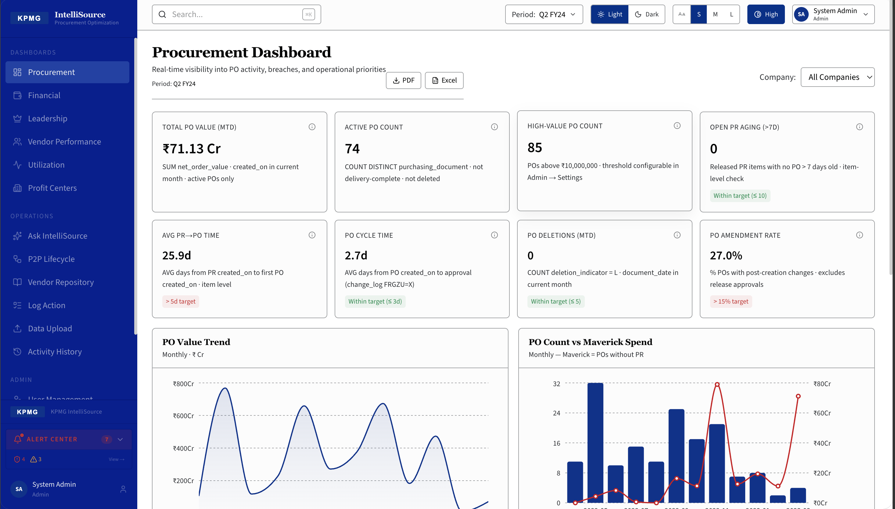
Procurement Dashboard
PO Lifecycle · Maverick Spend · Cycle Time
₹71.13 Cr
Total PO Value
74
Active POs
85
High-Value POs
(above ₹1 Cr)
2.7 Days
Avg PO Cycle
Time
19%
Maverick
Spend Rate
Audience: Procurement Manager
KPMG | IntelliSource | CONFIDENTIAL

Slide 3
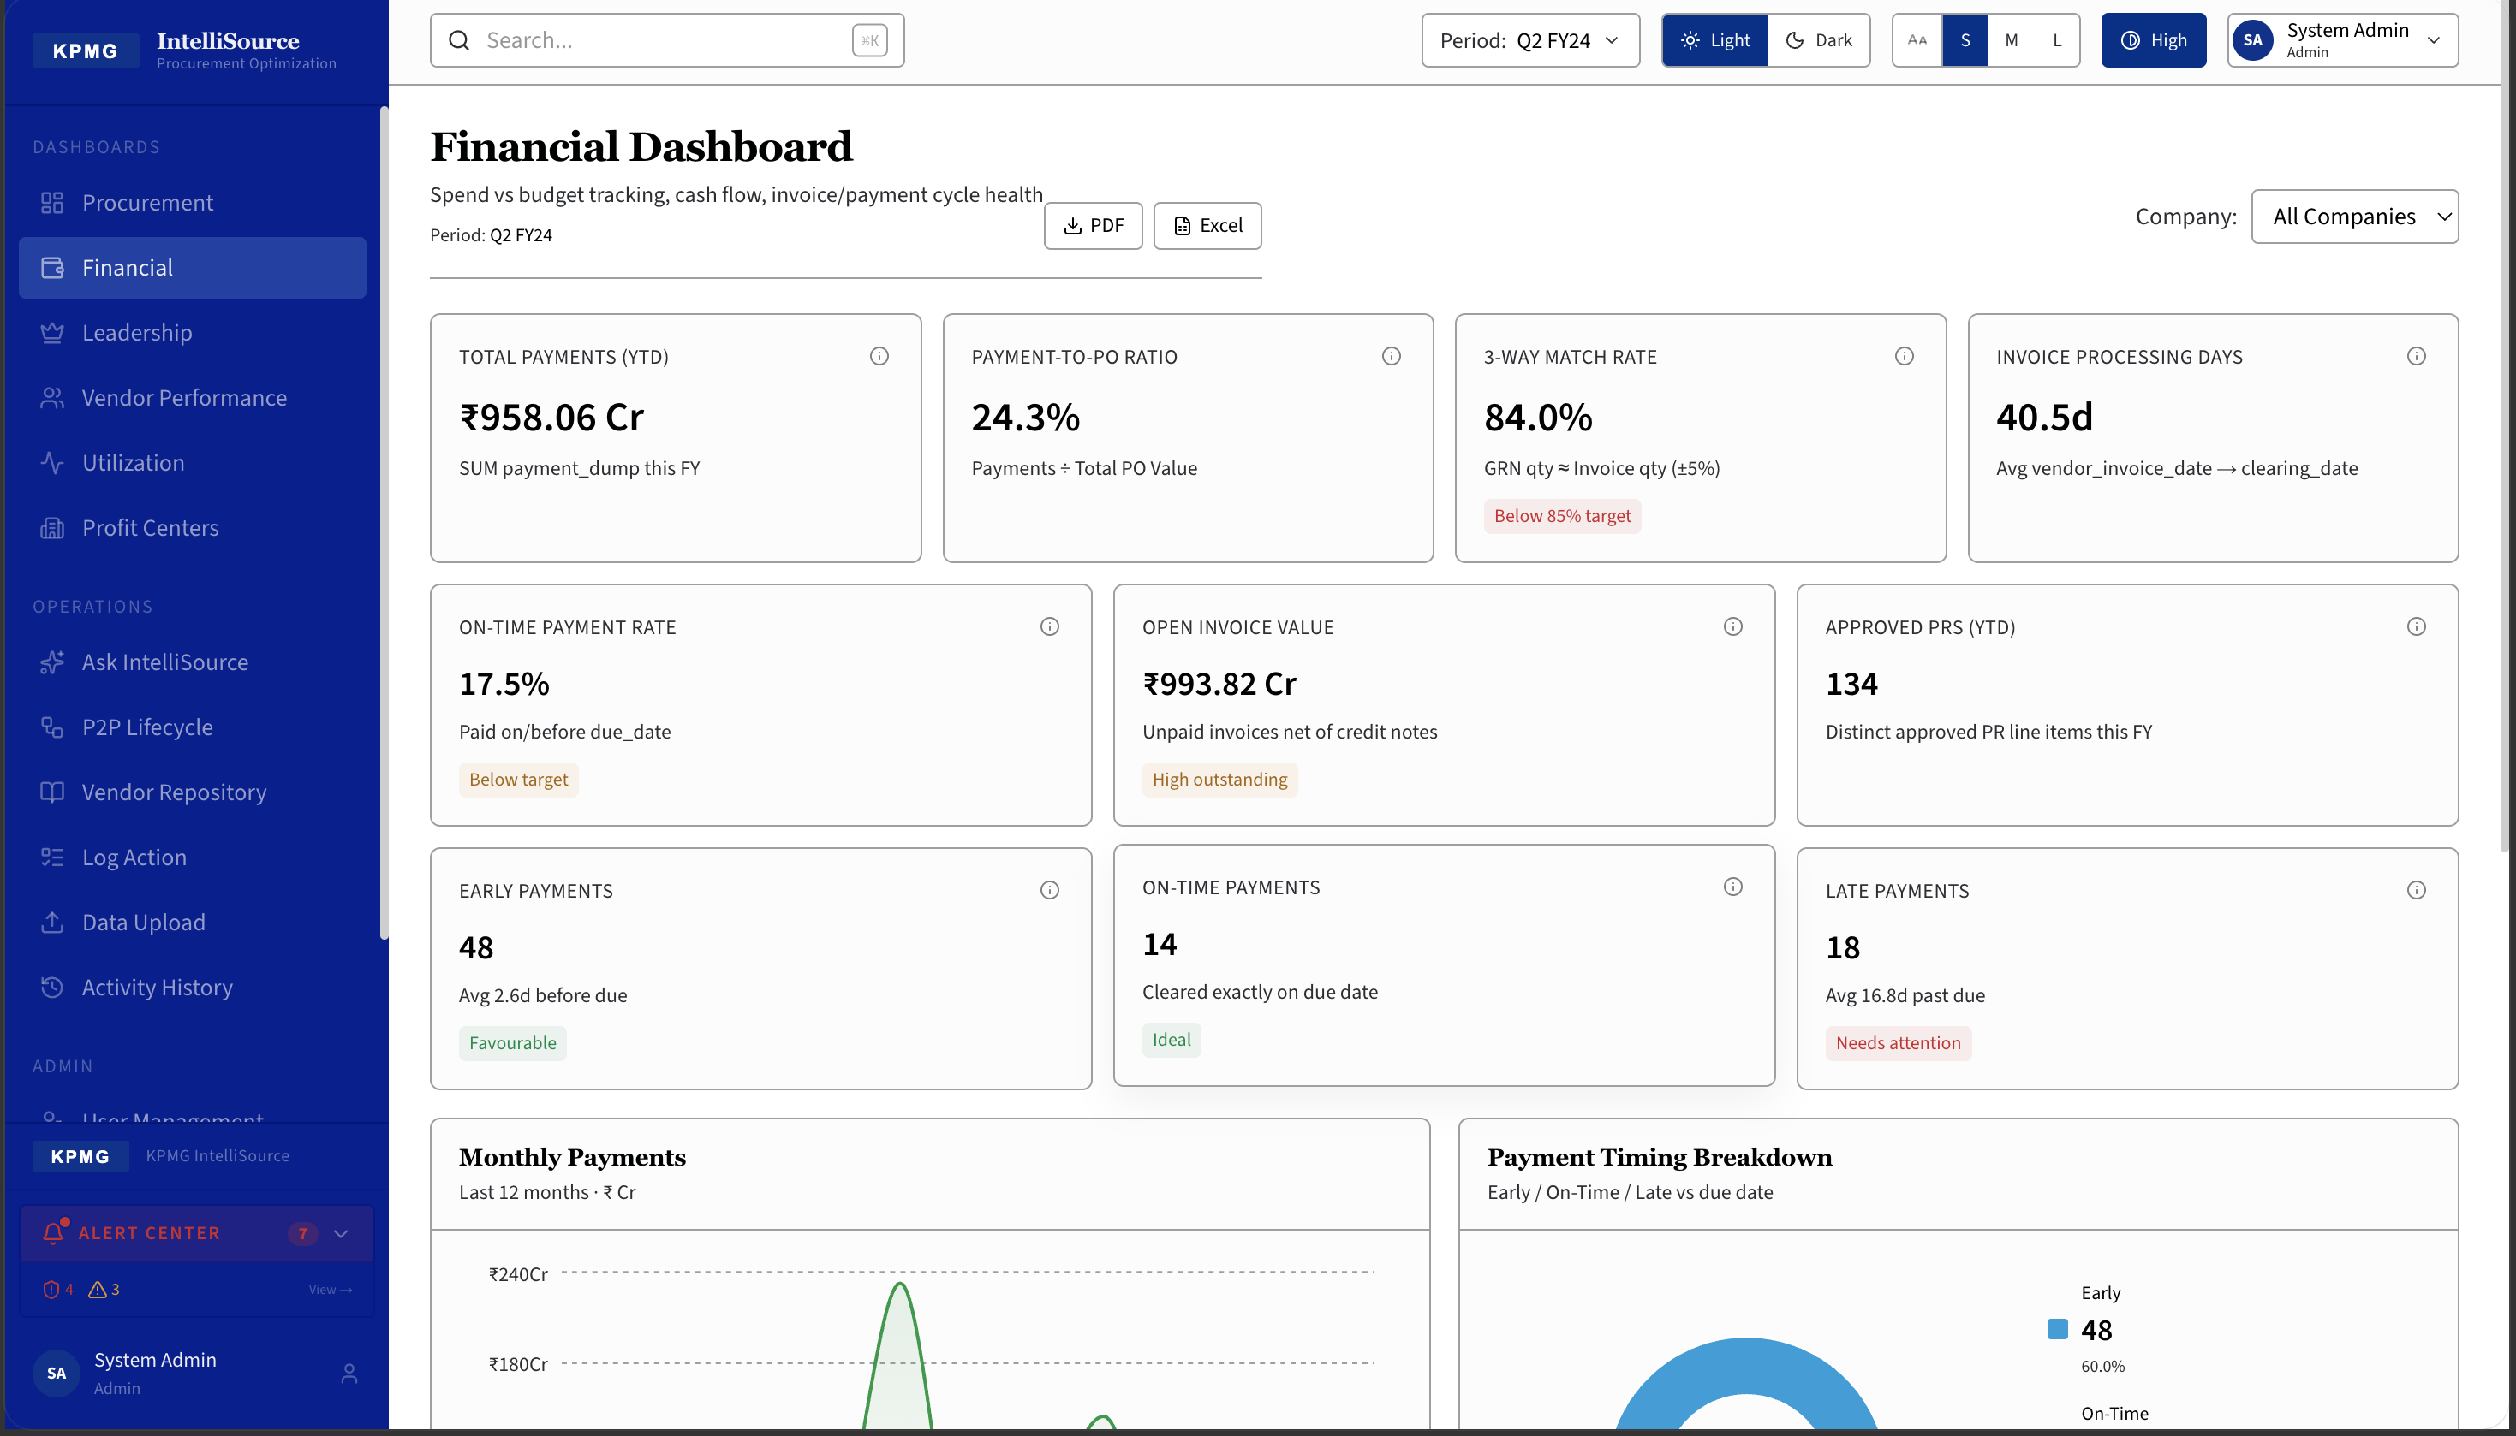
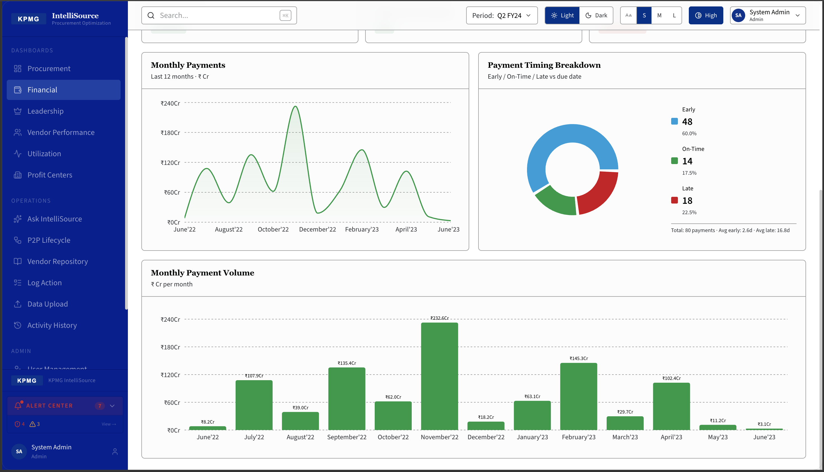
Financial Dashboard
Payments · 3-Way Match · Duplicate Detection · Invoice Aging
₹958 Cr
Total Payments
YTD
84%
3-Way Match
Rate
40.5 Days
Avg Invoice
Payment Days
Live
Duplicate Invoice
Detection
Audience: Finance Controller
KPMG | IntelliSource | CONFIDENTIAL

Slide 4
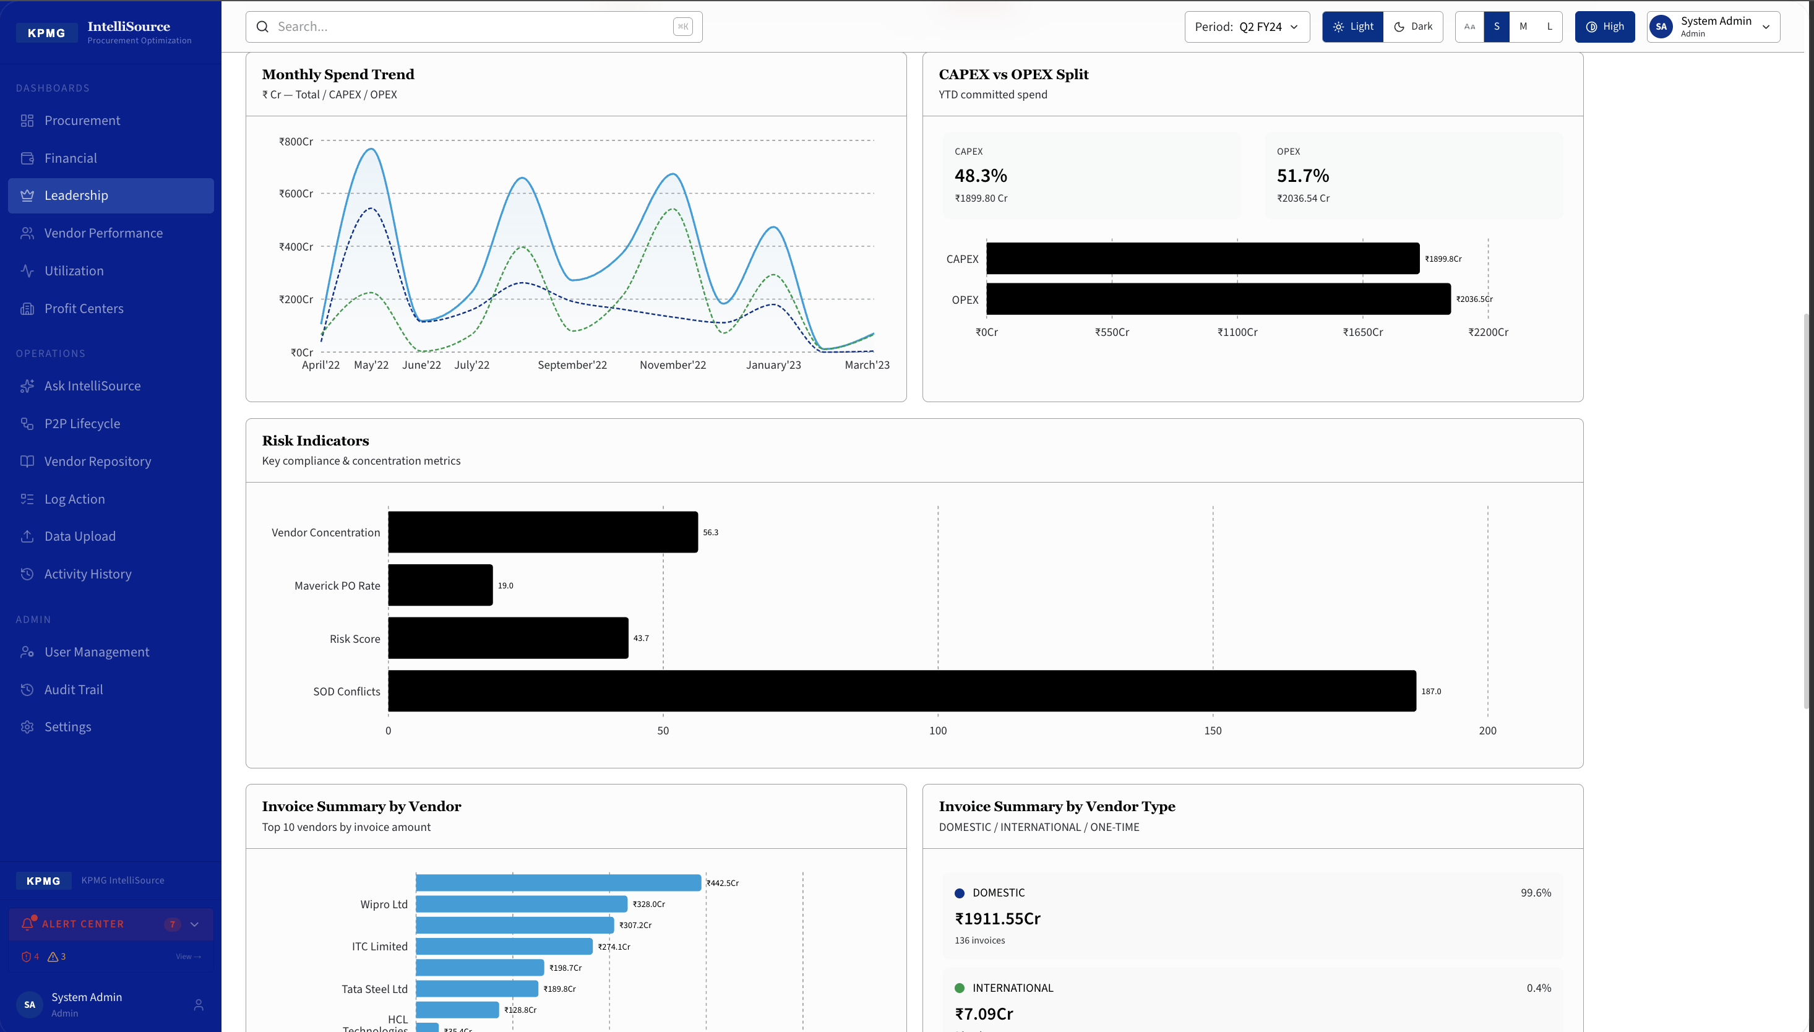
Leadership Dashboard
Board View · SOD Conflicts · Risk Indicators · Strategic Spend
₹3,936 Cr
Total Spend
All Companies
187
SOD Conflicts
4 Control Points
19%
Maverick
Spend Rate
44.5 Days
End-to-End
P2P Cycle
85 POs
High-Value POs
> ₹1 Cr
Audience: CFO · CPO · Board
KPMG | IntelliSource | CONFIDENTIAL

Slide 5
Segregation of Duty Conflicts
Automatically detected by IntelliSource — invisible in SAP standard reporting
187
PO Create → PO Release
Same user created and approved the purchase order
PO Create → GRN Post
SOD Violations
Detected — First Upload
Same user raised PO and posted the goods receipt
GRN Post → Invoice Post
Same user received goods and created vendor invoice
Invoice Post → Payment
Same user posted invoice and cleared the payment ← highest risk
Popup shows: Document · SOD Type · Vendor · User · Date · Export to Excel
KPMG | IntelliSource | CONFIDENTIAL

Slide 6
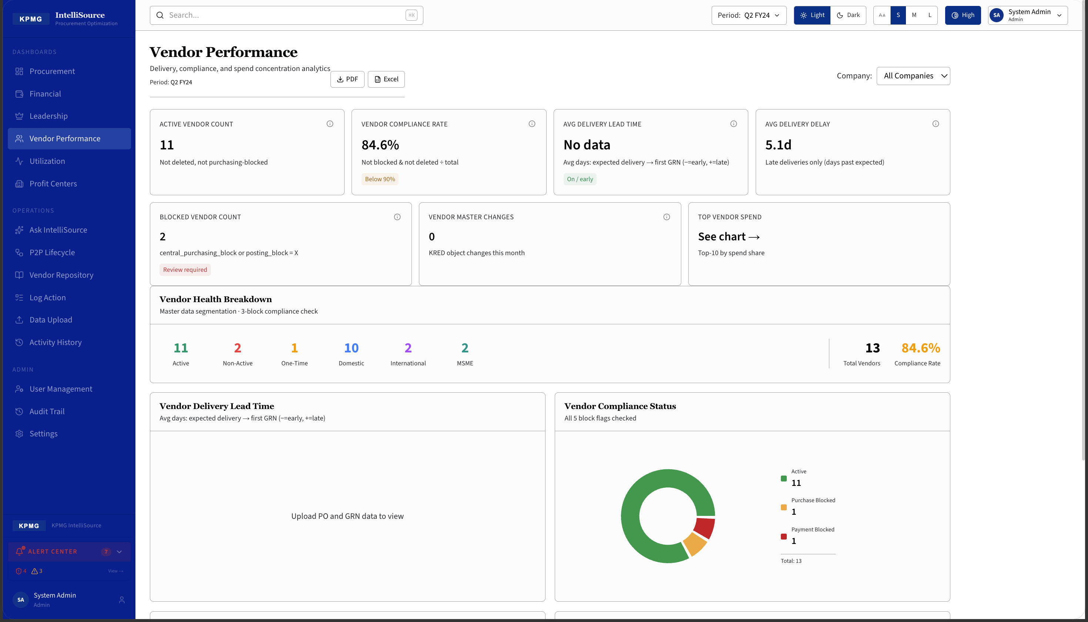
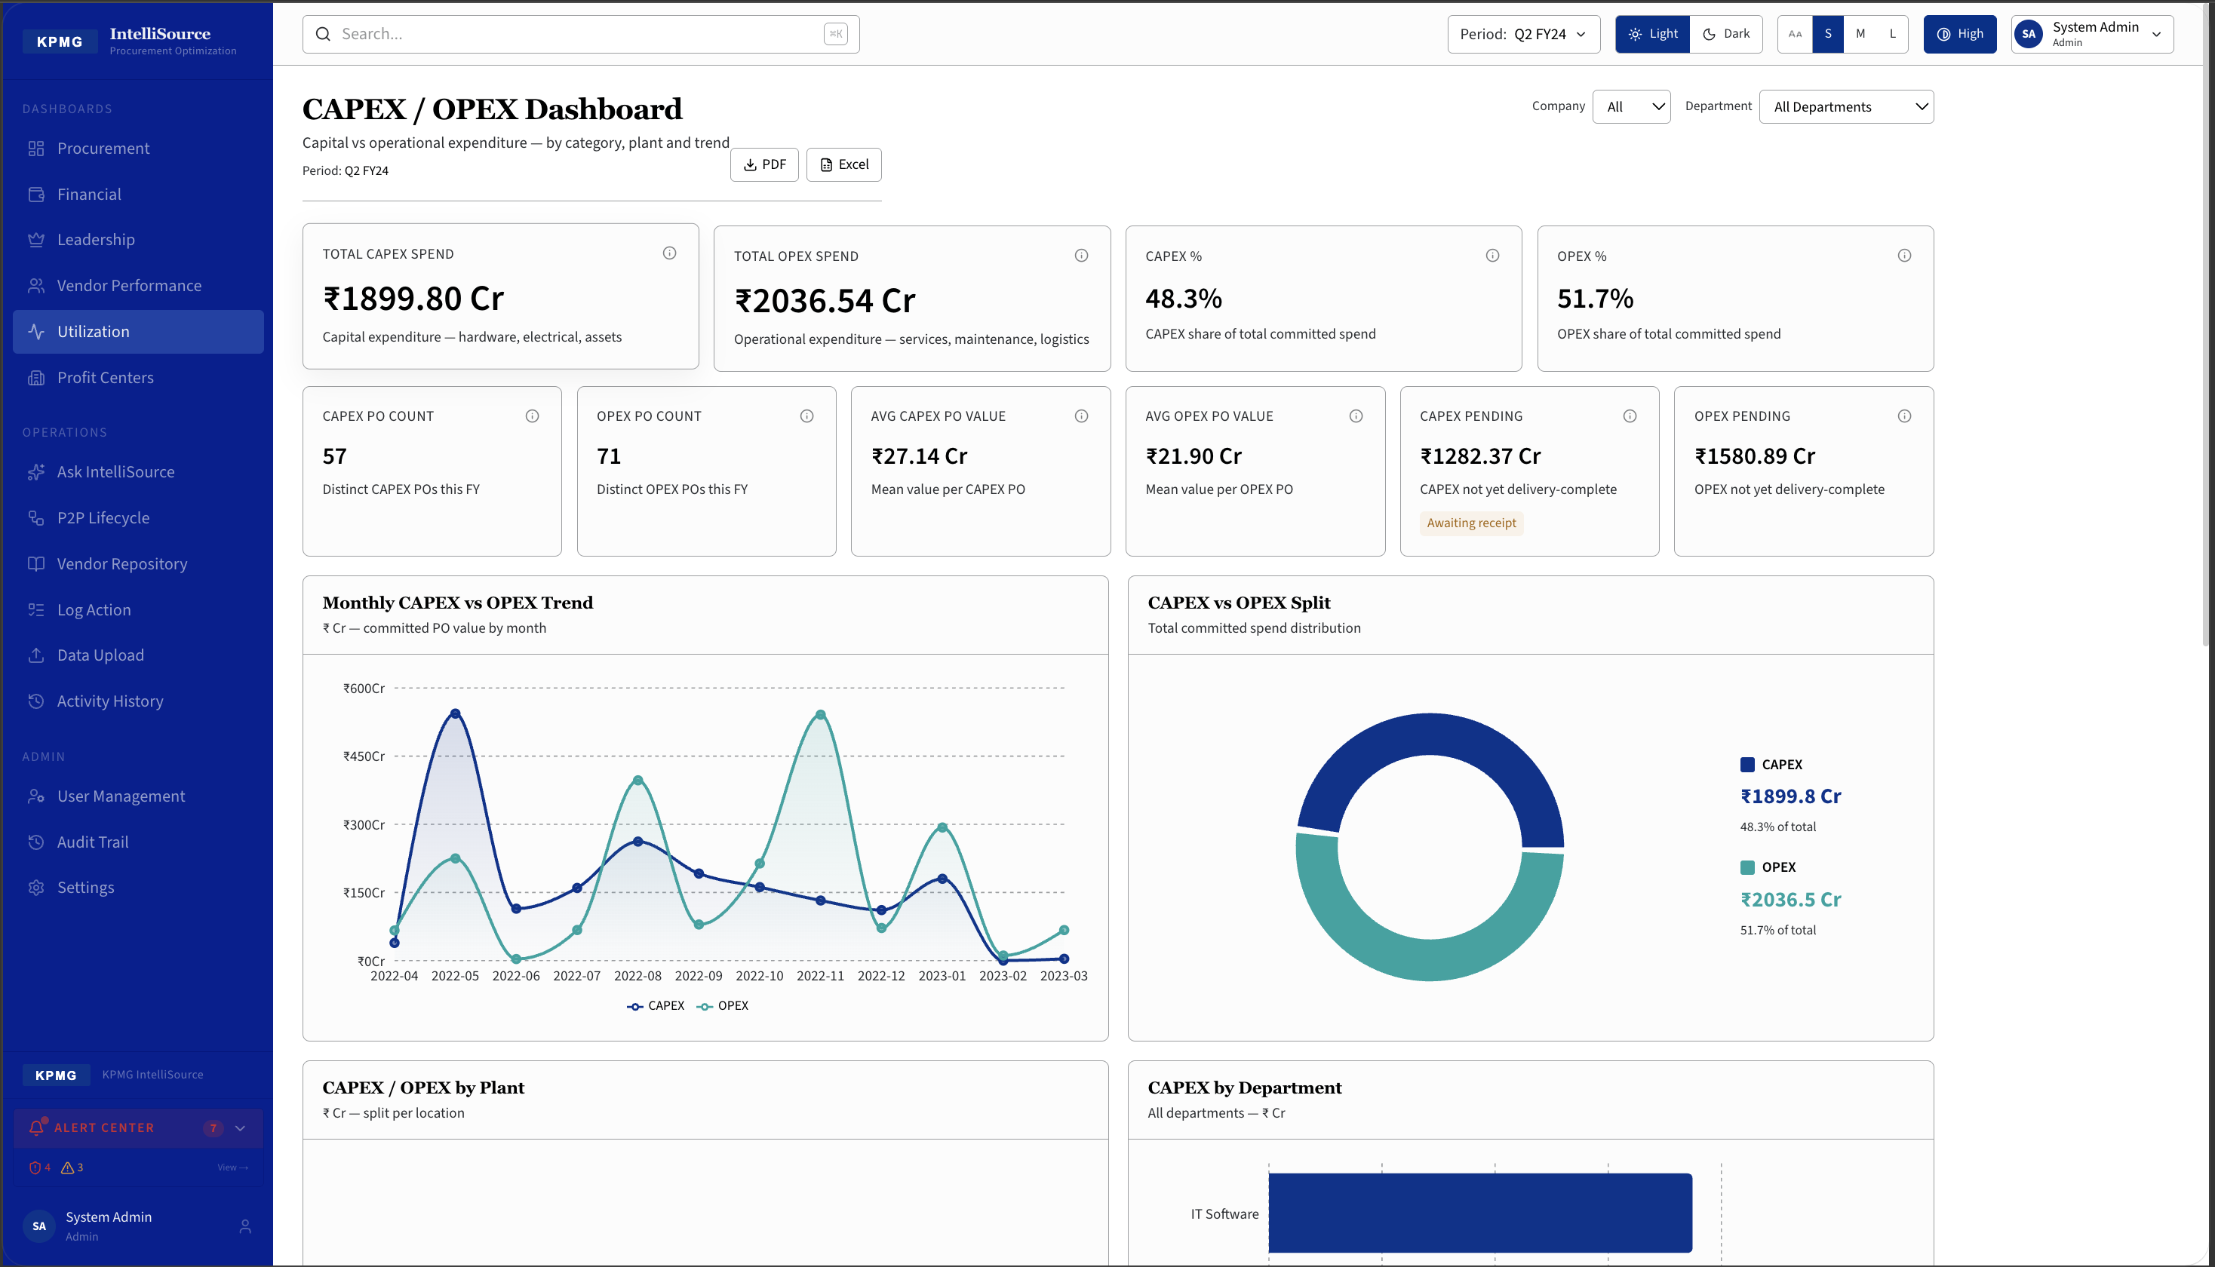
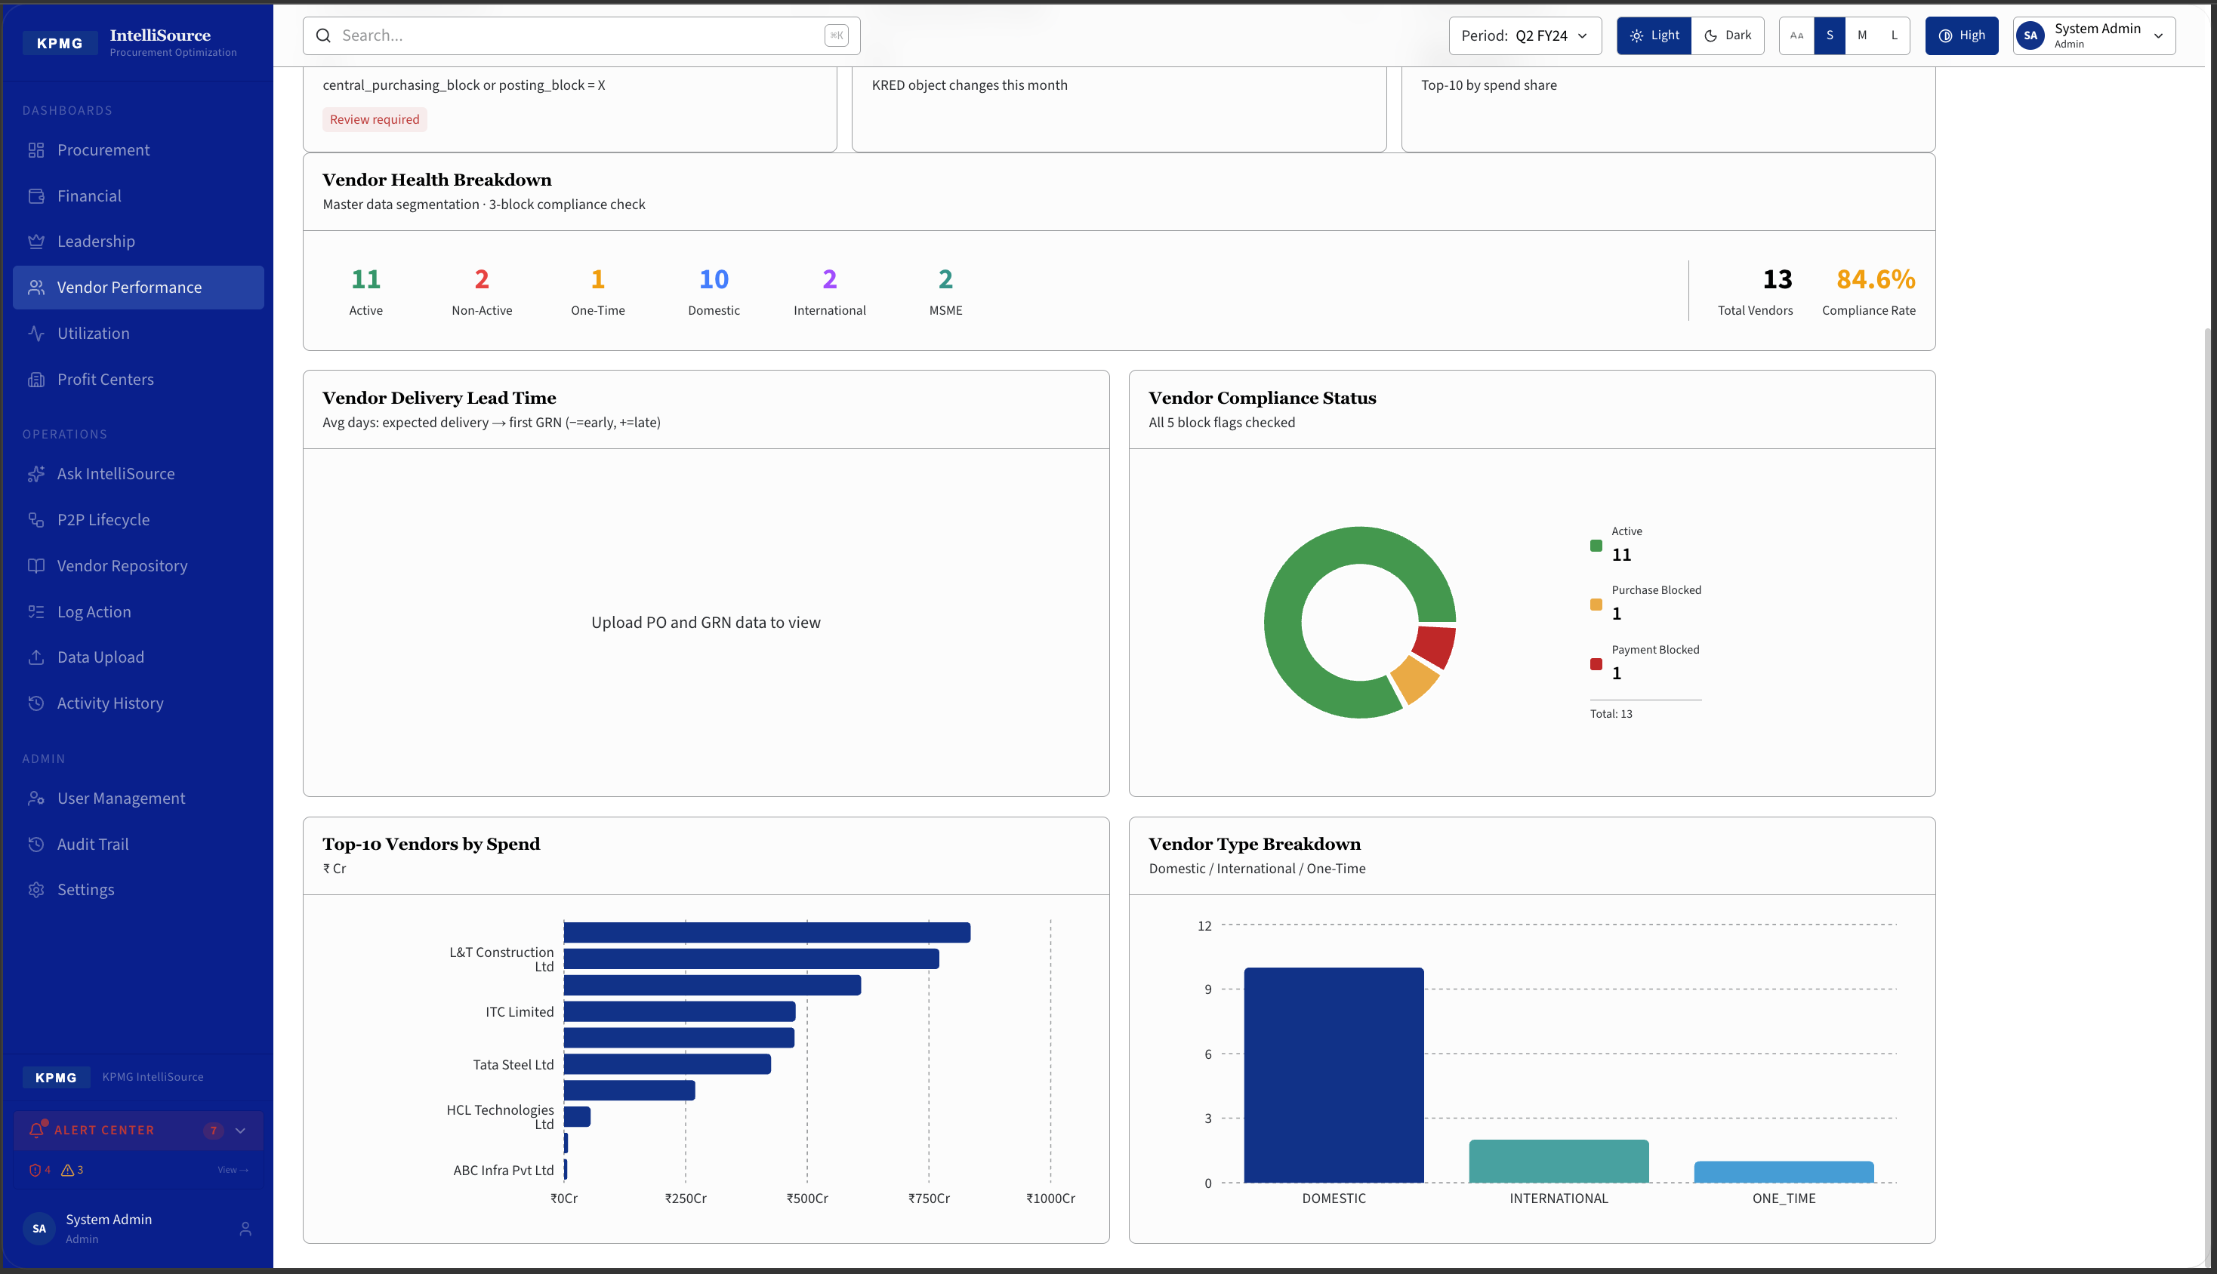
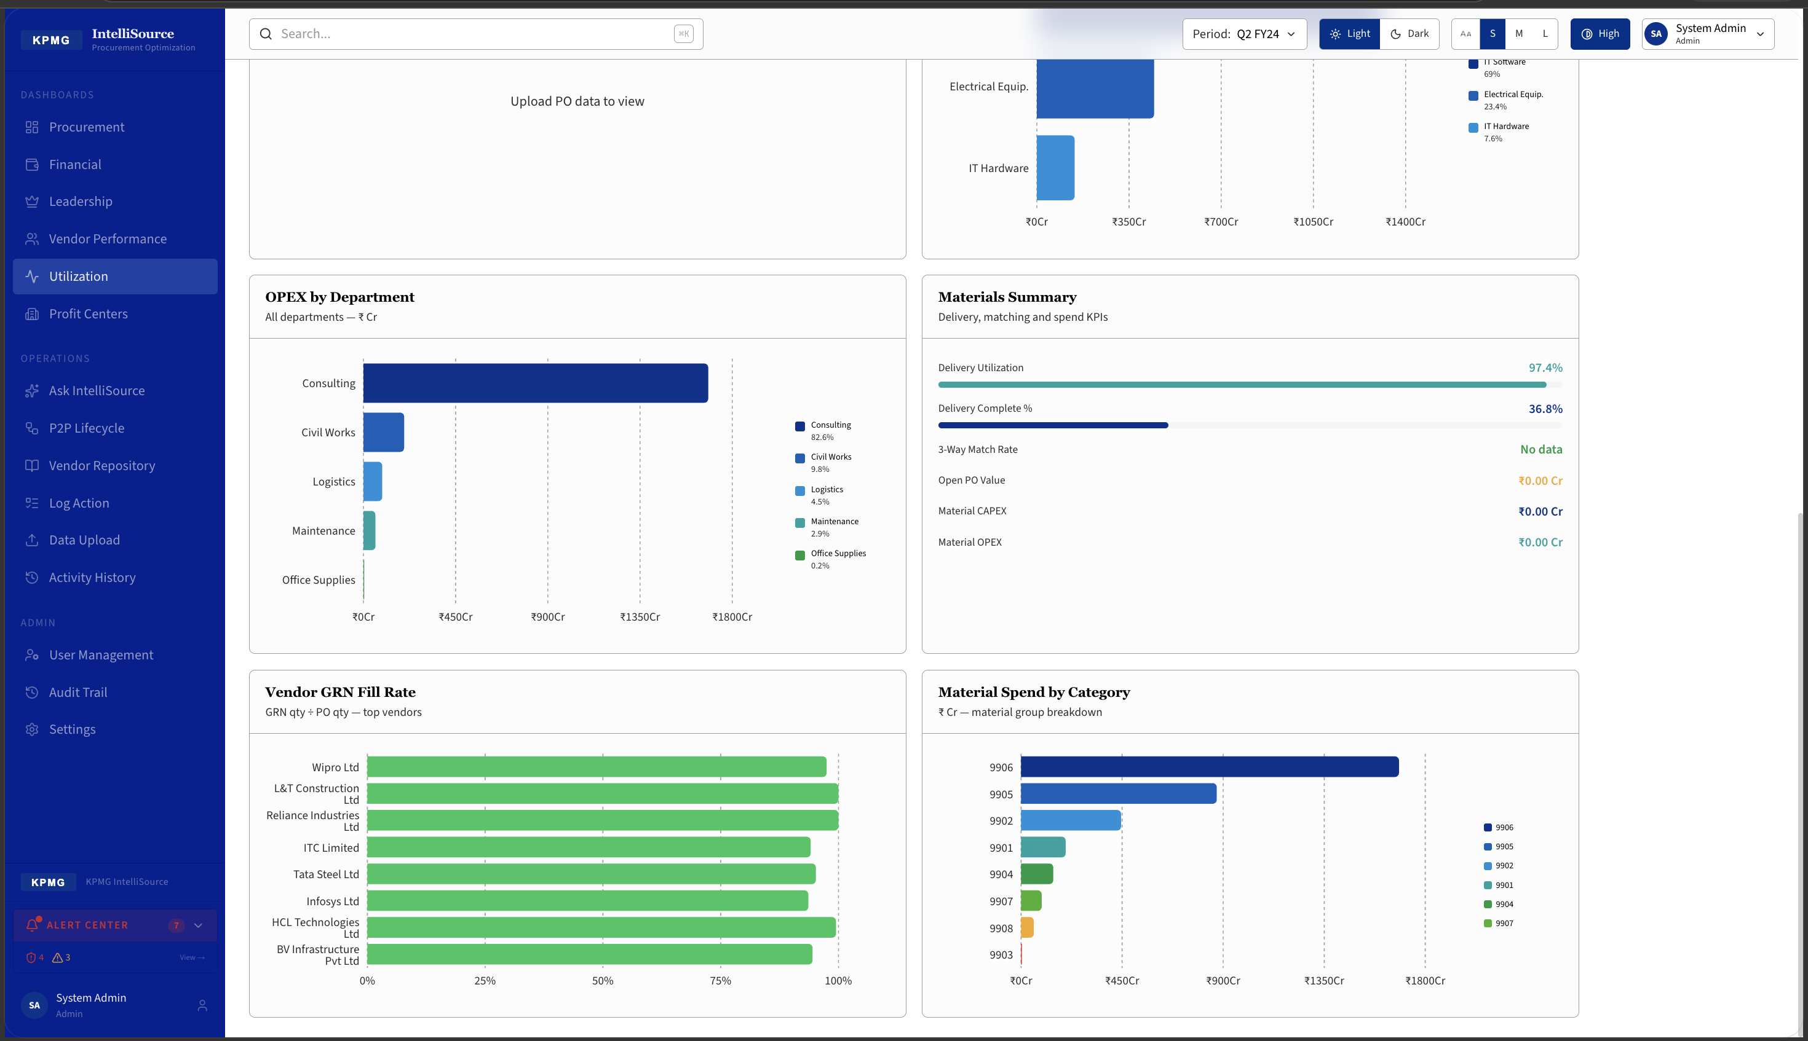
Vendor Performance & CAPEX / OPEX Dashboard
Compliance · Lead Time · Spend Split · Department Breakdown
Vendor Performance
CAPEX / OPEX (Utilization)
11 Active Vendors · 84.6% Compliance · 2 Blocked · 5.1d Avg Delivery Delay
CAPEX ₹1,899 Cr (48.3%) · OPEX ₹2,036 Cr (51.7%) · 39 Profit Centres · 97.4% Delivery Utilisation
KPMG | IntelliSource | CONFIDENTIAL

Slide 7
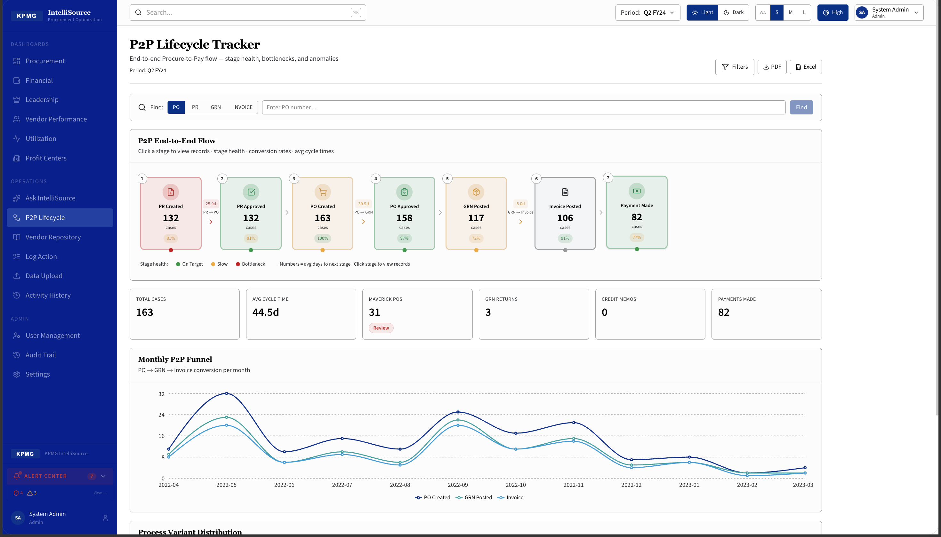
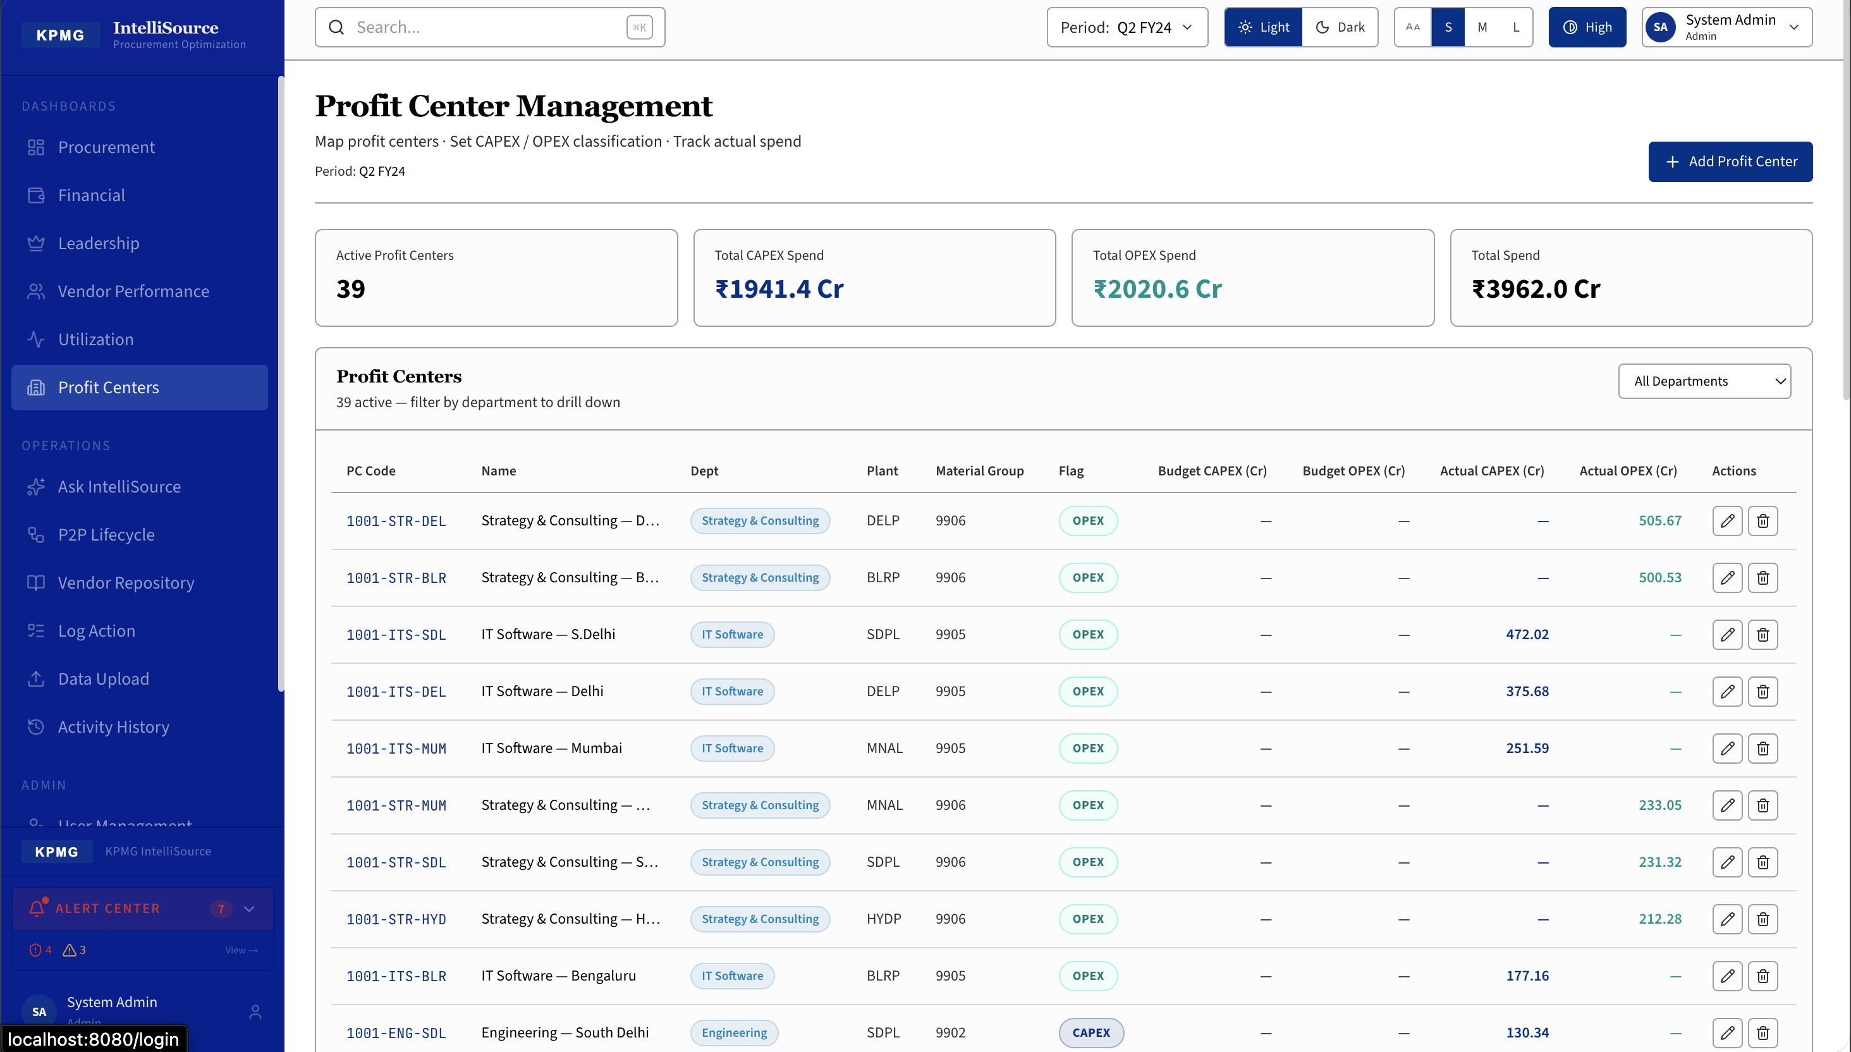
P2P Lifecycle Tracker & Profit Centers
End-to-End Procure-to-Pay · Stage Health · 39 Active Profit Centers
▸ 39 Active Profit Centers
▸ CAPEX ₹1,941 Cr · OPEX ₹2,021 Cr
▸ Total Portfolio: ₹3,962 Cr
▸ Filter by department · drill to PO line
132 PRs → 163 POs → 117 GRNs → 106 Invoices → 82 Payments · Avg 44.5 Days
KPMG | IntelliSource | CONFIDENTIAL

Slide 8
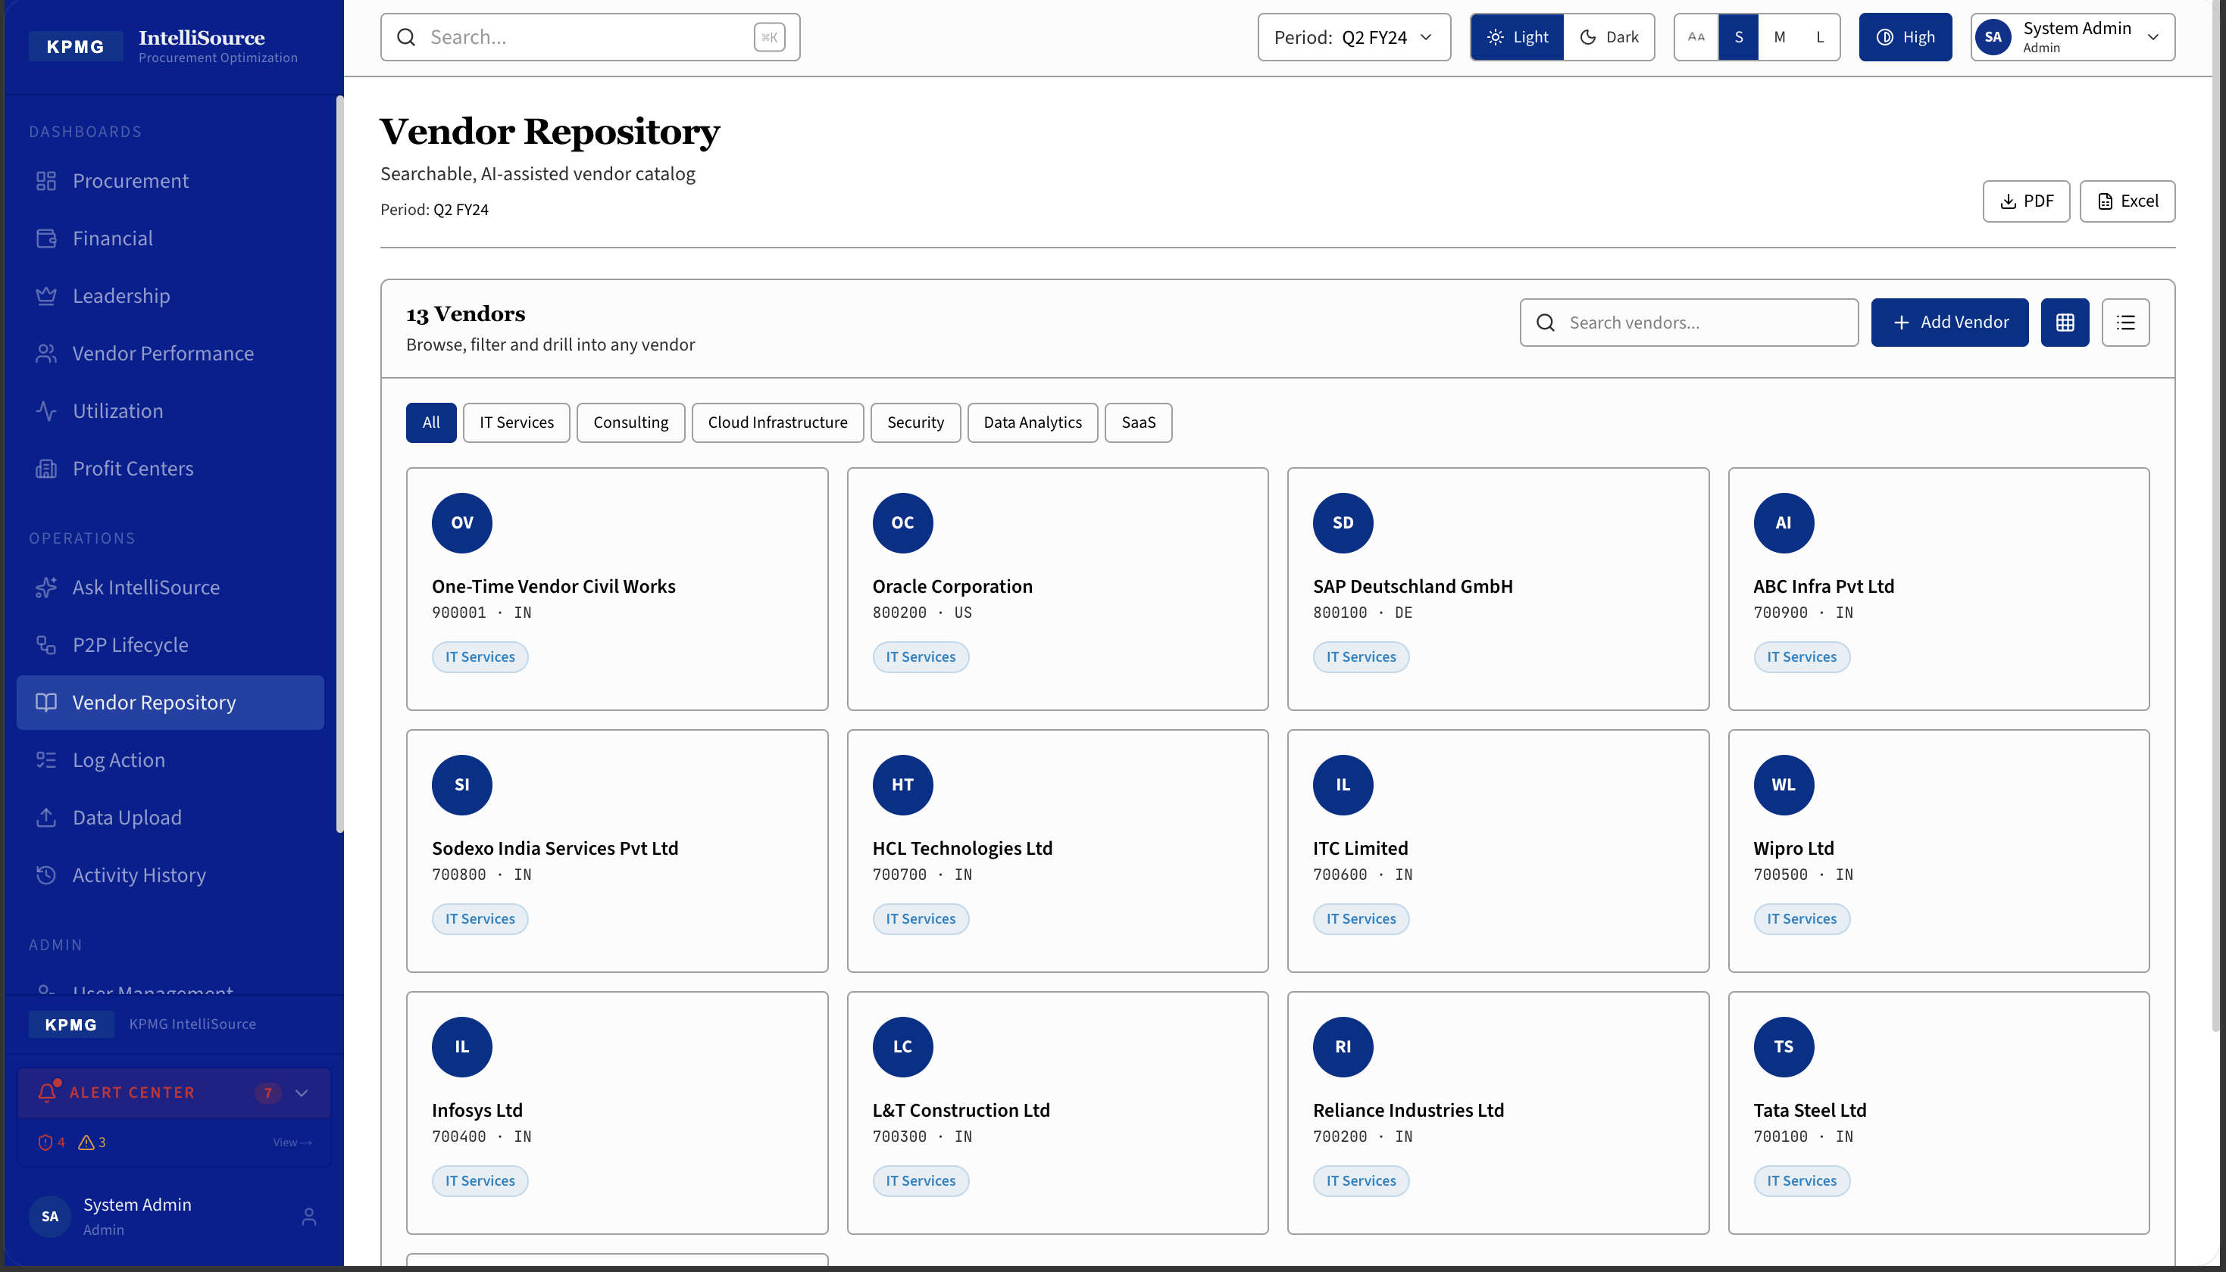
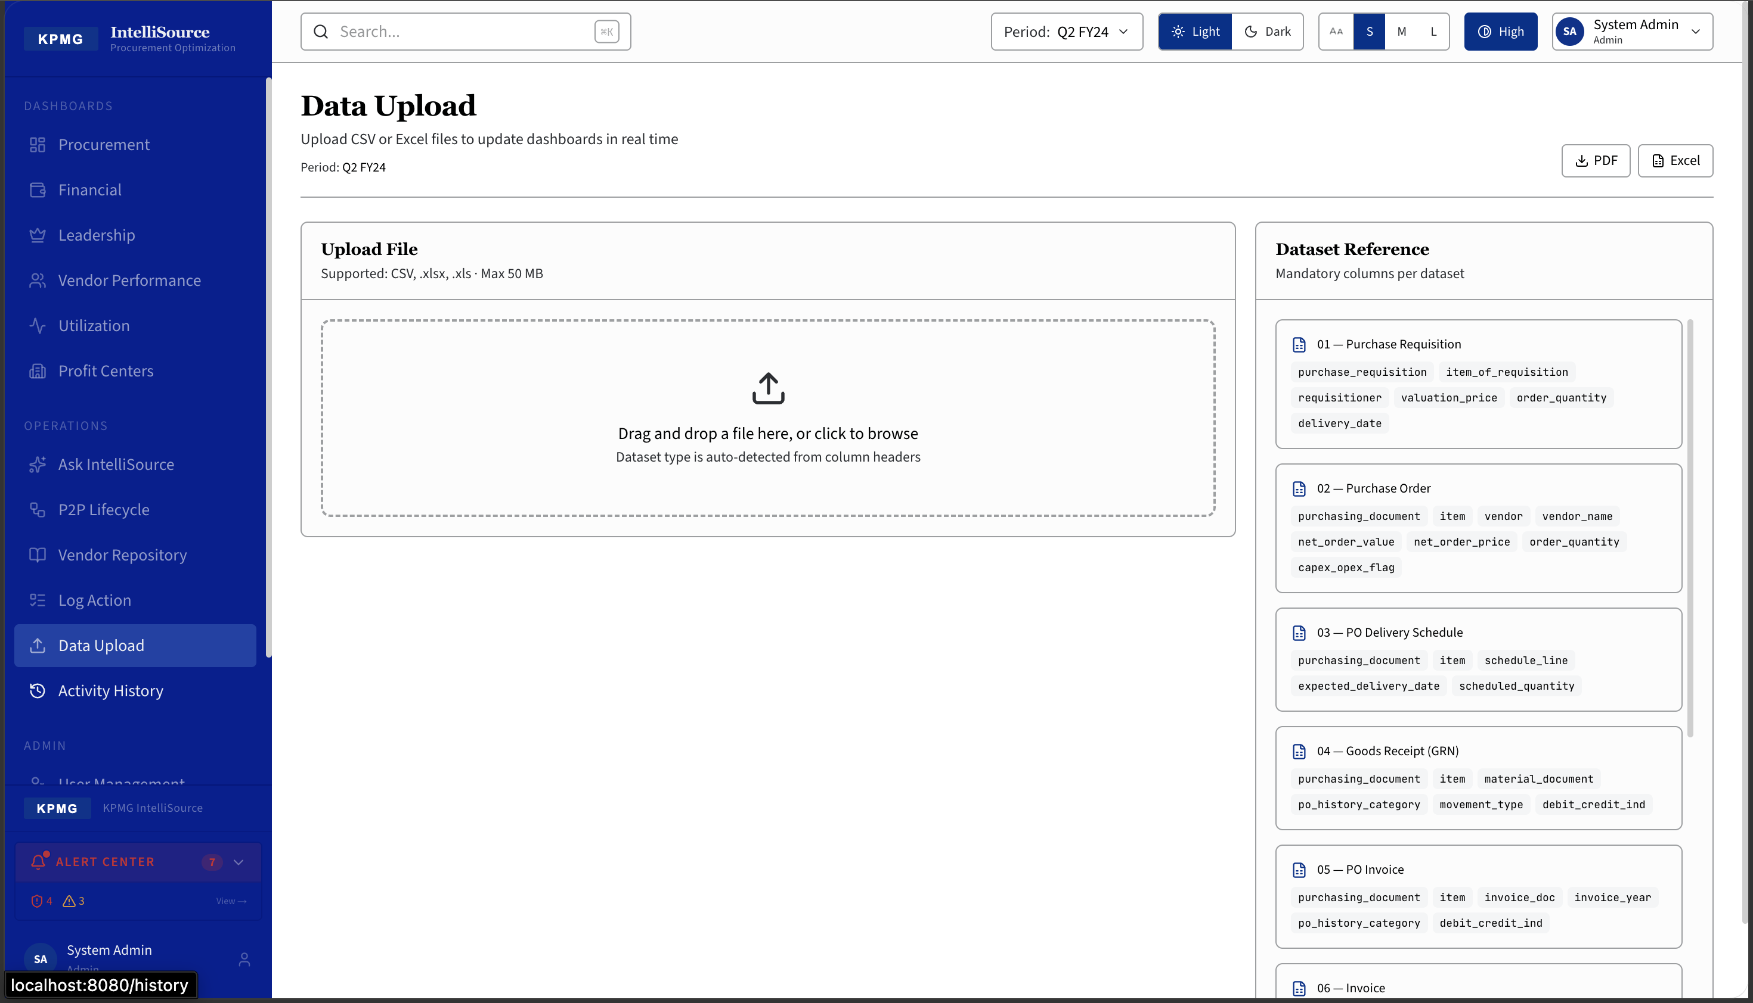
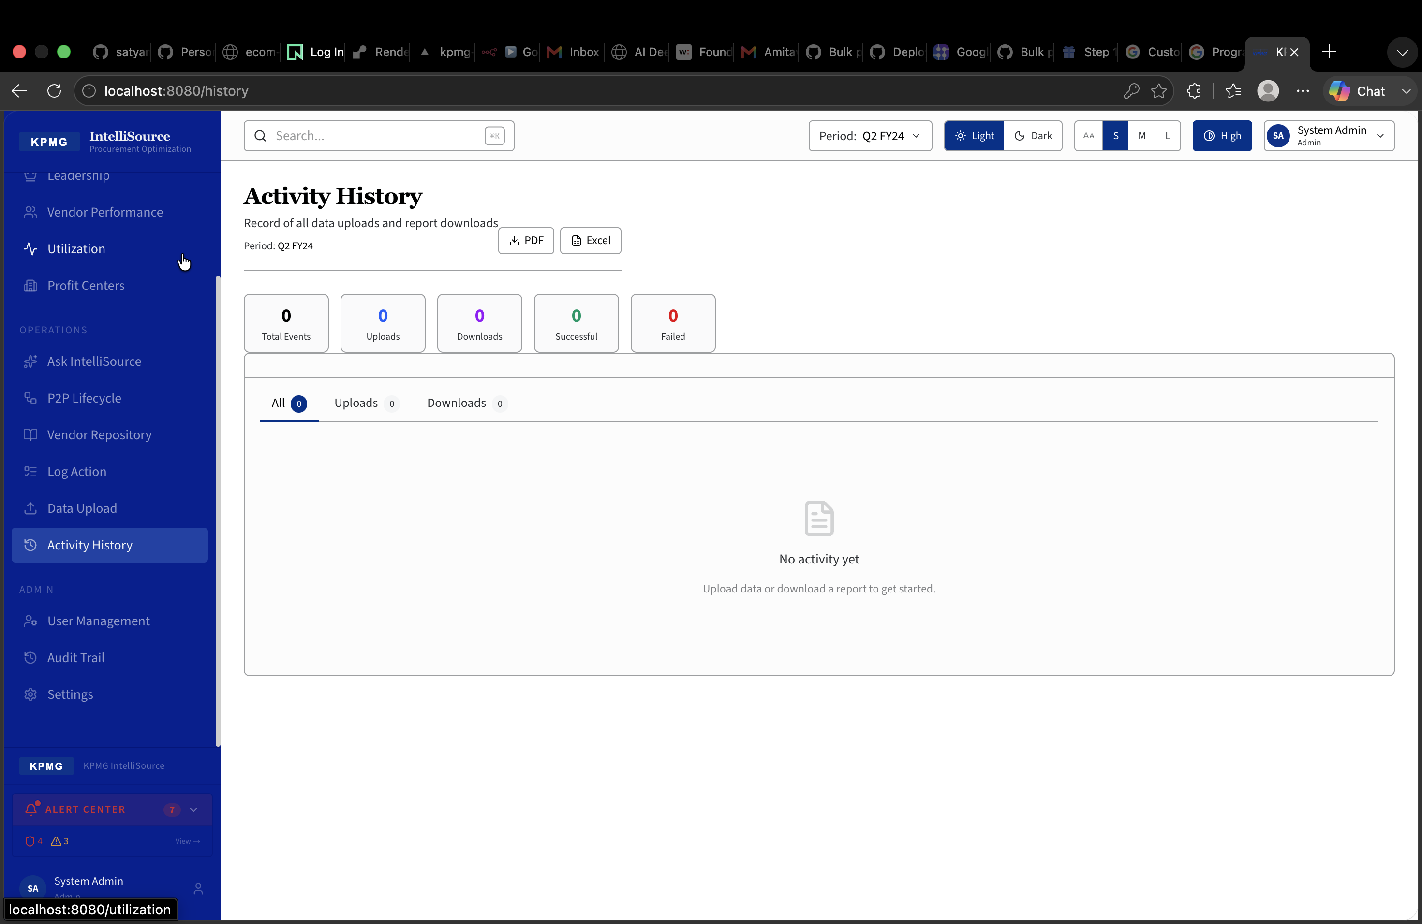
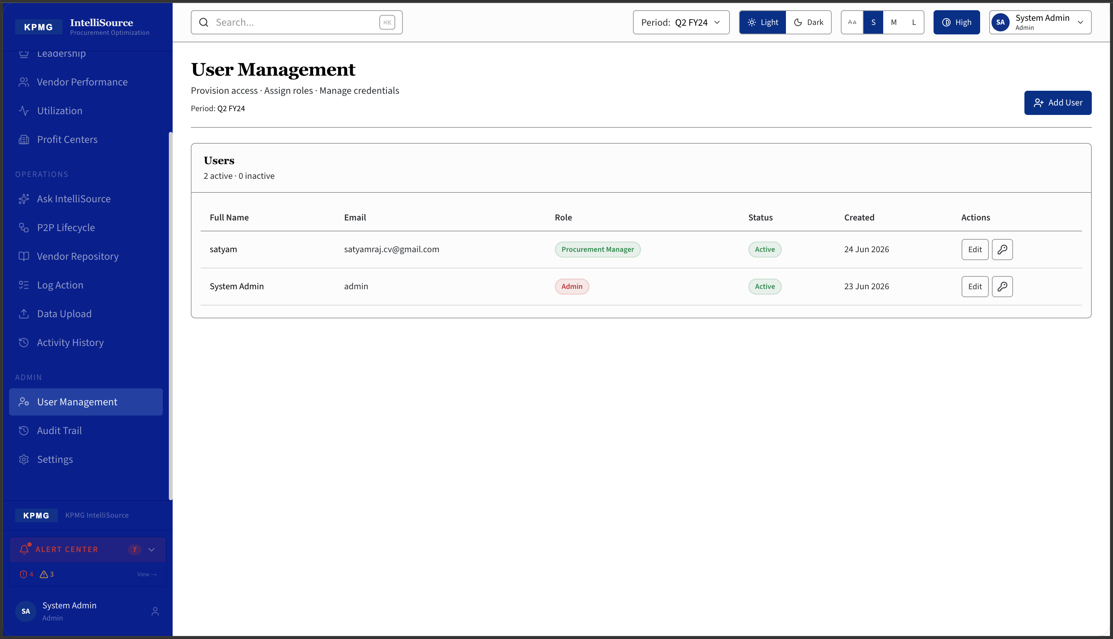
Operations
Vendor Repository · Data Upload · User Management · Activity History
Vendor Repository — 13 vendors, searchable catalog
Data Upload — CSV/Excel, auto-detect, live refresh
Activity History — upload & download audit trail
User Management — role-based access control
KPMG | IntelliSource | CONFIDENTIAL

Slide 9
KPMG
Thank You
IntelliSource — Procurement Intelligence, Powered by KPMG
Week 1
Data readiness — SAP export access
Week 2
Pilot upload — single company code
Week 3
Stakeholder walkthrough — live demo
Week 4
Go / No-Go — full deployment
getdev24@gmail.com
KPMG India | Procurement Advisory | CONFIDENTIAL

