Slide 1
KPMG
India
IntelliSource
P2P Intelligence & Analytics Platform
Executive Demo Pitch | 60-Second Value Proposition | SAP Comparison
KPMG India | Procurement Advisory | CONFIDENTIAL
2026

Slide 2
The Problem
What SAP Cannot Tell You
SAP records every transaction. It does not tell you what went wrong.
🔍 No Cross-Document Visibility
📊 No Real-Time Governance Metrics
⏱ Decisions Made on Stale Data
SOD conflicts span PO → GRN → Invoice → Payment. SAP stores each in a different module. No standard report joins them. Auditors find these conflicts — you should find them first.
Maverick spend, duplicate invoices, CAPEX vs. OPEX split, payment before GRN — each requires a separate transaction, a manual export, and an analyst with Excel.
By the time a weekly report is ready, the payment has cleared, the vendor is paid, and the audit finding is already written. Procurement intelligence must be live.
One duplicate payment event: ₹5–50 lakhs. One SOD audit finding: ₹20–80 lakhs in remediation. One year of blind spots: priceless.
SAP Transaction: FBL1N — Vendor Line Items
IntelliSource — Financial Dashboard: Duplicate Invoice Detection
[Insert SAP FBL1N screenshot — shows raw vendor line items with no anomaly flags, no duplicate detection, no cross-document context. Analyst must export and manually VLOOKUP against MB51 and ME2M to find issues.]
[Insert IntelliSource Financial Dashboard screenshot — shows Duplicate Invoice Rate KPI card, live count, and drill-down table with vendor, invoice ref, amount, and duplicate count — no manual work required.]
KPMG India — IntelliSource | P2P Intelligence & Analytics Platform
CONFIDENTIAL

Slide 3
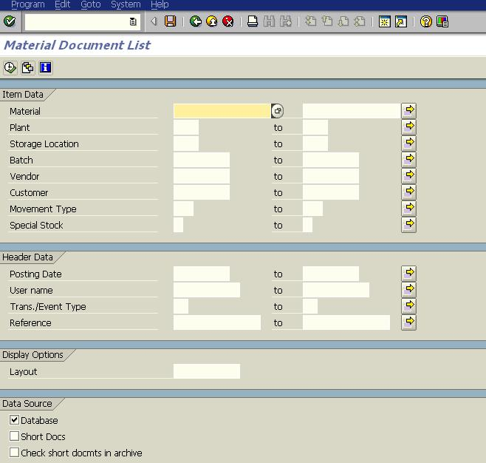
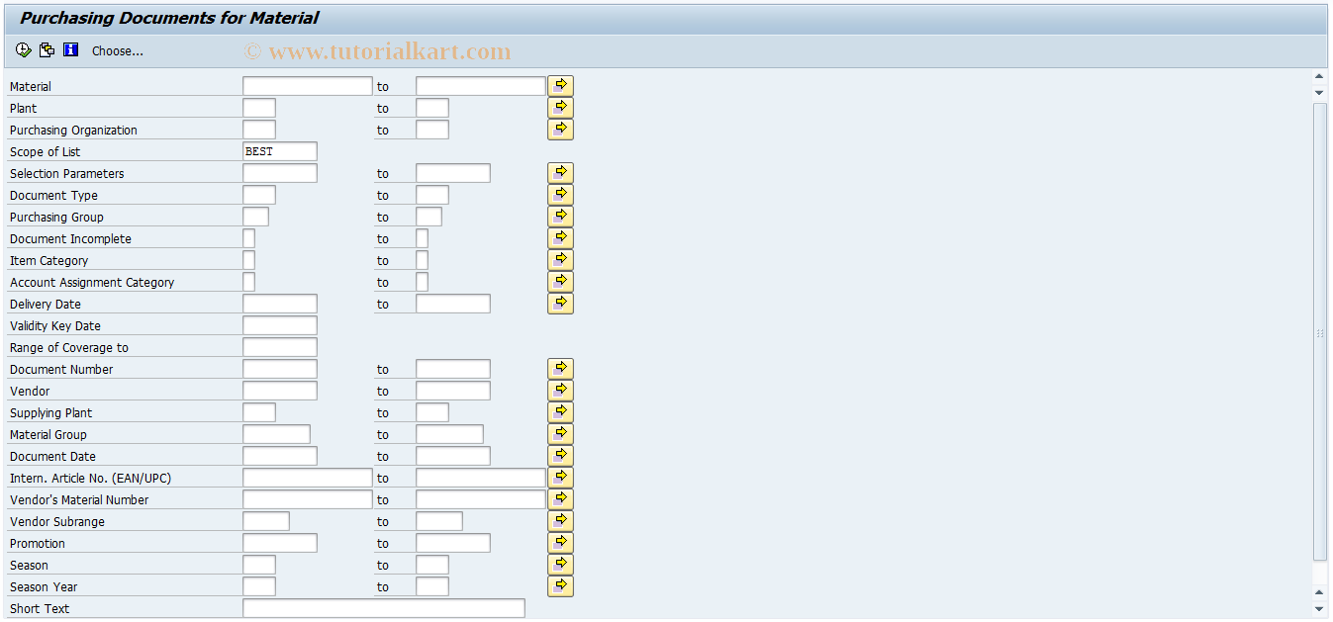
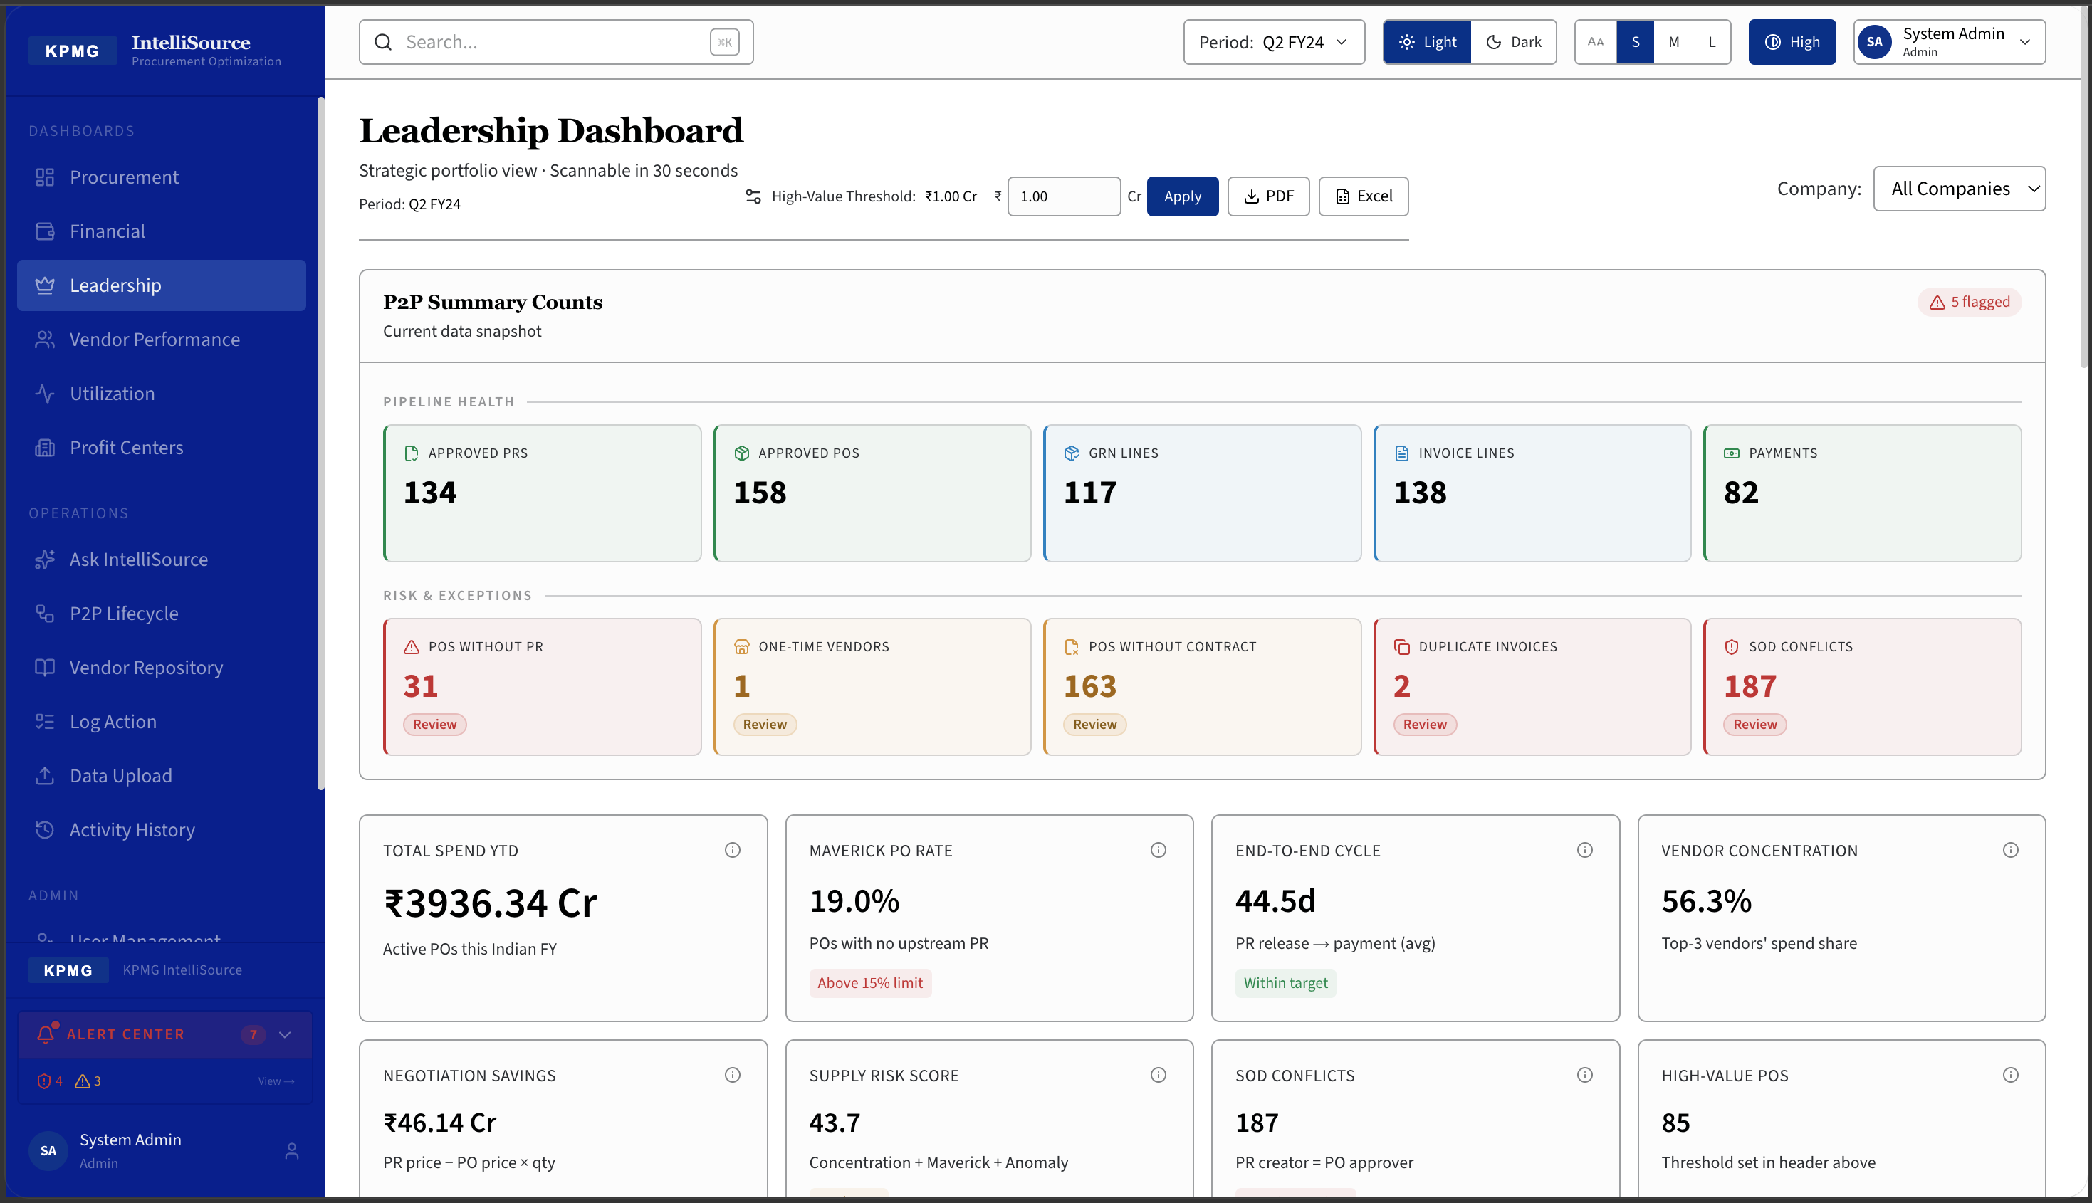
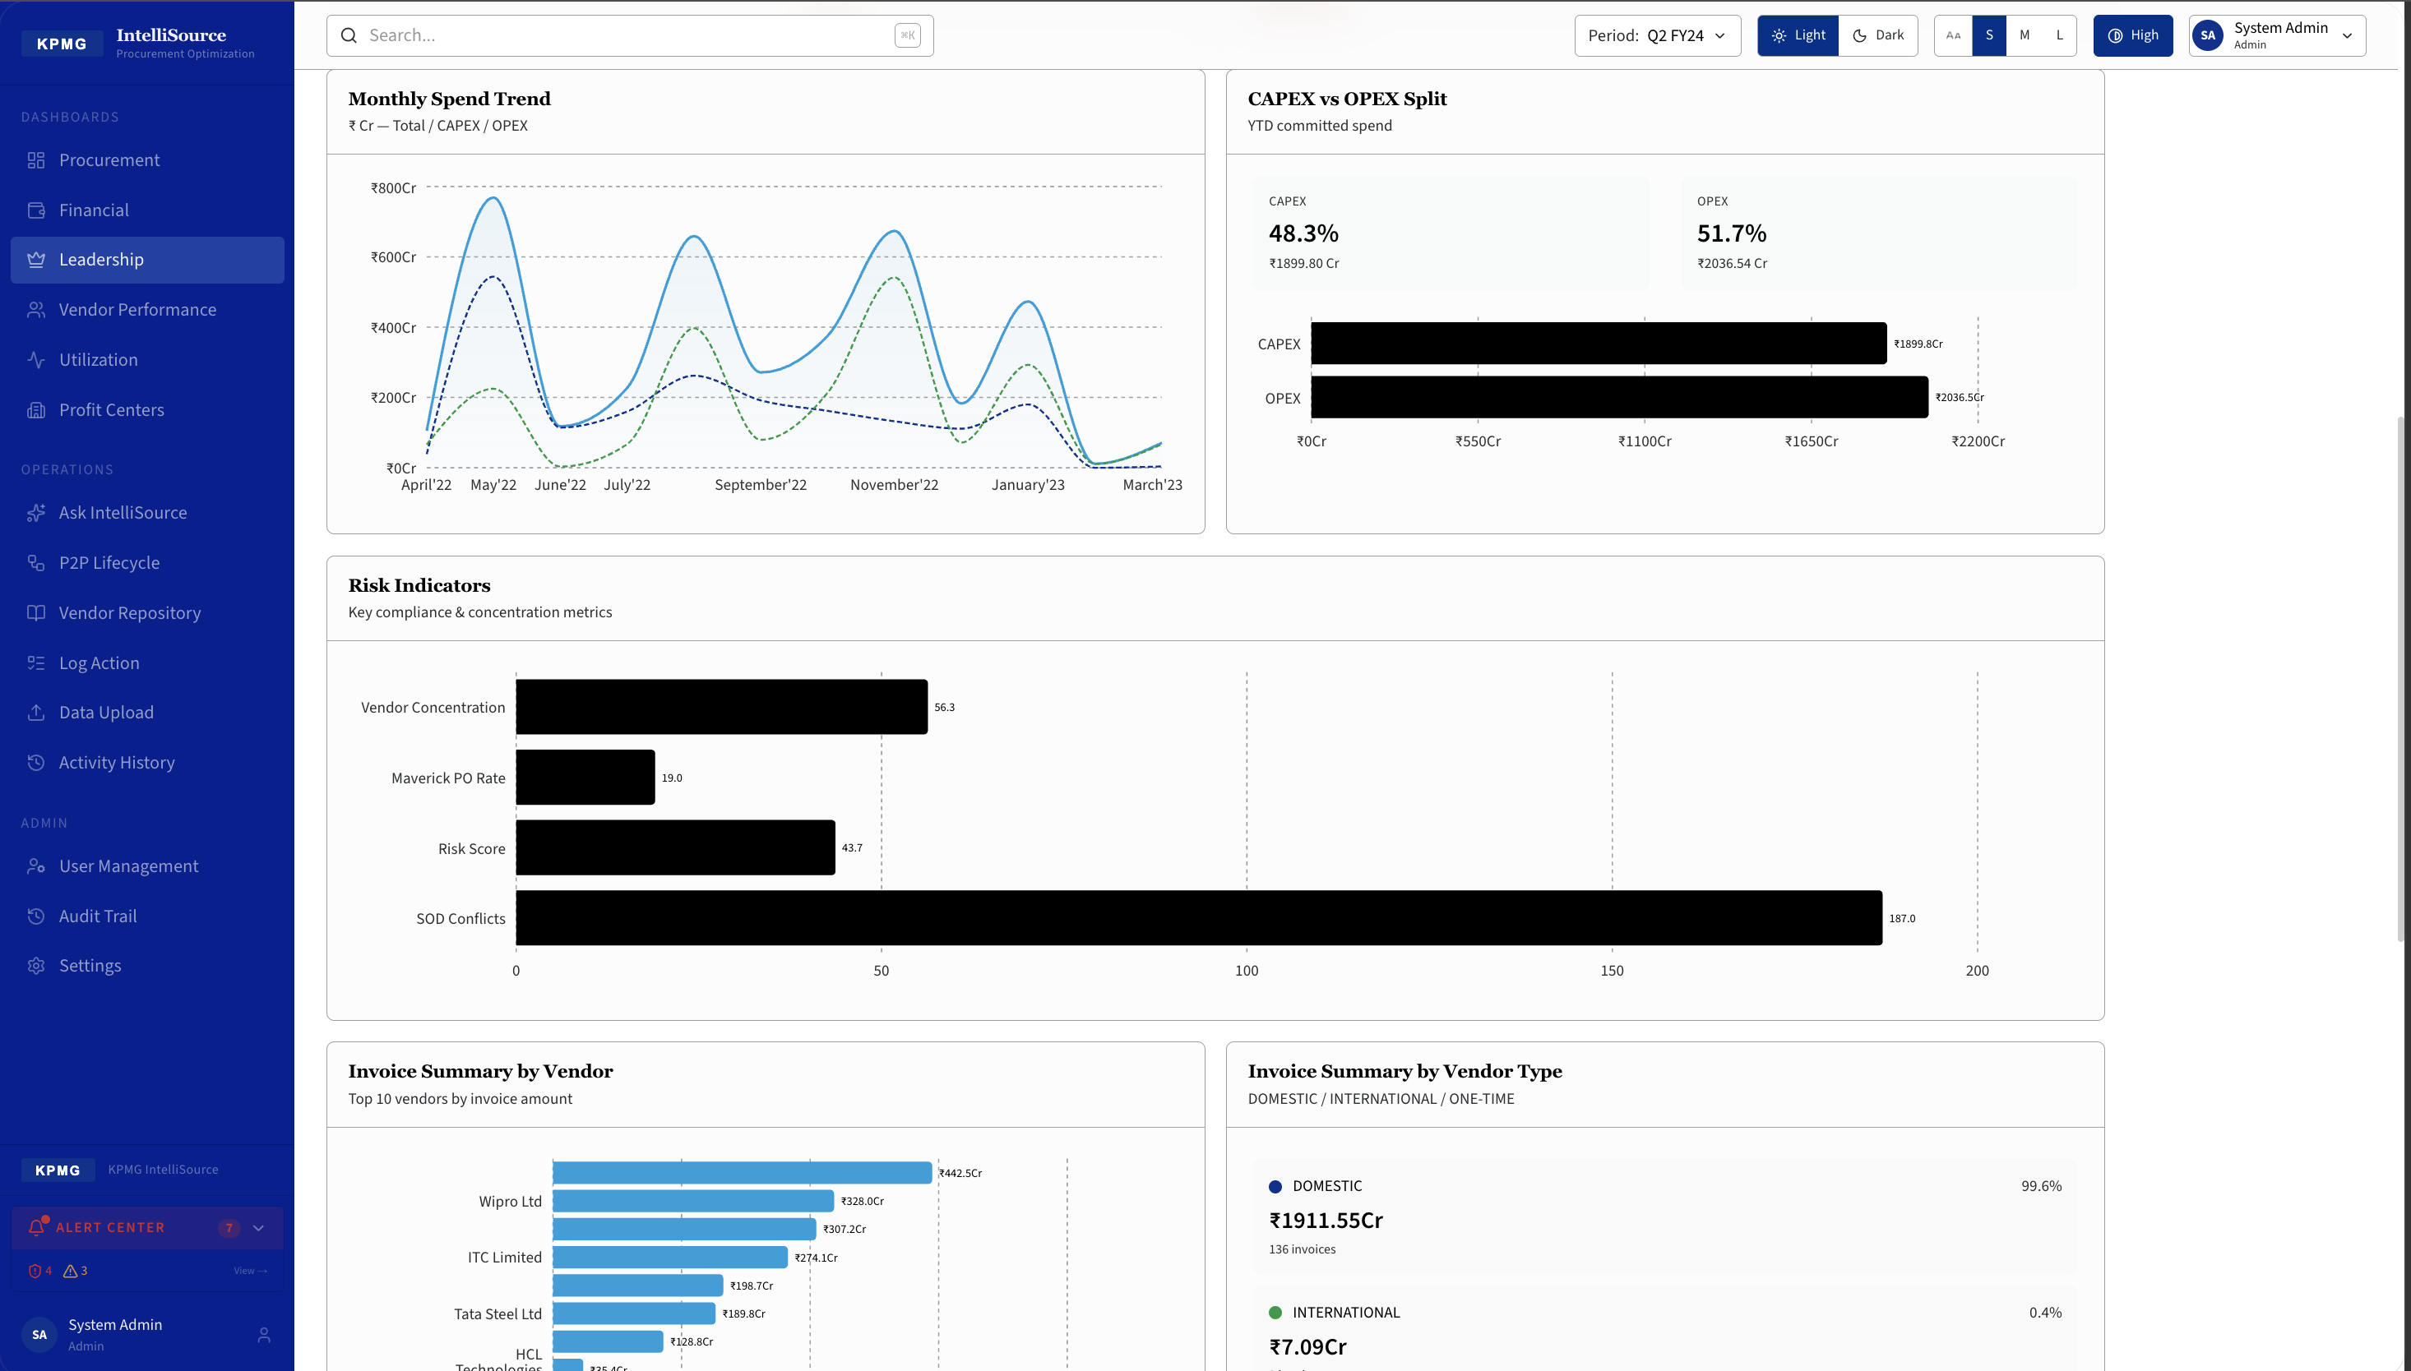
SAP vs IntelliSource
Where IntelliSource Fills the Gap
🔴 SAP Standard — What You Get Today
🟢 IntelliSource — What You Get Now
SAP — ME2M (Purchase Orders) + MB51 (GRN) — Separate Transactions
IntelliSource — Leadership Dashboard (SOD Conflicts + Risk Panel)
[Insert IntelliSource Leadership Dashboard screenshot] SOD Conflicts: 187 shown as live KPI. Hover → popup shows all conflicts by type (PO-Release, PO-GRN, GRN-Invoice, Invoice-Payment) with document numbers, vendor names, and users — updated the moment data is uploaded.
VS
✕ 6–8 transaction codes to see full P2P picture
✓ 5 role-specific dashboards — one upload, all metrics live
✕ No cross-document creator comparison
✓ SOD conflict detection across all 4 P2P control points
✕ Maverick spend requires ME2M + VLOOKUP on PR list
✓ Maverick spend auto-flagged from PO data (no VLOOKUP)
✕ Duplicate invoices: no standard detection
✓ Duplicate invoice detection before payment clears
✕ CAPEX/OPEX split: manual material group export
✓ CAPEX/OPEX: auto-classified, live, drillable to PO line
✕ SOD conflicts: not natively computed anywhere
✓ P2P cycle time: PR → PO → GRN → Invoice → Payment
✕ Data is stale — batch jobs, not live
✓ Live — upload once, refresh all in < 90 seconds
KPMG India — IntelliSource | P2P Intelligence & Analytics Platform
CONFIDENTIAL

Slide 4
The Proof.
187
11
1
SOD Conflicts Found — First Upload
Years SAP Running Without Surfacing One
Day to Escalate All 47 to Internal Audit
One client. Large enterprise. SAP live for eleven years across 3 company codes. First upload to IntelliSource. Ninety seconds to process. Invoice vs. Payment Segregation of Duty check: same user who posted the invoice also cleared the payment — 47 times. Not detected by SAP authorisation matrix. Not caught by internal audit. Not visible in any standard report. Every conflict surfaced with the document number, vendor, user name, and date. Internal audit had all 47 escalated and under review within the same business day.
KPMG India — IntelliSource | SOD Conflict Detection
CONFIDENTIAL

Slide 5
IntelliSource in 60 Seconds
Presenter Script
PRESENTER SCRIPT — 60 SECONDS
TIMING GUIDE
Your Finance team runs FBL1N. Your Procurement team runs ME2M. Your audit team runs their own report. Three exports, three Excel files, three versions of the truth — and by the time someone VLOOKUPs them together, the payment is already gone. IntelliSource eliminates that gap. One platform. Five dashboards. Every P2P metric your CFO, CPO, and Finance Controller needs — live, from SAP data, the moment it is uploaded. But here is what makes clients pay for it: IntelliSource finds what SAP was never designed to show you. Your authorisation matrix prevents one person from posting and clearing a payment — in theory. IntelliSource checks every invoice and every payment in your system and surfaces each violation with a name, a document number, and a date. One client. First upload. 47 SOD conflicts. SAP had been running eleven years. None of them visible. That is not a dashboard. That is a governance layer your organisation does not have — and your auditors are going to ask for it. IntelliSource. From KPMG. Because procurement intelligence should not require a data analyst.
0–10 sec
The problem — 3 exports, 3 versions of truth
10–20 sec
IntelliSource intro — one platform, 5 dashboards
20–35 sec
The differentiator — what SAP cannot show you
35–50 sec
The SOD story — 47 conflicts, 11 years invisible
50–60 sec
Close — governance layer, auditor demand
💡 Pause after the 47 number. Let it land.
KPMG India — IntelliSource | P2P Intelligence & Analytics Platform
CONFIDENTIAL

Slide 6
Data Architecture
SAP Source → IntelliSource Table → Dashboard KPI
SAP Transaction / Table
IntelliSource Table
What It Captures
Drives These KPIs
ME5A / EBAN
pr_dump
Purchase Requisitions
Procurement · Leadership
ME2M / EKKO
po_dump
Purchase Orders
All 5 Dashboards
MB51 / MKPF
grn_dump
Goods Receipts (GRN)
Financial · Leadership · Vendor
MIR6 / RBKP
po_invoice_dump
PO Invoice Linkage
SOD Conflicts · P2P Tracker
FBL1N / BKPF
invoice_dump
AP Invoices
Financial · Leadership
F110 / BKPF
payment_dump
Outgoing Payments
Financial · Leadership · P2P
XK03 / LFA1
vendor_master
Vendor Master
Vendor Performance
AUT10 / CDHDR
change_log
PO Change History
SOD: PO Create vs Release
ME2L / EKET
po_delivery_dump
Delivery Schedule
Vendor Delivery Lead Time
Upload CSV exports from SAP → IntelliSource ETL deduplicates, validates, classifies → all KPIs recomputed in < 90 seconds.
KPMG India — IntelliSource | P2P Intelligence & Analytics Platform
CONFIDENTIAL

Slide 7
Business Case & Next Steps
Why Now. Why IntelliSource.
₹50–250 Lakhs
₹20–80 Lakhs
800 Hours/Year
3–5 Days
Duplicate invoice recovery (Year 1) 0.1–0.5% of AP spend
Audit finding cost avoided per SOD finding caught early
Analyst time saved: manual P2P reporting eliminated
Go-live timeline for single company code deployment
Recommended Next Steps
Week 1
Data readiness check — confirm SAP export access for 5 transaction codes
Week 2
Pilot upload — single company code, validate KPI logic against your data
Week 3
Stakeholder walkthrough — 60-minute demo with Procurement + Finance + Audit
Week 4
Go/No-Go decision — full deployment or phased rollout across company codes
KPMG India — Procurement Advisory | getdev24@gmail.com | IntelliSource Pilot available immediately
KPMG India — IntelliSource | P2P Intelligence & Analytics Platform
CONFIDENTIAL

