Slide 1

Note: The data and information in this document is reflective of a hypothetical situation and client. This document is to be used for KPMG Virtual Internship purposes only.
Sprocket Central Pty Ltd
Data analytics approach
[Division Name] - [Engagement Manager], [Senior Consultant], [Junior Consultant]

Slide 2
Note: The data and information in this document is reflective of a hypothetical situation and client. This document is to be used for KPMG Virtual Internship purposes only.
Agenda
Introduction
Data Exploration
Model Development
Interpretation

Slide 3
Note: The data and information in this document is reflective of a hypothetical situation and client. This document is to be used for KPMG Virtual Internship purposes only.
Introduction
New Customer Interest Analysis-
We focus on some factors about customers as following -
Gender wise interest on purchase bike
Age distribution
Customer who owns car

Slide 4
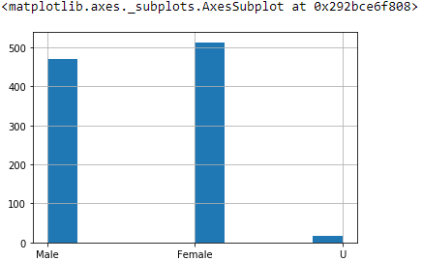
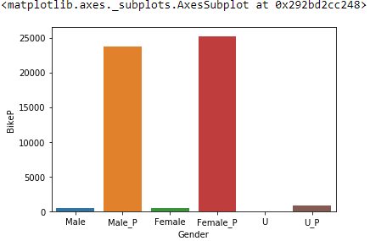
Note: The data and information in this document is reflective of a hypothetical situation and client. This document is to be used for KPMG Virtual Internship purposes only.
Data Exploration
Gender wise Interest Analysis-
We can see here that female are more interested in purchased bike over the last 3 years
So we should focus on advertises on Female customers than Male customers

Slide 5
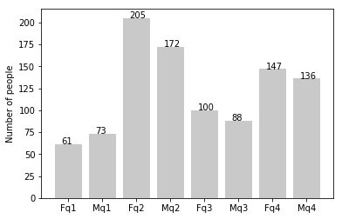
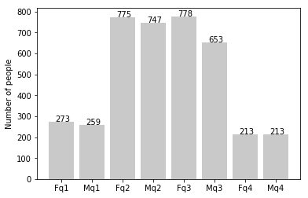
Note: The data and information in this document is reflective of a hypothetical situation and client. This document is to be used for KPMG Virtual Internship purposes only.
Model Development
Age Distribution-
As we can see, mostly our new customers are between 25 to 48 years old.
Number of customers from 48 to 59 years old has big drops on percentages.
There is a slightly increase in number of customers over 59 years old in term of percentages
It looks like the percentages of under 25 years old not really change.

Slide 6
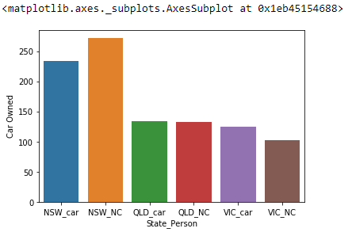
Note: The data and information in this document is reflective of a hypothetical situation and client. This document is to be used for KPMG Virtual Internship purposes only.
Interpretation
State wise car own Analysis-
We can see that the NSW people are more in counting that have no car
We should approach them more than other state
VIC and QLD has more customers that own car that who don’t but we can try to have something so that those owns car will buy bikes.

Slide 7
Note: The data and information in this document is reflective of a hypothetical situation and client. This document is to be used for KPMG Virtual Internship purposes only.
Appendix

Slide 8
Note: The data and information in this document is reflective of a hypothetical situation and client. This document is to be used for KPMG Virtual Internship purposes only.
Appendix
This is an optional slide where you may place any supporting items.

