Slide 1

OPTICAL CHARACTER RECOGNITION USING TESSERACT
Guided By:- Mr. Ankur
kulhari
Presented By:- SATYAM SINGH

Slide 2
ABSTRACT:-
Common method of digitizing printed texts
Subtle software which is as highly overlooked as it is simple.
Numerous applications and uses – editing, scanning, searching, comparison, compact storage and many more!
OCR is a field of research in pattern recognition, artificial intelligence and computer vision.

Slide 3
WHAT IS OCR? :-
Optical character recognition or optical character reader (OCR) is the conversion of images of typed, handwritten or printed text into machine-encoded text, whether from a scanned document, a photo of a document, a scene-photo (for example the text on signs and billboards in a landscape photo) or from subtitle text superimposed on an image (for example from a television broadcast).

Slide 4
SCOPE
Automating the most of the paperwork involved in different kind of industries.
In the legal industry, there has also been a significant movement to digitize paper documents. In order to save space and eliminate the need to sift through boxes of paper files.
Considering banking for instance, a cheque can be inserted into a machine, the writing on it is scanned instantly, and the correct amount of money is transferred.
It may prove itself as a very helpful tool to the visually impaired people which is easily and highly imaginable.

Slide 5
WHEN AND WHY OCR? :-
Widely used as a form of information entry from printed paper data records – whether passport documents, invoices, bank statements, computerized receipts, business cards, mail, printouts of static-data, or any suitable documentation – it is a common method of digitizing printed texts so that they can be electronically edited, searched, stored more compactly, displayed on-line, and used in machine processes such as cognitive computing, machine translation, (extracted) text-to-speech, key data and text mining. OCR is a field of research in pattern recognition, artificial intelligence and computer vision.

Slide 6
What's the advantage of OCR?
Once a printed page is in this machine-readable text form, you can do all kinds of things you couldn't do before. You can search through it by keyword (handy if there's a huge amount of it), edit it with a word processor, incorporate it into a Web page, compress it into a ZIP file and store it in much less space, send it by email—and all kinds of other neat things. Machine-readable text can also be decoded by screen readers, tools that use speech synthesizers (computerized voices, like the one Stephen Hawking uses) to read out the words on a screen so blind and visually impaired people can understand them. (Back in the 1970s, one of the first major uses of OCR was in a photocopier-like device called the Kurzweil Reading Machine, which could read printed books out loud to blind people.)

Slide 7
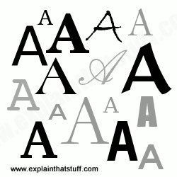
How does OCR work?
Let's suppose life was really simple and there was only one letter in the alphabet: A. Even then, you can probably see that OCR would be quite a tricky problem—because every single person writes the letter A in a slightly different way. Even with printed text, there's an issue, because books and other documents are printed in many different typefaces (fonts) and the letter A can be printed in many subtly different forms.

Slide 8
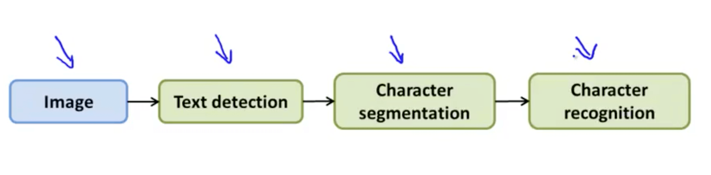

Slide 9
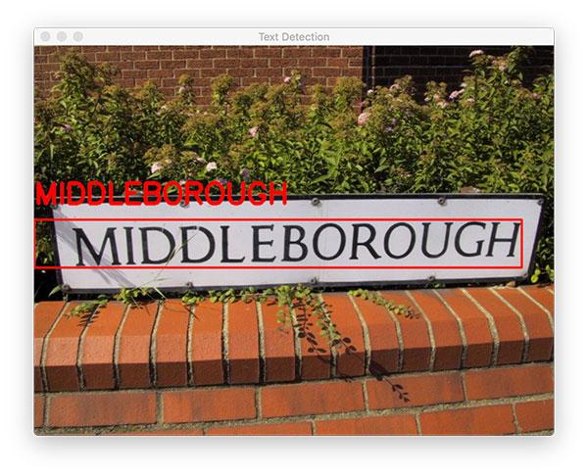
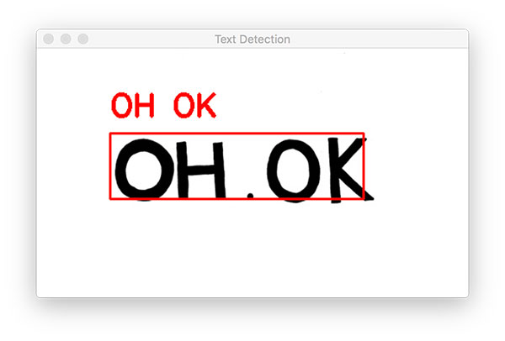
Working

Slide 10
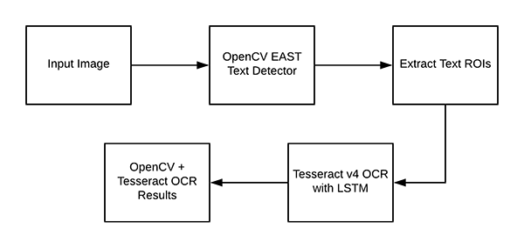
Understanding OpenCV OCR and Tesseract text recognition :-

Slide 11
Limitations of OCR
Limited Documents
OCR works best with good quality typed documents. Handwritten documents cannot be easily read by OCR software. Likewise, typed fonts that resemble handwriting -- as well as non-Latin fonts -- create many errors during the OCR process. If the document has poor contrast, is creased or dirty, or the text and the background are similar in darkness, then OCR may not work well. OCR has difficulty with documents that have both images and text. Spreadsheets will also produce more errors.
Accuracy
No OCR software is 100 percent accurate. The number of errors depends upon the quality and type of document, including the font used. Errors that occur during OCR include misreading letters, skipping over letters that are unreadable, or mixing together text from adjacent columns or image captions. If high accuracy is required -- as with converting digital books to electronic format -- then a clean-up of the electronic text will be needed.

Slide 12
Limitations of OCR
Work-Arounds
OCR has difficulty differentiating between characters, such as the number zero and a capital "O." To work around this, a special OCR font can be used, such as writing out zero. However, this works only for documents created with OCR in mind, such as questionnaires. When creating questionnaires that will be hand-written, researchers also use boxes for each letter.
Additional Work
Even if the scanned image of the original document is high-quality, additional steps must occur to clean up the OCR text. It is very labor-intensive to correct the errors created by OCR. A person has to manually compare the original document and the electronic text. People also make errors when typing text from a document, but sometimes it is faster to skip the OCR step.

Slide 13
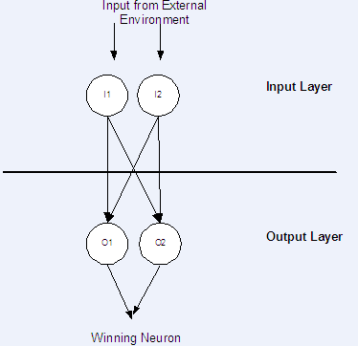
KOHONEN NETWORK:-
The Kohonen network is presented with data, but the correct output that corresponds to that data is not specified. Using the Kohonen network this data can be classified into groups.

Slide 14
MODULES :-
The Modules that were identified in the Optical Character Recognition system are as follows:-
Document Processing
Neural network System Training
Document Recognition
Document Editing and
Document Searching

Slide 15
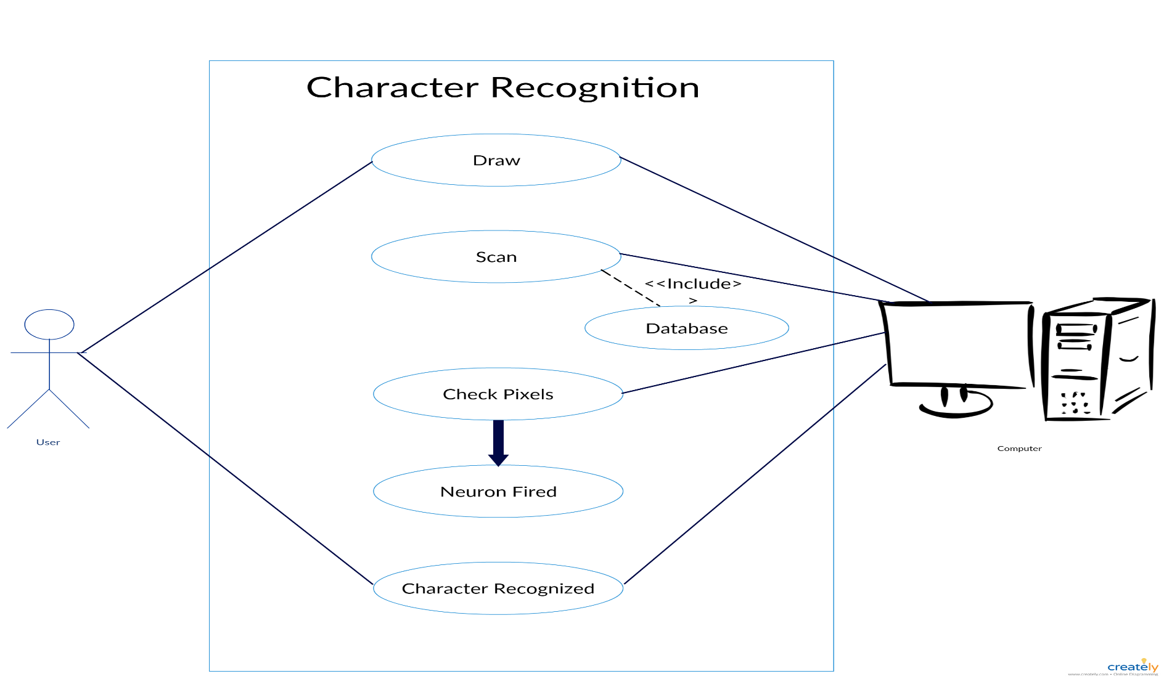
OVERALL USECASE DIAGRAM:-

Slide 16
OVERALL CLASS DIAGRAM:-
Editor
Document
HelpFrame
cut()
copy() paste() new()
open()
find()
docid : integer docname : String docsize : integer doctype : String
getDocumentDetails() scanDocument() covertToImage() storeImage()
Entry
recog : int downSampleLeft : int downSampleRight : int downSampleTop : int downSampleBottom : int
HEntry
MainScreen
hLineClear() vLineClear() findBounds()
editor() helpFrame() printedFrame()
handWrittenFrame()
hLineClear() hLineClearWithin() vLineClear() vLineClearWithin()
1
1
1..*
TrainingSet
KohenNetwork
1..*
inputCount : int outputcount : int trainingSetCount : int
LearnMethod = 1:int LearnRate = 0.3:double quitError : double
PrintedFrame
1..*
1..*
1..*
1..*
open_action() train_action() topen_action() recogniseAll_action()
setInputCount() setOutputCount() setTrainingSetCount() setClassify()
copyWeights() clearWeights() winner() normalizeInput()

Slide 17
DESIGN OF SCREEN SHOTS FOR OCR:-
The screenshots that describe the operations carried out by our system are as follows :-
Main Screen
Hand Written Recognition Screen
Scanned Document Recognition Screen
Training Screen
Recognition Screen
Editor Screen

Slide 18
