Slide 1
KAVACH
कवच — the digital armour for zero-harm industrial operations
AI-Powered Industrial Safety Intelligence for Zero-Harm Operations · Problem Statement 1
It sees the compound risk no single alarm can.
Team SlideHustlers · Satyam Kumar · ET AI Hackathon 2.0 (Economic Times × Unstop)
Notes:
KAVACH means armour. One line: plants have plenty of alarms; nobody watches the combination. We built the layer that does — and measured it.

Slide 2
THE PROBLEM
Every safety system worked. Eight workers died.
January 2025, Visakhapatnam Steel Plant. Entrapped gases exploded in a coke oven battery. The facility had functioning gas detectors, digital permit-to-work, SCADA. The investigation that followed found warning signals in the gas-pressure data — but “no intelligence layer connected those readings to operational decisions in time.” This is the recurring pattern across Indian heavy industry: the data exists, spread across five systems that do not talk. The judgment connecting them lives in one overloaded human head.
6,500+
fatal workplace accidents in India, FY2023 (DGFASLI) — excluding most mining & construction
60%+
of large facilities coordinate their own digital safety tools with manual handoffs (FICCI 2024)
8 lives
lost in a plant where every individual safety system was working as designed
Data present. Unacted upon. That is not a hardware gap — it is a software problem.
KAVACH · Team SlideHustlers
Notes:
Anchor on the real 2025 incident. The key phrase is from the public investigation: signals existed, no layer connected them. Frame: software problem, not hardware.

Slide 3
WHY IT KEEPS HAPPENING
Each system watches one signal. The combination kills.
DCS / SCADA
Gas detectors
e-Permit to work
CMMS / maintenance
Shift handover
alarms when ONE tag crosses ONE limit
each knows its own ppm, nothing else
forms and signatures; blind to live process
work orders; blind to who is where
one paragraph, written by a tired human
06:30 — the combination no system could see: gas-main pressure drifting upward for 4 hours (below every alarm limit) + crew of five entering the connected basement + gas-main isolation omitted + a single-point gas test + a handover note that missed the drift.
Why can't the plant just wire them together? Trip systems are deliberately simple — certification demands it; nobody certifies judgment. Different vendors, different decades, different departments. The only combination-watcher today is a supervisor at 6 AM, after a week of 200 acknowledged alarms.
KAVACH · Team SlideHustlers
Notes:
This slide pre-answers the biggest jury question: don't plants already have this? Each box is real tech they own; the red panel is what none of it can see.

Slide 4
THE SOLUTION
KAVACH — the intelligence layer plants are missing
1
FUSE
2
REASON
3
ACT
One live picture from systems that never talked: sensor trends, active permits & isolations, gas tests, work orders, shift changeovers, plant connectivity.
Eight compound-risk rules watch combinations, not thresholds — sub-alarm drift + occupied confined space + omitted isolation = CRITICAL, hours before any single alarm.
Alert with full evidence and the governing regulation → orchestrated response (suspend permits, isolate, notify, evacuate) → auditable prevention report.
→
→
Reads from the systems a plant already owns. Replaces none of them. Safety-instrumented trips stay untouched underneath — KAVACH is the judgment layer above, in software, retrofittable to any plant that has data.
KAVACH · Team SlideHustlers
Notes:
Three verbs: fuse, reason, act. The bottom line is the business posture: retrofit, not replace.

Slide 5
THE DEMO SCENARIO
One morning, replayed minute by minute
06:00
06:30
09:30
10:30
Shift handover — the drift is not mentioned
Crew of 5 enters basement — KAVACH: CRITICAL
Riser valve throttled — back-pressure builds
The explosion — in the recorded event
02:30
06:15
08:30
09:39
Gas-main pressure starts a slow sub-alarm drift
Gas test: PASS — but single-point only
Hot-work permit 20 m from basement vent
First uncleared conventional alarm (CO 52 ppm)
Six individually-explainable signals, one lethal combination. A fictional composite built from publicly reported investigations — every beat is a documented failure mode. All data is synthetic, generated by our deterministic digital twin (34 tagged instruments, 600 scripted minutes, labelled ground truth).
KAVACH · Team SlideHustlers
Notes:
Walk the dots left to right. Every beat is defensible — ask me about any of them. Cyan dot = where KAVACH fires. Amber = where the plant's own systems first react. Red = too late.

Slide 6
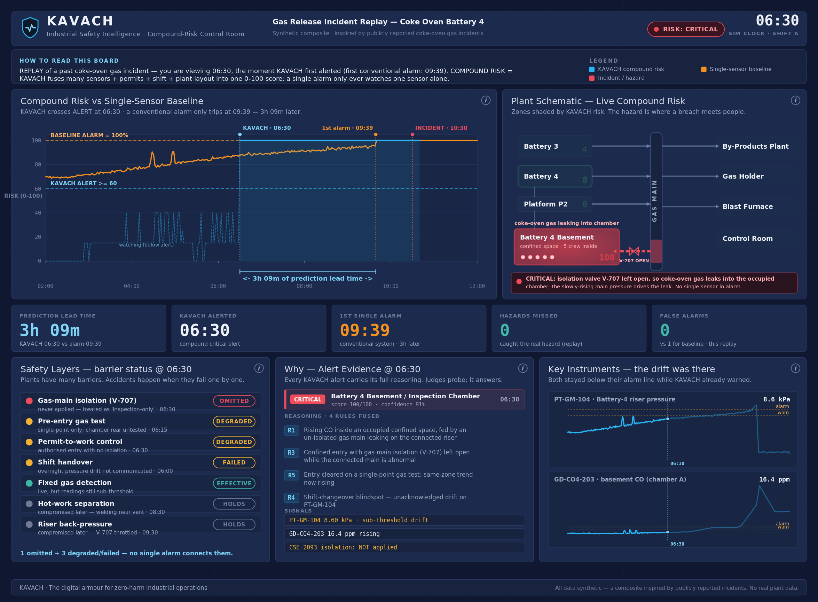
THE PRODUCT
One toggle shows what the plant could not see
BASELINE view the plant's own single-sensor alarms, replayed faithfully. The board stays green until 09:39 — 50 minutes before the explosion.
KAVACH view same morning, same data: CRITICAL at 06:30 with four named rules, the driving sensors ringed on the schematic, gas-flow into the occupied basement animated, and every piece of evidence one click away.
KAVACH · Team SlideHustlers
Notes:
This is a real screenshot of the live control room, not a mock-up. In the video/live demo we scrub the timeline and flip the toggle — the contrast is the whole pitch in one gesture.

Slide 7
MEASURED, NOT CLAIMED
The judges' own evaluation focus — answered with numbers
+3 h 09 m
prediction lead time: compound alert 06:30 vs first uncleared single-sensor alarm 09:39 (189 min)
78.8% → 0%
false-negative rate: share of the 240 min of worker exposure left unwarned — baseline vs KAVACH
0 vs 1 · 9 supp.
false alerts on a fully benign day: KAVACH 0, baseline 1 (calibration spike) — 9 context suppressions
Every number is computed by the built-in metrics lab against scenario ground truth, exposed live at /api/metrics, and asserted by the automated verification suite on every run.
KAVACH · Team SlideHustlers
Notes:
The PS evaluation focus literally asks for: detection vs single-sensor baselines, lead time, false-negative reduction. We built the baseline INTO the product and measure all three continuously. 4.7x more warning time.

Slide 8
BUT WE WROTE THAT SCENARIO
So we tested it on 120 it had never seen
The fair objection We authored the plant, the scenario, the ground truth and the baseline. A demo you wrote yourself is not evidence. What we did A generator produces scenarios the rules have never seen — randomised hazard zone, which barriers fail, drift rate, timings, noise, and a third of them fully benign. The unmodified engine is scored across all of them.
ACROSS 120 UNSEEN SCENARIOS
KAVACH
baseline
Hazards detected
100%
100%
Median lead time
+85 min
—
Median FN rate
0.0%
39.4%
False alerts, benign days
0.0%
0.0%
Warned earlier
67 of 68
—
It failed the first time — and that is the point. The held-out run exposed two real defects: 4 missed hazards in a zone the gas rule had overfitted away from, and a 13.5% false-alert rate on benign days (it alerted on CO at 13 ppm against a limit of 30, with the crew fully protected). Both were fixed at the root — multi-hop gas reachability, and crediting intact barriers. After the fixes: detection 94.1% → 100%, false alerts 13.5% → 0%, median lead 78 → 85 min. The one scenario where KAVACH still loses to the baseline is printed by the tool, not hidden.
KAVACH · Team SlideHustlers
Notes:
This is the slide that separates us from a demo. We built the experiment that could disprove us, it did, we fixed the causes and re-ran it. python eval_run.py 120 reproduces it from seeds.

Slide 9
EXPLAINABLE BY DESIGN
Every alert arrives with its proof
CRITICAL 100/100 — Battery 4 Basement · 06:30 Rules fired R1 Rising gas-main trend feeding an occupied confined space R3 Gas-main isolation OMITTED on the entry permit R5 Gas test was single-point — chamber rear untested R4 Shift handover blind spot — drift unacknowledged Signals, with values PT-GM-104 8.6 kPa, rising ~4 h (still below the 9.0 warn limit) Drift detector: sustained +slope while sub-threshold Connectivity: gm_corridor → cob4_basement via open V-707 Operational context CSE-2093 — crew of 5 inside · WO-8812 in progress · confidence 0.9
Regulatory basis — attached to the alert Factories Act 1948, S.36(2) entry into confined space with dangerous fumes — conditions & certification OISD-STD-105 — Work Permit System confined-space / vessel-entry permit: isolation & representative gas testing DGMS guidance gas testing by competent persons; continuous monitoring
Not a black box — a witness. Every alert and every orchestrated action carries rules, live values, permits and citations. Audit-ready in a statutory environment.
KAVACH · Team SlideHustlers
Notes:
This is the actual 06:30 alert from the engine — the same content the UI evidence panel shows. If a judge probes any line, the system can answer.

Slide 10
BEYOND DETECTION
From alert to orchestrated response, with citations
1
2
3
4
5
6
7
Raise
Suspend
Isolate
Notify
Evacuate
Re-test
Monitor
CRITICAL alert with evidence bundle
CSE-2093 confined-space entry halted
close gas-main leg feeding the chamber
shift supervisor · safety officer · control room
zones from the plant connectivity graph
representative multi-point gas test
hold until trend clears and permit re-issued
The counterfactual, computed Intervention at 06:30 is 240 minutes before the incident — the crew leaves the chamber 3 hours before conditions turn lethal. The 08:30 hot-work permit and the 09:30 valve throttle simply never happen.
Auto-generated Incident-Prevention Report One click → a regulator-ready document: full timeline, evidence, rules, statutory citations, and the with/without-KAVACH comparison. Markdown + branded PDF, generated by the system itself. PS asks to compress “the critical first 10 minutes from chaos to coordinated response.” This is that, pre-armed 4 hours early.
KAVACH · Team SlideHustlers
Notes:
Every action chip carries its own regulatory citation in the product. The orchestrator is a deterministic state machine — pre-approved playbook, human gates above defined thresholds.

Slide 11
STRESS-TEST IT LIVE
Judges don't have to trust us — they can try to break it
“What if the isolation had been applied?”
“What if the gas test had been done properly?”
“What if a second CO channel starts rising?”
R3 clears instantly. Zone risk falls 100 → 70, CRITICAL → ALERT. The system rewards the correct barrier.
Representative multi-point test → R5 clears. Score drops further — two barriers restored, risk de-escalates honestly.
Corroboration rule R7 joins, confidence rises. More evidence = stronger alert, not alarm spam.
A live sandbox console (/whatif) injects conditions and re-runs the full engine deterministically — same rules, same code path as the replay. In finale Q&A, the jury drives. Verified: what-if results are bit-identical on recompute.
KAVACH · Team SlideHustlers
Notes:
Interactivity is the credibility play: a rules engine that de-escalates when barriers are restored proves it reasons about causes, not correlations.

Slide 12
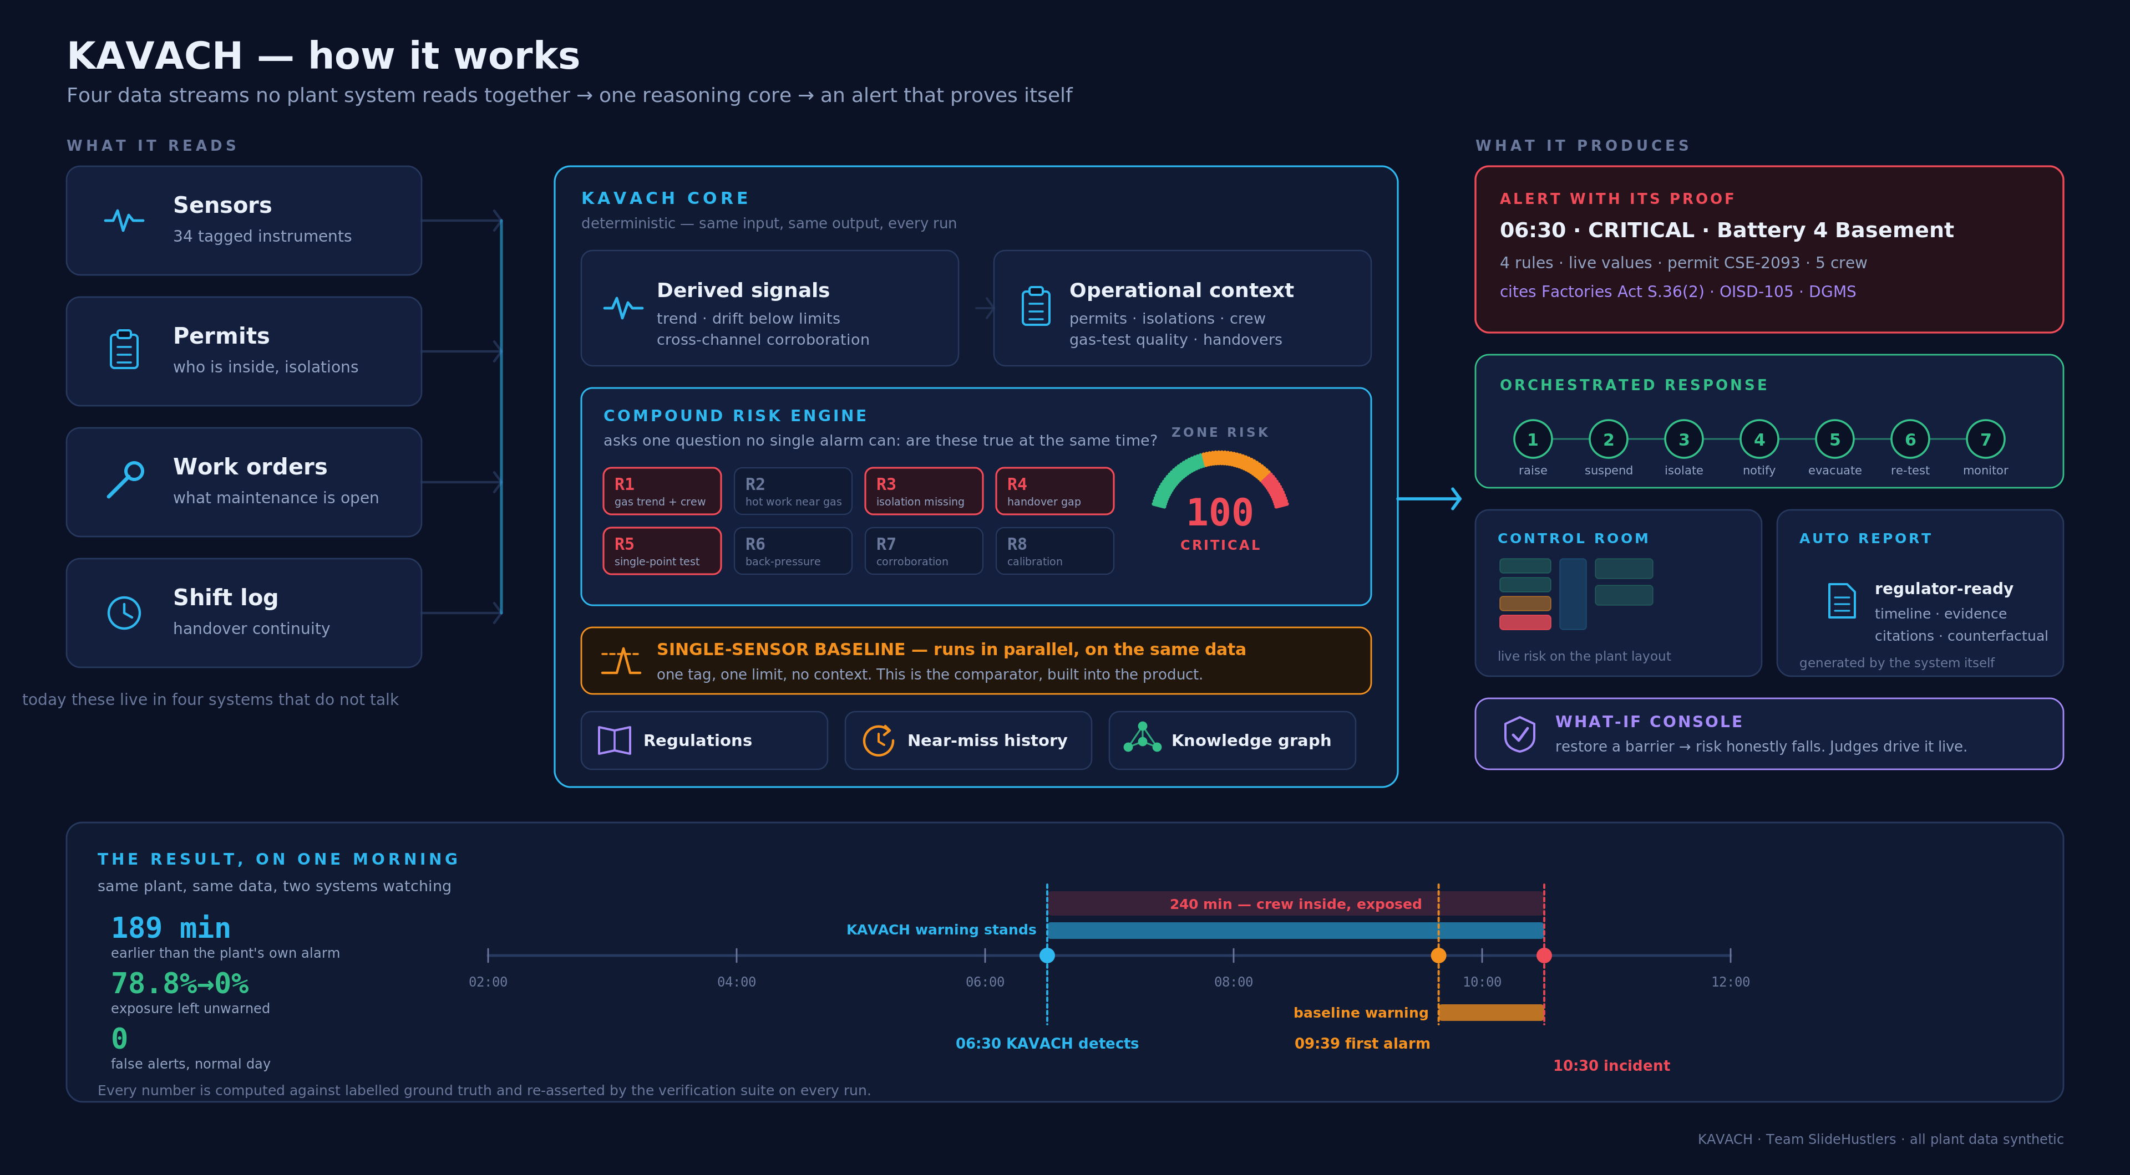
UNDER THE HOOD
Deterministic core. Agentic edges.
Stack FastAPI · pure-Python engines Next.js 14 · inline-SVG UI (~91 kB) WebSocket live streaming (4 Hz) Deterministic Seeded twin · cached horizon · zero external dependencies — the demo cannot fail LLM: optional OpenAI narration of alerts with a hard deterministic fallback Verified Automated suite asserts every claim: lead time, FN/FP, rule timings, citations, what-if — ALL PASS
KAVACH · Team SlideHustlers
Notes:
Full diagram is docs/architecture.svg in the repo. Emphasize: the twin and a real plant share one interface — swap the simulator for OPC-UA connectors and nothing downstream changes.

Slide 13
BUSINESS IMPACT
Retrofit, not replace — that is the entire go-to-market
Phase 1 — Observe
Steel · coke · refining · chemicals · mining
Read-only connectors: OPC-UA / historian, e-PTW & CMMS exports. No process writes, no downtime, no re-certification. Weeks, not years.
asset-heavy sectors where the Vizag pattern repeats — and where Factories Act / OISD / DGMS audits already create compliance pull
Phase 2 — Advise
New plant = a config, not a project
KAVACH alerts with evidence in the control room. Trust is earned on the plant's own near-misses — and measured (FN/FP dashboards).
layout JSON + thresholds + connector mapping; the rules and engines are plant-agnostic — that is the scalability story
Phase 3 — Orchestrate
The twin ships with the product
Pre-approved response playbooks: permit suspension, notifications, evacuation sequencing. Human gates above defined thresholds.
operator training, HAZOP-style what-if drills, and regression-testing of rule changes — revenue before the first connector
The ask: one coke-oven battery, 90 days, advisory mode. KAVACH proves itself on the plant's own data — every near-miss it catches is evidence no slide can fake.
KAVACH · Team SlideHustlers
Notes:
Business impact is 25% of the score. Key line: retrofit posture makes the TAM every plant with data, and the twin itself is sellable (training + drills).

Slide 14
WHAT'S REAL, WHAT'S NEXT
Synthetic by necessity — deterministic by design
Our data honesty policy Real SCADA + permit data is locked behind NDAs — for every team. We built a high-fidelity digital twin instead: 34 realistically-tagged instruments with physics-consistent behaviour A 600-minute composite scenario of documented failure modes A benign day that tests restraint, not just detection Labelled ground truth, so every metric is honest Every surface — UI, README, this deck — says the data is synthetic. Judges should trust what a team says about its own data.
CCTV / PPE vision module
the PS's computer-vision lane — pre-trained detection feeding the same evidence model
Worker positioning (UWB/BLE)
live crew locations on the heatmap; evacuation routing per person
Pattern intelligence
rules learned from near-miss corpora — the PS's incident-pattern lane, seeded by our RAG layer
Fleet view
multi-plant roll-up for corporate EHS — same engines, one pane
Roadmap — each item extends the working evidence model, none re-architects it.
KAVACH · Team SlideHustlers
Notes:
Pre-empt the synthetic-data question by owning it proudly. Roadmap maps to the PS's remaining suggested build areas — we built the spine, these are limbs.

Slide 15
The data already exists in every plant.
KAVACH makes it act in time.
KAVACH · कवच
“Railways built KAVACH for trains. We built it for the workers inside the plants.”
github.com/satyam11081998-lab/slidehustlers_et · demo video linked in the Unstop submission · Team SlideHustlers — Satyam Kumar
Notes:
Close on the counterfactual: eight workers walk out at 06:42. Thank the jury; invite them to the what-if console.

